Slide 1
Building Resilient
T
R
A
N
S
P
O
R
T
A
T
I
O
N
A
N
D
T
R
A
N
S
I
T
1

Slide 2
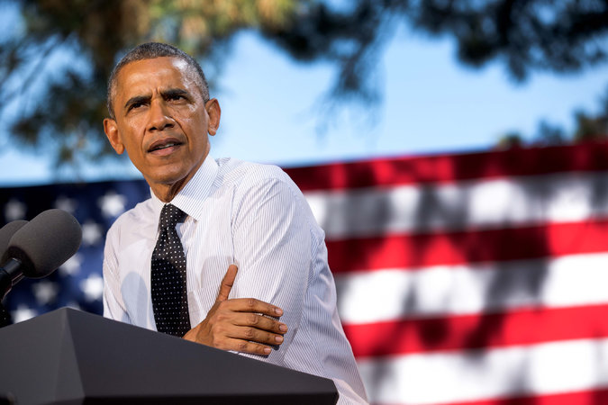
White House Climate Change Initiatives
Goals
Guarding the electricity supply
Improving local planning for flooding
Coastal erosion and storm surges
Better predicting landslide risks as sea level rise and storms and droughts intensify
President Obama last month
EPA plan – states to submit proposals to curb carbon pollution
“War on Coal”
Source: NY Times
2

Slide 3
Outline
General Aspects About Transit and Transportation: Where are our problems?
Transportation and Land Use: How to build a sustainable and resilient transportation system?
Case Studies: Learning from global practices
Looking Forward in San Diego: Applying different techniques to maximize the resiliency of our transportation system
3

Slide 4
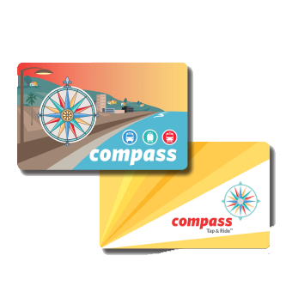
General Facts
3,149,069 People (San Diego County)
People
2013
2013
Passengers 82,105,000
Passenger Miles
361,807,000
Total Farebox Revenue:
$ 90,651,000
4

Slide 5
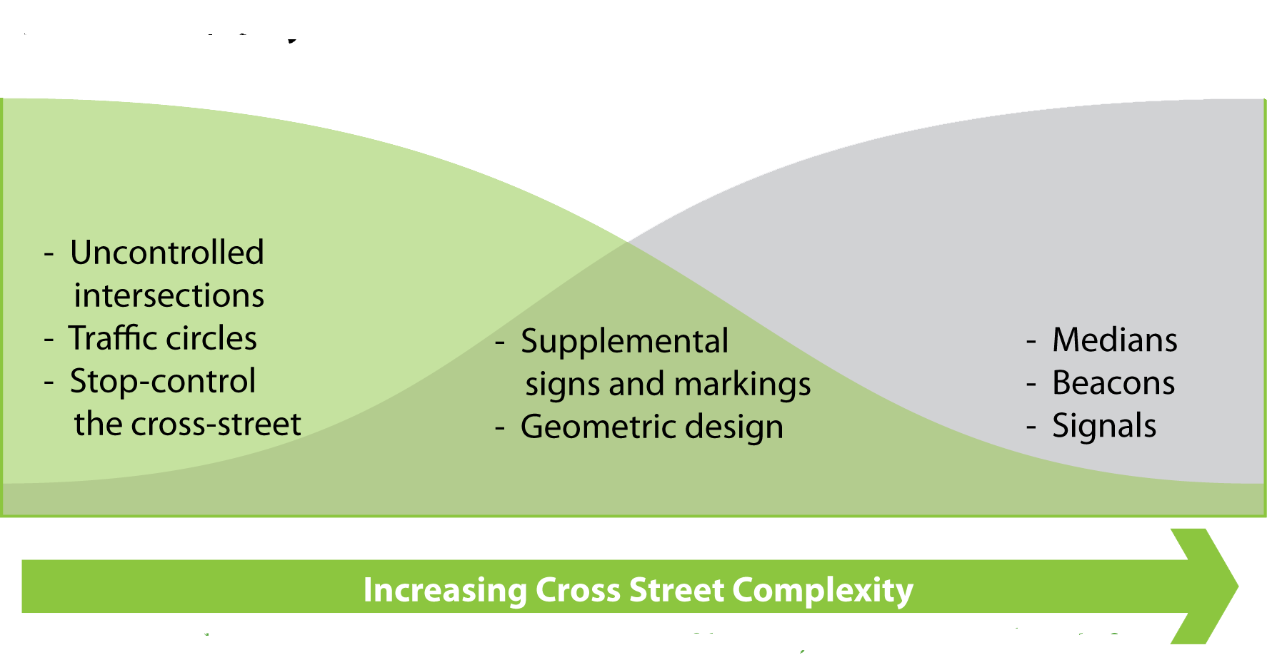
The Objective
Increasing speed, volume, number of lanes and decreasing number of crossing gaps
Minimize Delay
Maximize Safety
+
5

Slide 6
Simple Equationquation
Travel times Reduction
Improve Air Quality
Travel Safety
More Productivity, Better Quality of Life
6
+

Slide 7
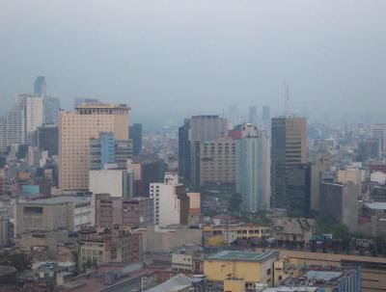
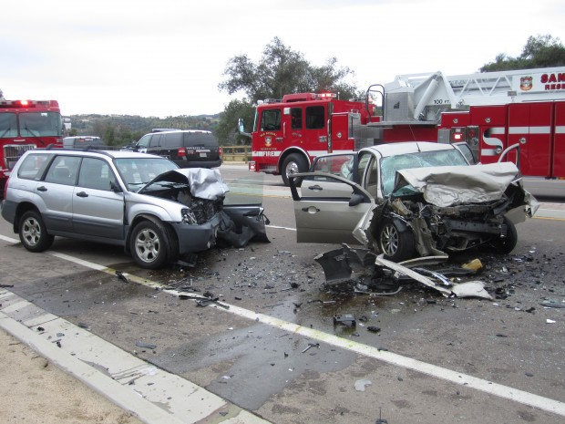
The Problems
Health
Air Pollution
Casualties in Traffic
Infrastructure
U.S. Trends
Global Warming
“We CANNOT become what we want to be by remaining who WE are.”
7
– Max DePree

Slide 8
Fatal Traffic Crashes in California by age group
In:
Total:3811
2012
#1 in U.S.
8

Slide 9
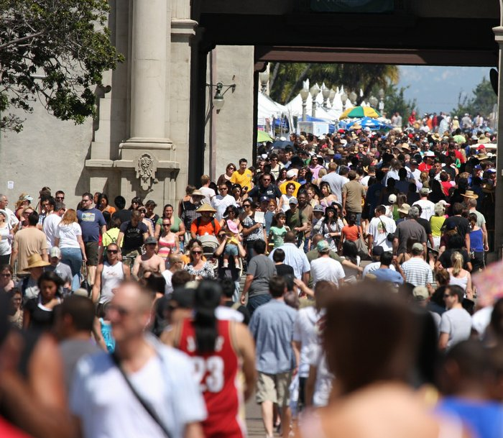
Are You at Risk from Air Pollution?
Groups at Risk | Number of People
Pediatric Asthma | 52,020
Adult Asthma | 203,011
COPD | 106,254
Cardiovascular Disease | 707,051
Diabetes | 187,806
Children Under 18 | 726,602
Adults 65 & Over | 362,928
Poverty Estimate | 462,997
According to the American Lung Association San Diego was listed one of the 25 most polluted cities in the country.
San Diego Grade: F
Source: The American Lung Association
9
Notes:
Air pollution now kills more people than high cholesterol
http://www.washingtonpost.com/blogs/wonkblog/wp/2012/12/20/air-pollution-now-kills-more-people-than-high-cholesterol/
http://www.utsandiego.com/news/2013/Apr/24/air-quality-lung-association-san-diego/
To improve its grade, air-quality experts said the San Diego region will have to push harder for electric and gas-sipping vehicles, cleaner diesel engines and bigger cuts in port pollution. The new “State of the Air” report analyzes monitoring records for ozone and long and short-term particle pollution, applying the association’s own formulas to interpreting the data. While federal air-quality standards exclude certain high pollution days, the association’s counts include every day that exceeds the government’s prescribed limits.
Ozone forms from the reaction of tailpipe emissions and other sources with sunlight. It can cause shortness of breath, asthma attacks, lung inflammation and premature death. Particle pollution consists of tiny, airborne particles of varying sizes. They can trigger asthma attacks and lung inflammation, and are linked to heart attacks, stroke and premature death, especially among the elderly, young children and babies. These particles get lodged in the lungs and can penetrate the bloodstream. Researchers from the University of Southern California also have found that children growing up in polluted neighborhoods or within one-third of a mile from a freeway have reduced lung capacity. The lung association rates U.S. cities and counties according to pollution levels, ranking places with highest and lowest air pollution.
Not so much these days. I can also remember when we could rarely see the mountains in summer.

Slide 10
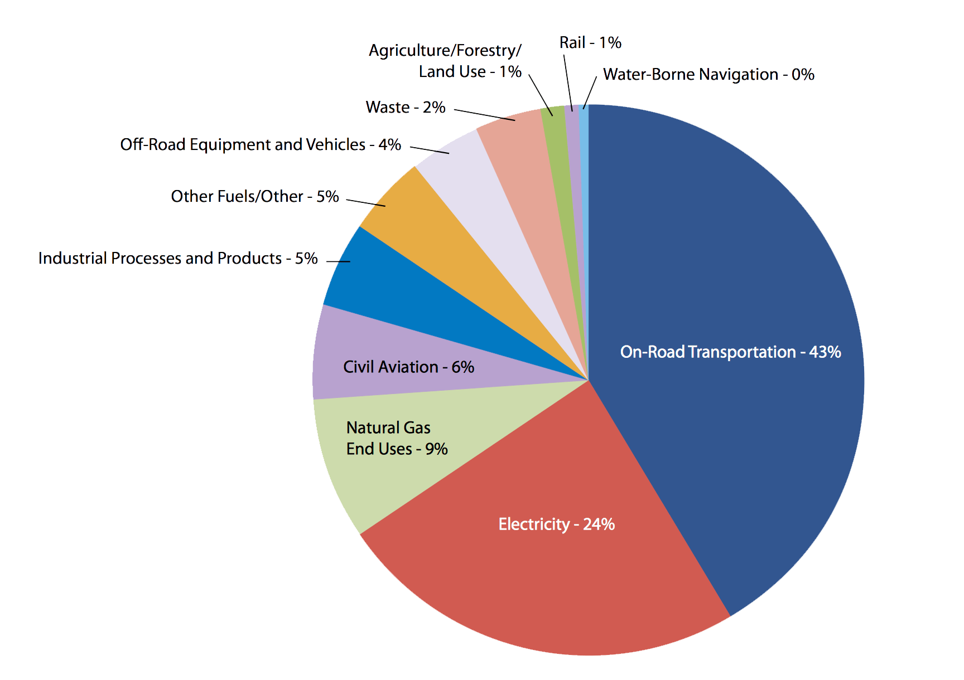
San Diego County Greenhouse Emissions by Sector in 2010
Nearly 60% of total regional emissions are associated with individuals (e.g., cars, light-duty trucks, residential electricity and natural gas consumption)
Source: San Diego County GHG Inventory Executive Summary
10
Notes:
Premature Death
Asthma Attack
Heart Attack, Stroke
Cardiovascular Harm
Lung Cancer
Low Birth Weight
Infant Mortality
Wheezing, Coughing
Shortness of Breath
Susceptibility of Infection
Lung Tissue Redness, Swelling

Slide 11
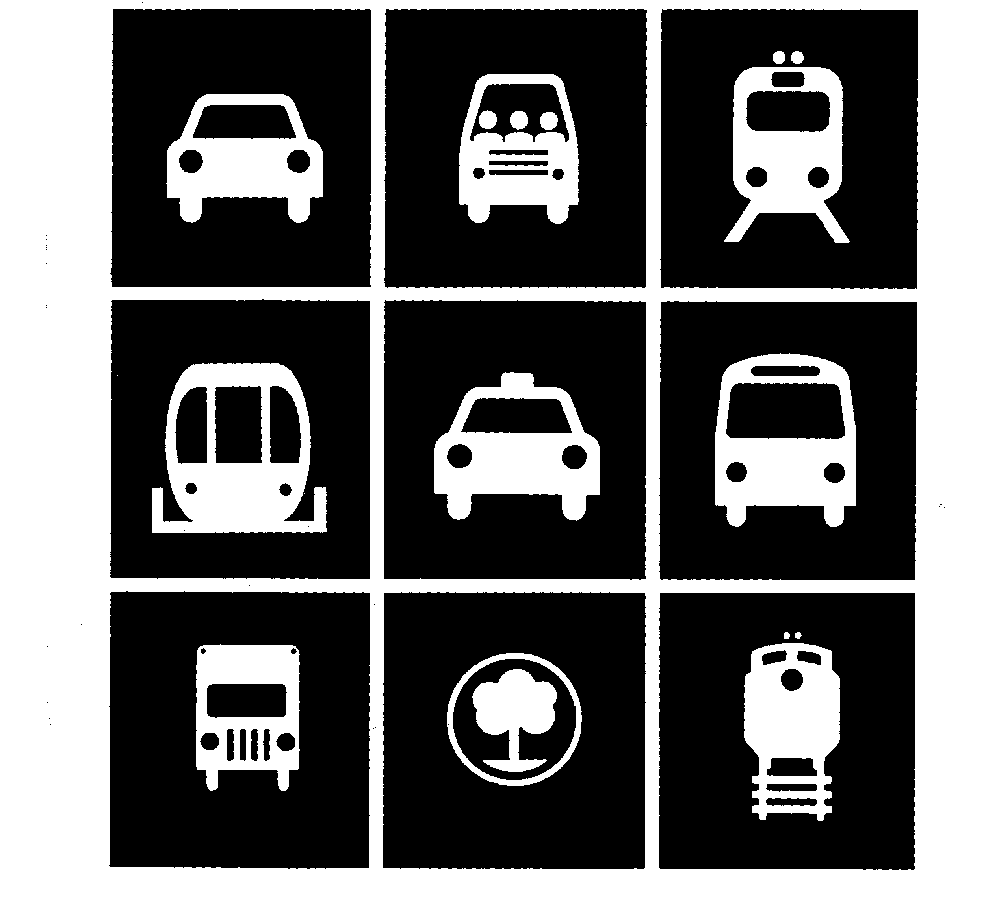
Setting a New Paradigm
Record 10.7 Billion Trips Taken On U.S. Public Transportation In 2013
The Highest Transit Ridership in 57 years (Growth of 1.1%)
Policy goals should be used to increase transit market share
Share of the transportation mode still well below what it was in the 1960s, 1970s and 1980s.
11
Notes:
Another thing to remember is that the vast majority of American's do not have access to quality or attractive transit services. So how do you expect them to climb on board when the service is not even there?
Less than half of Americans have access to public transit services within walking distance of their homes. And an even smaller percentage have access to transit that operates an attractive level of service.
In contrast, over 80% of Canadian's have access to transit within walking distance of their homes. This number is near 100% in urban areas.
If we want transit to succeed in America, then we have to put out a better product and bring transit to most American's. And that is sadly not happening in many places at this time. Single LRT lines don't count, when your buses end at 7pm and run every hour.
The nation's trains, buses and commuter rail carried more trips last year than in 2008, when gas prices soared to $4-$5 per gallon and many were forced out of their cars by necessity. That year saw the highest ridership totals since 1957.
"There's a fundamental shift going on," Melaniphy says. "This isn't a one-year blip. More and more people are deciding that public transportation is a good option."
A trip is considered any segment of a passenger's commute. For instance, a person who takes a bus to the subway and takes that to work has taken two trips.
Share of the transportation mode – that is, the percentage of commuters who take transit versus driving, walking, etc. –
"It's probably not fair to expect them to do those kinds of numbers again," Pisarski says. "You're talking about a society where probably 30% of the society didn't own a vehicle. Now, less than 10% of households don't have a vehicle, and only 3% of households with workers don't have a vehicle.”
In contrast, over 80% of Canadian's have access to transit within walking distance of their homes. This number is near 100% in urban areas.
If we want transit to succeed in America, then we have to put out a better product and bring transit to most American's. And that is sadly not happening in many places at this time. Single LRT lines don't count, when your buses end at 7pm and run every hour.

Slide 12
Falling Trolley Ridership Numbers in the last 5 years in San Diego
Source: Comprehensive Annual Financial Report for the fiscal years ended june 30, 2013 and 2012, San Diego Metropolitan Transit System San Diego, California
12

Slide 13
Stalling Transit Ridership Numbers in the last 5 years in San Diego
Source: Comprehensive Annual Financial Report for the fiscal years ended june 30, 2013 and 2012, San Diego Metropolitan Transit System San Diego, California
13

Slide 14
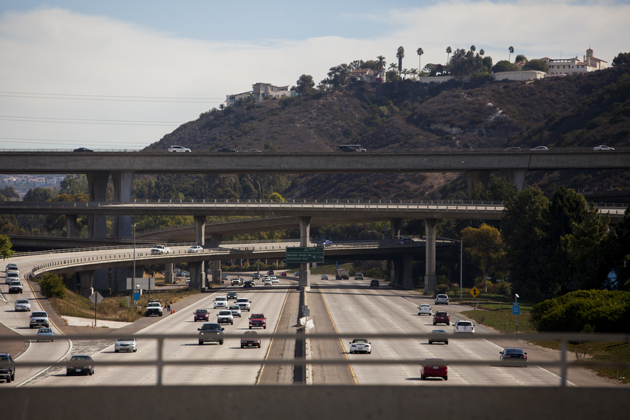
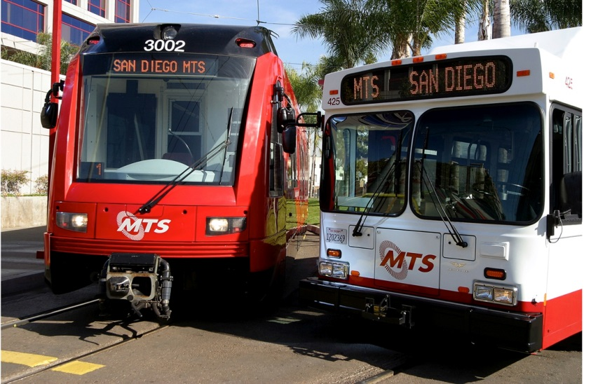
Explanations?
In 2012, only 2.7% of the County’s workforce commuted to work by Public Transportation. For these 40 thousand workers, the commute time in San Diego by public transportation was double those driving alone.
Our region ranks 33rd in the nation in terms of workforce access to transit, below El Paso, TX & Stockton, CA
14

Slide 15
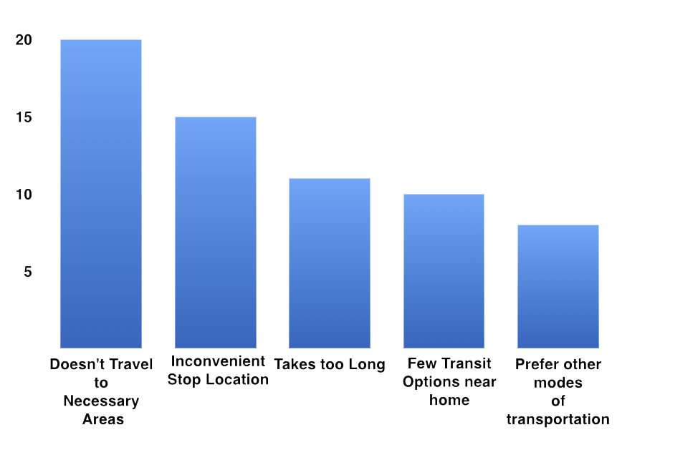
Public Transit Obstacles
Primary Barriers to Increased Public Transit Ridership in San Diego County
Clearly, people are not interested in public transportation
Source: Equinox Center
15

Slide 16
Our Systems are FAILING
Most of us expect our infrastructure to perform without missing a beat and provide us with uninterrupted service forever.
16

Slide 17
Transportation and Land Use
Patrick Poon
17

Slide 18
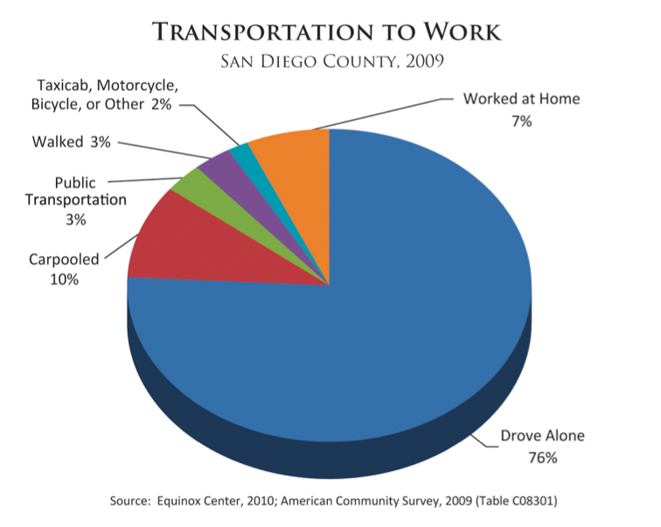
Different Types of Cities
Walking Cities
Automobile Cites
Transit Cities
18

Slide 19
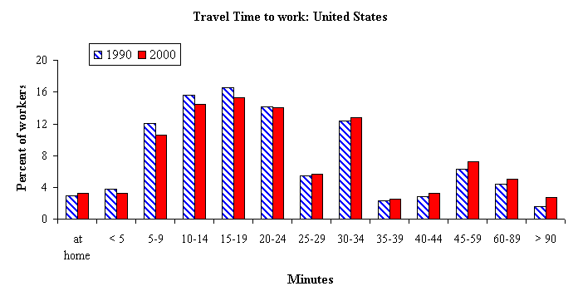
Travel Time Budget
People in cities on average are willing to travel around 30mins to work and half an hour home again.
In some cities undergoing rapid change, people will adapt by moving their housing or job, or finding better transportation options.
Travel time to work in United States
Source: US department of Transportation - Federal Highway Administration
19

Slide 20
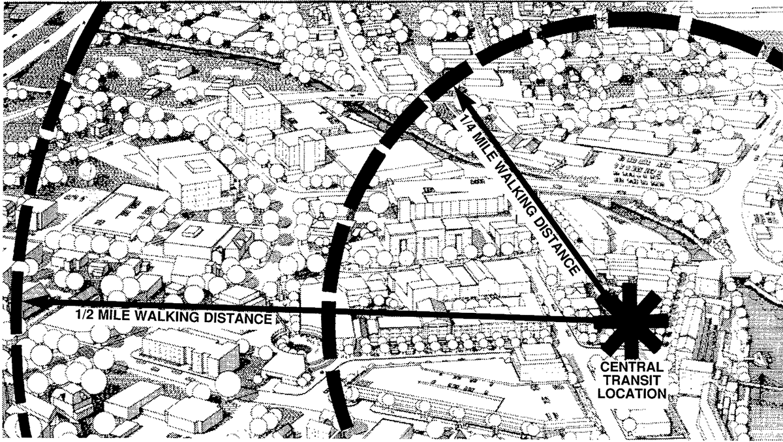
Transit Use and Walking Distance
Experts generally conclude that typical transit riders will walk up to a quarter-mile to a bus stop and a half-mile to a train station.
Source: Land Use Impacts on Transport - How Land Use Factors Affect Travel Behavior, Todd Litman
20

Slide 21
Transit-Oriented Development (TOD)
An approach to development that focuses land uses around a transit station or within a transit corridor.
Characteristics | Rationale
A mix of uses | Rising energy prices
Moderate to high density | Road congestion
Pedestrian orientation/connectivity | Climate Change
Transportation choices | Shrinking household sizes
Reduced parking | Increasing demand for urban living
High quality design | Interest in green building and walkable neighborhoods
21
Notes:
https://www.youtube.com/watch?v=tL9mCOTjngA

Slide 22
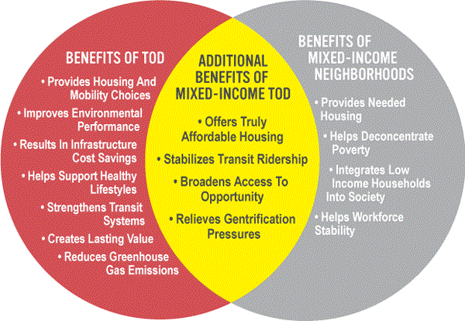
Transit-Oriented Development (TOD)
22

Slide 23
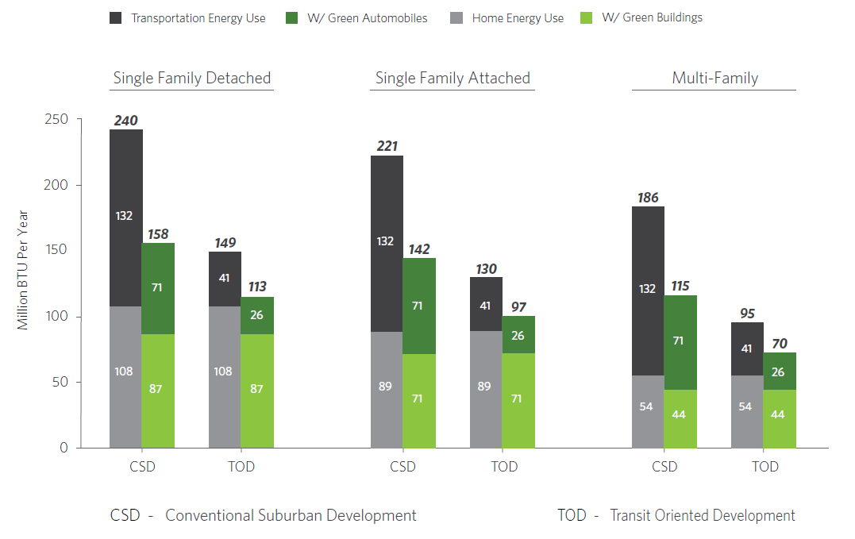
Source: EPA
23

Slide 24
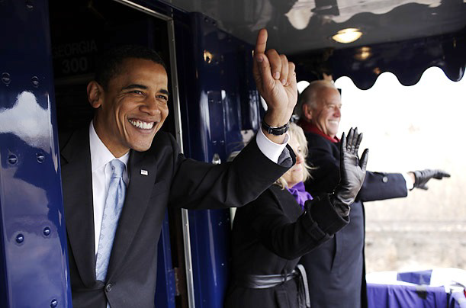
“The days where we are just building sprawl forever –those days are over. Republicans, Democrats, everybody recognizes that that is not a smart way to design communities.” - President Obama
24

Slide 25
Resilient Transit and Transportation System
A transit system that is faster than traffic in major corridors.
Viable centers along the corridors that are dense enough to service a good transit system.
Walk-able areas and cycling facilities that can mean easy access by non-motorized means, especially in these centers.
Services and connectivity that can guarantee access at most times of the day or night without time wasted.
Source: Resilient Cities: Responding to Peak oil and Climate Change, Peter Newman
25

Slide 26
Resilient Transit and Transportation System
Phasing out freeways and phasing in congestion taxes that are directed back into the funding of transit and walk/cycle facilities as well as traffic-calming measures.
Continual improvement of vehicle engines to ensure emissions, noise, and fuel consumption are reduced, especially a move to electric vehicles.
Regional and local governance that can enable visionary green transport plans and funding schemes to be introduced.
Source: Resilient Cities, Peter Newman
26

Slide 27
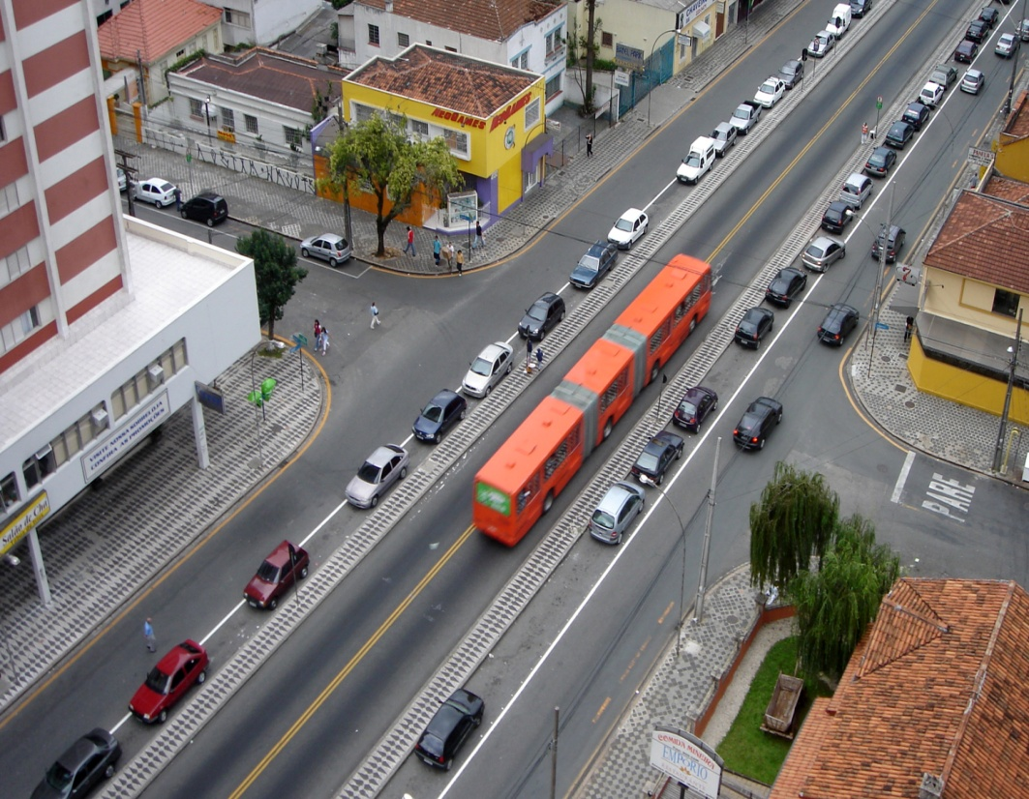
Resilient Transit and Transportation System
A transit system that is faster than traffic in major corridors.
Combination of transportation and land-use options that are favorable for green modes and offer a time savings when compared to car travel
Light-rail Transit (LRT)
Bus Rapid Transit (BRT)
Transit-Oriented
Development (TOD)
27

Slide 28
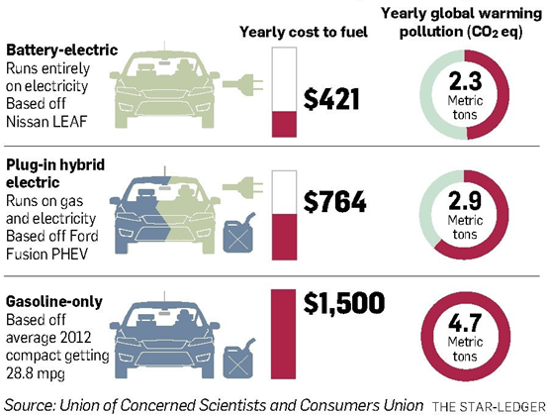
Resilient Transit and Transportation System
Continual improvement of vehicle engines, especially a move to electric vehicles.
Hybrid Electric Vehicles
Plug-in Hybrid
Electric Vehicles (PHEV)
Lithium ion batteries
Hybrid Engines
Extended-Range
Electric Vehicles
Battery Electric Vehicle
Nissan Leaf (2014)
84 miles per charge
126/101 MPGe
city/highway
28

Slide 29
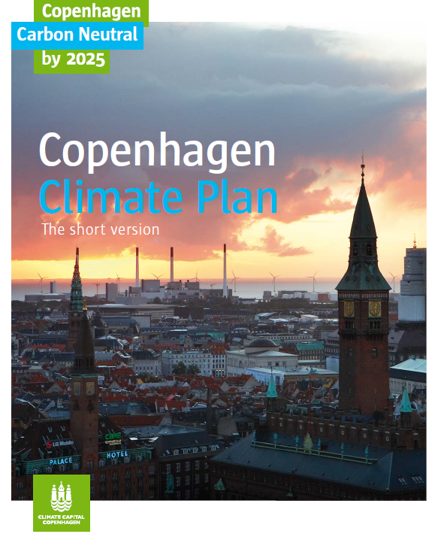
Resilient Transit and Transportation System
Strong Regional and Local Governance and Strong Citizen Support to Enable Visionary Green Transport
SANDAG
Regional Bicycle Plan
Regional Transit Oriented Development
Alternative Land Use/ Transportation
Active Transportation Implementation Strategy
Travel Demand Models
Regional Complete Streets Policy
Cities are organisms that work as a whole regional system and as a series of local parts.
Regional transit systems cannot work unless local systems feed into them.
Source: Resilient Cities, Peter Newman
29
Notes:
http://www.sandag.org/uploads/projectid/projectid_349_17112.pdf

Slide 30
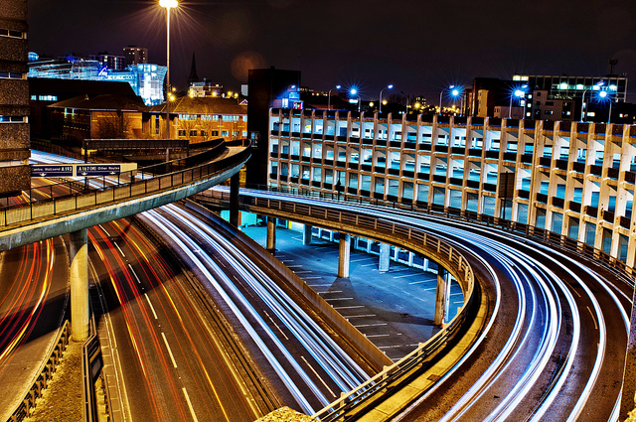
Case Studies: Global Transportation Best Practices
Vincent Tong
30

Slide 31
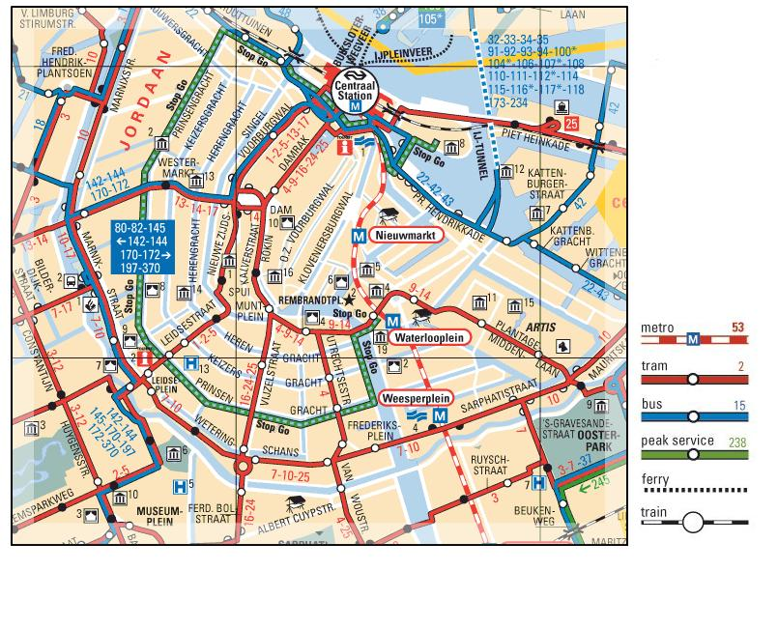
Learning From Others
31

Slide 32
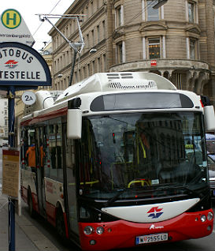
Vienna: Smart City Initiatives
Leading Smart & Sustainable European City. Top Quality of Life in world. Mercer Study
96% of Residents have excellent access to public transportation
Integrated with Modern Technology
Efforts to connect outlying districts to city center.
Bus recharging integrated with existing 230 km tram system.
15 minutes enough to charge buses for 150 km of travel
32

Slide 33
Vienna: Transportation Breakdown
33
Source: Mobil in Wein (Modified)

Slide 34
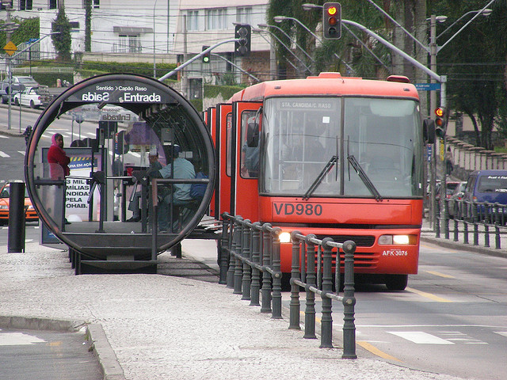
Curitiba: Bus Rapid Transport (BRT)
Dedicated Bus Lanes
High Capacity Buses
Elevated Platforms
Enclosed Stations
Off Bus fare Collection
Limited Stops
Other Examples: Chicago, Cleveland
BRT Chicago—Ashland Avenue Bus Rapid (Video)
34
Source: RP&E
Notes:
As often as every 90 seconds.
70% of Curitiba Communters use BRT
•Compared to eight other Brazilian cities of its size, Curitiba uses about 30 percent less fuel per capita.
10% of income on travel
http://81.47.175.201/livingrail/index.php?option=com_content&view=article&id=725:bus-rapid-transit-operation-the-curitiba-case&catid=37:technologies&Itemid=126
https://www.youtube.com/watch?v=_csc2ZDuQLo

Slide 35
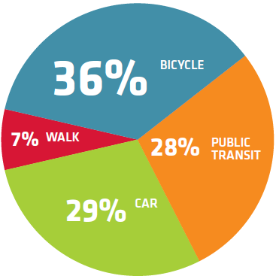
Copenhagen: Cycling
In 2012
Population: 550,000
Bicycles: 650,000
Cars: 125,000
Ratio: 5.2 Bikes/Car
Transportation Breakdown
Copenhageners will take 75% of trips by bicycle, on foot or by public transport (and 50 % of trips to work or school will be by bike, up from 36% currently) by 2025
4 out of 5 off all Copenhageners have access to a bike.
35
Source: City of Copenhagen
Notes:
Carbon Neutral by 2025
Reduce 20% of emission by 2015
Why do Copenhageners cycle?
It’s faster – 56 %
It’s more convenient – 37 %
It's healthy - 26 %
It’s cheap –29 %
It’s a good way to start the day/well-being - 12 %
It’s because of new job/relocation - 9 %
It’s because of the environment - 5 %
Do cycle tracks encourage more people to cycle?
Yes, every time the city creates a new cycle track, it results in 20% more cyclists (and 10% less cars) using that stretch.
How much does a cycle track cost?
1 km of cycle track costs approx. DKK 8 million
1 km of cycle lane costs approx. DKK 500.000
As a comparison, it costs DKK 1 billion to create 1km of metro and DKK 70-100 million for 1km of wide motorway.

Slide 36
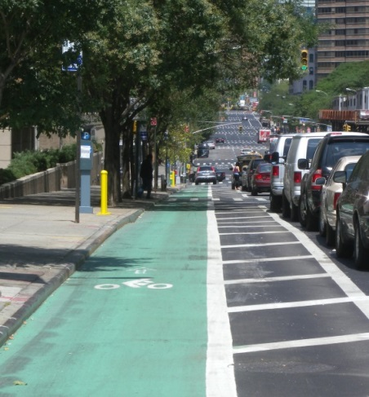
Cycling in Portland vs. Copenhagen
 | Copenhagen | Portland
Ranking | Top Biking City in the World | #1 Biking City in the America
Modal Share | 36% of Commuters (50% by 2015) | 6% of Commuters
City Size | 33.28 square miles | 145.09 square miles
Pop Density | 17,000 per square mile | 4,375 per square mile
Infrastructure | 220 mi cycle track | 319 mi bikeways (8 mi cycle track)
Copenhagen making effort to replace car space with people/cycling space
$60 Million for Portland’s bike Infrastructure. Equivalent to One mile of urban freeway.
36
Source: City of Portland & Copenhagen
Notes:
Vienna 10,366 per square mile
Curitiba 10,523 per square mile

Slide 37
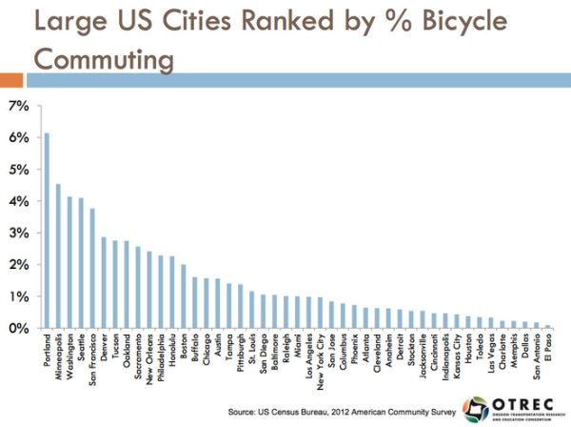
Cycling in USA
37

Slide 38
Smart Transportation Network
Alison Taylor, Vice President of Sustainability, Siemens Infrastructure & Cities
Smart Systems
Multi-Modal Systems
Real-Time Data
Integrated Energy Systems
Modern Rail Controls
Prioritized Signaling
38
Source: Siemens
Notes:
31:23 – 35:50
https://www.youtube.com/watch?v=a0NAZi6AVeQ
-Technologies important for emergency
-Prioritized signaling for emergency vehicles
-Multi-modal systems.
-Real time data.
-Modern Rail controls

Slide 39
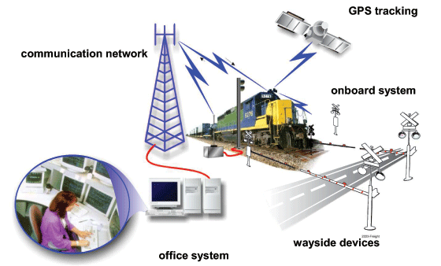
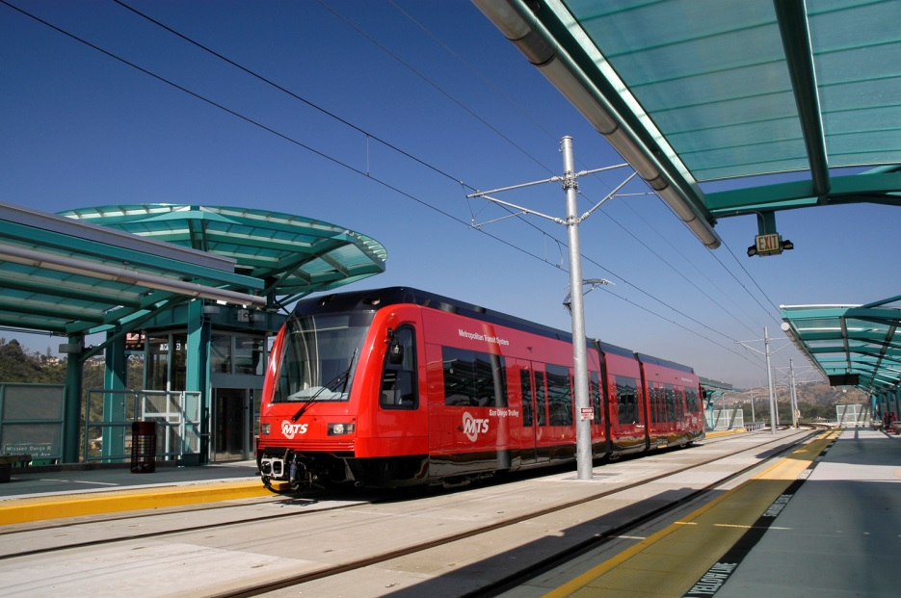
Positive Train Control System
Automatic train control to optimize track usage
Shorter distances between cars for increased capacity
Flexibility in extreme traffic situations.
39
Source: Siemens

Slide 40
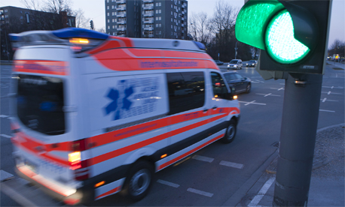
Houston: Vehicle-to-Infrastructure communication
Traffic Lights & Vehicle communication
400 intersections around county that measures traffic density
Less time at stops = fuel consumption
Critical for efficiency of evacuation purposes
40
Source: Siemens

Slide 41
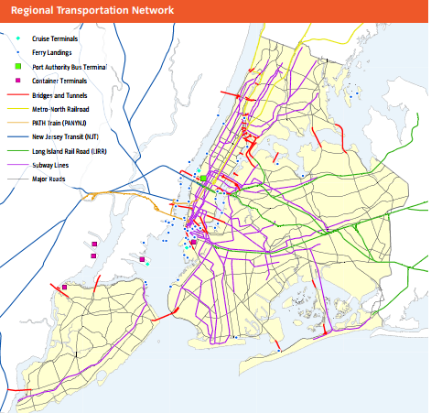
NYC Resiliency Action Plan
Overview
8.3 Million People
6,000 Miles of Streets
12,000 Traffic Signals
8,000 Bridges
Largest Transportation System in America
41
Source: NYC.gov
Notes:
Complex behemoth made up of subway networks, bus networks, commuter railroad networks, and ferry networks.

Slide 42
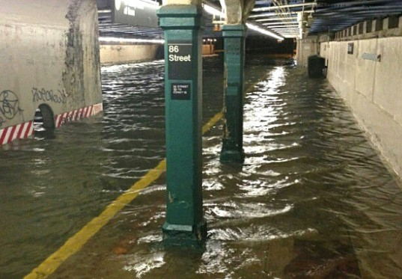
SuperStorm Sandy
Storm surges hit NYC on October 29.
Flooded vehicular tunnels, subway systems, roads, and airports.
Transportation outages, impairing mobility in and out of the city
42
Source: NYC.gov

Slide 43
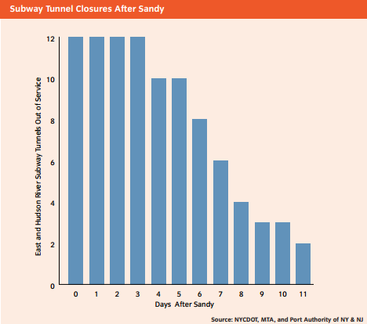
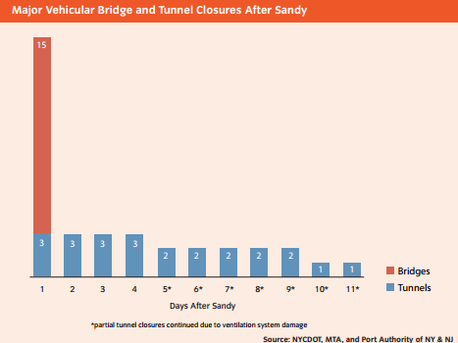
Sandy Related Closures
Subway Tunnel Closures After Sandy
Major Vehicular Bridge & Tunnel Closures After Sandy
Shutdown of portions of Harbor, Inundated rail yards
Damaged Landing docks for maritime transporation
Flooding damaged traffic signal control boxes + underground conduits & cables exposed to salt water
43
Source: NYC.gov

Slide 44
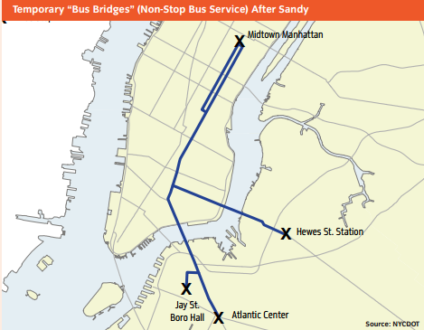
Resiliency First Response
Temporary Response
Cars entering congested districts required to have three or more occupants.
Three new temporary, high-capacity, point-to-point bus routes
East River Ferry service patter modified to increase capacity and provide faster service.
44
Source: NYC.gov

Slide 45
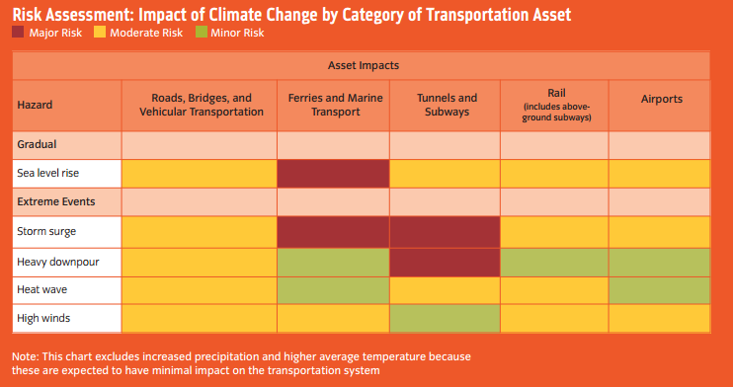
Risk Assessment
45
Source: NYC.gov

Slide 46
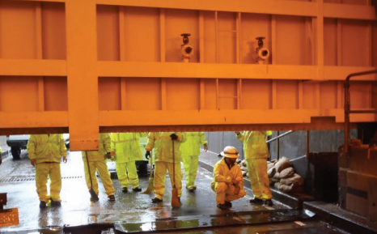
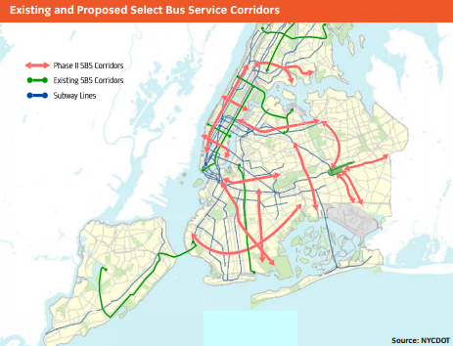
Initiatives for Increasing Resiliency
Reconstruct and resurface damaged streets
Integrate resiliency features into future projects. ex) storm water management best practices
Elevate traffic signals and provide backup electrical power
Watertight measures to protect tunnels and bridges
Alternative transportation methods if main ones fail
Plan for and install new pedestrian and bicycle facilities to improve connectivity to key transportation hubs
Improved communication for restoration of transportation services
Implement expanded services to increase system flexibility and redundancy
46
Source: NYC.gov

Slide 47
Increasing Transportation & Public Transit Resiliency in San Diego
Cameron Heyvaert
47

Slide 48
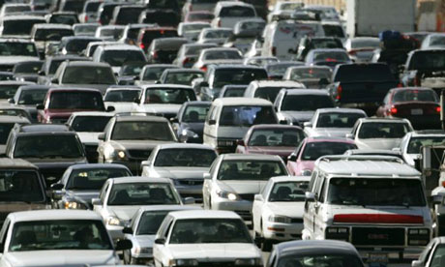
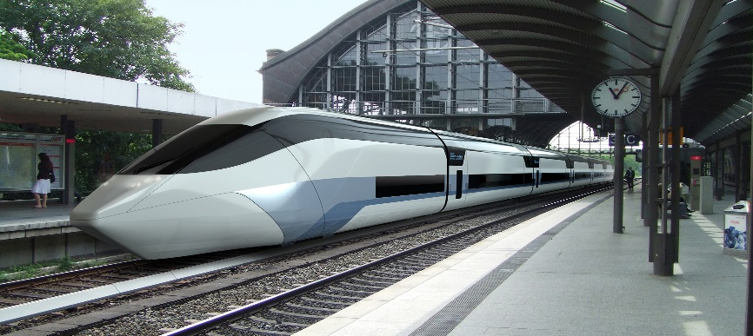
Realistic Steps Toward a More Resilient Future for San Diego
Altering Current Development
Taxes
HOT/HOV Lanes
Carpooling
Car Sharing
Bicycling
Public Transit
Addressing Future Development
Focusing on Both Accessibility & Mobility
TOD (Transportation Oriented Development)
48

Slide 49
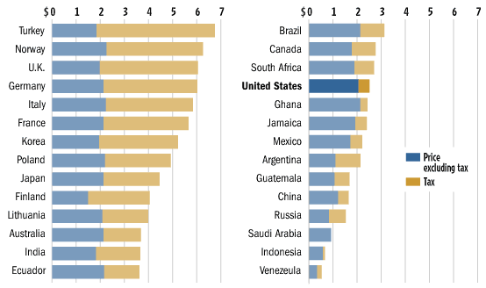
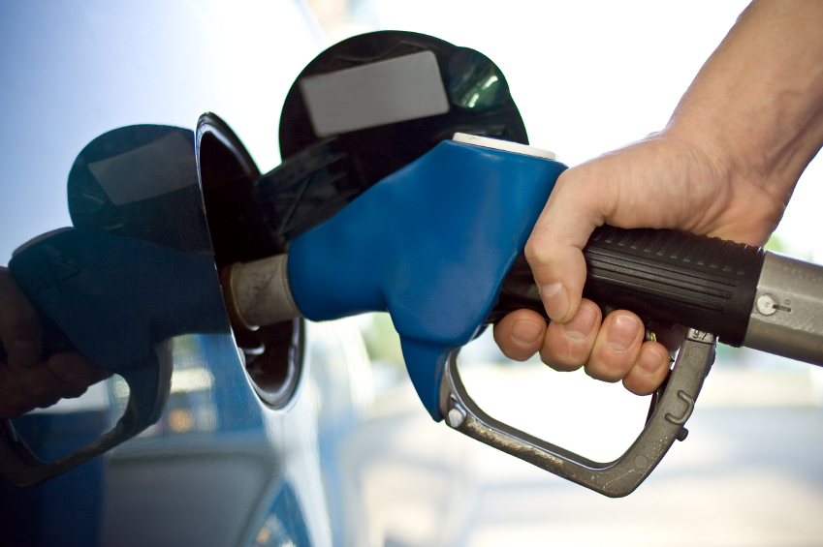
Raising Taxes on Gasoline at the Pump
Wall Street Journal Online 2008
Raising taxes on petroleum is the simplest and most effective solution in encouraging public transit
It is also the least desirable option
49

Slide 50
Global Public Transit Participation
San Diego Public Transit Participation
76% Drove Alone
10% Carpool
6% Work at home
3% Walk
3% Public transit
2% Other (motorcycle, bicycle)
National Geographic Greendex Survey Report 2009 (Left)
Equinox Center (Above)
50

Slide 51
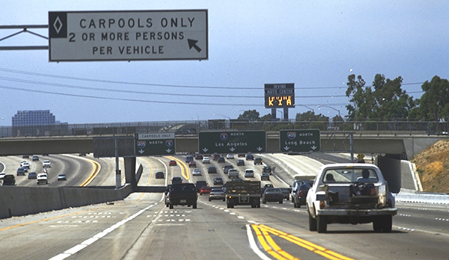
HOT (High Occupancy Toll)
Alternative to HOV
I-15 corridor in San Diego among many new HOT options
Range from $0.50 to $8.00 depending on peak traffic hours
Increased revenue for transportation departments
$17 million in first 10 years
Congestion pricing a possible option?
51

Slide 52
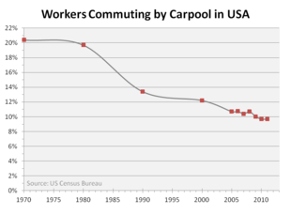
Carpooling is a Simple Solution
Despite extensive efforts, carpooling rate in US continues to decrease
San Diego efforts
Carpooling
Vanpooling
Schoolpooling
Teleworking
Bicycling
52

Slide 53
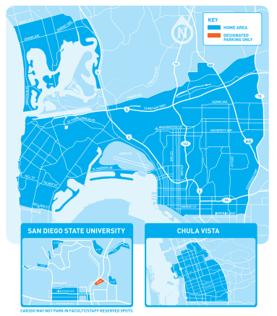
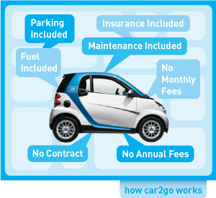
Car Sharing
$0.41/minute
A more personal option
53

Slide 54
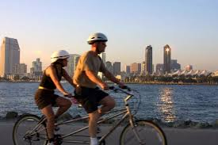
Why Don’t We Bike More in San Diego?
“40% of trips are less than 2 miles” – VoiceofSanDiego
In an average year there are 263 days of sunshine in San Diego
Perfect Biking Weather!
City | San Diego, CA | Portland, OR
Precipitation (inches) | 10.40 in. | 39.14 in.
Temperature (degrees Fahrenheit) | 63.7° F | 54.5° F
Population Density (People per Square Mile) | 4,003 | 4,375
Miles of Bike Path | 509 miles | 319 miles
Percentage Commute by Bicycling | 1.3% | 6%
Percentage Commute by Public Transit | 3% | 12%
Sources from US Climate Data, SANDAG & PortlandOregon.gov
54

Slide 55
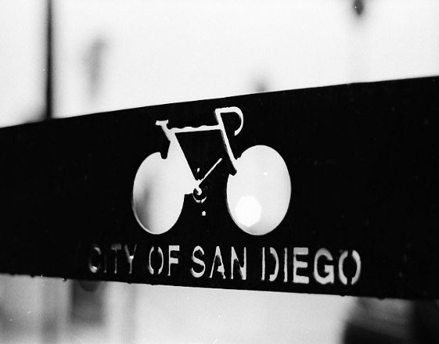
Concerns Regarding Biking in San Diego
Safety
A dedicated bicycle lane was not present on the cyclist’s side of the roadway in 97.2 % of all accidents
Lack of “Class 1” bicycle lanes
Segmented bike paths
Lack of awareness
Distance
Storage
A more bike-friendly environment requires adopting a new lifestyle
55
Notes:
http://www.10news.com/home/homepage-showcase/deathtraps-for-san-diego-bicyclists-continue-killing01112013

Slide 56
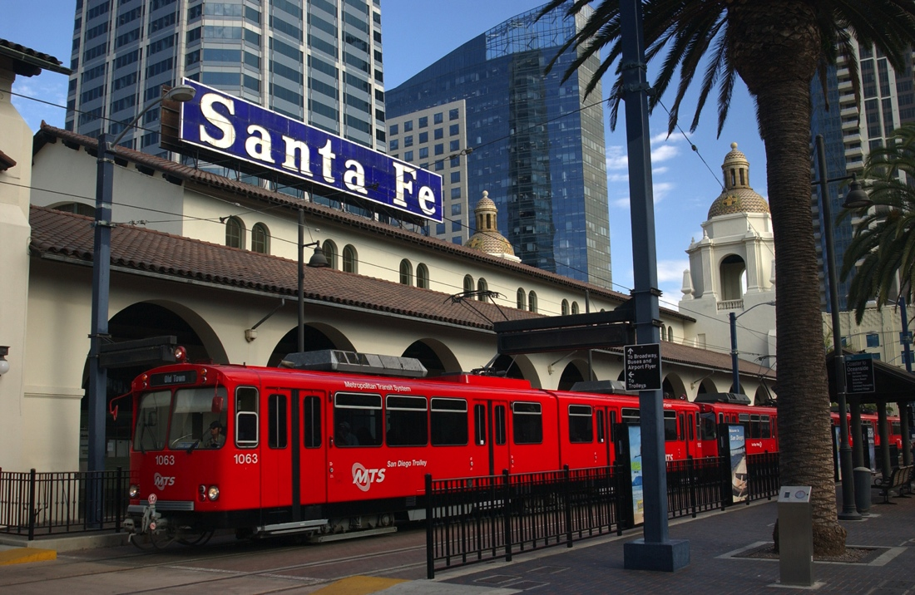
Public Transit Expansion (2050 Regional Transportation Report)
$214 billion in local, state and federal funding
Largest percentage allocated to highway improvements (adding HOT/HOV lanes)
By 2050 there will be an additional 1.25 million residents
“The Plan envisions most of these new jobs and homes situated in environmentally sustainable communities that are more conducive to walking and bicycling. They also will have more access to public transit.”
– 2050 Regional Transportation Report
56

Slide 57
Cleveland National Forest Foundation vs. SANDAG
Public transit confronts an additional challenge: environmental sustainability
San Diego Superior Court ruled that the 2050 Regional Transportation Report did not properly address greenhouse gas emissions
Source: Jack Shu, National Cleveland Forest Foundation
57

Slide 58
Public Transit Delay
Percentage of non work-related trips accessible within 15 minutes, by mode
 | Existing | No Build (2050) | Revenue Constrained (2050)
Drive Alone | 71% | 67% | 67%
Carpool | 72% | 68% | 68%
Transit | 4% | 4% | 8%
Percentage of work and higher education trips accessible within 30 minutes in peak periods, by mode
 | Existing | No Build (2050) | Revenue Constrained (2050)
Drive Alone | 73% | 68% | 70%
Carpool | 74% | 69% | 72%
Transit | 7% | 8% | 14%
SANDAG 2050 Regional Transportation Report
58

Slide 59
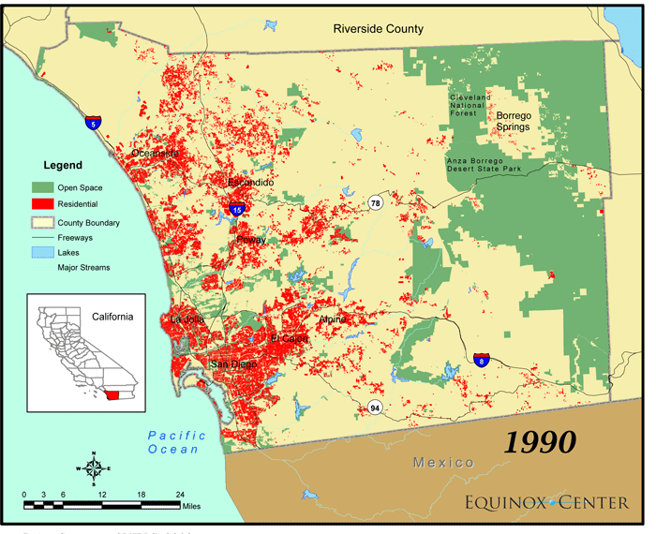
Accessibility & Mobility
Primary barriers to increased public transit ridership in San Diego County:
Doesn’t travel to necessary areas
Inconvenient stop locations
Takes too long
Few transit options near home
Planning for the Future
According to a San Diego Regional Transportation Public Opinion survey by the Equinox Center
59

Slide 60
Addressing Future Development: TOD
Requires a change in lifestyle
Transit system must address the topography of San Diego
Picture Source: railvolution.org
60

Slide 61
Host & Sponsors
Hosted By:
Sponsored by:
61

Slide 62
Special Thanks to Partners
62

Slide 63
Further Information
Contact Info:
Cameron Heyvaert, cheyvaert@sandiego.edu
Fernando Cesar Dos Santos, fernandocsj@gmail.com
Patrick Poon, patrickpoon7@hotmail.com
Vincent Tong, vdtong@gmail.com
Thank you for your time!
63

