Slide 1
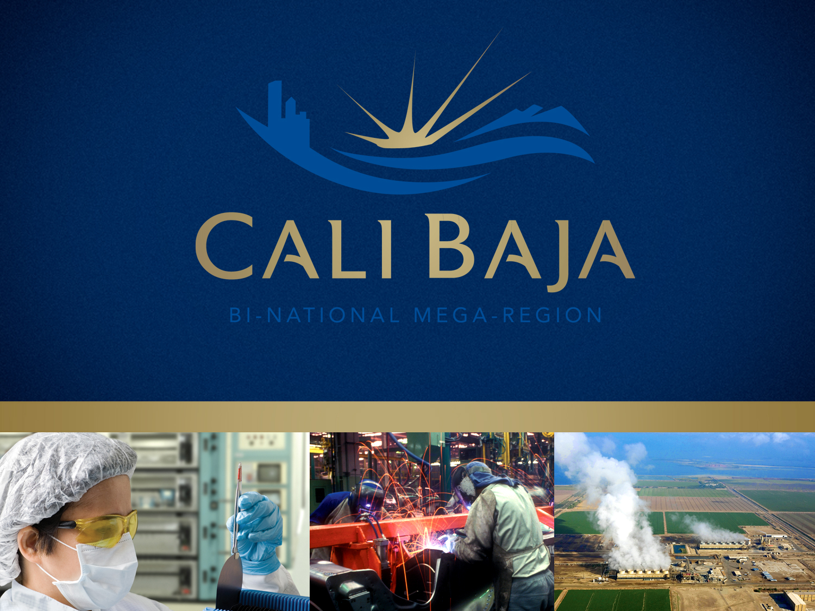

Slide 2
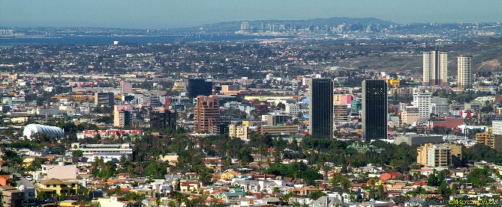
Tijuana – San Diego Border
Note: Picture -Tijuana EDC

Slide 3
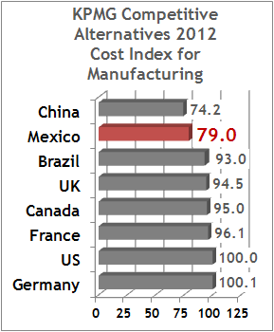
Globally Competitive
China: times they are changin’
  Boston Consulting Group: by 2015, China mfg costs approx. $4.50/hr
  Total China costs for mfg & logistics to North American markets increasing
KPMG: 2012 Competitive Alternatives study found little difference in Mexico v China costs
One of San Diego’s unique advantages is nearshore proximity to lower-cost, globally competitive manufacturing in Baja California
Note: slide from Crossborder Group

Slide 4
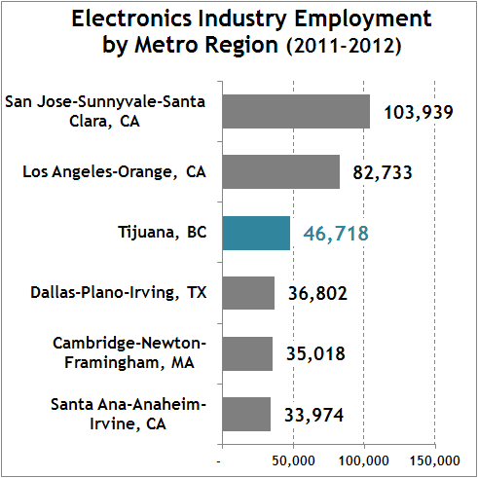
Competitive Industries
Note: slide from Crossborder Group

Slide 5
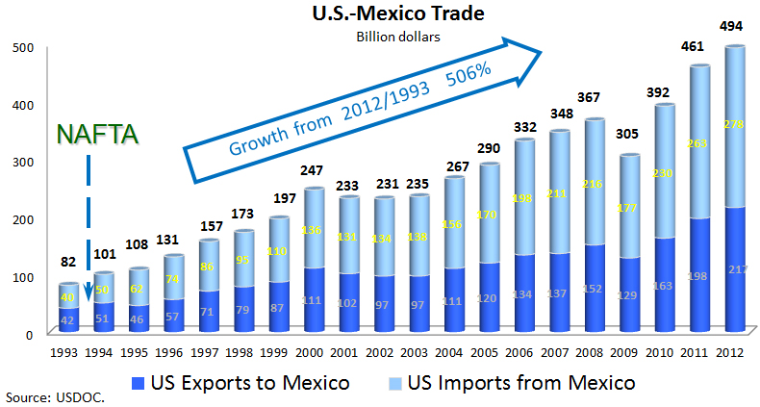
U.S. – Mexico Trade - Growing
(Billions of Dollars)
Note: slide from SANDAG
Notes:
Ten emerging Mega-Regions in the United States.

Slide 6
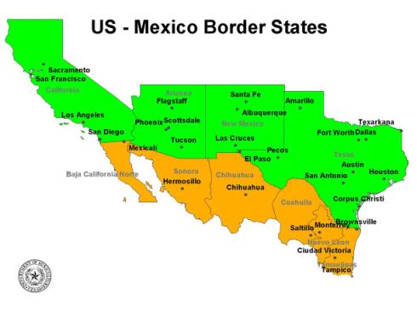
US – Mexico Border
Number of States
  Mexico 6
  US 4
Population (millions)
  Mexico 19.7
  US 70.9
Economic Size (Billions)
  Mexico 159
  US 3,341
  Total 3,500
Source: U.S. Bureau of Economic Analysis / Inegi (2011)
4th or 5th GDP in World (IMF or World Bank)
Notes:
Ten emerging Mega-Regions in the United States.

Slide 7


Opportunity Cost of Border Wait Times
Value of Lost Economic Benefits U.S. – Mexico
(Wait Time Ranges: Cars 0.5-2.5 hrs; Trucks 1-6 hrs)
$7.2 Billion in Output Lost =
18
Super Bowls
62,000 Jobs Lost =
4 Google Companies
Note: slide from SANDAG
Notes:
Ten emerging Mega-Regions in the United States.

Slide 8
Why a Mega-Region
“The real driving force of the world economy is a new and incredibly powerful economic unit: the mega-region…
China is not our real competitor. Rather, we should be thinking about the great mega-regions around Shanghai, Beijing and the Hong Kong-Shenzhen corridor.”
Richard Florida, April 2008

Slide 9
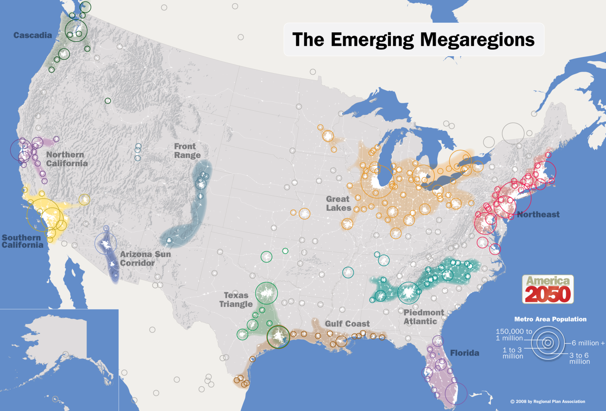
What is a Mega-Region?
Our Mega-Region
Source: America2050.org
Notes:
Ten emerging Mega-Regions in the United States.

Slide 10
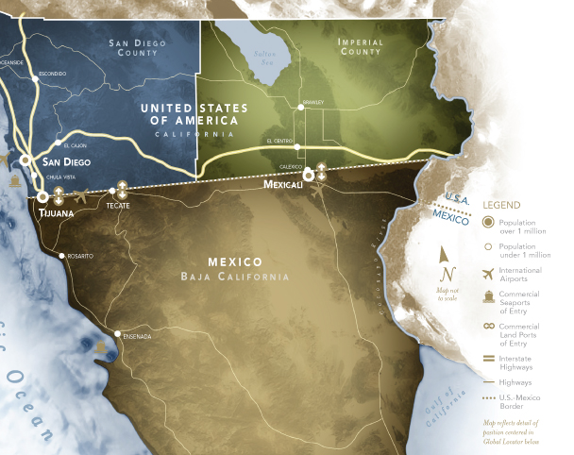

Slide 11


CaliBaja Strategy:
Complimentary Capabilities
Baja California
Sophisticated manufacturing: aerospace-MedDev…
Competitively priced labor
Steady supply of engineers
International trade logistics
Imperial County | San Diego County
Renewable energy sources: geothermal, solar, wind | Knowledge based economy: Telecomm, Software, Biotech
Large tracts of developable land | Educated Workforce
Water | World class academic and research centers
Agri-business | Quality of Life
Notes:
Ten emerging Mega-Regions in the United States.

Slide 12
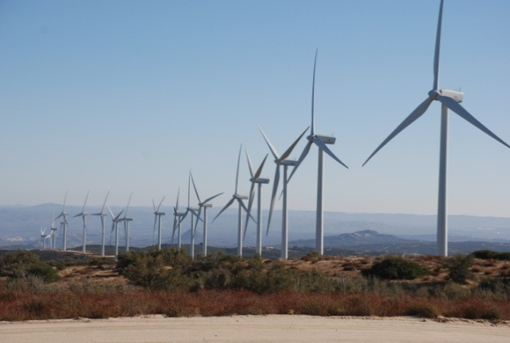
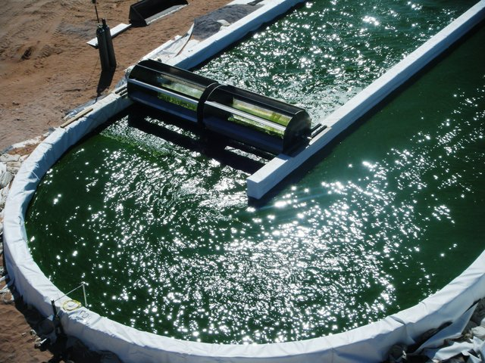
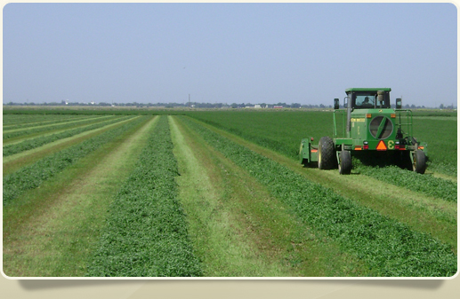
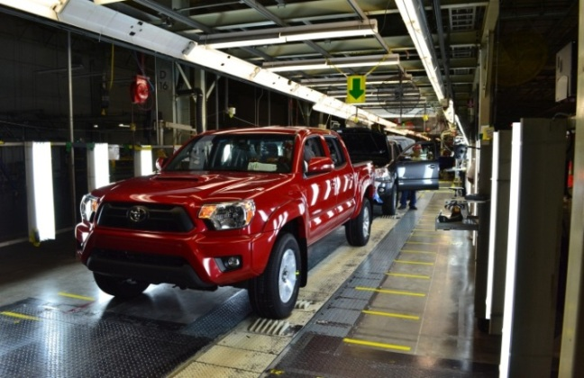
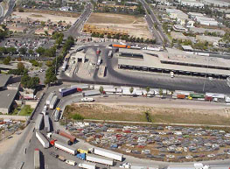
Finding Common Ground:
Five Strategic Industries
Cleantech
Applied Biotech
Agribusiness
Source: www.glennmosier.com
Advanced Manufacturing
Logistics
Notes:
The mega-region project addresses four industries that are established or emerging in all three regions.
Those are: alternative and renewable energy development, generation and transmission; logistics – the movement and warehousing of goods; manufacturing, with an emphasis on smaller, specialty manufacturing companies; ag-biotech; and biotechnology and medical devices, with a focus on providing opportunities for manufacturing that might otherwise be outsourced overseas.
In 2013, we will be adding agribusiness.

Slide 13
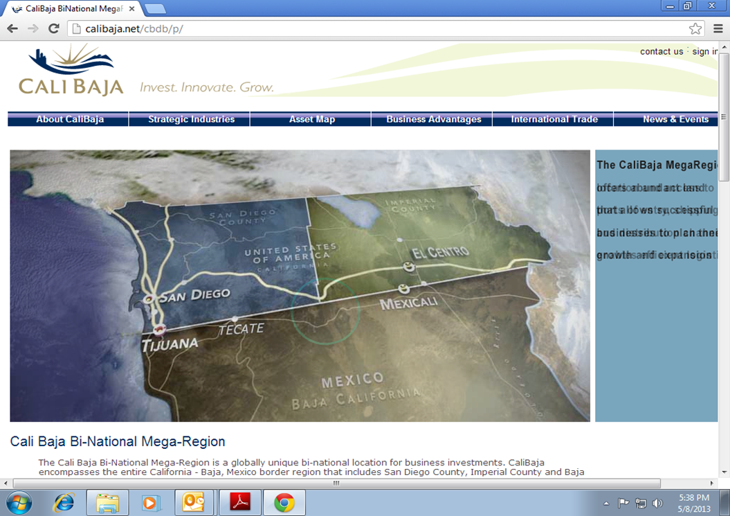
CaliBaja.org
Economic Development Tool

Slide 14
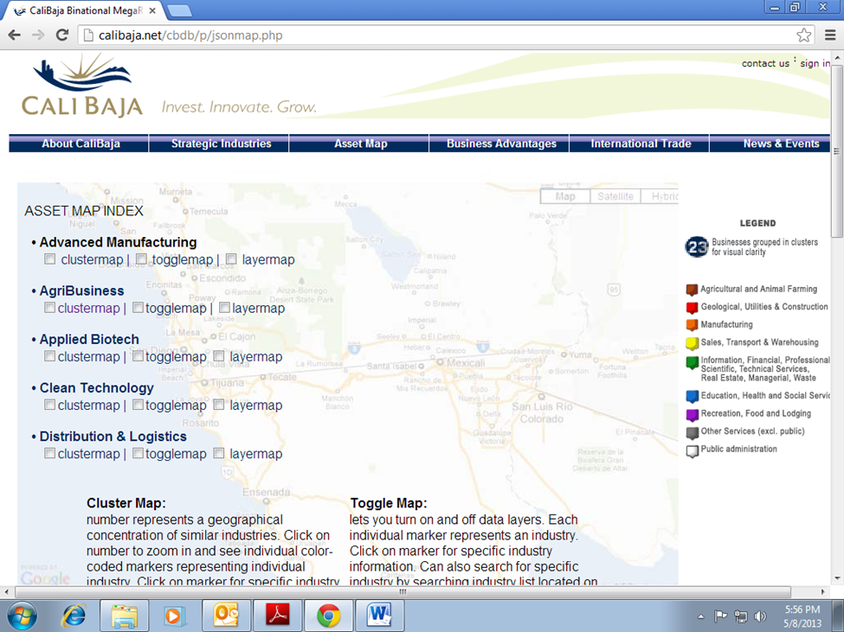
Asset Map - Strategic Industries

Slide 15
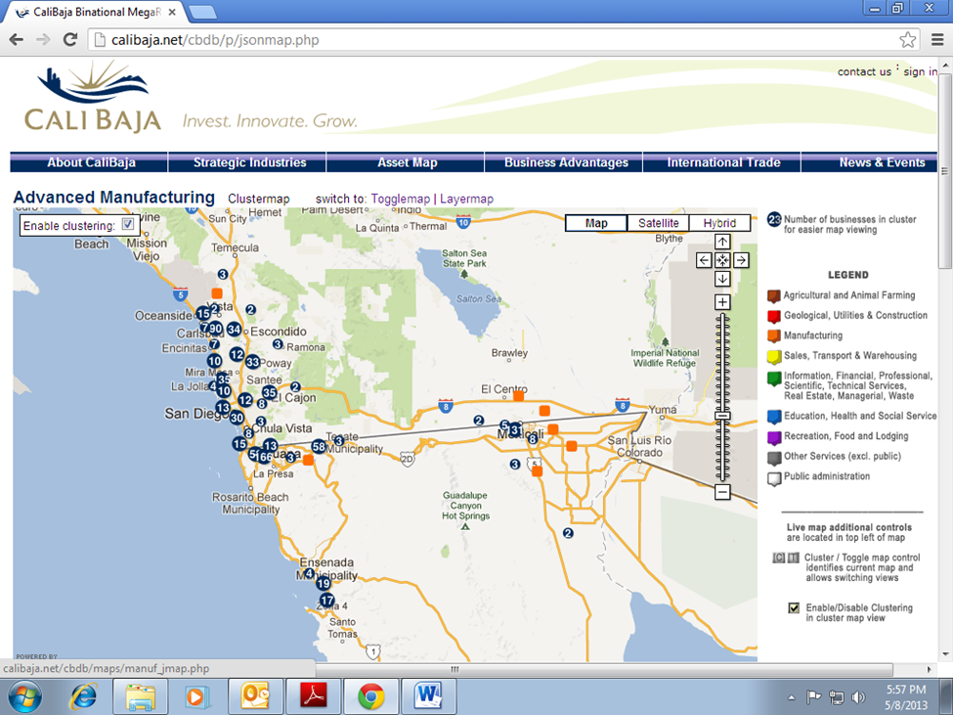
CaliBaja Strategic Industries:
Advanced Manufacturing

