Slide 1
City of San Diego Climate Action Plan
Seth Litchney
Senior Planner
Planning Department
Cody Hooven
Sustainability Manager
Economic Development Department
www.sandiego.gov/planning/genplan/cap/

Slide 2
Why?
State regulations
General Plan
CEQA streamlining
Public Health
Resource Efficiency
Leadership
Jobs
Sustainable energy supply
Quality of life
Notes:
Keeps us on track to comply with state regs - AB32, S-3-05, S-X-XX (2030), potentially SB32 if passed
Fulfills mitigation measure of our 2008 Gen Plan = ENFORCEABLE
Will streamline the GHG portion of CEQA
More than just because we have to…
Public health benefits – cleaner air
Cost savings (for business, residents, and the City) from Efficiently Uses Existing Resources (energy, water, less waste generation)
We want to be a leader in sustainability – we’re a Smart City
Creates New Jobs and new business opportunities
Increases sustainable Energy Production, including local production
Improves Quality of Life – more biking, walking, transit, living closer to work, more trees…
We’re putting forward a bold plan. It will be a living document – monitored and updated over time to capture progress, new regs, activities, and technology

Slide 3
Projected Greenhouse Gas (GHG) Emissions Levels & Targets
Notes:
2020 – state and federal actions get us most of the way to our targets (90%)
2030, 2035 – rely more on regional and local actions.
Targets –
2020 – AB32
2030 – EO B-30-15 – 40% below 1990 levels
2050 – EO S-3-05 (2035 is used because it is 50%/halfway to 2050 targets of 80% reduction below 1990 levels)
SB32 – would make 2030 and 2050 targets into law

Slide 4
2010 Community-Wide Emissions
Notes:
Sources of emissions

Slide 5
Federal, State, and Regional Actions
AB32 – 1990 levels by 2020
EO B-30-15 – 40% below by 2030
EO S-3-05 – 80% below by 2050
SB350 (just passed) – 50% increased energy efficiency and 50% renewable portfolio standard by 2030
Low Carbon Fuel Standards
SANDAG SB375 transportation plan
Vehicle Fuel Efficiency Standards
Notes:
State and federal actions are helping us achieve our goals -
SB32 – just failed to pass, would have codified EO S-3-05

Slide 6
2035 Goals
100% Renewable Energy
50% Smart Transit
Zero Waste
Efficient Buildings
Climate Resilience
Notes:
Goals listed here are for 2035
Plan contains: Strategies – goals – actions
Many actions are for the City to implement
Any policy change will be through public process
Transit goals are for TPAs
Other jurisdictions with 100% renewable energy goal (various years): San Jose, Marin County, Palo Alto, Aspen, Santa Barbara, State of Hawaii, Vermont
Various circumstances – some have their own utility, access to hydropower, CCA, etc.

Slide 8
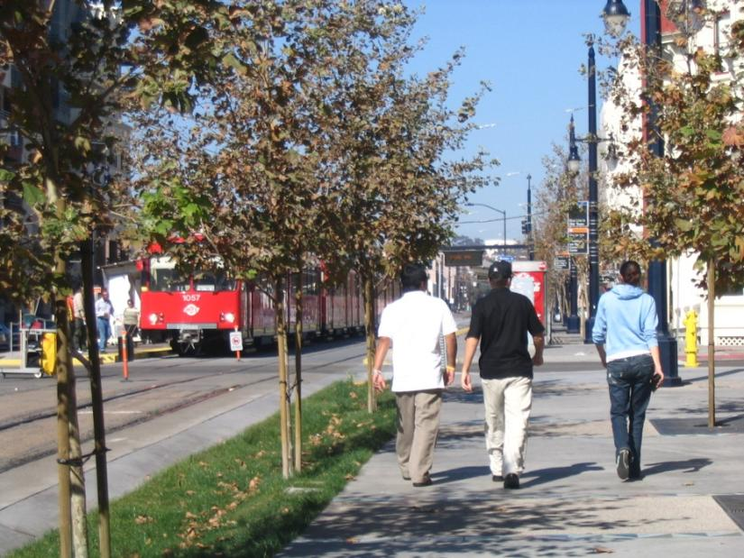
CEQA Streamlining
California Environmental Quality Act
Certified GHG Reduction Plan
Future Projects

Slide 9
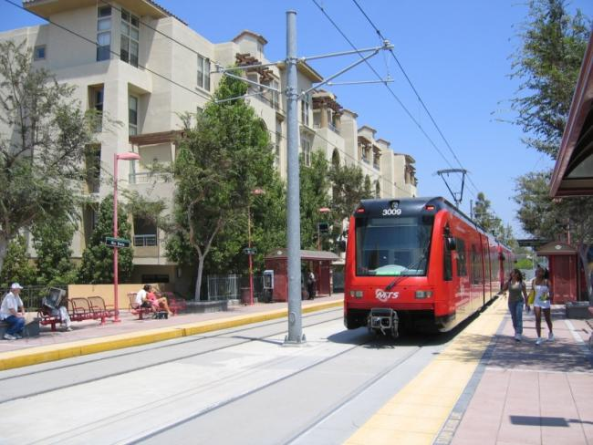
CEQA Streamlining
1. Screening Criteria
Gap-Based Approach
Local Data
CAP Emission Reductions
List of Projects Below Screening Criteria
Residential, Non-Residential, & Mixed Use

Slide 10
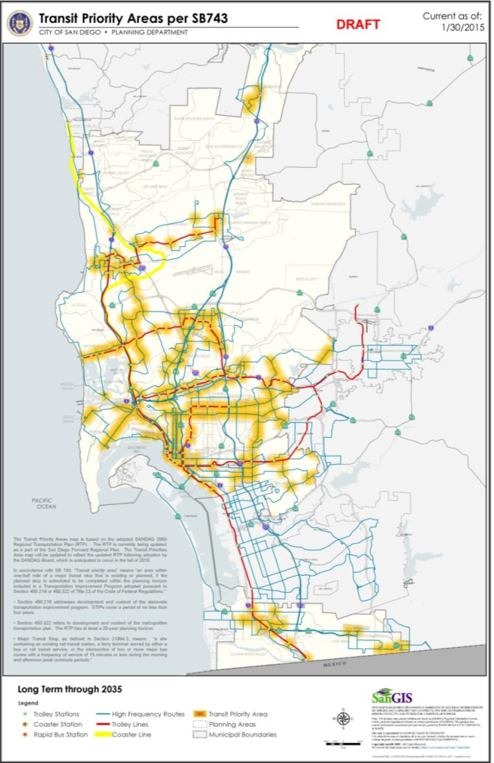
CEQA Streamlining
2. CAP Checklist
Based on Actions in CAP impacting new development
Part 1: Land Use
Transit Priority Areas
General Plan/Zoning Compliance
Bicycle Master Plan Implementation

Slide 11
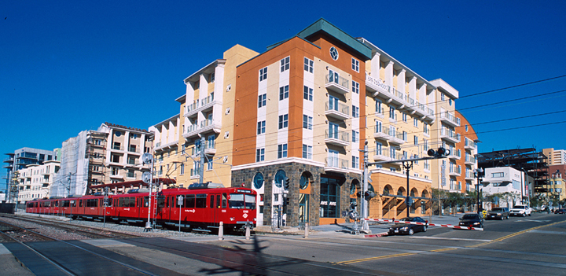
CEQA Streamlining
2. CAP Checklist
Part 2: Energy/Water/Waste/Tree Canopy
Part 3: Expanded Energy/Water/Waste/Tree Canopy
Only needed if project cannot comply with Part 1

Slide 12
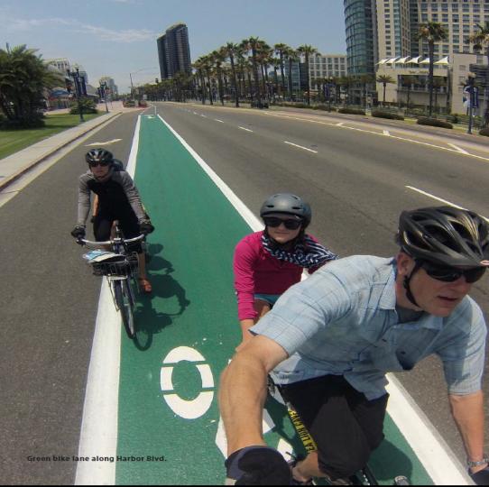
CEQA Streamlining
3. Greenhouse Gas Emission CEQA
Threshold of Significance
GHG Analysis
1350 metric tons CO2e per year

Slide 13
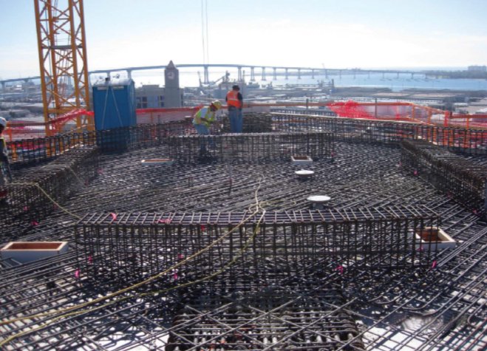
CEQA Streamlining
Provides Certainty for Development
Ensures New Development Complies with CAP or Limits Emissions
Streamlines the CEQA Process, especially in TPAs

Slide 14
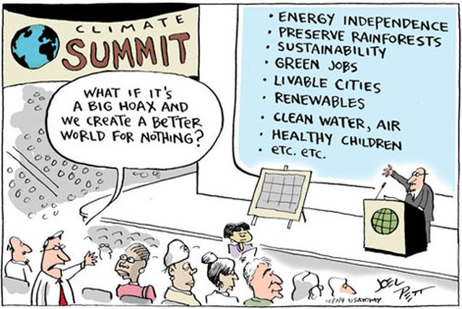
Economic Opportunity
Notes:
Costs of inaction – loss of economic opportunities in green jobs, venture capital, new technology development, skilled workforce, reduced health problems, more walking, biking, lower cost of transportation…. SD Pride as a cleantech hub with a highly skilled workforce and a high QOL
New report “Benefits of Global Action” June 2015 – peer-reviewed and published by White House in conjunction with MIT, the Pacific NW National Laboratory, and the National RE Laboratory
analyzing 20 sectoral impacts – from health, infrastructure, ag, and electricity – reports that keeping change to 2 degrees celsius (seen by most scientists as threshold before catastrophe) will save close to $1 Trillion by 2100 in power costs, infra repairs, health spending, damaged crops, disaster recovery, and lost productivity
For example, SLR and storm surge = $5-7 trillion without action, down to $800 billion with adaptation and increased resiliency
The benefits of action are greater in the future; Current inaction is attributed in research literature to a delay in benefits. In other words, do nothing today will cost us even more in the future.

Slide 15
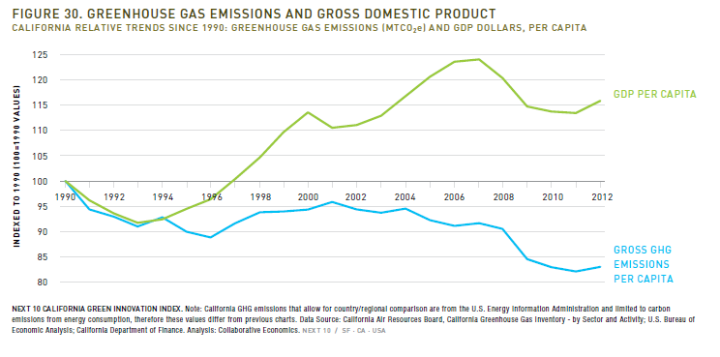
Economic Opportunity
GDP ⇧16%
GHG emissions ⇩17%
Source: 2015 California Green Innovation Index, Next10
Notes:
Cost savings = reduced operating costs for city, businesses, and residents
CAP and related programs provide certainty for a local, clean tech innovation economy
CA ranks among top 10 nations in renewable energy production

Slide 16
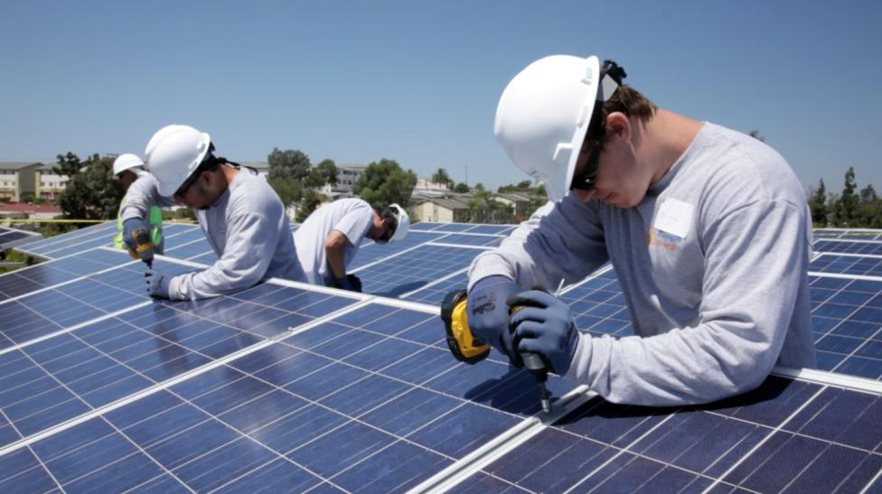
Economic Opportunity
SD Region: 25,000 clean economy jobs as of January 2014, third highest in the state
Average monthly electricity bill decreased
Notes:
Venture capital investment, etc.
CA monthly electric bills details:
-4% residential
-57% industrial
increased 8% commercial

Slide 17
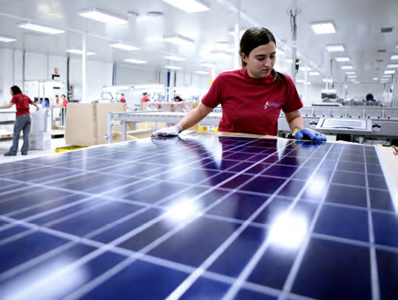
Energy
100% renewable electricity on the grid
90% of city fleet will be zero emissions
Alternative fueled municipal solid waste trucks
Notes:
Now we’re getting into specifics on CAP actions
Few cities have a similar goal – we’re leading the way
List other cities:
Currently generate ~25MW of renewable energy (landfill gas and solar) = about 30% of municipal needs
Planned for 11-30 MW more in near future
City fleet – 90% of city fleet with be ZEV
San Vicente Hydrodam – feasibility study approved in June 2015, could generate up to 500MW of energy through storage

Slide 18
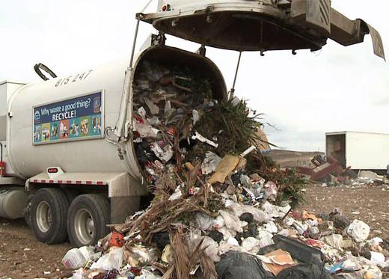
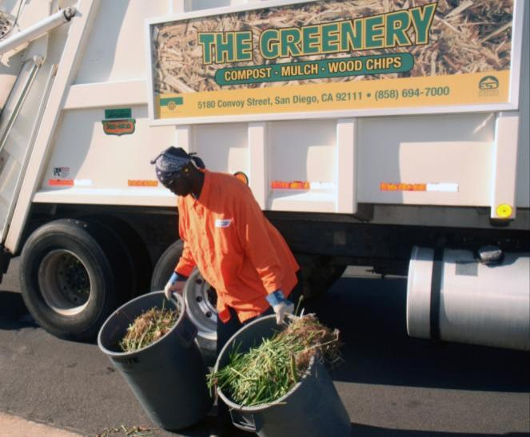
Zero Waste
Zero Waste (by 2040)
Capture 80% of landfill and 98% of wastewater gas
Notes:
Also, increase curbside recycling and greenery collection and add kitchen compost

Slide 19
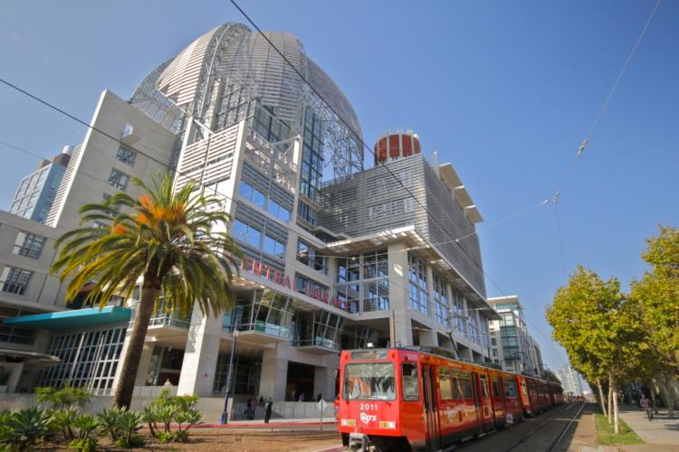
Efficient Buildings
15% energy use reduction in half of homes
Develop a Municipal Energy Strategy + reduce City use 25%
Support ongoing water efficiency
Notes:
Residential energy disclosure ordinance
Water – we’re currently surpassing 2020 goals; additional 16% reduction targeted for 2016
Pure Water will provide 1/3 of city’s water by 2035
Removed point-of-sale mandate (remind audiences if interested)
With California’s current building standards, today’s new homes use 50 percent less water indoors than a home built prior to 1980 and are approximately 50 percent more energy-efficient than new homes built to national energy standards.

Slide 21
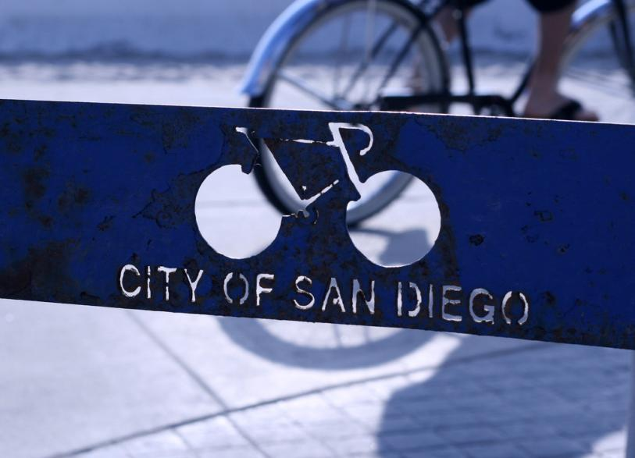
Smart Transit & Land Use
50% Mode Share Shift
18% biking
7% walking
25% mass transit
Notes:
These goals are based on Transit Priority Area maps which are based on SANDAG 2050 RTP
TPAs- in areas with existing or planned-for development
Transit:
Mobility element of Gen Plan, City of Villages strategy, and Transit Priority Areas
Walking – pedestrian improvements in TPAs, draft Ped Plan
Biking – Bike Master Plan
- Over 10,000 Evs in the region; over 700 charging stations

Slide 22
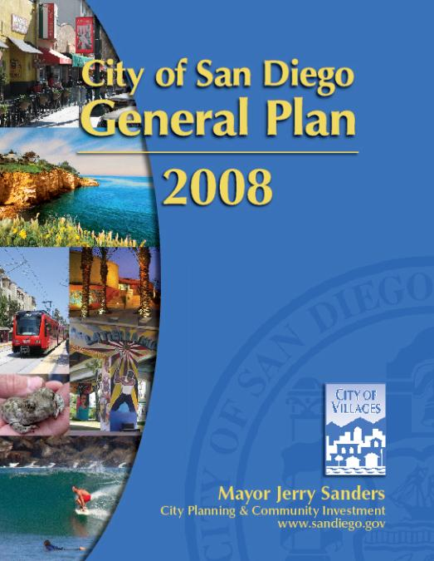
Smart Transit & Land Use
Implement the General Plan
City of Villages Strategy
Regional Planning/Inter-Jurisdictional Coordination
Guide future growth into a sustainable, citywide development pattern

Slide 23
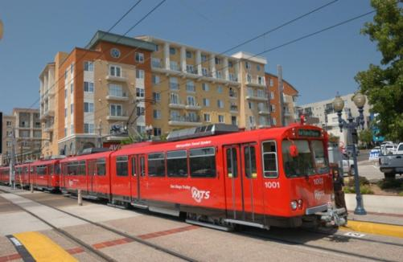
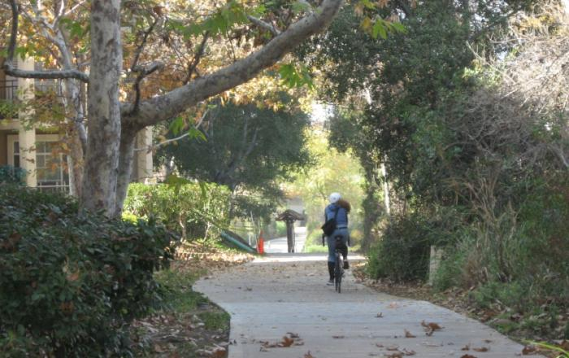
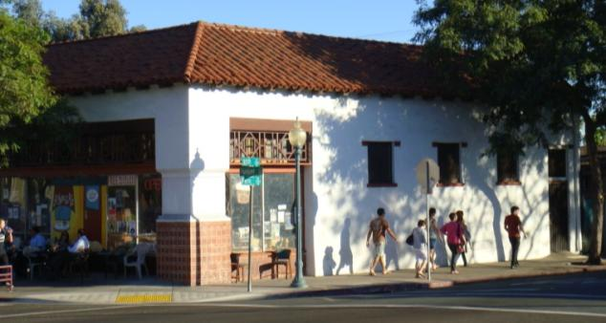
Smart Transit & Land Use
Mobility Element
To improve mobility through development of a balanced, multi-modal transportation network.

Slide 24
Smart Transit & Land Use
Transit Priority Areas (TPA)
½ mile from Trolley/High Quality Bus Stop

Slide 25
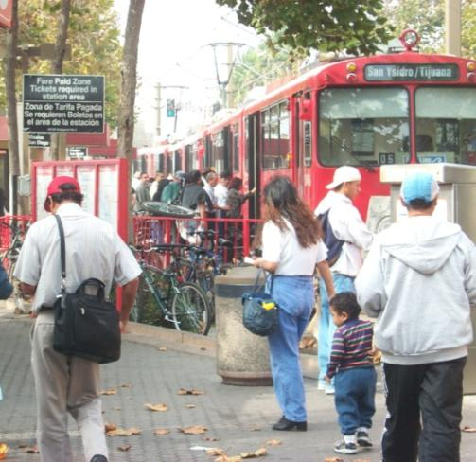
Smart Transit & Land Use
Transit Use
Implement the General Plan’s Mobility Element and the City of Villages Strategy in TPAs to increase the use of transit.
Achieve mass transit mode share of 12% by 2020 and 25% by 2035 in TPAs.

Slide 26
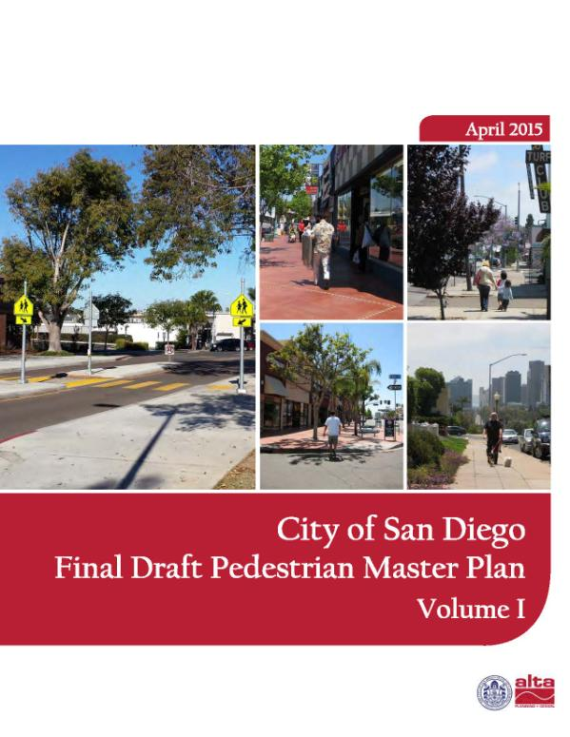
Smart Transit & Land Use
Walking
Implement pedestrian improvements in TPAs to increase commuter walking opportunities.
Achieve walking commuter mode share of 3% by 2020 and 7% by 2035 in TPAs.

Slide 27
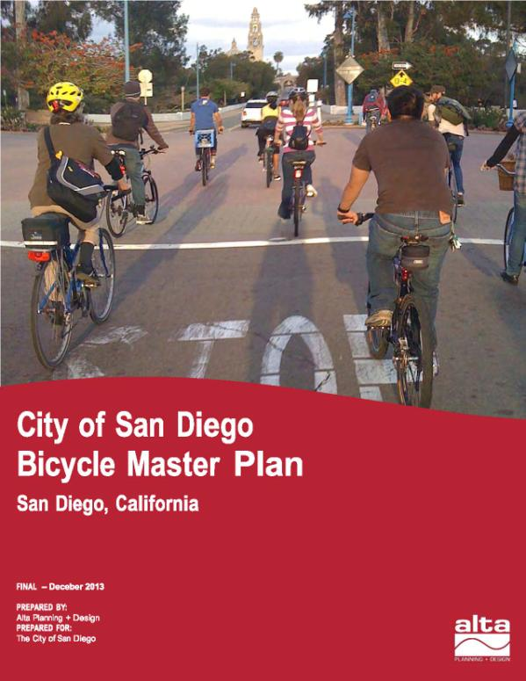
Smart Transit & Land Use
Biking
Implement the City of San Diego’s Bicycle Master Plan to increase commuter bicycling opportunities
Achieve 6% bicycle commuter mode share by 2020 and 18% mode share by 2035 in TPAs.

Slide 28
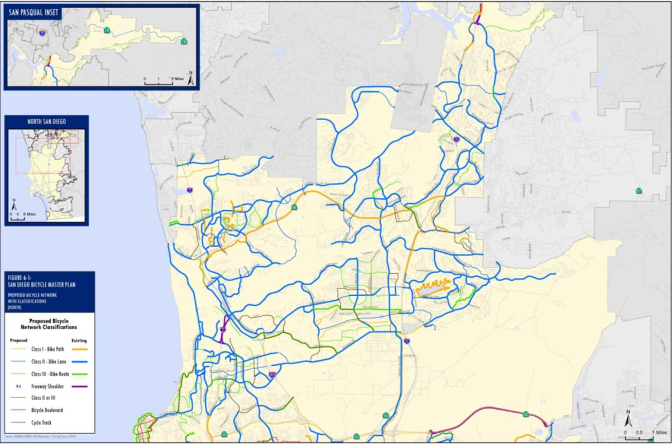
Smart Transit & Land Use
Bicycle Master Plan

Slide 29
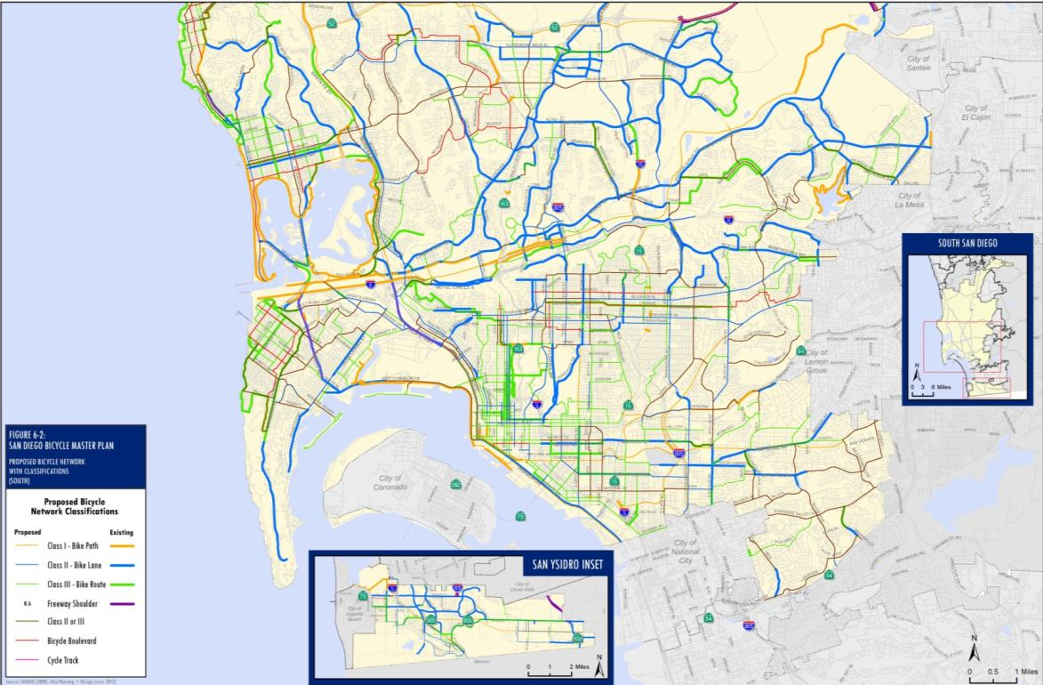
Smart Transit & Land Use
Bicycle Master Plan

Slide 30
Smart Transit & Land Use
VMT Reductions
Implement transit-oriented development within TPAs.
Reduce average vehicle commute distance by two miles through implementation of the General Plan City of Villages Strategy by 2035.

Slide 31
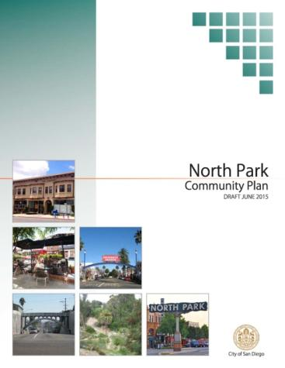
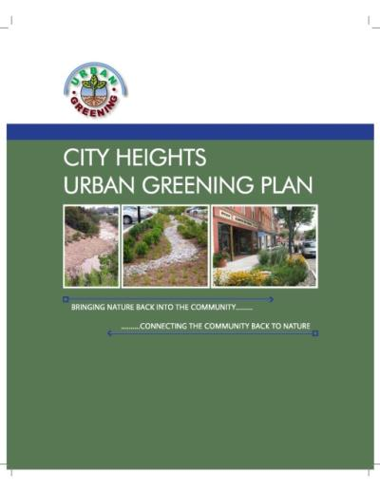
Smart Transit & Land Use
Implementation
New Development (CEQA Incentives)
Community Plan Updates
Grant Programs (Cap & Trade Funds)
City Projects

Slide 32
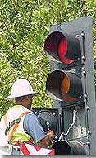
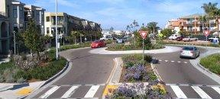
Smart Transit & Land Use
Other City Actions
Roundabouts
Retiming Traffic Signals

Slide 34
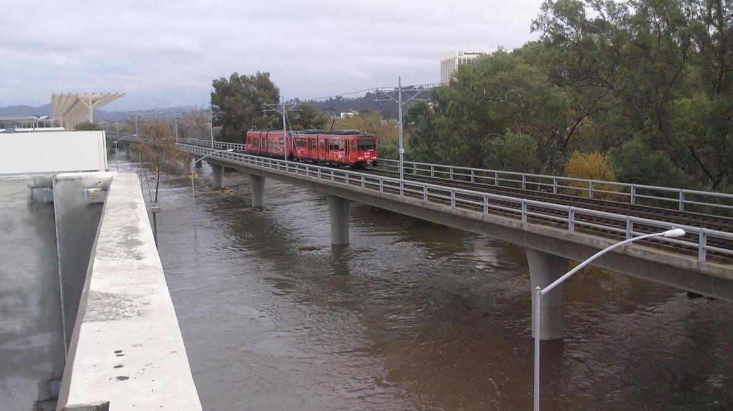
Climate Resilience
Planning getting started
Risk reduction and business continuity
Notes:
More intense and humid heat waves
More intense storms and drought
Increased water and energy demand
Increased fire frequency, intensity & area covered
Sea-level rise and coastal effects
Mitigation and adaptation complement each other – co-benefits
Dev Park Master Plan that prioritizes parks in underserved communities
Urban Forest Management Plan
Green Infrastructure (building with nature) projects already underway (rain gardens, bioswales, etc.)

Slide 35
Report: San Diego, 2050 Is Calling. Climate Education Partners. www.sandiego.edu/2050
Notes:
“Global warming”
Impacts

Slide 36
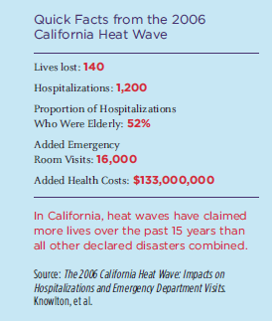

Slide 38
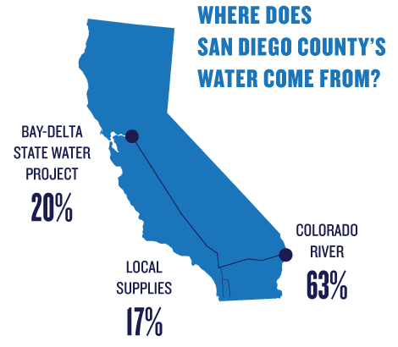
Notes:
Water demand increasing 46% by 2035 due to increased population
Increased heat = increased evaporation
Reduced snow pack reduces amount of imported water available
Economic growth dependent on water
NEED – consider local supply and conservation
Earthquake – water delivery infrastructure at risk
City – Pure Water Program – will provide 30% of our drinking water by 2035, considerations such as cost and energy use need to be weighed
500 year low on snow pack in the Sierras

Slide 39
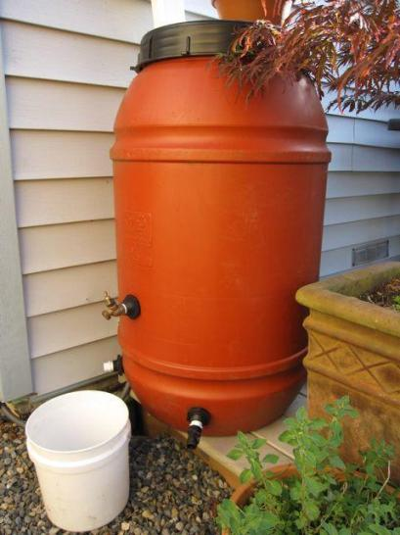
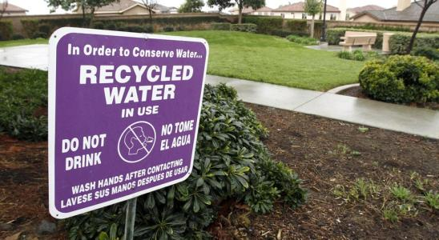
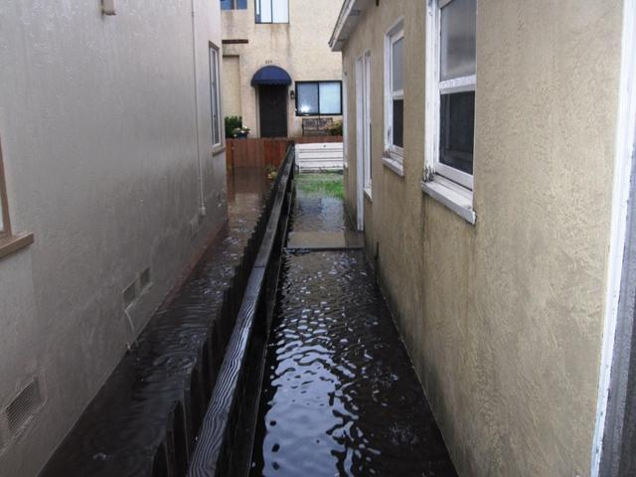
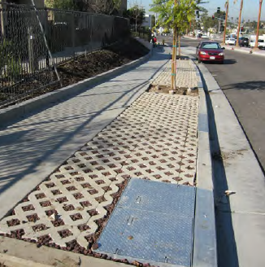
Conserving the water we have… And dealing with the water we get
Notes:
Reduce and reuse!
The City of San Diego has a Rain Barrel Rebate program that offers $1.00 per gallon, up to 400 gallons/ $400 per property.
Purple Pipe – reclaimed water use
Low Impact Development/Green Infrastructure:
A series of 25 filtration trenches run along the southern parkway of Logan Avenue and the eastern parkway of 43rd Street. Storm water runoff flows into special inlets that filter out trash and be filtered before sending the filtered water to the storm water conveyance system and nearby Chollas Creek.
Pure Water System
LID builds with nature and creates redundancy to the stormwater system, allowing us to better handle more water and extreme weather events
Latest City conservation numbers – 27% reduction county-wide 2013 to now

Slide 40
Notes:
Brush removal

Slide 41
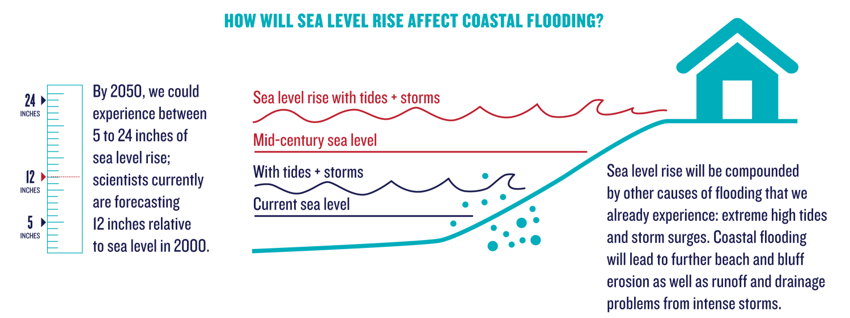

Slide 42
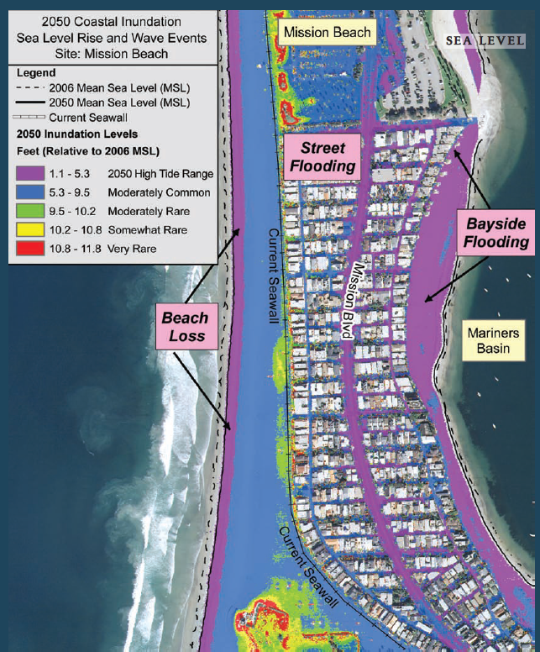
Focus 2050 Report, The San Diego Foundation

Slide 43
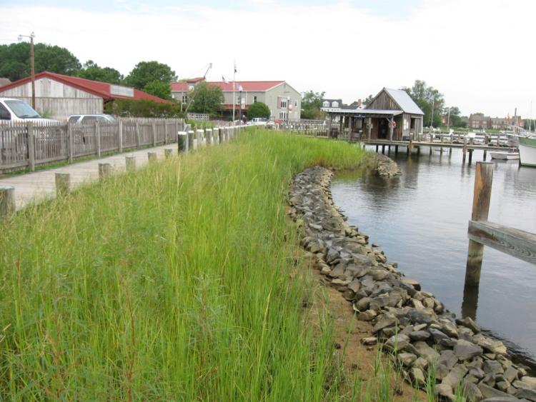
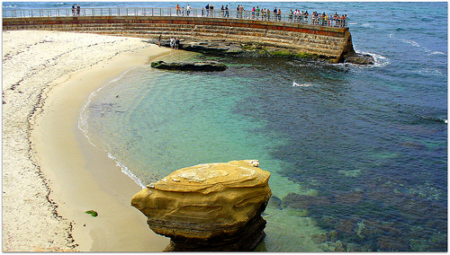
Coastal Adaptation Strategies
Eyeonannapolis.net
Notes:
“Softscape and hardscape” strategies
Set backs
Building pad elevation (or roadway)
Seawalls
Curved seawalls to deflect waves
Retreat
Adaptive management – costs now vs costs later, lifespan…
Foundation support for future height increases

Slide 44
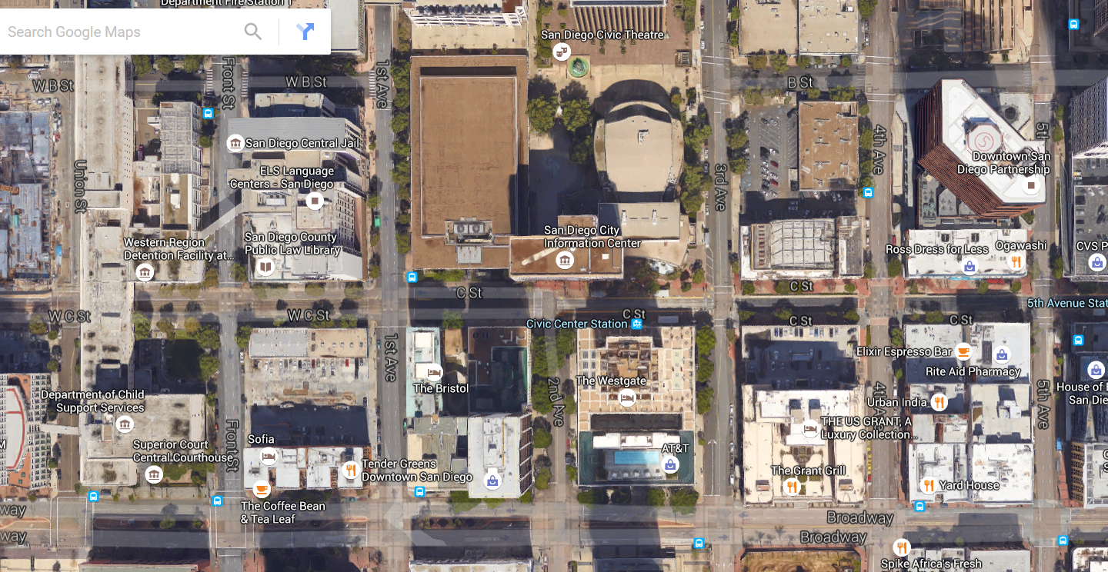
Urban Tree Canopy
Notes:
Urban Tree Management – Goal = 35% by 2035
Supports carbon sequestration, SW compliance, clean air, raise property values, reduce street maintenance costs, reduce stress, QOL, adaptation (shade)… Conserve water! (intercept rainfall and increase stormwater retention, and require little water after establishment)
Significant loss of urban tree coverage 1985-2002 when city underwent substantial development (39% increase in developed area) – lost 27% tree cover, currently at ~4-7%

Slide 45
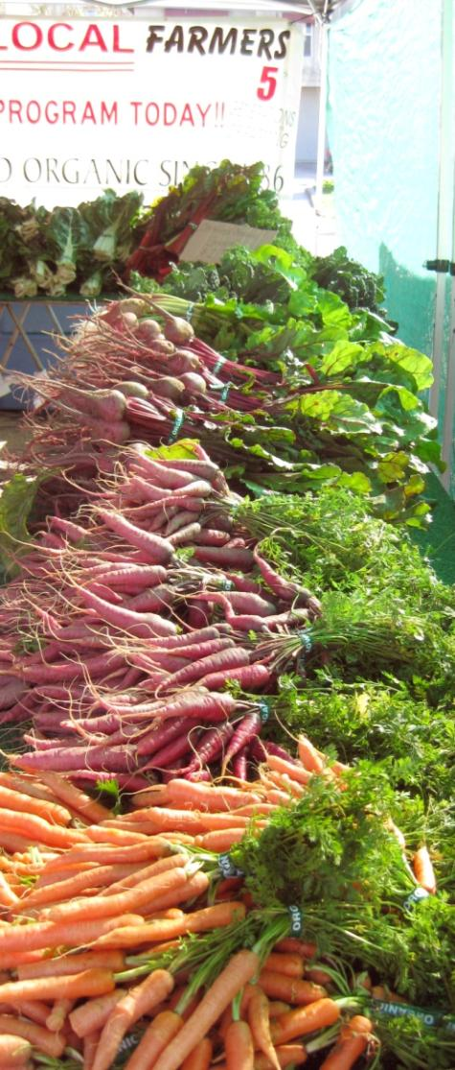
Next Steps
Sept. 29 - Comment period closes
October 29 – Planning Commission
November 4 - Committee on the Environment
December – City Council Adoption
January 2016 to …2035
Implementation
Monitoring and reporting
Updates
Notes:
Living document

