Slide 1
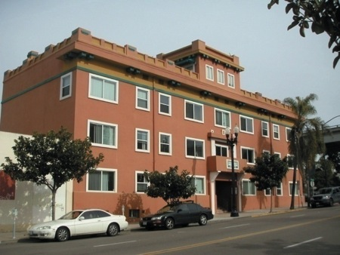
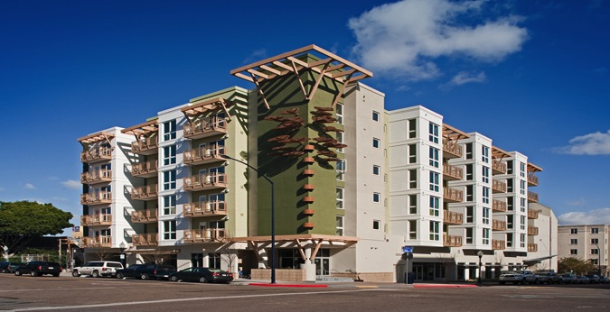
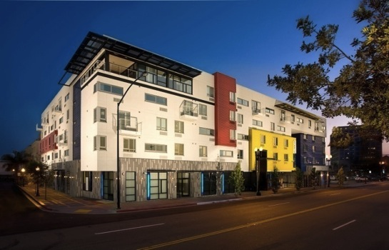
San Diego’s Housing – Are we meeting the needs?
Eri Kameyama
Civic San Diego
October 22, 2013

Slide 2
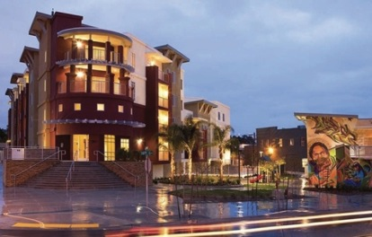
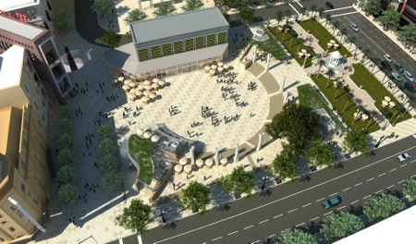
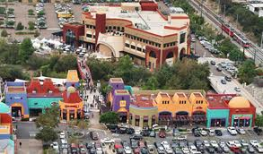
Civic San Diego Who we are
Created in response to the State’s dissolution of redevelopment, Civic San Diego is the merger of Centre City Development Corporation (CCDC) and Southeastern Economic Development Corporation (SEDC) and charged with the vision of
Winding down redevelopment;
Management of former redevelopment agency housing and non-housing assets; and
Advancing economic development, neighborhood investment and revitalization, and urban planning and permitting.

Slide 3
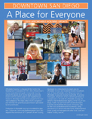
Former CCDC’s Track Record in Affordable Housing Downtown for Everyone
“Diversity among residents .. Is one of the hallmarks of great urban environments” (Downtown Community Plan)
Redevelopment Law
- 20% of Tax Increment towards production of affordable housing
- 15% of total housing units affordable
Helped create approx. 4,000 affordable homes in Downtown
Approx. 20% of all units built in downtown since 1975 are affordable

Slide 4
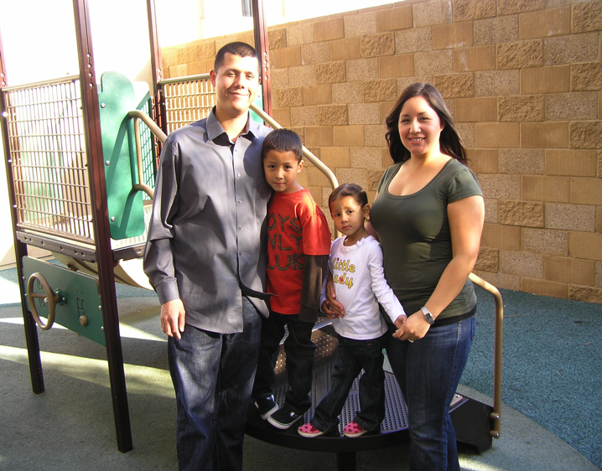
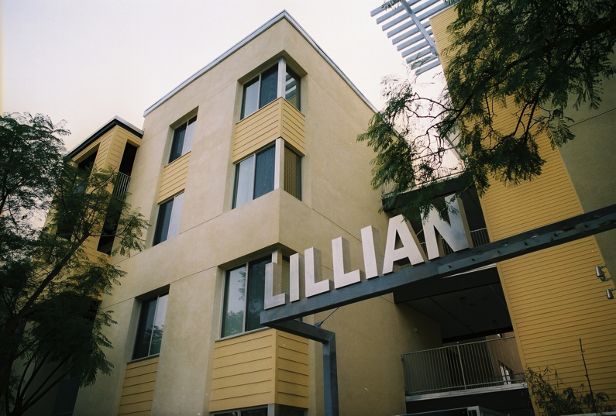
Affordable Housing Who lives there?
Household Income Limit for a family of four:
Extremely Low (30% AMI) | Very Low (50% AMI) | Low (80% AMI) | Moderate (120% AMI)
$24,800 | $41,300 | $66,100 | $91,100
“Because the rent at Lillian Place is affordable, we can focus on other things in life and make sure we can succeed.” (Raymond Bernal)

Slide 5
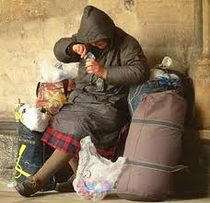
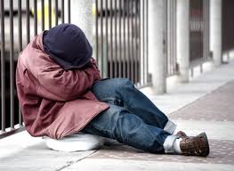
Ending Homelessness “Plan toward Ending Homelessness in Downtown”
Requirement for inclusion of supportive housing units in all new affordable housing projects (2009)
Downtown Registry Week (2010) – Identified 1040 homeless individuals, of which 279 identified as most vulnerable
Campaign to End Homelessness in Downtown – Housed 255 most vulnerable individuals from 2010 – 2013
Adoption of “5-year Plan toward Ending Homelessness in Downtown” (2011)
Connections Housing (2013)
Homeless count in downtown - reduced from 1048 in 2011 to 896 in 2013 (per Point in Time count)

Slide 6
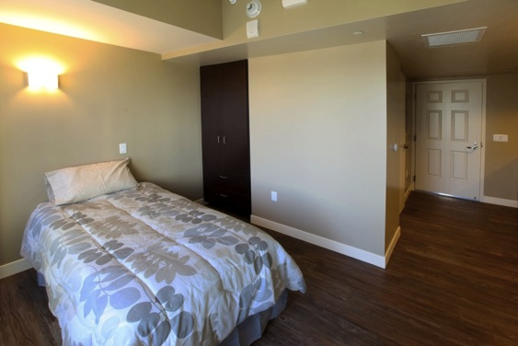
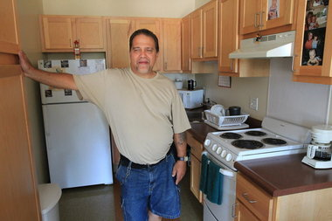
Ending Homelessness Supportive Housing
Permanent Housing + Supportive Services
Successful model to reduce street homelessness in major cities
Require all new affordable projects to include supportive units
Leverage MHSA Funding
NIMBY
Helped create 454 supportive housing units in downtown (of which 161 units, or 35% created since the policy was adopted)
200 additional supportive housing units are in the pipeline

Slide 7
Former CCDC Comprehensive Approach to Affordable Housing
Good Design | Affordable housing with attractive design to blend in the community
Supportive Housing | Require minimum of 15% of total units for homeless/special needs population
Green Building | Minimum LEED Silver or equivalent
Family Housing | Include more 2-3 bedroom units with amenities to attract families to downtown
Density | High-rise affordable housing to accommodate future growth
Neighborhood Revitalization/Public Benefits | Key locations. Add uses to revitalize the surrounding neighborhood
TOD | Affordable housing near transit
Creative Financing | Combining 4% and 9% TC,

Slide 8
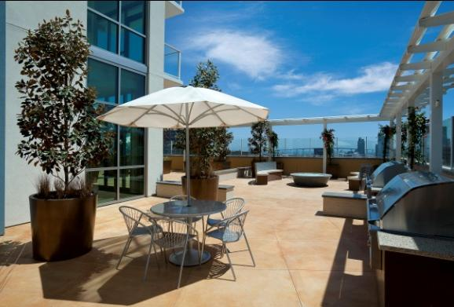
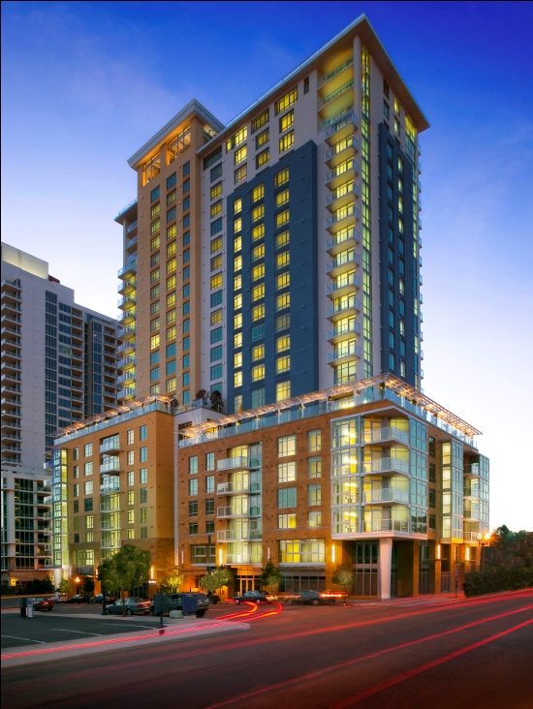
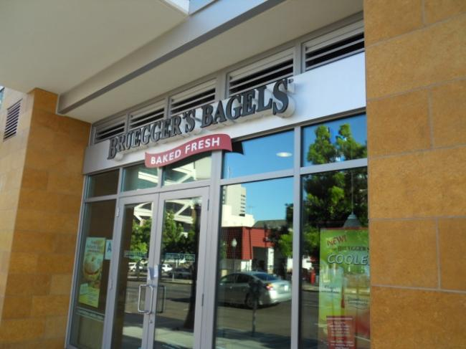
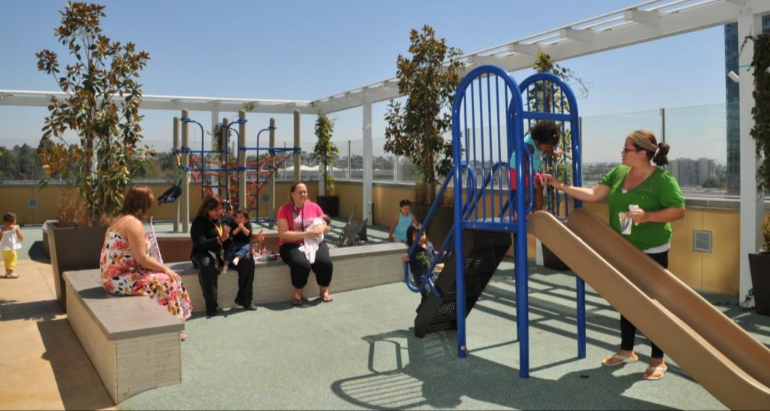
Ten Fifty B (2010)
Affirmed Housing Group
Family Affordable Housing w/ Ground Floor Retail (229 units)
LEED Gold
Notes:
2007 – Housing bubble
Originally designed as market-rate condos
Bought from KB Homes
23 stories
Ground Floor Retail
Close from Trolley Stop
Approximately half of the units are 2 and 3 bedrooms. It has great play areas for children and many families with kids live there.
Photovoltaic panel

Slide 9
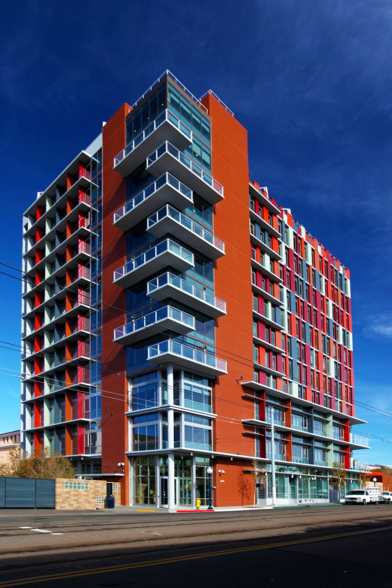
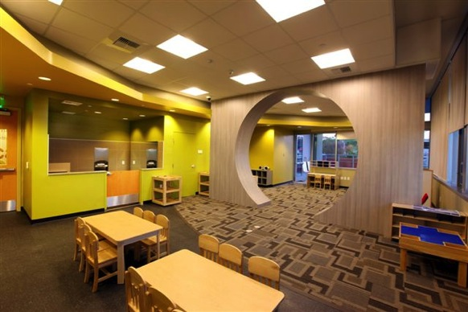
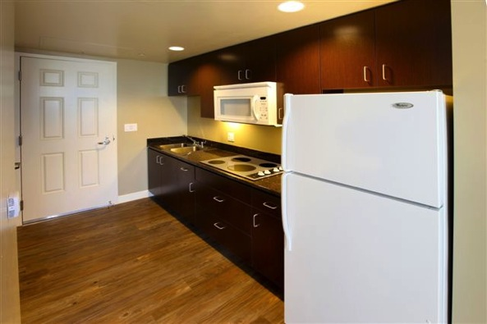
15th & Commercial (2011)
S.V.D.P Management, Inc.
Child Care Center, 150 Transitional beds, 65 Permanent Units w/49 Supportive Units
Green Point Rated
INCLUDE OTHER PHOTOS
Notes:
Mixed-use
Serving the homeless and at-risk population
12 stories
Near Trolley stop

Slide 10
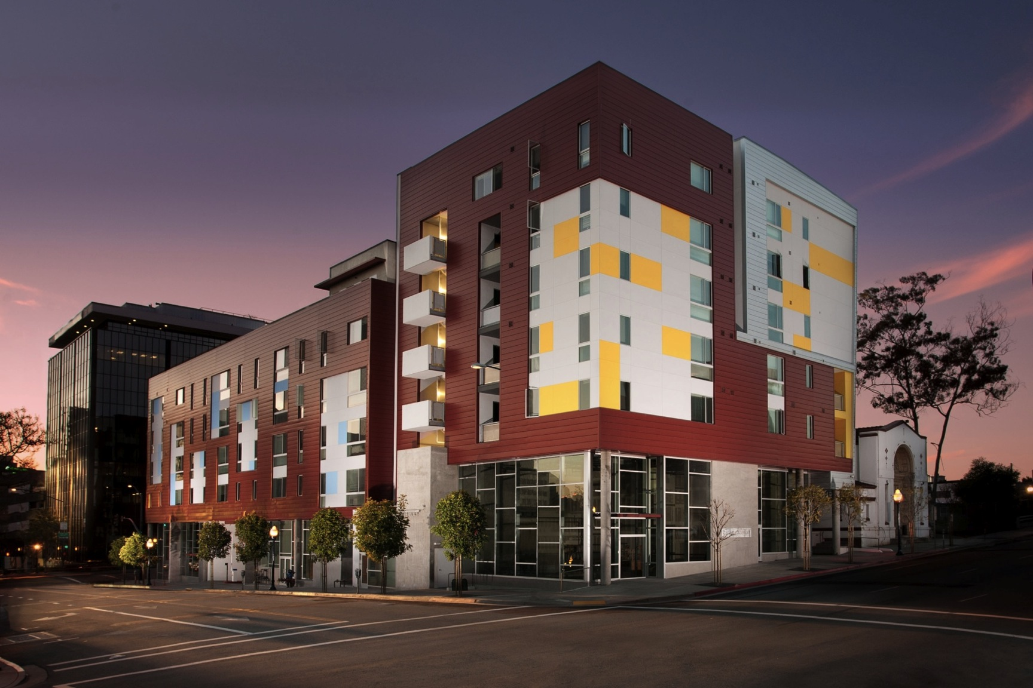
Cedar Gateway (2012)
Squire Properties & ROEM
42 Family Units + 23 Supportive Units
Ground Floor Retail, Public Parking, Historic preservation
LEED Platinum
Notes:
Mixed-use
Mixed-population – mixing family units with supportive housing units – Strong opposition from condo project across the street
Ground Floor retail – revitalization effects. Neighbors
Public Parking
Preservation of adjacent historic building
Green building – LEED Platinum (includes green roof)

Slide 11
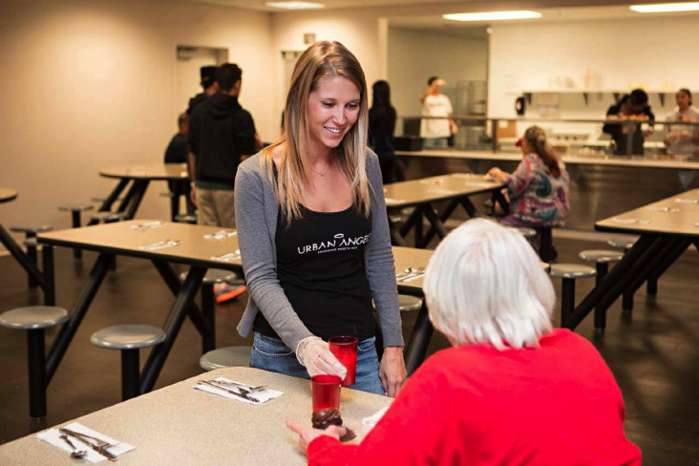
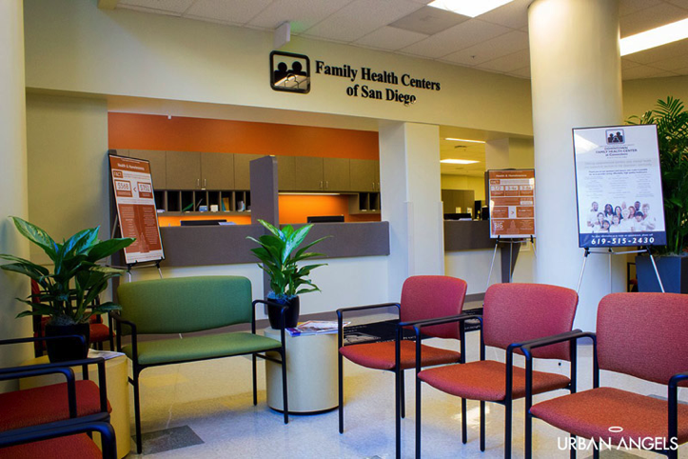
Connections Housing (2013)
Affirmed Housing Group & PATH
Homeless Service Center, Family Health Center, 150 Transitional beds, 75 Supportive Housing Units
Notes:
One-stop shop for the homeless
Historic rehabilitation
Model to reduce homelessness in the1/4 mile radius
Effectively reduced street homeless population within ¼ mile radius from 192 in May 2012 to 82 in April 2013

Slide 12
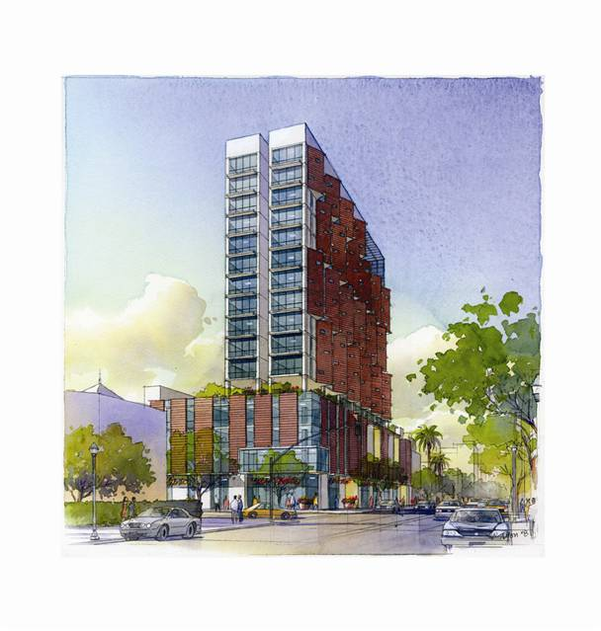
Celadon (East Village) 250 special needs and workforce units, by BRIDGE Housing
Total Budget | $82M ($328k/Unit)
City Subsidy | $22M ($87k/Unit)
Stories/FAR | 17 stories
Units | Living Units, studios, 1 Bedroom
Retail | 5,800 SF
Affordability | 30–60 % AMI
Supportive Housing | 88 units
Estimated Completion | 2015
Notes:
High-rise
Special Needs (35%)
4% and 9%
LEED Silver minimum

Slide 13
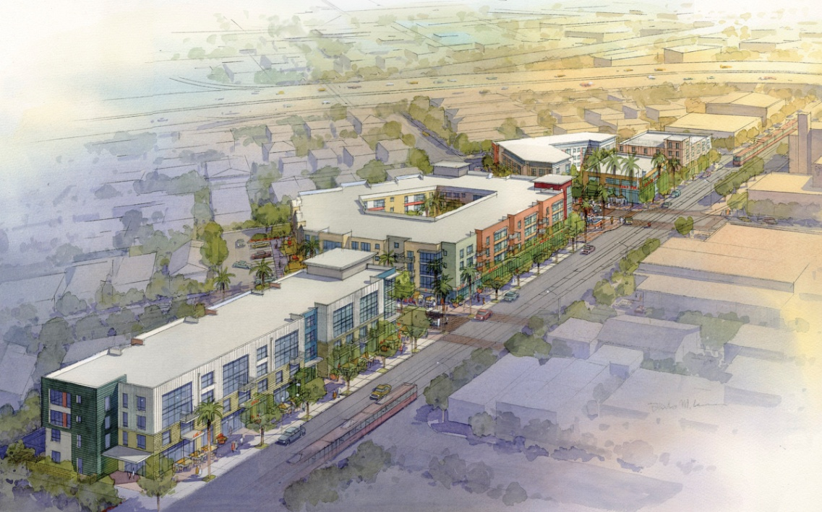
COMM22 (Logan Heights) Mixed-use project with 69 senior and 128 family units by BRIDGE Housing
COMM22
Total Budget | $56M (family housing)
City Subsidy | $9.255M
Stories/FAR | 4 stories
Units | 1,2&3 Bedrooms
Retail | 15,000 SF
Affordability | 30–60 % AMI
Supportive Housing | 13 units
Estimated Completion | 2015
Notes:
TOD

Slide 14
Affordable Housing Master Plan Housing Assets
Owned by the City as Successor Housing Entity
Remaining resource for affordable housing
Include the following:
1) Encumbered Low/Mod funds for enforceable obligations
2) Unencumbered Low/Mod housing bond proceeds
3) 23 real properties acquired by former RDA for affordable housing purposes (Downtown, Southeastern SD)
4) Notes receivable, DDAs/OPAs
5) Ground leases recorded on affordable housing properties
6) Covenants (affordability restrictions) recorded on affordable housing properties
Successor Housing Entity to create a Housing Asset Fund
Owned by the City as Successor Housing Entity
Excess Housing Bond Proceeds - Approx. $33 million
Loan Repayments
Lease Revenues
23 Real Properties

Slide 15
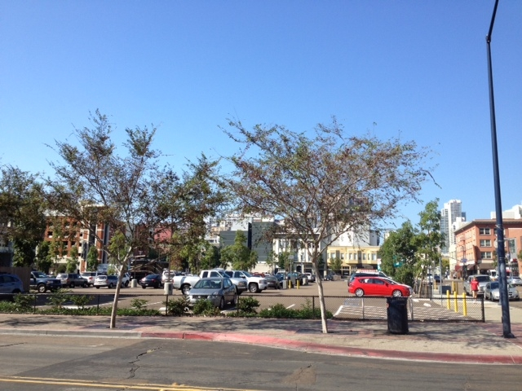
Affordable Housing Master Plan Real Estates Assets
23 Properties in Downtown and Southeastern SD
Five downtown properties proposed to be competitively sold for high density, mixed-use development
- minimum of 15% of residential units must be affordable
- proceeds from sale dedicated to Affordable Housing City-wide through NOFA

Slide 16
Affordable Housing Master Plan Guiding Principles
Maximize quality unit production with limited resources
Homeless housing
Maximize leverage with other funding sources
Development of affordable housing on real properties retained by Housing Successor Entity
Geographic diversity – Fund projects City-wide
TOD – Fund projects with proximity to public transit
Catalyst for neighborhood investment
Sustainability
Allow for flexibility
Competitively bid to select development partners
Use conservative assumptions
16

Slide 17
Affordable Housing Master Plan Proposed Affordable Housing Projects
 | FY2013 | FY2014 |  | FY2015 | FY2016 | FY2017 | TOTAL
Subsidies for Projects on City-owned properties |  |  |  |  |  |  | $ 40.5M
Atmosphere | $12.2M |  |  |  |  |  | $ 12.2M
13th & Market (50%) |  | $ 17.2M |  |  |  |  | $ 17.2M
Hilltop & Euclid |  |  |  |  | $2.0M |  | $ 2.0M
Ouchi Site |  | $ 0.72M |  |  |  |  | $ 0.72M
6395-97 Imperial |  | $ 0.4M |  |  |  |  | $ 0.4M
40th & Alpha |  | $ 0.48M |  |  |  |  | $ 0.48M
Monarch Site |  | $ 7.5M |  |  |  |  | $ 7.5M
13th & Broadway |  |  |  |  |  |  | $ 0
Subsidies for Other Projects |  |  |  |  |  |  | $ 4.8M
Churchill |  |  | $ 3.0M |  |  |  | $ 3.0M
VVSD V |  |  | $ 1.8M |  |  |  | $ 1.8M
City-wide NOFA |  |  |  | $8.0M | $6.4M |  | $ 14.4M
TOTAL USE | $12.2M |  | $31.1M | $8.0M | $8.4M | $0 | $59.6M
BALANCE | $22.8M |  | $12.6M | $5.7M | $0 | $1.2M

Slide 18
Affordable Housing Master Plan City-wide NOFA
An estimated total of $14.4M available in FY’15 and FY’16
Ensure geographic diversity
Potentially in collaboration with SDHC and other local funding partners
Objectives and selection criteria to be determined
Likely emphasis on affordable housing with units targeted for the homeless population (minimum 40% of units projected)
15% of units to be set aside as supportive housing
Portion of funds to be set aside for projects in those communities desiring repayment of bond proceeds

Slide 19
Affordable Housing Master Plan Estimated Affordable Housing Production
 | # of Low/Mod Units | # of Homeless Housing
Low/Mod units in mixed-Income housing developed by market-rate developers on Housing Assets (not subsidized by HTF) | 285 | 0
Low/Mod units in affordable and mixed-income housing developed on Housing Assets (subsidized by HTF) | 488 | 241
Other affordable housing projects City-wide subsidized by HTF | 260 | 151
TOTAL | 1,033 * | 392 *
19
* Does not include 447 units in pipeline projects (9th & Broadway or COMM22).

Slide 20
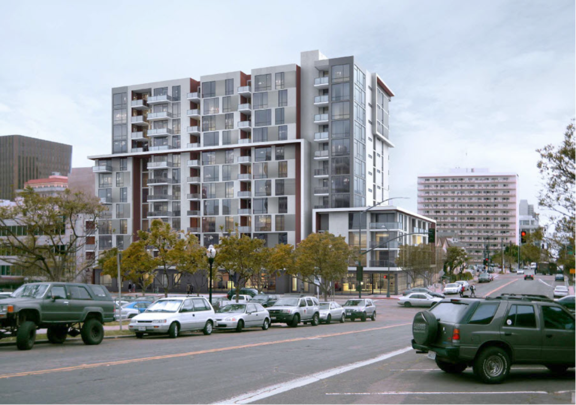
Atmosphere (Cortez) 205 family and special needs units, by Wakeland Housing
Total Budget | $82.6M ($403k/Unit)
City Subsidy | $11.6 million ($56k/Unit)
Stories/FAR | 12 stories, FAR 6.5
Units | Living Units, 1, 2 & 3 Bedrooms
Retail | 1,000 SF
Affordability | 30–60 % AMI
Supportive Housing | 41 units
Estimated Completion | 2016

Slide 21
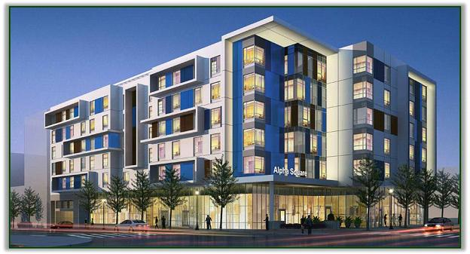
Alpha Square (East Village) 203 special needs units, byChelsea & Alpha Project
Total Budget | $47.6 million ($138k/Unit)
City Subsidy | $17.6 million ($85k/Unit)
Stories/FAR | 6 stories, FAR 4.54
Units | Living Units
Retail | 5,417 SF
Affordability | 30–60 % AMI
Supportive Housing | 76 units
Estimated Completion | 2016

Slide 22
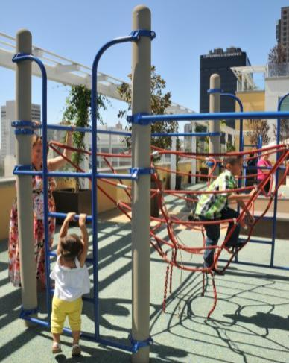
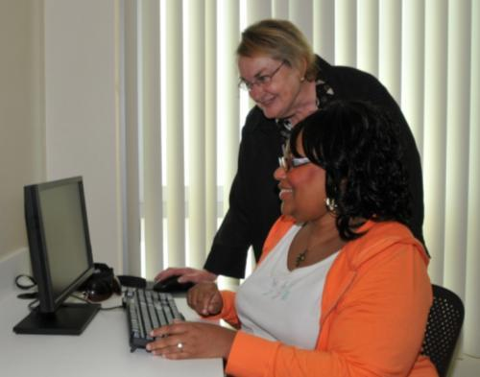
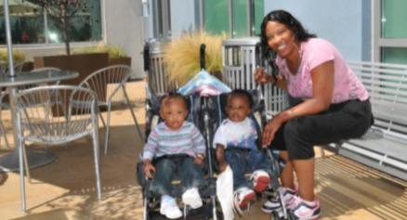
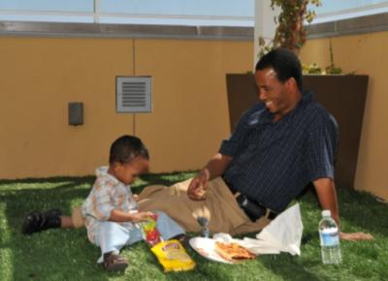
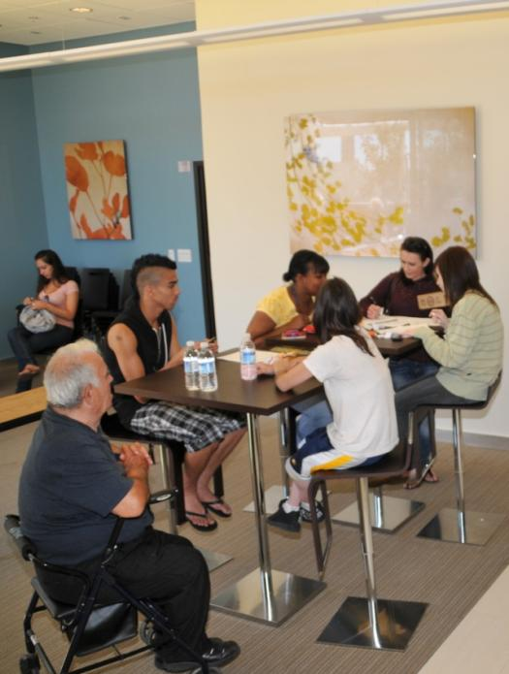
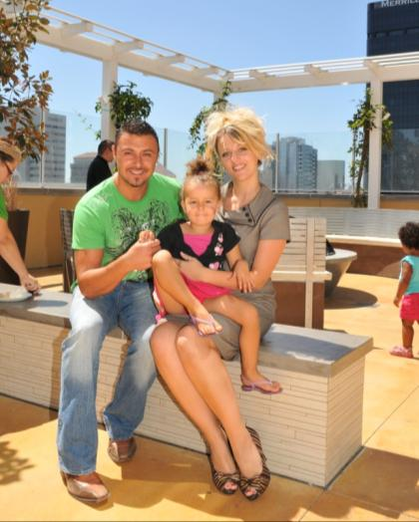
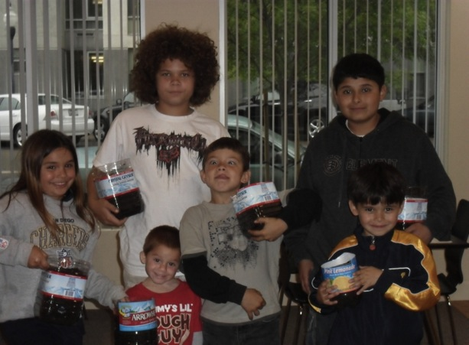
1050B Computer room

