Slide 1
Drivers for Indirect Potable Reuse

Slide 2
Drivers for Reuse
Principal driver is water stress (need for water)
Scarcity of renewable freshwater resources due to:
  Population increases
  Industrial development
  Droughts
  Global climate changes

Slide 3
Drivers for Reuse
Other drivers include:
  Conservation of potable supply
  Environmental enhancement
  Pollution abatement
  Reliability of supply
  High cost of alternative sources of water
  Regulatory policies/regulations

Slide 4
MWD Water Rates Rise When Sales Fall
19.7% Increase
75% Increase
85% Increase

Slide 5
Cost of Imported Water to San Diego - Nearly Double by 2018

Slide 6
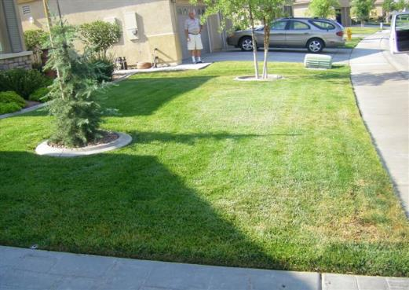
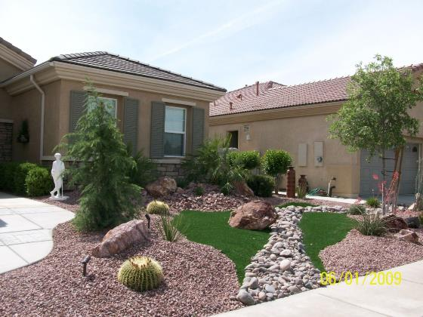
Immediate Response is Conservation

Slide 7
Short/Intermediate Term Response is Non-potable Reuse

Slide 8
Short/Intermediate Response is Indirect Potable Reuse

Slide 9
Long Term Response is Direct Potable Reuse

Slide 10
Predictions
( the next 25 years)

Slide 11
#1 – Technology Advances will decrease $ and eventually allow direct potable reuse
Reverse osmosis (RO) to be replaced by NanoElectrolyticOsmosis (NEO)
Genetic engineering will develop high-rate digestion bacteria that will more efficiently convert biosolids to fuel
Real-time monitoring of all water quality constituents will be developed and approved by regulatory agencies

Slide 12
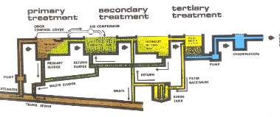



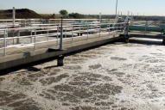
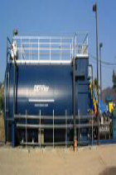
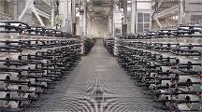
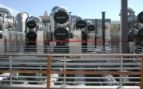
#2 – Full integration of resource management into reuse planning
Interim Step is from Bolt-On Approach
Microfiltration
(MF)
Reverse Osmosis
(RO)
Ultraviolet Light with H₂O₂
Barrier
Backwash
OCSD Plant 1
Brine
OCSD Outfall
To Liquid Process Integration
Pretreat
MBR
RO/UV

Slide 13
#3 – Full integration of resource management into reuse planning
Total Urban Resource Recovery Systems
Sewage
Primary Clarification
or
Filtration
Low Energy Membrane
for BOD and TDS removal
Primary
Revenue
Sources:
Water & Energy
Urban food waste
Septage
Misc. organics
Electricity
Methane
Efficient
Electricity
Generation
Nutrient
Removal and
Recovery
Optimized
Anaerobic
Digester
CO2
Secondary
Revenue
Sources:
Biofuel, Fertilizer & Carbon Credits
Algae Conversion
to Biodiesel
Final
Filter
Biodiesel
Inorganic Fertilizer

Slide 14
#4 – The nexus between water and energy and the public response to climate change will impact how we view the cost of water
We will be billed not by the units of water we used, but by the carbon footprint that is created by developing the water supply
For example, groundwater will have low carbon foot print while desalination will be high

Slide 15
#5 – The pace of reuse development will be relatively slow unless…..
“You never let a serious crisis go to waste. And what I mean by that it's an opportunity to do things you think you could not do before”.
Rahm Emmanual
Crisis is Opportunity

Slide 16
Past Lessons are Present Lessons are Future Lessons
VISION
POLITICAL
WILL
GRANTSMEN-
SHIP
INNOVATION
PARTNERSHIP
LEADERSHIP
Keys to
Reuse Success

Slide 17
History of Advocacy
(the last 25 years)

Slide 18


Advocacy Groups can Address Non-Technical Barriers to Indirect Potable Water Reuse
Public/user perception and cultural issues – “Toilet to Tap Syndrome”
Better documentation of economics of water reuse
Support by local authorities/policy makers
Project funding

Slide 19
New Players Advocating for Reuse
1984
Surfriders
1985
Heal the Bay
Stop discharge into Bay
1990
WateReuse Association
Promote reuse
Protect Oceans

Slide 20
New Players Advocating for Reuse
1991
NWRI
1992
Bureau of Reclamation
Fund Reuse (Title XVI)
1999
Coastkeeper Alliance
Promote healthy coast
Promote Water Supply

Slide 21
San Diego IPR Coalition
(broad based advocacy)
Insert graphic with IPR Coalition logos and tell the story

