Slide 1

AB 32 and Prop 23
The Fight for California’s Clean Energy Future
Alex Jackson
NRDC
Energy & Water Sustainability Event
September 14, 2010
Notes:
-Provide brief overview of AB 32 and P23; look at ramifications for our state depending on what voters decide on Nov. 2.
-Look at potential effects on jobs, clean tech investments, risks of further dependence on fossil fuels, and the larger impacts of moving backwards on climate change here in CA, where we have historically been out in front.

Slide 2
  Impact of AB 32 on CA GHG Emissions
Without AB 32
With AB 32
Mandatory Reporting
Emission Limits Begin
Statewide Limit at 1990 Levels
Sources: Assembly Bill 32 (Nunez-Pavley, 2006); California Air Resources Board
Notes:
AB 32 overview (what is AB 32?)
-1990 GHG levels by 2020
-performance target; economy-wide; broad authority Air Resources Board craft suite of policies get us there cost-effective manner
Complimentary goals
-Reduce GHG Emissions
-Foster clean energy development, position CA as leader
-Protect Public Health (provisions require CARB to maximize co-benefits, avoid disproportionate impacts)
Emissions limit is 427 MMT, which board adopted in Dec. 2007
2020 limit is about 10% below today’s (2008) levels (475 MMT), about 25% below forecasted BAU levels in 2020 (575 MMT in 2020).
-reflects updated BAU following economic downturn; previous forecast 30% below projected BAU (600 MMT in 2020)

Slide 3
Notes:
2010 update from 2008 Scoping Plan
-Pavely I (AB 1493) in BAU—28 MMTs
-20% RPS—8 MMTs
-25 MMTs taken out of BAU from recession
C-T only 20% reductions; gets all the press
-but important backstop to complimentary policies; send price signal into economy
RES
-legislature failed pass RPS bill; ARB process developing 33% RES regulation, scheduled go to board later this month
Emission reductions measures not only aspect AB 32
-Reporting Protocols. Under AB 32, major polluters are required to
report their emissions annually to CARB.
-Cost of Administration Fee. This fee pays for more than 170 staff at 6
different agencies carrying out AB 32 regulatory activities.1
3

Slide 4

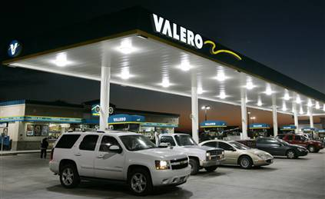



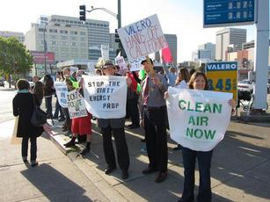

Proposition 23
The 2010 Ballot Initiative to Suspend AB 32
Notes:
-More than 90% of the funding for Prop 23 has come from outside California.
-No campaign: coalition environmental, cleantech, labor, consumer groups, local governments, business leaders

Slide 5
Proposition 23: Ballot Title
SUSPENDS IMPLEMENTATION OF AIR POLLUTION CONTROL LAW (AB 32) REQUIRING MAJOR SOURCES OF EMISSIONS TO REPORT AND REDUCE GREENHOUSE GAS EMISSIONS THAT CAUSE GLOBAL WARMING UNTIL UNEMPLOYMENT DROPS TO 5.5 PERCENT OR LESS FOR ONE FULL YEAR.
Notes:
-Lawsuit challenge to AG’s ballot title succeeds in partial revisions; “polluters” to “sources of emissions,” “laws” to “law”

Slide 6
Proposition 23 Text
(a) From and after the effective date of this measure, Division 25.5(commencing with section 38500) of the Health and Safety Code is suspended until such time as the unemployment rate in California is 5.5% or less for four consecutive calendar quarters.
(b) While suspended, no state agency shall propose, promulgate, or adopt any regulation implementing Division 25.5 (commencing with section 38500) and any regulation adopted prior to the effective date of this measure shall be void and unenforceable until such time as the suspension is lifted.
Notes:
-Framed as a “temporary suspension of AB 32” to increase appeal
-4.8% originally

Slide 7
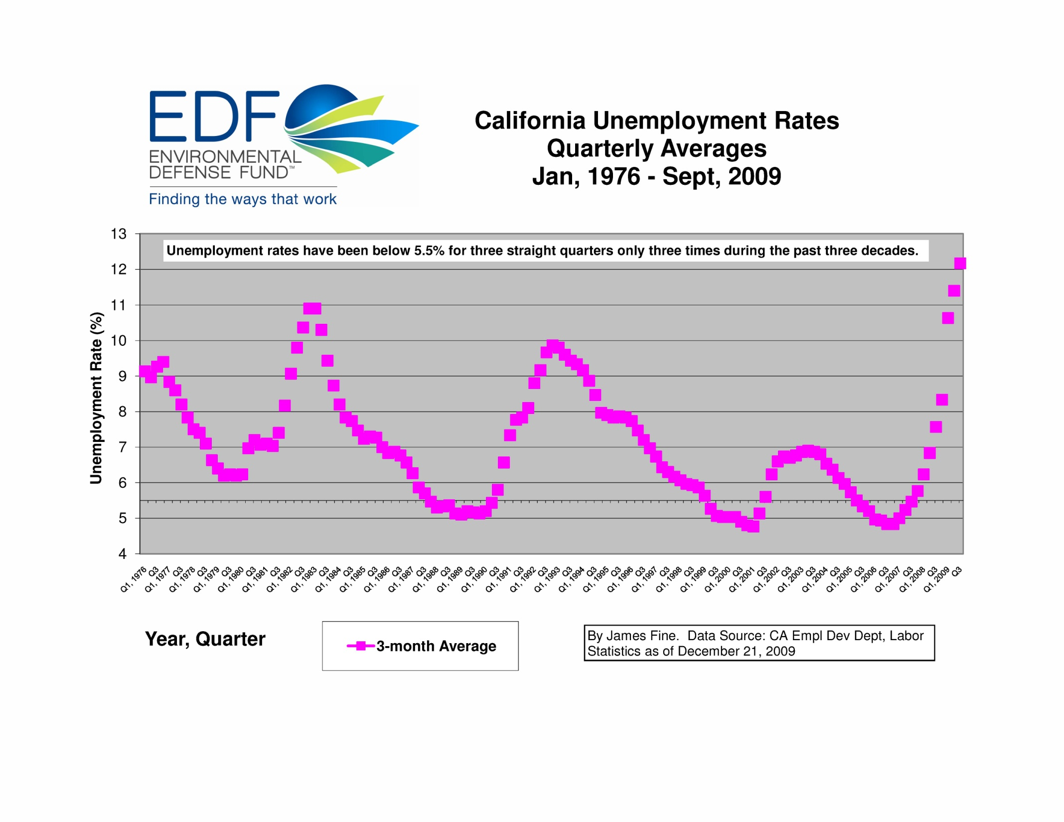
Notes:
-note: unclear whether P23 refers to seasonally adjusted or raw UER; adding to uncertainty
-when below (seasonally adjusted): Nov 1987-June 1990; Feb 1999-July 2001; April 2005-Sept 2007

Slide 8
The Threat of Prop 23
Costs of Inaction
  Water, Wildlife, Agriculture, Tourism, Real Estate
Existing Jobs and Future Jobs in Clean Energy Economy
Existing and New Investments in Clean Energy
  Market uncertainty
  Lose pace with China
Prolonged Energy Dependence
  Oil price shocks
California Leadership
  National, regional and international impacts

Slide 9
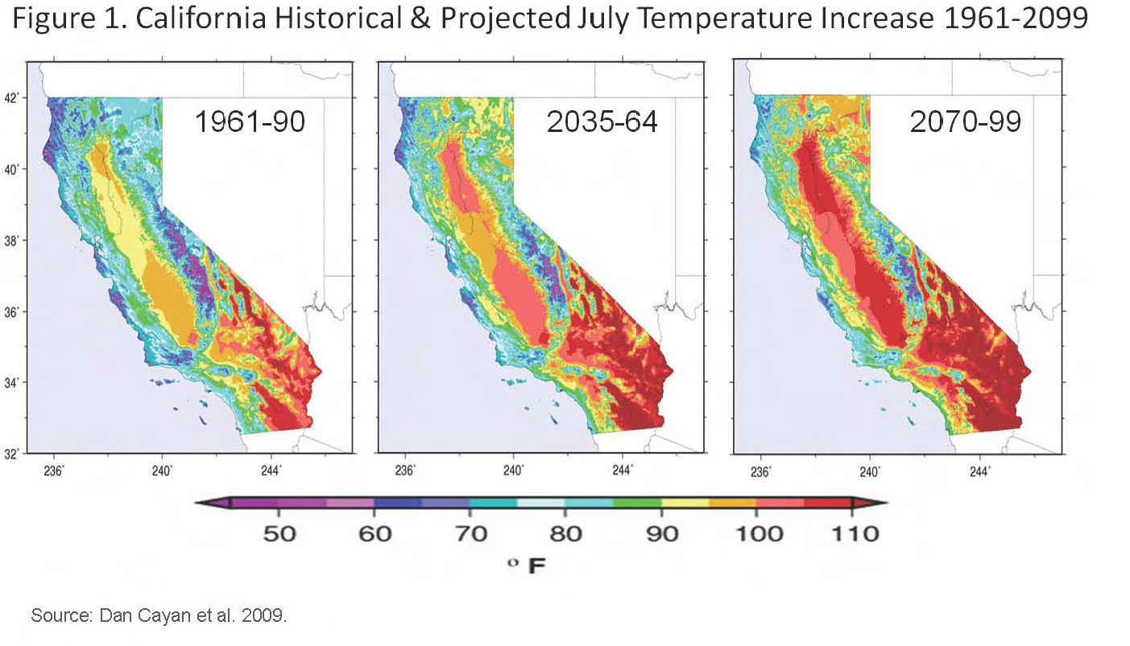
Costs of doing nothing
Notes:
These climate driven changes affect resources critical to the health and prosperity of California. For
example, forest wildland fires are becoming more frequent and intense due to dry seasons that start
earlier and end later. The state’s water supply, already stressed under current demands and expected
population growth, will shrink under even the most conservative climate change scenario. Almost half a
million Californians, many without the means to adjust to expected impacts, will be at risk from sea level
rise along bay and coastal areas. California’s infrastructure is already stressed and will face additional
burdens from climate risks. And as the Central Valley becomes more urbanized, more people will be at
risk from intense heat waves.

Slide 10
Economic costs of doing nothing
Notes:
If the state were to take no action to reduce or minimize expected impacts from future climate change, the costs could be severe. A 2008 report by the University of California, Berkeley and the non-profit organization Next 10 estimates that if no such action is taken in California, damages across sectors would result in “tens of billions of dollars per year in direct costs” and “expose trillions of dollars of assets to collateral risk.” More specifically, the report suggests that of the state’s $4 trillion in real estate assets “$2.5 trillion is at risk from extreme weather events, sea level rise, and wildfires“ with a projected annual price tag of up to $3.9 billion over this century depending on climate scenarios.
The figure at right, from a study by the Pacific Institute, shows coastal property at risk from projected sea level rise by county with replacement values as high as $24 billion in San Mateo County.

Slide 11
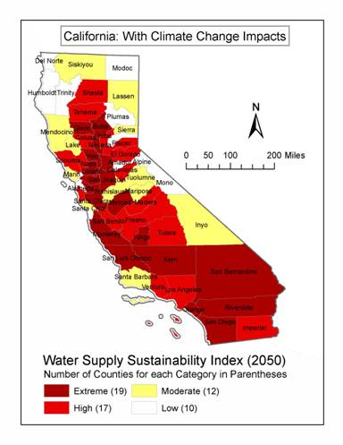
Costs of Doing Nothing
83 percent of California counties are at risk of water shortages by 2050 from climate impacts
Water shortages jeopardize $21 billion in crop losses by 2020
Source: NRDC; TetraTech
Notes:
Most expensive course of action is inaction
While CA alone can’t reverse climate change, numerous co-benefits, leadership spurs action (see next slides),

Slide 12
At Risk
Regional Distribution of CA’s more than 500k Green Jobs
10,358
4,276
23,261
120,032
1,987
37,727
13,354
178,547
37,735
Other green jobs the regions of which were not reported: 5,565
Source: EDD
Notes:
CA’s Employment Development Department counts more ore than 500,000 people who work in the industry (553,000), including 93,000 in manufacturing and 68,000 in construction
Supporting Fact: Since 2005 alone, green jobs have grown 10% in California, while overall statewide job growth was only 1%.
Supporting Fact: Between 1998 and 2007, green jobs nationwide grew at 2.5 times the rate of other jobs.
Supporting Fact: From 1995 to 2008, the number of California green businesses expanded 45% Next 10, California Green Innovation Index 2009, 2009, p. 70.
Nationwide, green jobs grew 9.1% compared to 3.7% for other jobs. See The Pew Charitable Trusts, The Clean Energy Economy, p. 8.

Slide 13
CA Industries with the Most Green Jobs
At Risk
Notes:
-note: not add up to 500k because only 5 categories
-7 of 10 top clean tech Co’s are in Cal; 3 of the nations top 5 cities for clean tech and energy are in Cal
-CA leads nation with over 10,000 clean energy businesses.
-One ex: recent UC berkeley study shows 33% RES lead to addition of roughly 10k ‘job years’ (one year of one job) each year from 2011-2020. So either 10k one year jobs or 1,111 permanent jobs
-

Slide 14
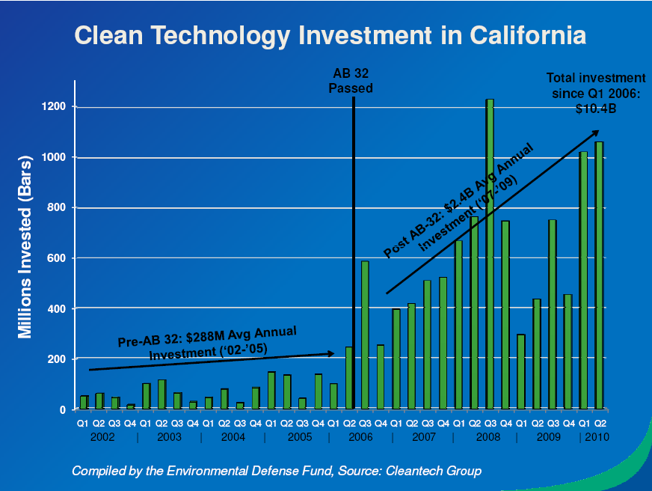
Notes:
After the law was passed in 2006, clean energy venture capital investment began pouring into our state at an unprecedented rate. In 2007 nearly $1.8 billion were invested in California clean tech companies - almost a 50 percent increase over the year before. While 2009 was a year of depressed investment - California still led the nation with $2.1 billion in clean tech venture capital investments…To delay or suspend AB 32 will eliminate thousands of jobs in California. Venture capital investment will leave the state and emerging businesses will close their doors.”

Slide 15
Clean Tech Investments in 2009 ($m)
At Risk
The National Venture Capital Association estimates that every $100 million in venture capital funding helps create 2,700 jobs
Notes:
Total jobs from 2009 = 56,700
60% of total N. America clean tech investment in 2009; more than 5x than nearest N. American competitor (Mass)

Slide 16
Prop 23 Threatens Emerging
Clean Energy Economy
“With an RES, we estimate that we would invest approximately $1 billion more per year in wind and $1.5 billion in solar. That would translate into roughly 40,000 jobs over the next five years. Clean energy advocates are always going on about how private capital is ‘sitting on the sidelines,’ waiting for a reliable policy signal. This is what they’re talking about.”
  Lew Hay, CEO of NextEra Energy
"Proposition 23 will kill markets and the single largest source of job growth in California in the last two years. Not only that, it'll kill investment in the long term for creating the next 10 Googles.“
  Vinod Khosla, prominent Silicon Valley venture capitalist
Notes:
NextEra Energy: America’s largest clean energy developer
-Sends wrong signal to state’s emerging clean tech economy, threatening job growth, existing and new investments

Slide 17
Suspended by Prop 23
At Risk
Ind. Statutory Authority
Notes:
-Uncertainty: some with solid support other authority, others not (even some EE measures)
-Prop 23 would also indefinitely suspend reporting requirement, severely restricting CARB’s ability to track pollution emissions or reductions and the administration fee, depriving agencies of the ability to carry out regulations.
-ARB need to repay $83M in past loans to administer the program to date
17

Slide 18
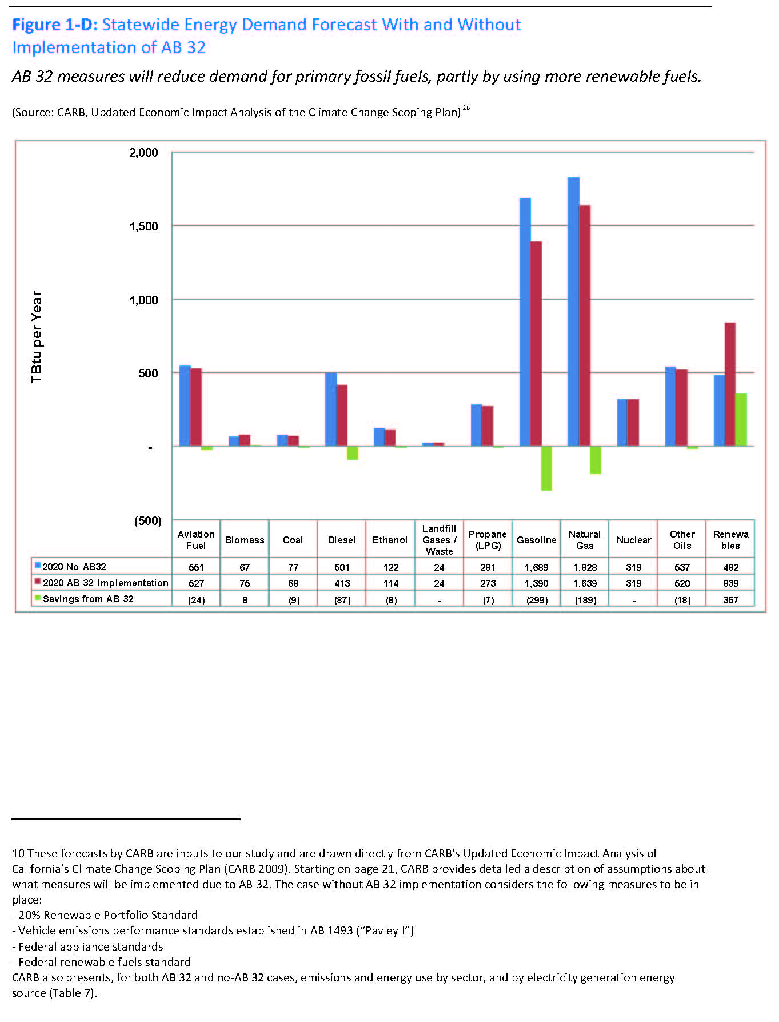
Fossil Fuel Dependence Continues
Notes:
-With AB 32, for the year 2020, imports to meet California’s demand for crude oil will fall by 75 million barrels (an 18% decrease) and California’s demand for natural gas will fall by 10% compared to levels without AB 32 implementation.
-Translates into a reduction in California’s 2020 import bill of more than $11 billion, assuming the same prices used in analyses of AB 32 economic impacts. If prices were to double, the value of reductions in crude oil and natural gas imports to satisfy California demand would amount to almost $20 billion.

Slide 19
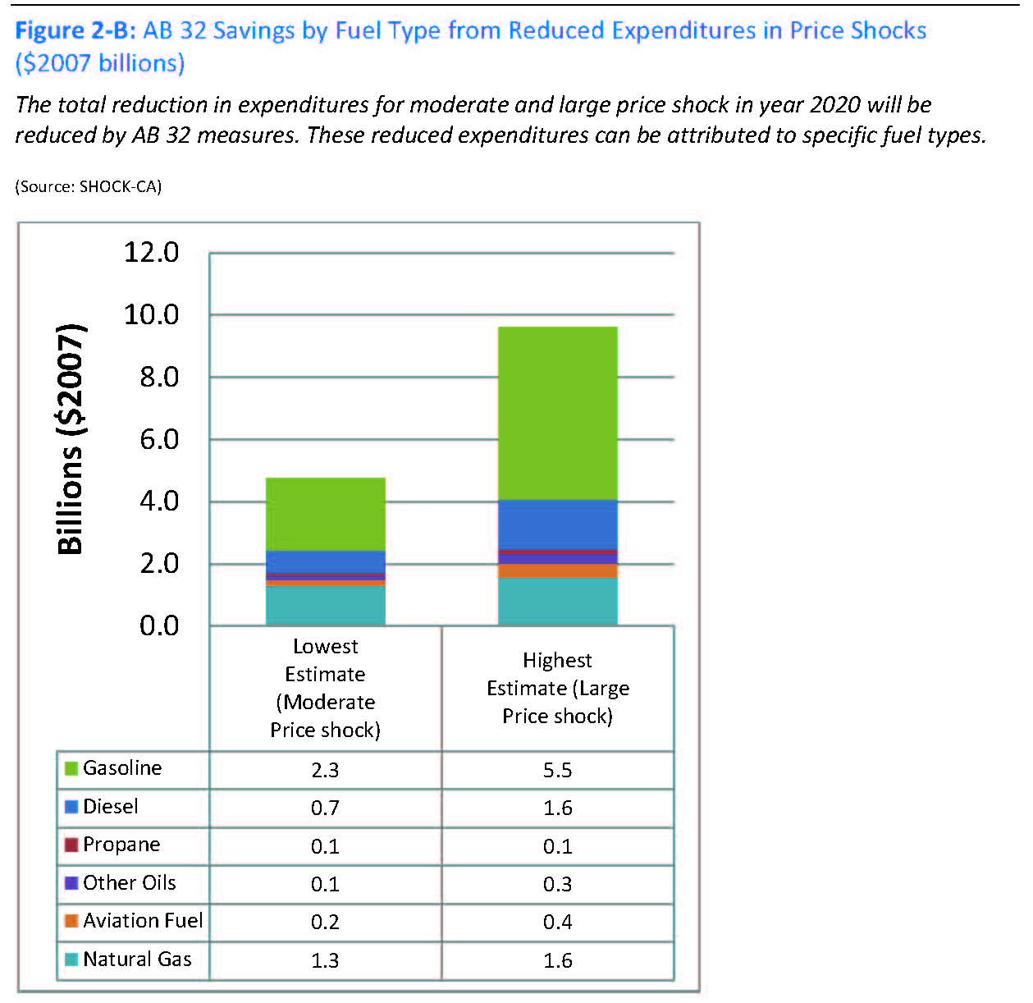
Exposing Californians to Risk from Oil Price Shocks
The average California household will save $332 in a moderate shock with high demand response, and $670 in a large shock with low demand response
Source: EDF; CRS
Notes:
-Savings amount to more than $4 billion under moderate price shock conditions and almost $9 billion in the large shock case.
-This equates to an extra $330 to $670 in savings on energy per household in 2020 after taking into account population growth.

Slide 20
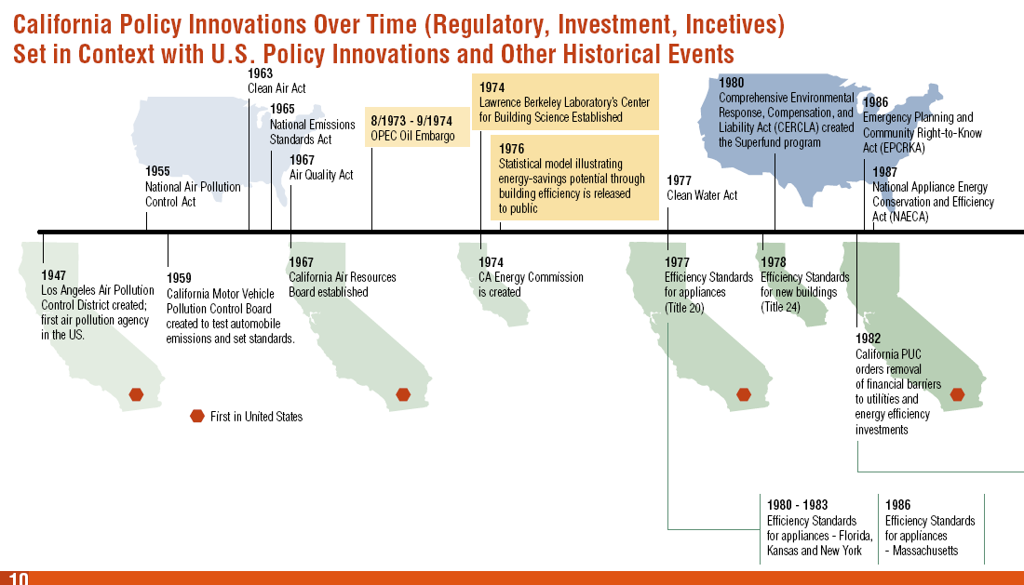
California’s Long History of Leadership
Regulatory history: CA (lower panel) vs. U.S. (upper panel)
Source: Next 10
Notes:
As goes California, goes the Nation”
Highlight: CA efficiency stds in 1977; feds in 1987

Slide 21
California’s Long History of Leadership
Notes:
-AB 1493 in 2002; federal passenger vehicle fuel economy standards just this year

Slide 22
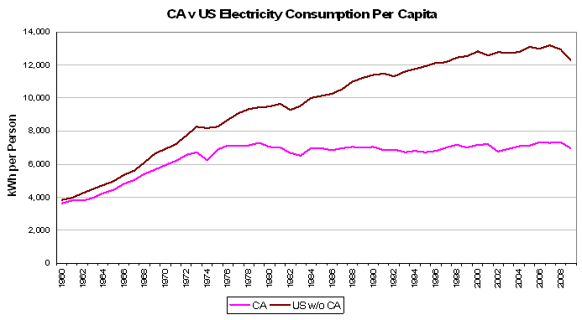
California Must Continue to Lead
At Risk
United States
California
Source: EIA
  Since 1975, California’s electricity consumption per capita has remained flat, while the rest of the country has increased approximately 50%
Source: EIA (data from 2008-09)
Notes:
And Since 1975, California’s energy consumption per capita has dropped almost 20%, while the rest of the country has remained flat.
This progress was based on an integrated effort to advance research, development and demonstration (RD&D) of more efficient technologies and processes through the Public Interest Energy Research (PIER) program, utility (IOU and POU) investments in efficiency programs that help consumers use those efficient technologies to lower their utility bills, and minimum efficiency standards for buildings and appliances that lock in the savings.
California is now recognized as the nationwide leader on energy efficiency. The state routinely ranks at the top of national assessments of energy efficiency performance; for example, the American Council for an Energy-Efficient Economy (ACEEE) ranked California number 1 in two recent studies based on expert ratings and quantitative analysis of state efficiency data
The benefits of the state’s efficiency policies are readily apparent. They have played an important role in making the state’s cost of electricity the fifth lowest in the country, measured as a fraction of GDP. And although residential electricity rates are somewhat higher than average, consumers’ electric bills are 24% below the national average, 45% lower than Texas. In addition, the state’s total energy productivity, the amount of GDP produced per unit of energy consumed, is 68% better than the national average.

Slide 23
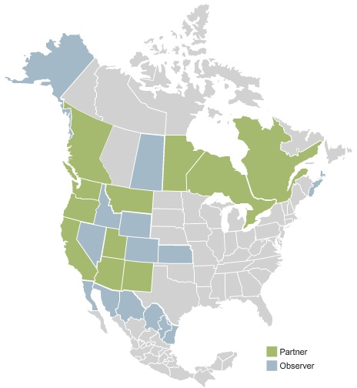
Western Climate Initiative (WCI)
Notes:
-7 US states; 4 Canadian provinces
-BC, Ontario, Quebec and CA have enacted legislation to date authorizing the creation of a cap-and-trade program
-NM and Manitoba are in the process
[MOQ]
-CA about half of WCI emissions
“What happens in California doesn't stay in California.” President of the National Petrochemical Association explained in a recent LA Times article discussing a Kansas oil company’s recent $1 million contribution to Prop 23,

Slide 24
California Must Continue to Lead
"(Congress is) asleep at the wheel on climate change, asleep at the wheel on job growth, asleep at the wheel on this industrial revolution taking place in the energy industry”
  Kevin Parker, global head of asset management at Deutsche Bank
"What the U.S. doesn't realize is that China is going from manufacturing hub to the clean-tech laboratory of the world.“
  Peggy Liu, founder and chairwoman of the Joint U.S.-China Collaboration on Clean Energy
Notes:
After the collapse of Senate talks on a national climate and energy bill like California's, a Deutsche Bank executive told Reuters that it would pour most of the $7 billion it has to invest in clean energy into China and Western Europe

Slide 25
Current Outlook
UPSIDE
1. Most California Ballot Initiatives Fail
2. Polling Says Strong Majority of Californians Support AB 32
3. Broad-based, Mobilized Coalition Getting Message Out
4. A Legitimate Story to Tell: Jobs & Economic Growth
DOWNSIDE
1. Deep Pockets
2. Polling Says Support Drops When Framed in Prop 23 Context
3. Bad Economy
4. An Deceptive Narrative: Energy Tax, Jobs, Bureaucrats

Slide 26
Polling Shows Context Matters
Public Support for AB 32
AB 32 & Job Impacts
AB 32 & the Economy
Source: PPIC, July 2010
Notes:
-80 percent of Democrats and 73 percent of independents are in favor, but only 39 percent of Republicans share this view

Slide 27
Questions

