Slide 1
The Future of Climate Science
Dr. Robert Bishop
World Resources Simulation Center
San Diego, USA, 21st Sept 2010

Slide 2
Predicting future conditions on Earth involves understanding many complex non-linear interconnected systems

Slide 3
Indeed, Weather and Climate are only the thin edge of the wedge!

Slide 4
Now is the time to focus on the bigger picture!
WEATHER & CLIMATE
ENVIRONMENT
BIOSPHERE
EARTH SYSTEM
SOLAR SYSTEM
CIVILISATION

Slide 5
Our problem: we have been treating the sciences as separate stovepipes and silos over the past 200 years!
In Research
In Research Funding
In Publishing
In Peer-review
In Conferences
In University Faculties
In Government Departments

Slide 6
The 21st C: Integration vs. Dis-Integration
To view the Earth as a whole and take an Holistic Approach
Seamless
Multi-scale (spectral, spatial & temporal)
Multi-science (physical, chem, bio, socio-economic)
The New Grand Challenge

Slide 7
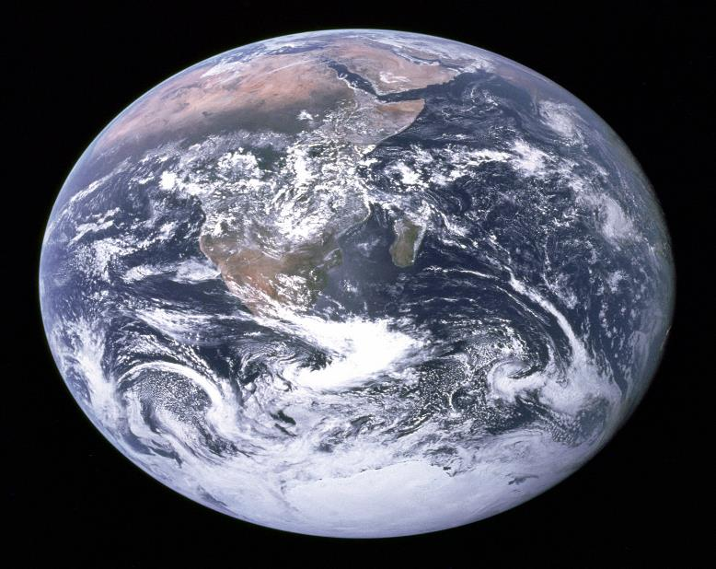
Nature is Seamless, Borderless & Integrated!

Slide 8
In the next 10 years …
Climate models will learn to integrate all natural sciences
– weather, climate, earth, environmental, helio & planetary sciences, etc
Climate models will assimilate much more of our observational data
– in situ, ocean, airborne, space based, etc
Climate models will resolve fine-detailed relevant phenomenon
– cloud microphysics, convection, vorticity, aerosols
Supercomputing resources, cloud computing & international grids
will all play their part, as will Google Earth, Wolfram Alpha & Wikis
Natural Science & Socioeconomic models will integrate successfully
Public-Private Partnerships will emerge as new key players

Slide 9

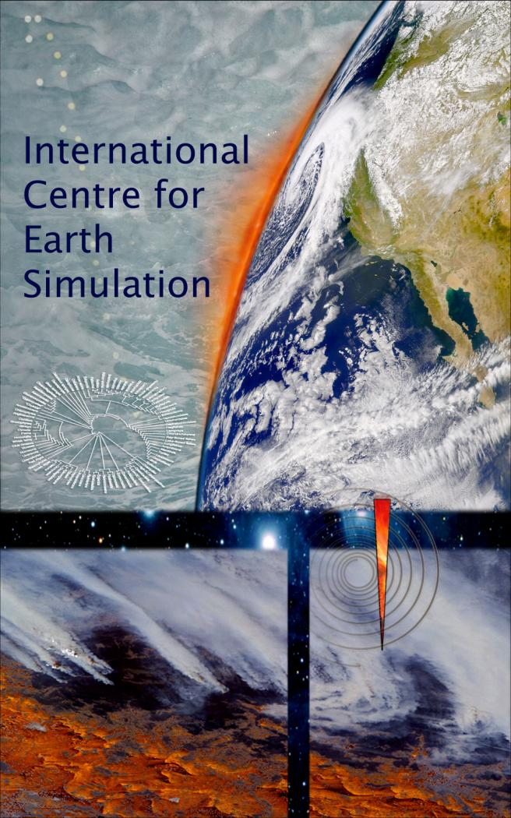

Slide 10
ICES: a sustained & dedicated facility with global focus
Modeling
Algorithms
Parameterisation
Data Assimilation
Computing systems
Scientific Integration
Science and Socio-economic interaction
An instrument for policy guidance & decision support

Slide 11
ICES Resource Allocation
CLIMATE &
WEATHER
SOCIAL
SYSTEMS
50% to next-generation model development
25% to global climate & earth systems community support
25% to developing world
ENVIRONMENT
SOLAR
SYSTEM
BIOSPHERE
EARTH
SYSTEM

Slide 12
ICES and Geoengineering
WEATHER &
CLIMATE
SOCIAL
SYSTEMS
ENVIRONMENT
Climate Remediation
CO₂ Removal
Solar Radiation Management
Unintended Consequences
SOLAR
SYSTEM
BIOSPHERE
EARTH
SYSTEM

Slide 13
ICES and Disaster Risk Management
WEATHER &
CLIMATE
SOCIAL
SYSTEMS
Community Resilience
Adaptation & Mitigation
Planning & Relief Strategies
Precursor Signals
ENVIRONMENT
SOLAR
SYSTEM
BIOSPHERE
EARTH
SYSTEM

Slide 14
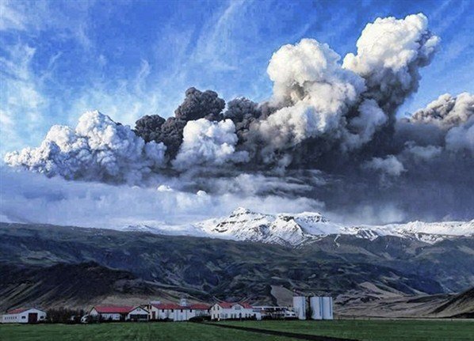
Volcanic ash cloud disrupts European economy
Mantle-Crust-Glacier-Rivers-Oceans
Weather-Agriculture-Economy-Society
150,000 flights cancelled, 15 million re-bookings

Slide 15
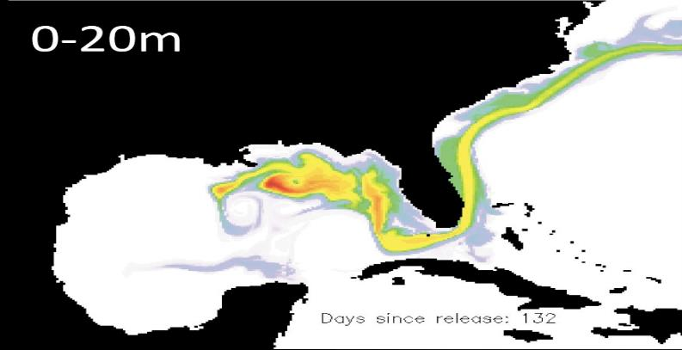
BP Oil Slick disrupts Gulf States economy
87 days of continuous flow
50km oil slick below the surface
5 million barrels of oil spilled - largest spill in history

Slide 16
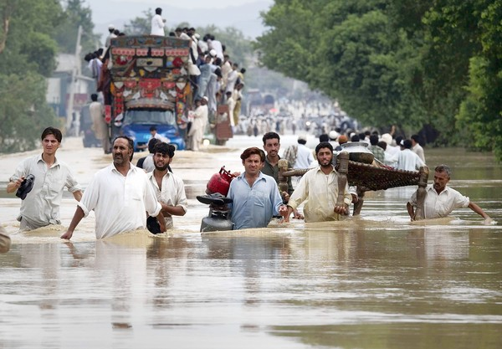
Extreme Rainfall – Northwest Pakistan
Heaviest monsoon in 80 years
20 million people displaced
1700+ deaths

Slide 17
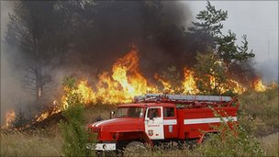
Record Heat Wave – Western Russia
Highest temperatures in 130 years
Spontaneous fires – peat bogs, crops, forests
70+ deaths from fire, 2000+ deaths from drowning

Slide 18
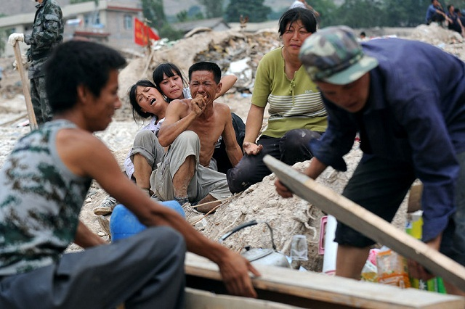
China - Gansu Landslide
Disruption from 47 hydro-electric projects
Massive deforestation - landslides
1500+ deaths

Slide 19
Recent Flooding Disasters
August 2010 | Gansu China | 1500+ | floods, landslides
August 2010 | Kashmir | 170+ | flash floods
August 2010 | Central Europe | 15+ | flash floods
July-Aug 2010 | West Pakistan | 1700+ | heavy monsoons
June 2010 | Southern France | 25 | flash floods
June 2010 | Southern China | 200+ | floods, landslides
June 2010 | Northern Brazil | 100+ | floods, landslides
June 2010 | Provence, France | 25 | flash floods
June 2010 | Poland | 15 | river flooding
April 2010 | Brazil | 200+ | rain, mudslides
March 2010 | Uganda | 350+ | rain, mudslides
Feb 2010 | Xanthia, France | 50+ | tempest, sea walls
Aug 2005 | Katrina, USA | 1,800+ | hurricane, levees

Slide 20
Other Major Natural Disasters
September 2010 | New Zealand | 0 | 7.1 quake
July-August 2010 | Russia | 2000+ | drought, fire, heat wave
June 2010 | USA | 10 | 38 tornadoes
April - June 2010 | USA | 11 | BP oil rig spill
April - May 2010 | Iceland | - | volcanic ash cloud
April 2010 | China | 2000+ | 6.9 quake
Feb 2010 | Chile | 700+ | 8.8 quake, tsunami
Jan 2010 | Haiti | 250,000+ | 7.9 quake
April 2009 | Italy | 300+ | 6.3 quake
Feb 2009 | Australia | 173 | bushfires
May 2008 | China | 87,000+ | 8.0 quake
Oct 2005 | Kashmir | 86,000+ | 7.6 quake
Dec 2004 | Indonesia | 225,000+ | 9.1 quake, tsunami
Dec 2003 | Iran | 31,000+ | 6.6 quake
Aug 2003 | France | 30,000+ | heat wave

Slide 21
Yokohama Earth Simulator
Opened March 2002, NEC SX-6

Slide 22
Dedicated Weather-Climate Systems
(TAKEN FROM THE JUNE 2010 LIST OF TOP500 SUPERCOMPUTER SITES)
Worldwide Ranking | Organisation | Country | Peak Teraflops | Sustained Teraflops | Supplier
# 37 | JAMSTEC | JAPAN | 131.07 | 122.40 | NEC SX9
# 39 | ECMWF | UK | 156.42 | 115.90 | IBM Power 575
# 40 | ECMWF | UK | 156.42 | 115.90 | IBM Power 575
# 41 | DKRZ | GY | 151.60 | 115.90 | IBM Power 575
# 61 | NAVO | USA | 117.14 | 90.84 | CRAY XT5
# 69 | NAVO | USA | 102.27 | 78.68 | IBM Power 575
# 78 | NCEP | USA | 93.85 | 73.06 | IBM Power 575
# 79 | NCEP | USA | 93.85 | 73.06 | IBM Power 575
# 90 | NCAR | USA | 76.40 | 59.68 | IBM Power 575
# 94 | IITM | INDIA | 70.39 | 55.11 | IBM Power 575

Slide 23

Proposed ICES Computing Resources
Dedicated Massively Parallel High Performance Computing
- 20 year transition from petaflop(10¹⁵)-exaflop(10¹⁸)-zettaflop(10²¹flops)
- 1 million cores, 1 billion threads, dynamic resource allocation
- co-designed hardware/software/applications/algorithms
Exabyte Hierarchical Storage & Automatic File Migration
High-Res 3D interactive immersion & image analysis
- auditorium level viewing with remote access, holographics, augmented reality
- scientist ‘in-the-loop’, cockpit environment, computational steering
Physically near to low cost power & cooling
- 20 megawatts (nuclear/hydro/solar), lake cooling, green design
Supplemented by:
- Cloud Computing, Grid Computing (public, private, hybrid)
- Google Earth, Wolfram Alpha, Wiki
- Citizen Science Computing

Slide 24
The Complexity of Earth System Modeling
Grid Size
Parameterisation
Algorithm development
Coupling, linkages & feedbacks
Representation of physical processes
Integration of the socio-economic processes
Initial & boundary condition determination
Uncertainty estimates & management
Statistical & ensemble methods
Hierarchy of models
Multi-models
Stochastics
Nextgen

Slide 25

Earth Data Challenges
Where ICES will play a role:
Data assimilation
Historical data re-analysis
Model output data storage
Model output data validation & verification
Where ICES depends on others:
Data access, meta-data, cataloging
Data quality control & harmonisation
Data availability (in situ, remote sensing)
Sparse data fill (Oceans, Africa, Antarctica)

Slide 26
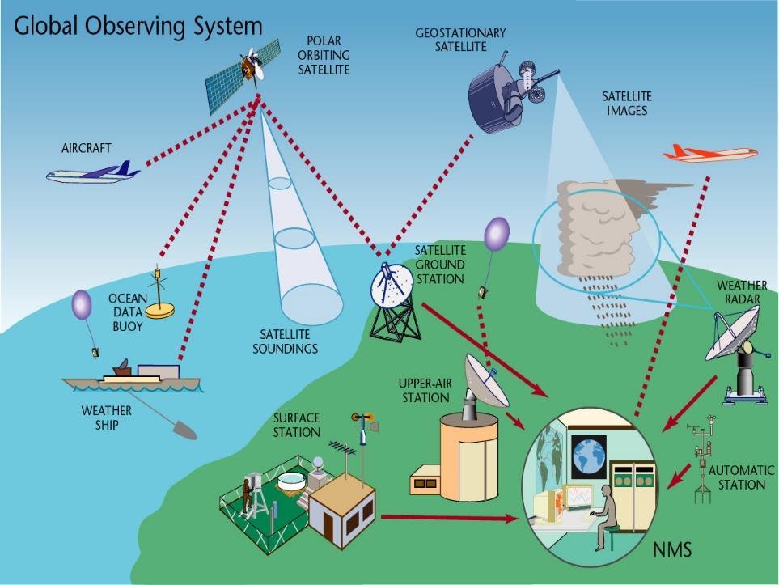

Slide 27
ICES Organisation Structure
Swiss based
Not-for-profit Foundation
Public-Private Partnership
Broad Scientific Participation
Inter-disciplinary Governance
Participation by Int’l Organisations
Experts Committee, Ethics Committee

Slide 28
Why Public-Private Partnership?
Fast
Agile
Simple
Flexible
Responsive
Non-political
Independent
New sources of funding

Slide 29
Why Switzerland?
History of international humanitarianism
Global thinking, neutral, trusted country
Science literate, educational infrastructure
Proximity to global policy bodies:
UNEP, WBCSD, IUCN, WWF
WHO, UNHCR, ICRC
WMO (WCRP, WWRP), GEO
WTO, WEF, UNCTAD, ILO, ITU, EBU
Partnerships: CERN, ETH, Canton Universities

Slide 30
ICES Core Actor’s Network
World Meteorological Organisation (WMO)
- World Climate Research Programme (WCRP)
- World Weather Research Programme (WWRP)
European Centre Medium-Range Weather Forecasts (ECMWF)
European Network for Earth System Modelling (ENES)
Group on Earth Observations (GEO Portal, GEO Grid)
UN International Strategy for Disaster Reduction
National Disaster Management Agencies
World Resources Simulation Center
National Meteorology Bureaus
National Geological Surveys
Global Earthquake Model
National Climate Centres
National Ocean Centres
National Space Centres
Research Universities

Slide 31

ICES Top Priorities
Utilize all available worldwide observational data
Support training of next generation ‘holistic thinkers’
Drive new paradigm Earth System Models by integrating weather, climate, bio, geo, space & social sciences
Improve process parameterisation and analysis
Maintain dedicated HPC in the top 10 of machines worldwide
Supply HPC cycles and software engineering support to national and regional centres worldwide
Use International Orgs & NGOs as comms channel

Slide 32

ICES Foundation Members
Board members:
Bob Bishop President, André Kaplun Secretary, Julien Pitton Treasurer
Bankers: UBS Auditors: PricewaterhouseCoopers
Expert Committee:
Dr. Ghassem Asrar Director, World Climate Research Programme, WMO
Prof. Martin Beniston Chair for Climate Research, University of Geneva
Director, Institute for Environmental Sciences
Prof. Marc Parlange Dean of the School of Architecture, Civil & Environmental Eng.
Ecole Polytechnique Federal Lausanne
Dr. Michael Rast Head of Programme Planning Office
Directorate of Earth Observation Programmes
European Space Agency
Prof. Jagadish Shukla President, Institute of Global Environment &
Society

Slide 33

Helping guide the successful transformation of human society in an era of rapid climate change and frequent natural disasters.

Slide 34
Back-up slides to follow

Slide 35
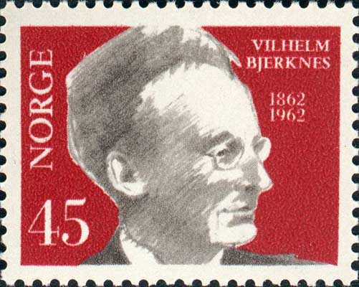
The Father of Modern Meteorology

Slide 36
Before the Age of Computing
In 1922, Lewis Fry Richardson, a British mathematician and meteorologist, proposed an immersive giant globe to numerically forecast weather. This “factory” would employ 64,000 human computers to sit in tiers around the interior circumference of a giant globe.

Slide 37
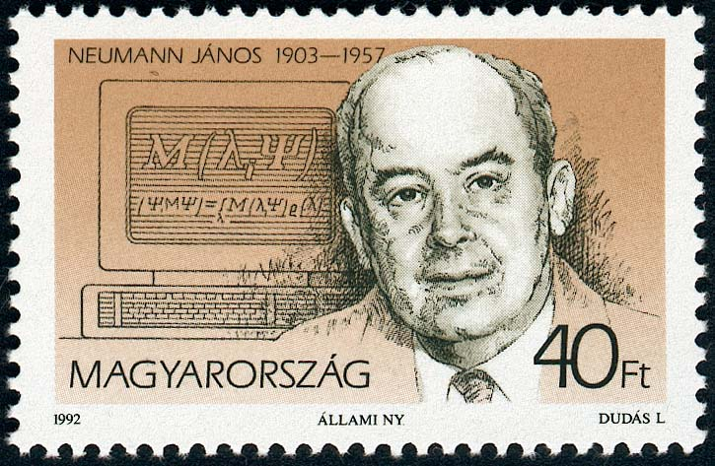
1950 ENIAC Meteorology Simulations

Slide 39
Weather & Climate Communities
(A Convergence of Methodologies)
Numerical Weather Prediction (NWP):
    National Bureaus of Meteorology today: 3~5 days
ECMWF today: 5~10 days
Future Goal: increased accuracy, and on to monthly & seasonal level
Climate modeling:
WCRP today: 100~1000 years
Future Goal : increased accuracy, and on to decadal & annual level
The 10-year Challenge:
Seasonal to inter-annual predictions
Global to regional to local forecasting
Coarse-grain to fine-grain spatial resolution
Extreme weather early warning

Slide 40
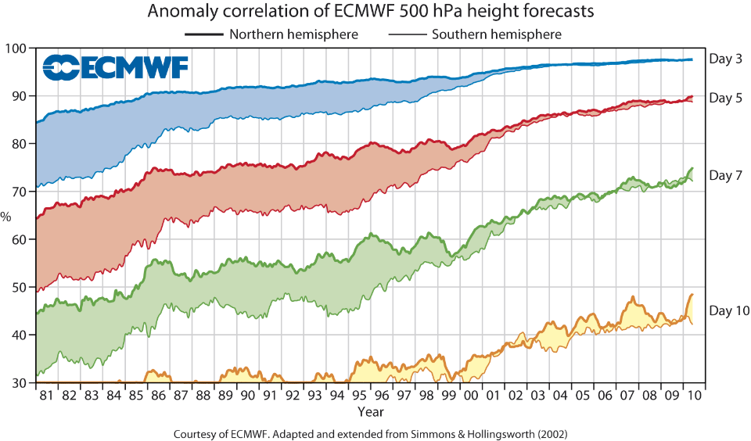

Slide 41
ICES in a Nutshell
Development of a transformative meta-science that integrates weather, climate, environmental, geo, bio, & socio-economic sciences
Next-generation modeling and simulation techniques
Assimilation of all available worldwide observational data
Technical support for national & regional climate centres
Teaching, training, capacity building
Decision support, communications
Dedicated supercomputing
Global networking
Visual paradigm
~200 professionals plus seconded experts

