Slide 1
China : The Future of Global Energy
Global Energy Network Institute (GENI)
Created by: Vincent Tong & Patrick Poon

Slide 2
Context
Originally presented on July 29,2014 to 70+ Chinese Students from the Doers Group visiting the World Resource SimCenter (WRSC) in San Diego to learn about the GENI Initiative.

Slide 3
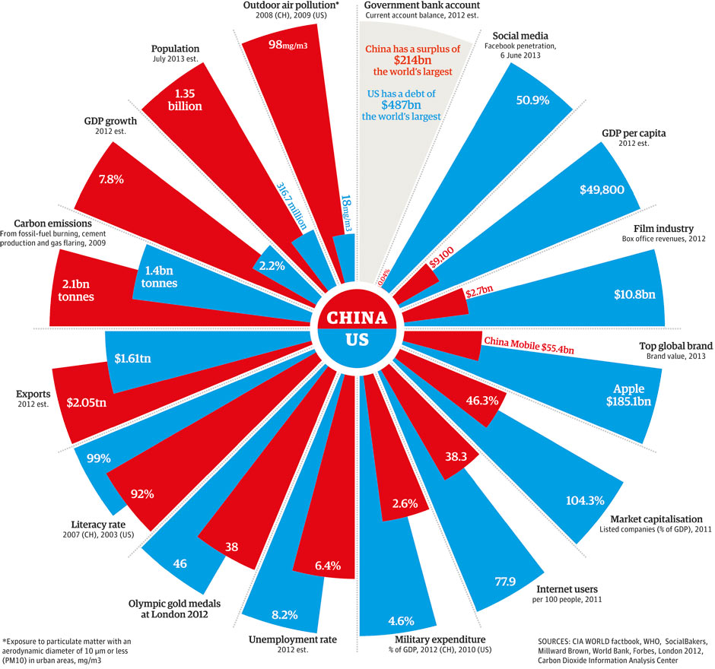
China & USA: Overview
Source: WHO

Slide 4
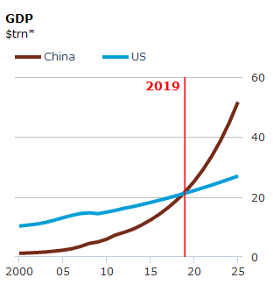
GDP Growth Forecast
Although the US currently has the more prosperous economy, experts predict that China’s exponential economic growth will propel it past the US by 2019 and almost double the US GDP by 2025.
Source: The Economist

Slide 5
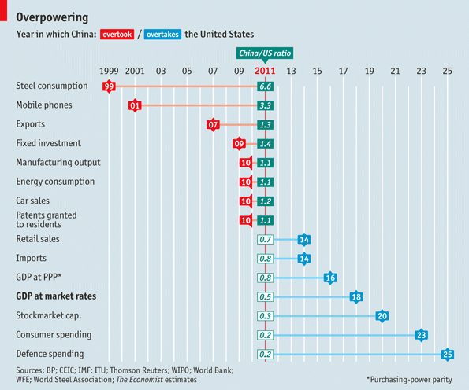
Surpassing the USA
In fact, China has been and will continue to surpass USA outputs in almost every major economic category.
Source: The Economist

Slide 6
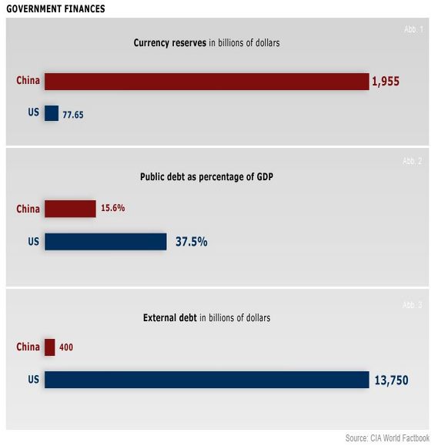
Economic Outlook
China has the funds to continue its tremendous growth while the US faces a mountain of debt.
Source: TopForeignStocks.com

Slide 7
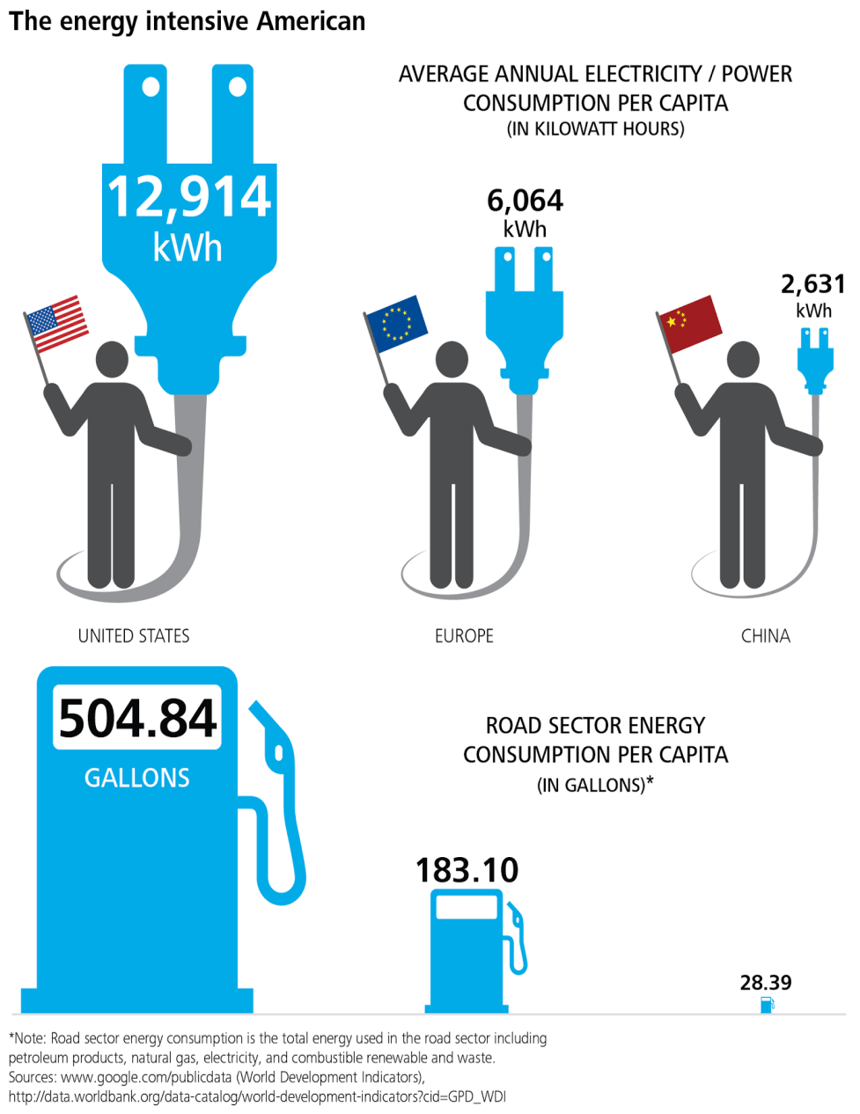
Energy Consumption per Person
The average American uses an incredible amount of energy. Although China is way behind in terms of individual energy consumption, as the country develops, this discrepancy will quickly diminish.
Source: Deloitte University Press

Slide 8
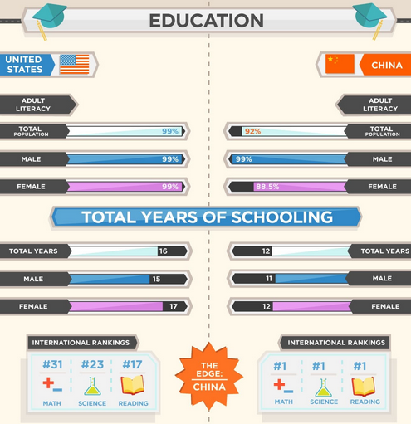
A Bright Future
China currently has the number one educational system in the world. Given this distinct advantage, students at the Doers Group have all the necessary tools to make a difference in future generations, especially in the energy sector.
Source: Master-of-Finance.org

Slide 9
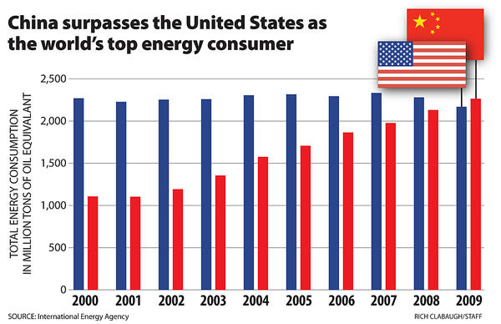
Top Energy Consumer

Slide 10
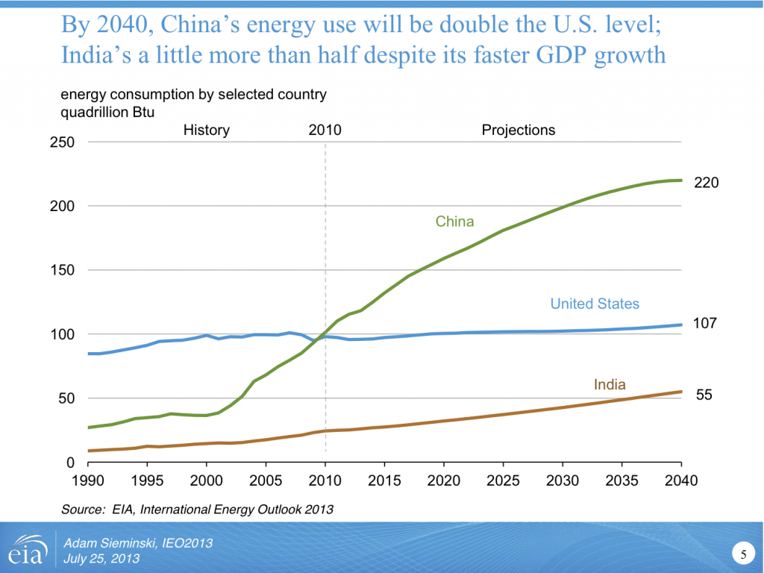
Continued Growth
Source: EIA

Slide 11
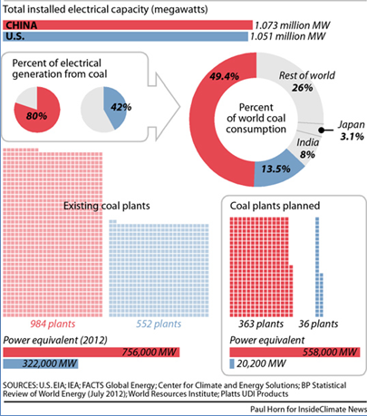
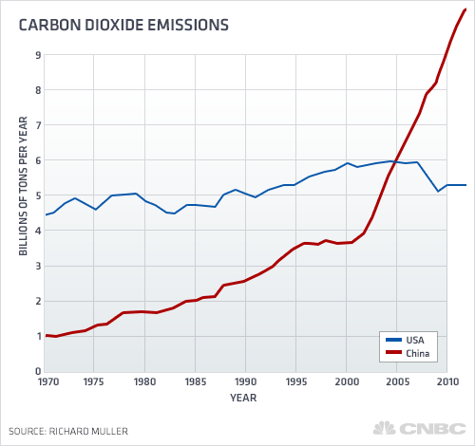
Coal Remains King
China is more energy hungry than ever, but they are accomplishing their cravings with heavy GHG emitting sources.

Slide 12
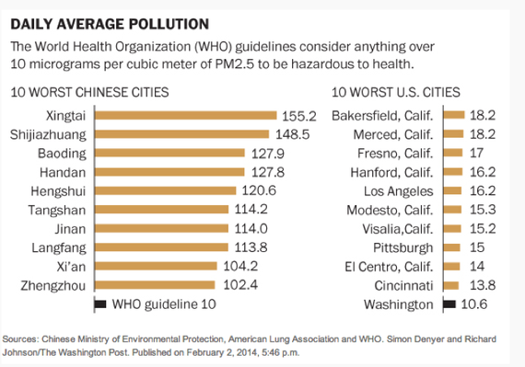
Pollution in China
The most polluting Chinese cities are way over the WHO guideline for hazardous pollutant levels in terms of the amount of PM2.5 in the atmosphere.
Source: The Atlantic

Slide 13
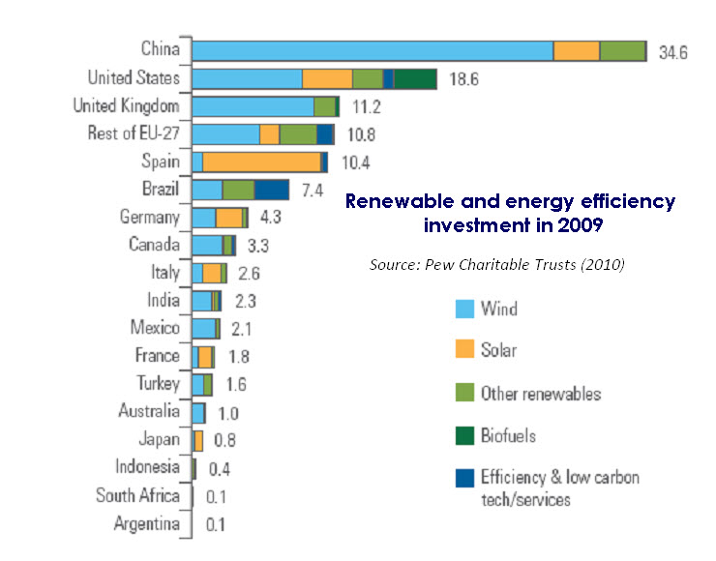
Hope for Change
Despite China’s current coal consumption, the country has invested more into sustainable energy sources than any other country.

Slide 14
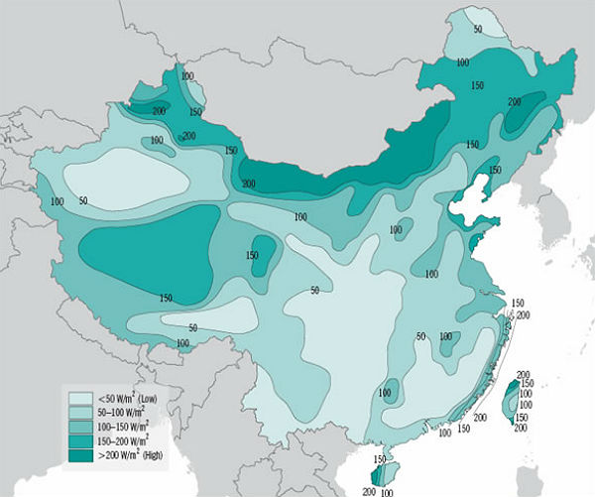
China: Wind Potential
China has invested more into wind energy than any other country since many parts of the country are optimal for harnessing wind energy.
Source: China Wind Power Center

Slide 15
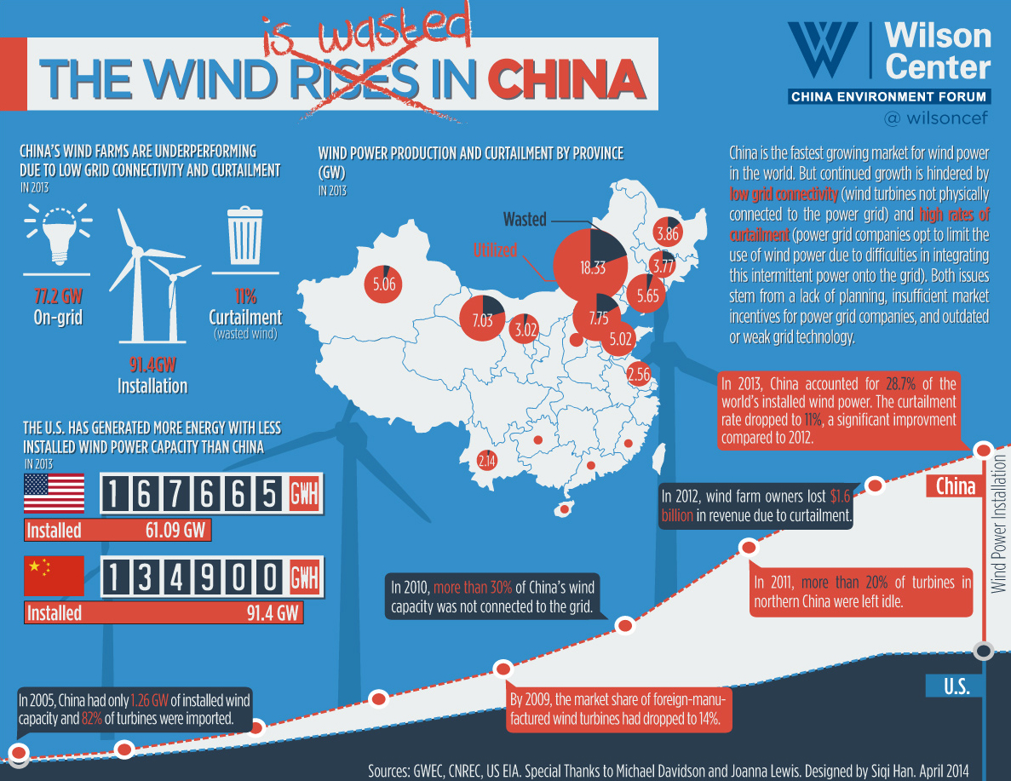
Need for Interconnected Grid
Source: Wilson Center

Slide 16
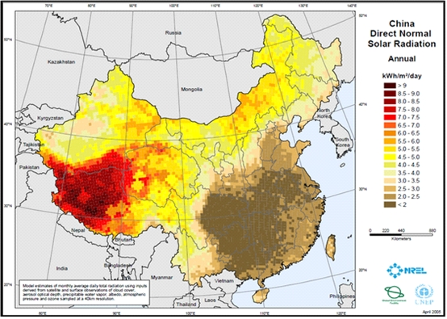
China: Solar Potential
Source: National Renewable Energy Laboratory

Slide 17
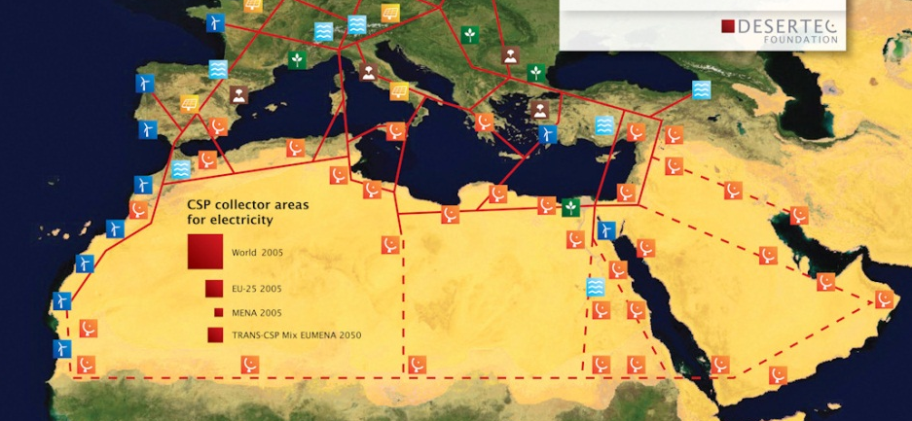
Solar Potential
A study conducted by the Desertec Foundation has shown that there is enough solar irradiation hitting the large red square pictured above to power the entire world, given existing photovoltaic technologies. China can apply these same principles given its enormous solar potential to power the entire country and more. However, what’s needed is an interconnected power grid to distribute this energy.
Source: Desertec Foundation

Slide 18
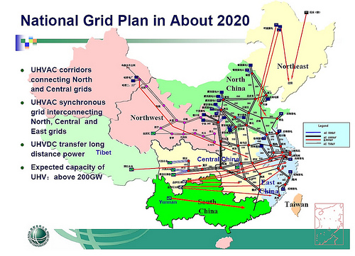
China’s Electric Grid
Luckily, China has plans to install a very expansive electrical grid, but here at GENI we have an even more ambitious goal.
Source: State Grid Corporation of China

Slide 19
GENI Initiative
The GENI Initiative focuses on linking renewable resources around the world using international electricity transmission, based on the visionary ideas of Dr. Buckminster Fuller. GENI envisions a day when the interconnection of electric power networks between regions and continents forms a global energy grid.

Slide 20
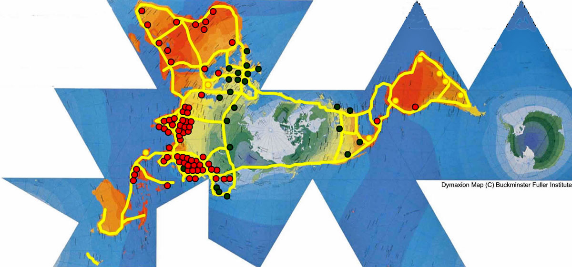
GENI Benefits
Decreased pollution from fossil and nuclear fuels
Reduced hunger and poverty in developing nations
Increased trade, cooperation, and world peace
Enables healthcare, communication, and access to clean water
Stabilized population growth

Slide 21
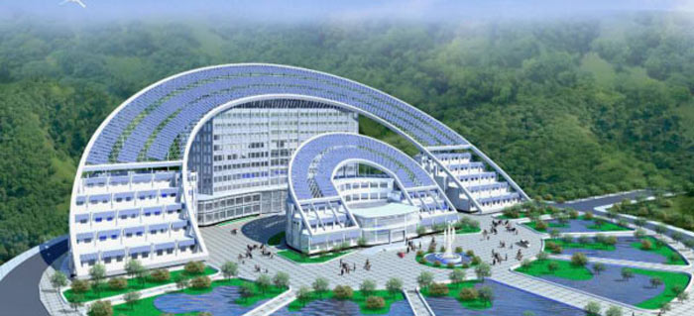
Thank you!
On behalf of GENI and WRSC, we would like to extend our gratitude to the Doers Group for taking the time to visit our facility. We hope the experience was valuable and that the students were able to immerse themselves visually into the future of global energy. We wish that one day, HIMIN solar can sponsor its very own SimCenter in Solar Valley for China to test and model future energy use.
For more information, please visit http://geni.org and http://www.wrsc.org/ or call us at 1-(619) 234-1088
Image: Excellerated Business School

