Slide 1

Topic of Discussion
“Stabilizing Climate: Shifting to Renewable Energy”
Presented by
Plan B Project Team
Plan B 4.0: Mobilizing to Save Civilization
by Lester R. Brown
1

Slide 2

Renewable Energy
Energy that comes from continually replenishing sources.
Source:TREIA
2
Notes:
http://www.treia.org/renewable-energy-defined

Slide 3
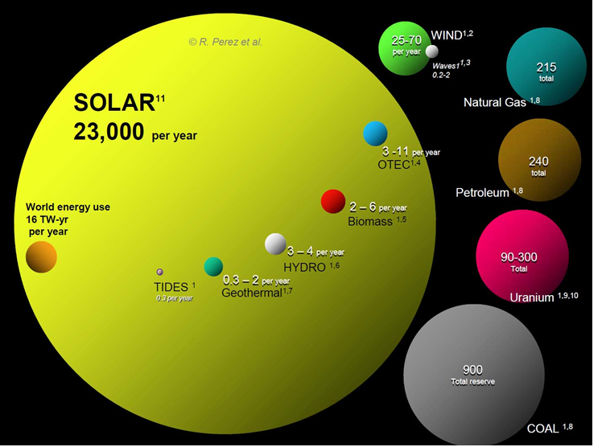
The Renewable Potential on Earth
Source: Perez et al
3
Notes:
http://www.renewablegreenenergypower.com/solar-energy-facts-solar-energy-alone-can-power-the-world/

Slide 4
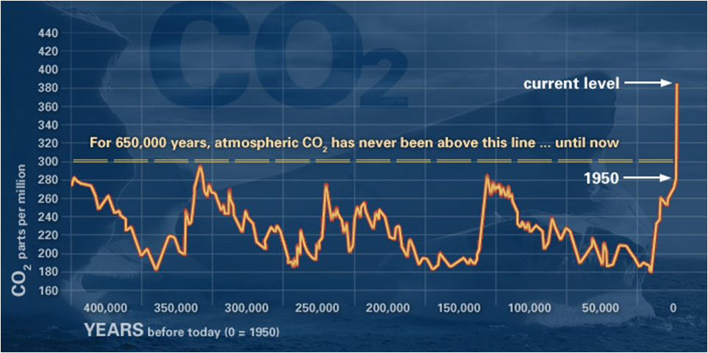
Why Should We Change to Renewables?
Source: UC Riverside
4

Slide 5

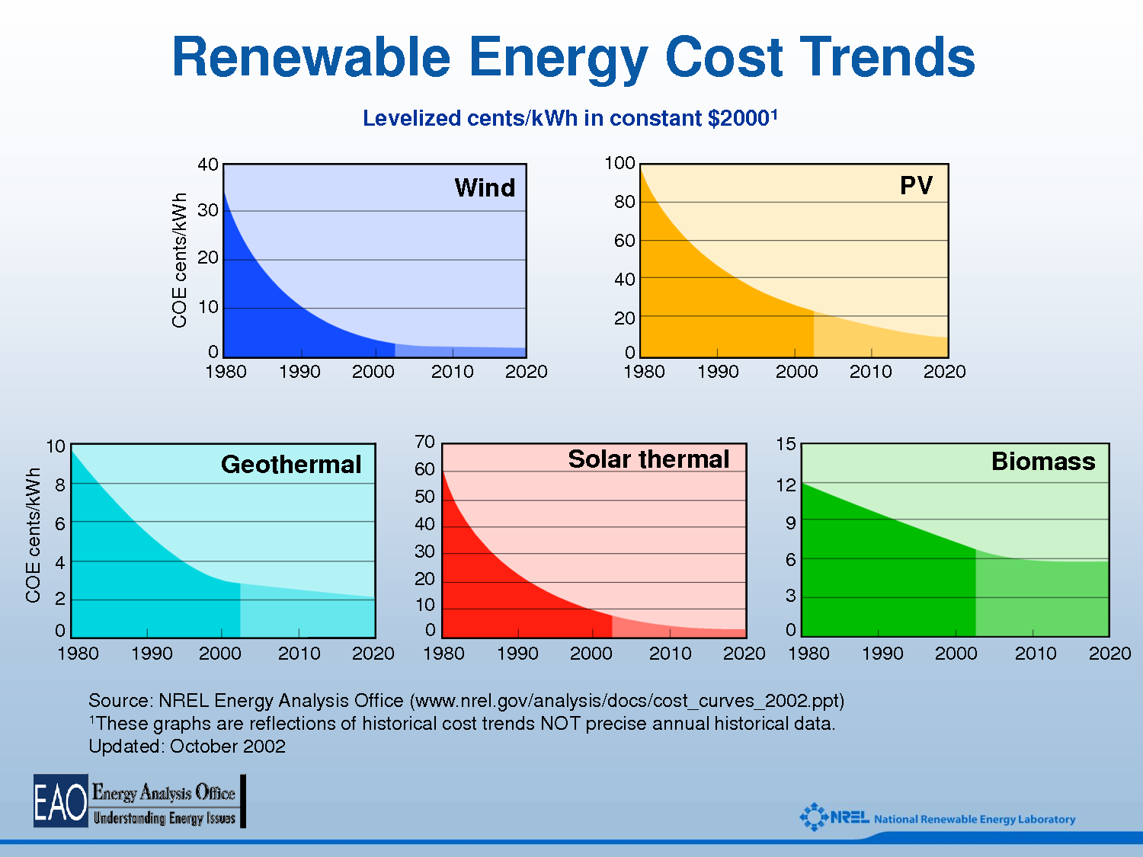
Why Should We Change to Renewables?
Cheaper Costs
Current Energy Price Trend: INCREASING
Source: NREL - National Renewable Energy Lab
5
Notes:
COE = Cost of Energy
Source: National Renewable energy Lab

Slide 6
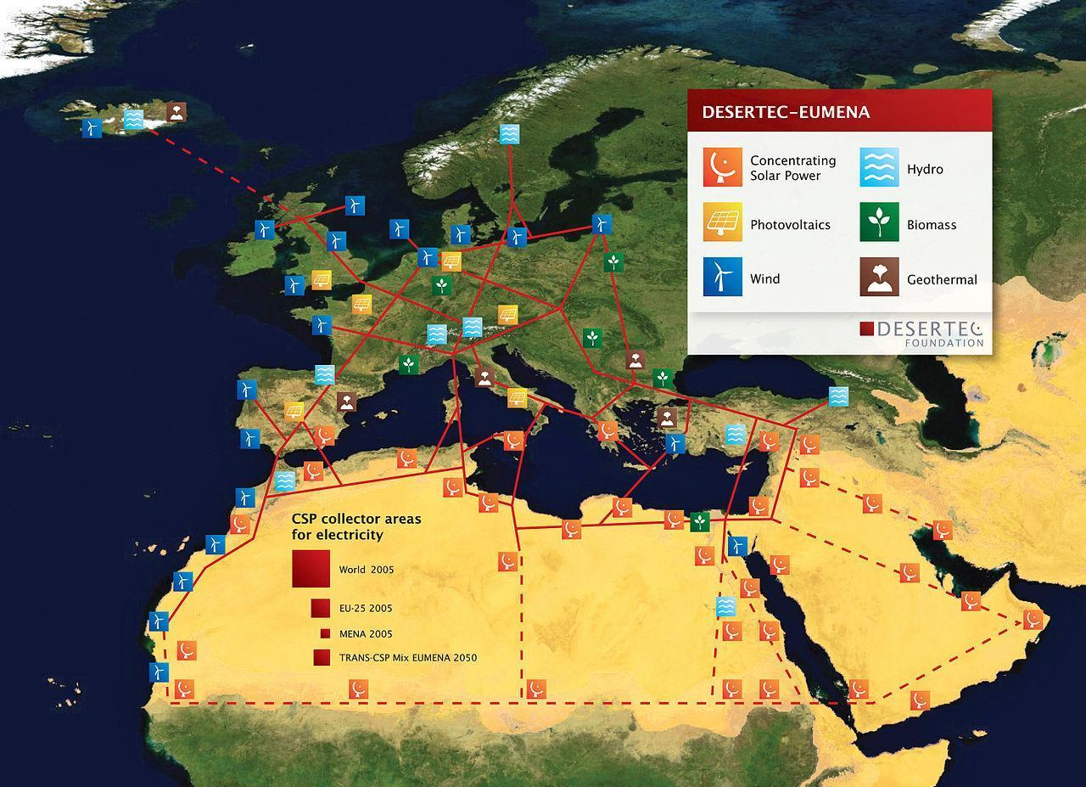
Why Should We Change to Renewables?
More Than Enough Supply
World 2010
Source: DESERTEC Initiative
6

Slide 7
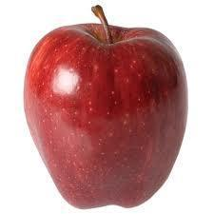

How to Quantify Energy
Energy - Joules
1 Joule 1000 Joules
1 meter
223.7 Miles per Hour
0.1 kg
1 Grape
=
~14,000 Joules
0.1 kg
Source: USDA
7
Notes:
Grape photo: http://upload.wikimedia.org/wikipedia/commons/thumb/3/34/Grape_and_forks.jpg/1280px-Grape_and_forks.jpg
Amount of energy in a grape: http://ndb.nal.usda.gov/ndb/foods/show/2257?fg=&man=&lfacet=&count=&max=&qlookup=&offset=&sort=&format=Abridged&_action_show=Apply+Changes&Qv=1&Q4179=1.0&Q4180=1&Q4181=1.0

Slide 8

How to Quantify Power
Power (Energy per unit of time) - Watts (Joules per second)
Standard american unit of energy - Kilowatt hour
(number of watts or kilowatts used in one hour)
1 kWh
=
3,600,000 Joules
(~250 Grapes)
36.7 kWh
=
Energy an average human in the US uses in a day
=
~1.3 x 10⁸ Joules
(~9000 Grapes)
Enough to run a Smart Electric Drive for ~70min.
Source: Worldbank 2010
8
Notes:
Energy Consumption :http://data.worldbank.org/indicator/EG.USE.ELEC.KH.PC
Calculated by myself

Slide 9
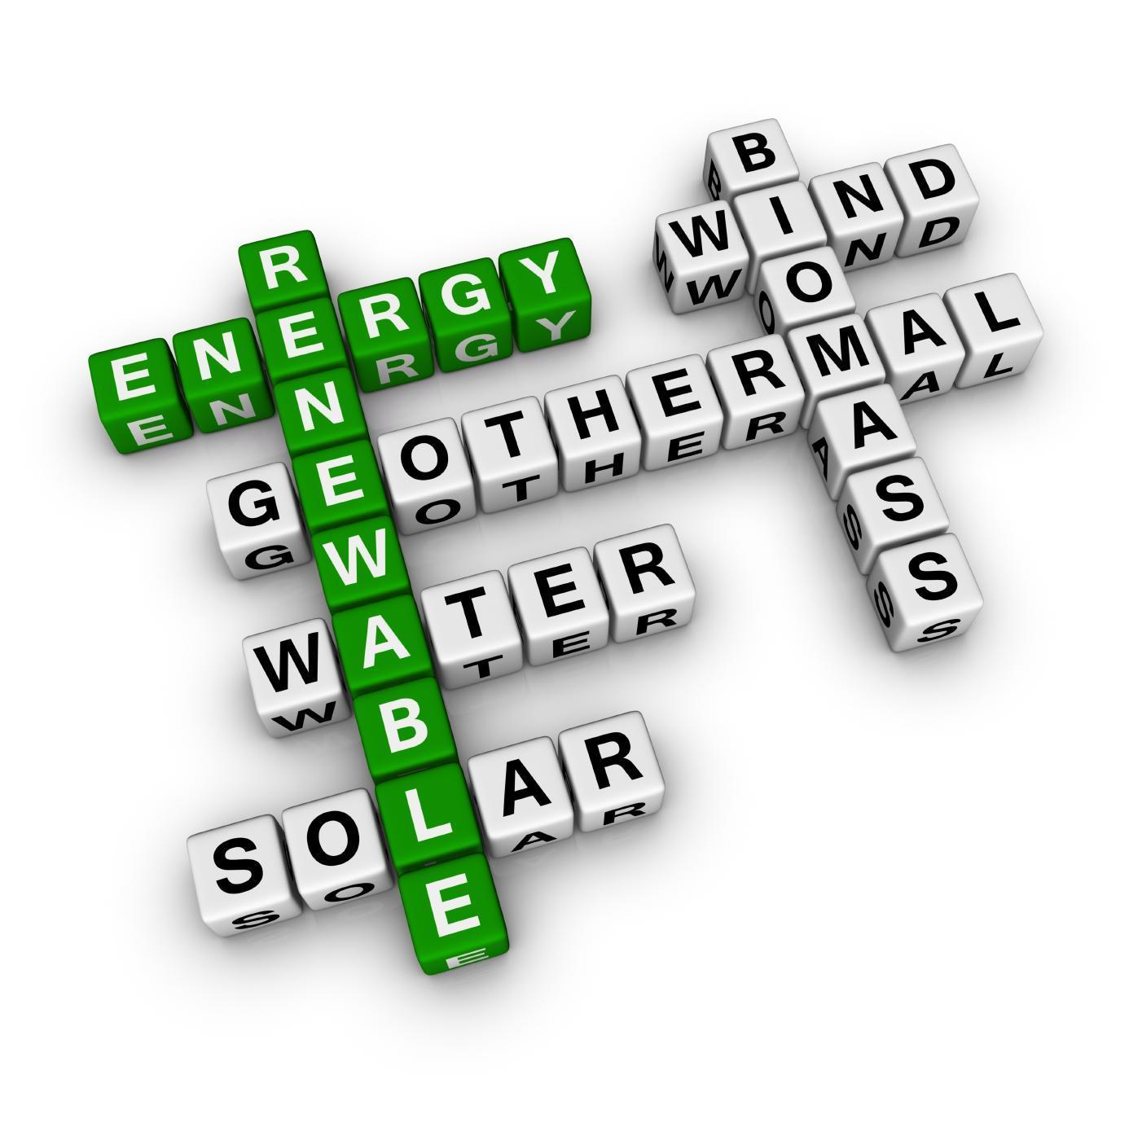
Our Renewable Resources
Source: Sustainable Energy Advantage
9
Notes:
http://www.sustainableenergyadvantage.com/seven-facts-about-renewable-energy/

Slide 10
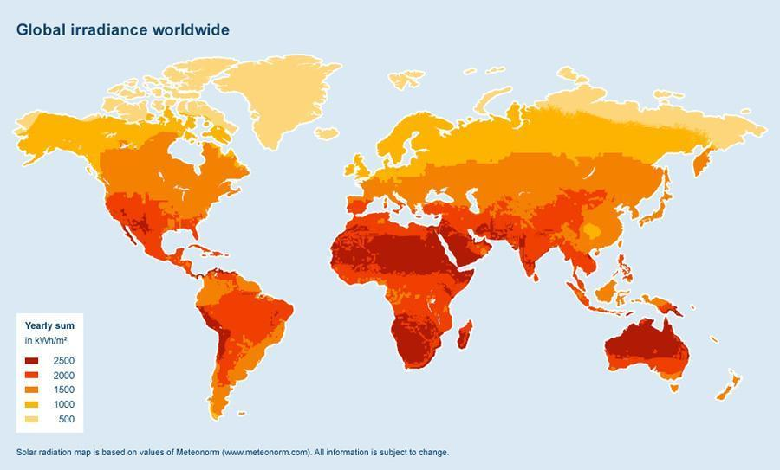
World Solar Potential
Source: Meteonorm
10
Notes:
M^2 = Height plus half length of the Board

Slide 11
World Solar Potential
In only 88 minutes,
the Sun provides enough Energy to
power the World for
one entire year.
Source: Ramez Naam – Scientific American
11

Slide 12
World Solar Potential
World Energy Consumption 2010 = 17,500 TWh
1 7 , 5 0 0 , 0 0 0 , 0 0 0 , 0 0 0 k W h
Antelope Valley - PV Power Plant = 623 GWh
2,100 acres
6 2 3 , 0 0 0 , 0 0 0 k W h
Another 22,000 Plants like this are needed
Source: Sandia.gov and World Energy Outlook 2010
12
Notes:
Biggest PV Power Plant (Antelope Valley) has an estimated annual generation of 623 GWh

Slide 13
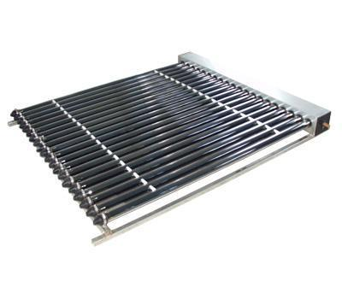




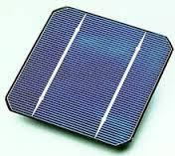
To heat up liquid
To heat up our homes
To make electricity
Gathering Radiation
13
Notes:
May remove slide
Steam: http://questionablekristina.deviantart.com/art/steam-stack-141276557
Turbine:

Slide 14
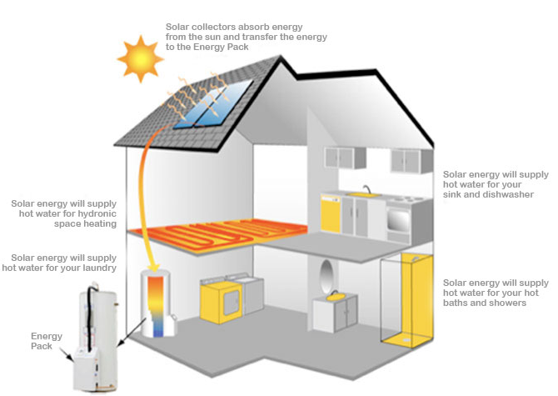
Solar Thermal Energy for Our Homes
Source: Radiance Solar
14
Notes:
http://www.radianceenergies.com/solar-basics/solar-basics.htm

Slide 15
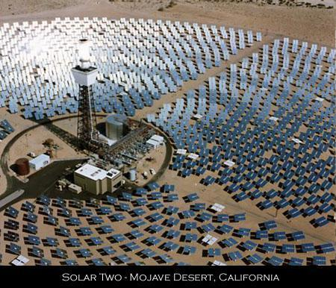
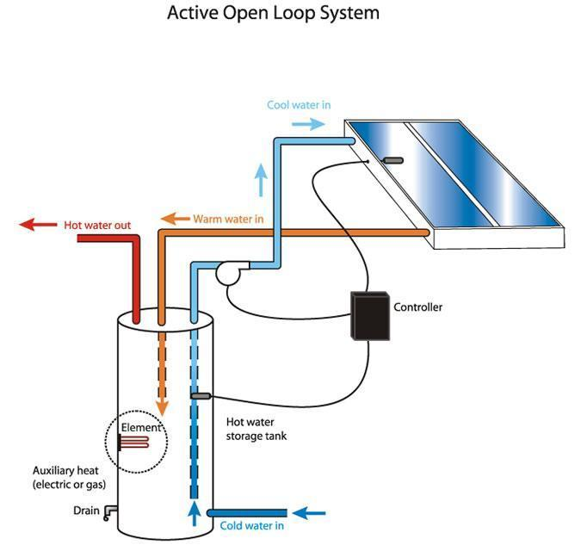
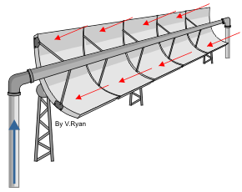
Most Common Types of Thermal Capturing
Direct Plate
Solar
Tower
up to 250ºF (120ºC)
Up to 1850ºF (1000ºC)
Parabolic
Up to 750ºF (400ºC)
15

Slide 16
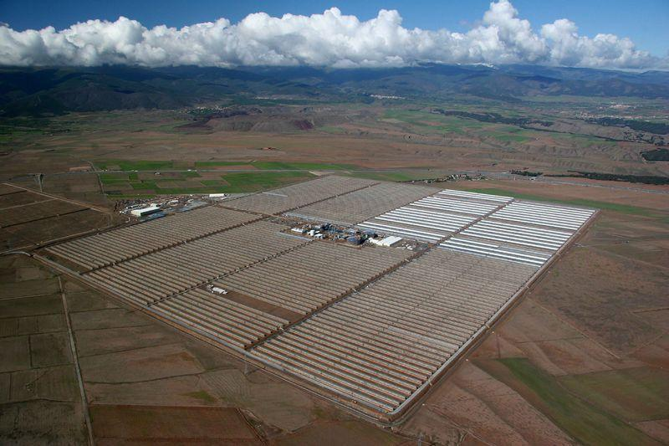
CSP - Parabolic Solar Power Plant
ANDASOL - SPAIN
540 GWh
180 MW
Storage for 7.5 hr
Electricity for
200,000 People
16
Notes:
Direct: http://www.inbalance-energy.co.uk/articles/solar_thermal_system_design.html
Tower: http://www.global-greenhouse-warming.com/solar-central-power-towers.html
Parabolic: http://www.technologystudent.com/energy1/solar3.htm
Temperatures (www.solarpaces.org)

Slide 17
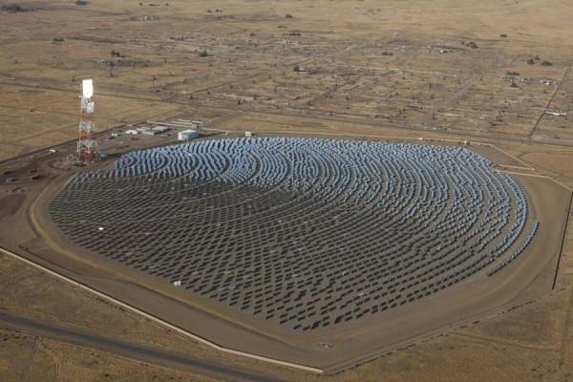
CSP - Solar Tower
INVANPAH - USA / CA
1080 GWh
392 MW
170,000 Heliostats
Electricity for
400,000 People
17
Notes:
Direct: http://www.inbalance-energy.co.uk/articles/solar_thermal_system_design.html
Tower: http://www.global-greenhouse-warming.com/solar-central-power-towers.html
Parabolic: http://www.technologystudent.com/energy1/solar3.htm
Temperatures (www.solarpaces.org)

Slide 18

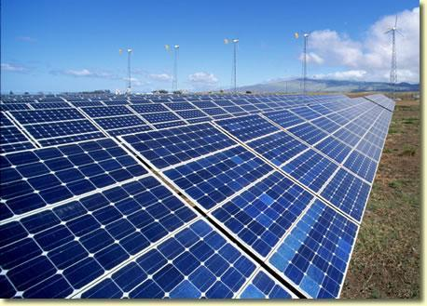
Solar Photovoltaic (PV)
Taking sunlight and directly turning it into electricity
18
Notes:
https://www.youtube.com/watch?v=x2zjdtxrisc&noredirect=1

Slide 19
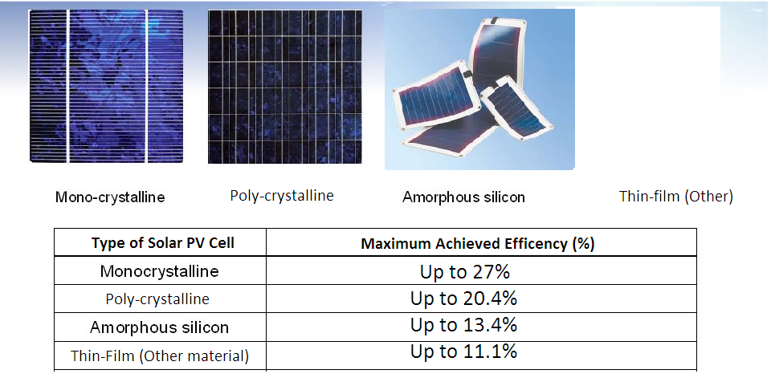
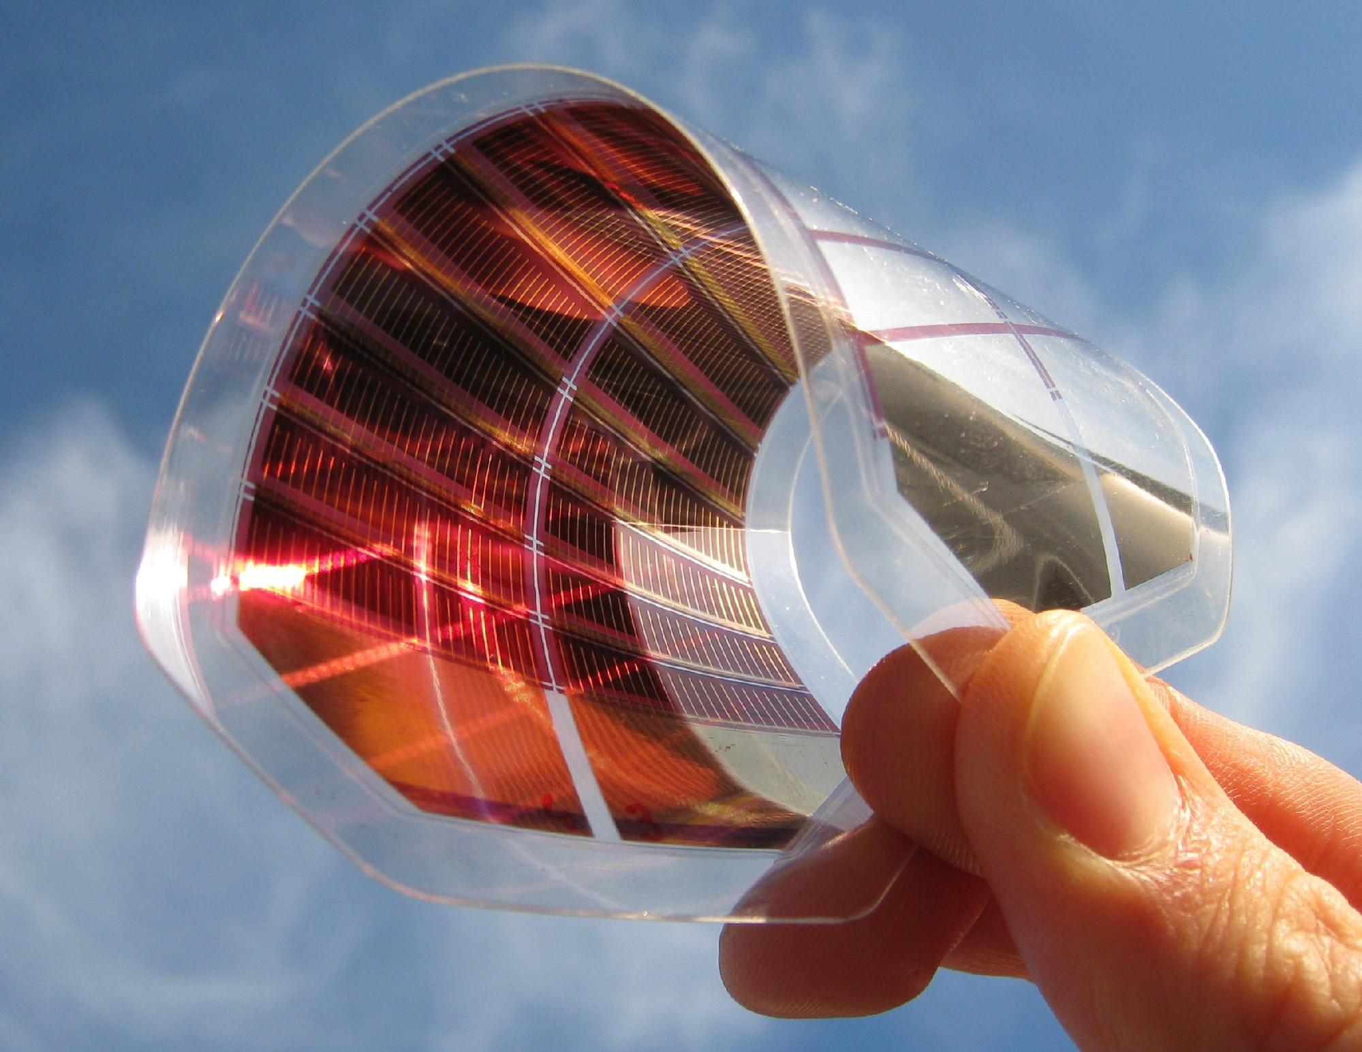
Types of Solar PV Capturing
Amorphous
Made from a thin film of Silicon
Thin-film (includes organic solar cells)
Made from a thin film of other materials
Monocrystalline
Made from a single crystal of Silicon
Polycrystalline
Made from multiple crystals of Silicon
Source: NREL - National Renewable Energy Lab
19
Notes:
http://www.solargreen.net.au/the-three-types-of-solar-cells.html
Picture: http://thebatteryclinic.com/wp-content/uploads/2010/11/types-of-solar-cells.jpg
Source for numbers: NREL (picture in folder)

Slide 20
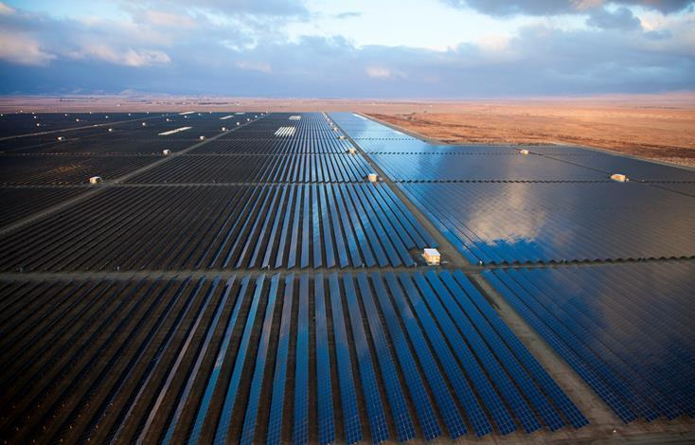
PV Power Plant
Antelope Valley - USA / CA
623 GWh
230 MW
3,700,000 PV Moduls
Electricity for
230,000 People
20
Notes:
Direct: http://www.inbalance-energy.co.uk/articles/solar_thermal_system_design.html
Tower: http://www.global-greenhouse-warming.com/solar-central-power-towers.html
Parabolic: http://www.technologystudent.com/energy1/solar3.htm
Temperatures (www.solarpaces.org)

Slide 21
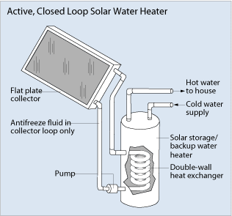
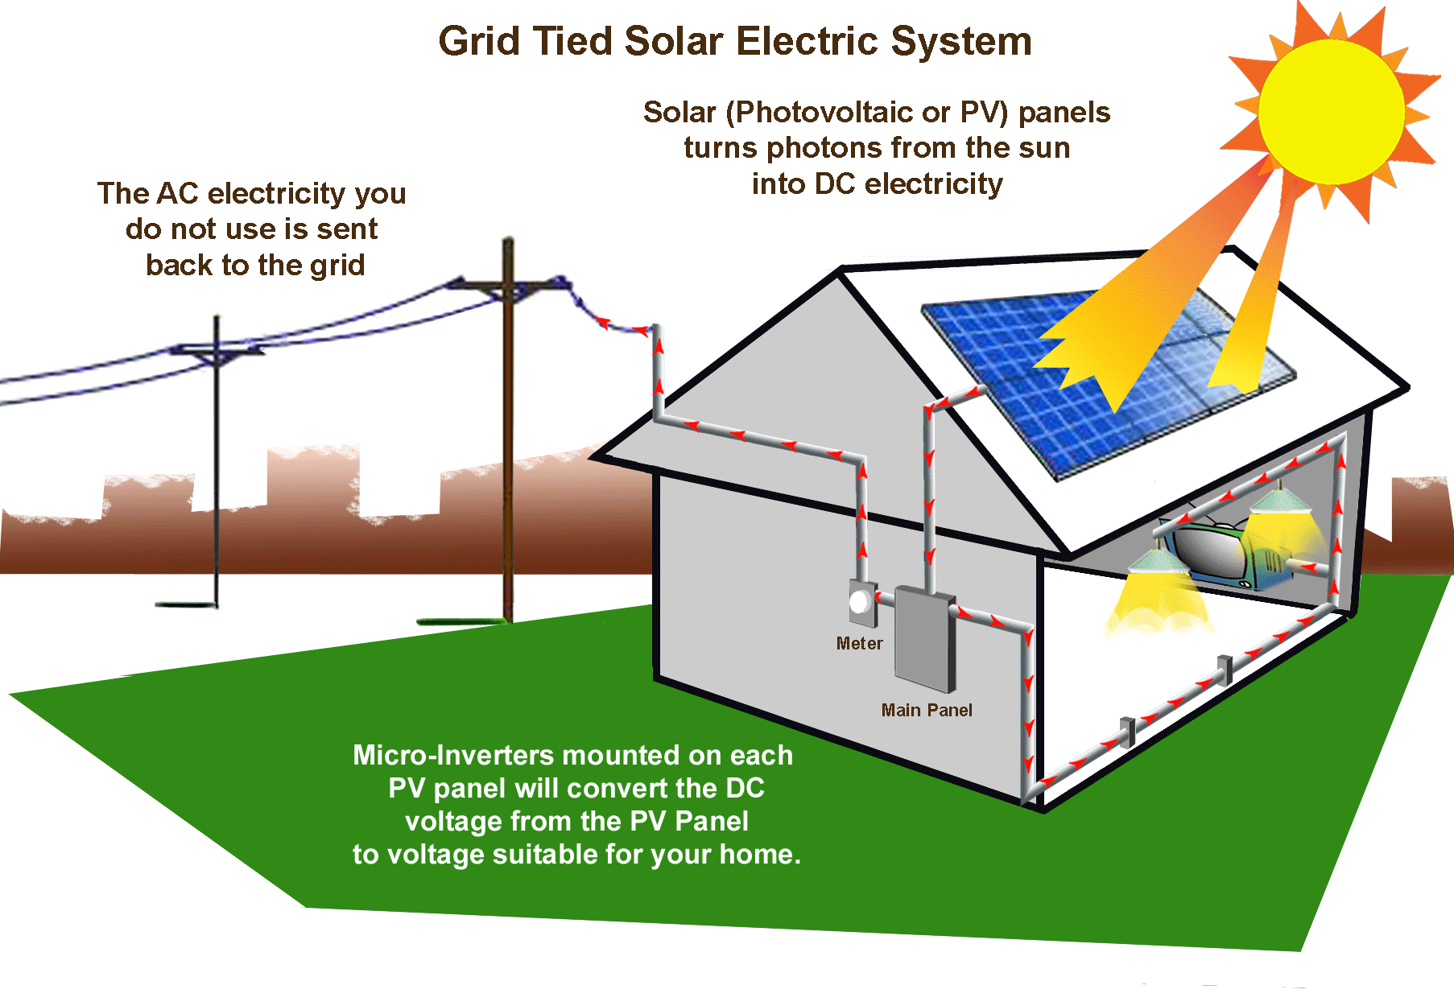
Home: Solar Energy
Solar heating - Getting hot water for homes
Home Solar panels - Create your own electricity and "sell back" excess energy
Source: ENERGY.GOV
21
Notes:
http://energy.gov/energysaver/articles/solar-water-heaters
Solar kits range from .1 -10 kW (multiple sources, looked online) (in 12 hours get 1.2 - 84 kWh)
.5 kW = ~$2000 5kW = ~$13,000
Daily energy consumption ~ 30kWh (http://www.eia.gov/tools/faqs/faq.cfm?id=97&t=3)

Slide 22
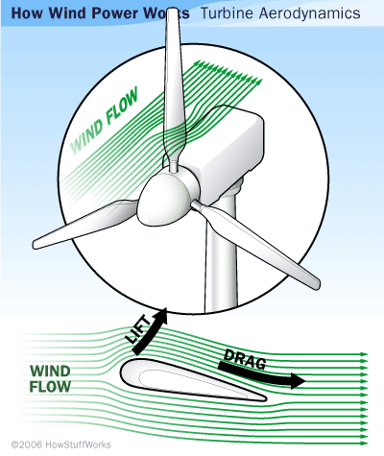
Wind Power
Converts the
kinetic energy
of the wind into mechanical energy, then
into electricity.
Source: Renewable Green Energy Power
22
Notes:
http://www.renewablegreenenergypower.com/interesting-facts-about-wind-power/

Slide 23
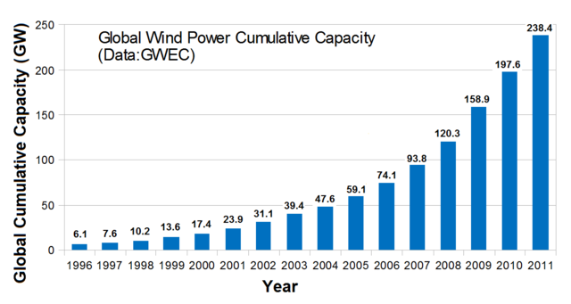
Global Wind Power
23

Slide 24
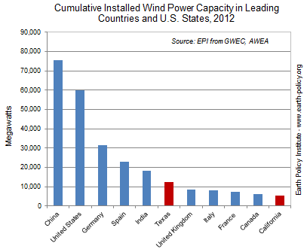
24

Slide 25
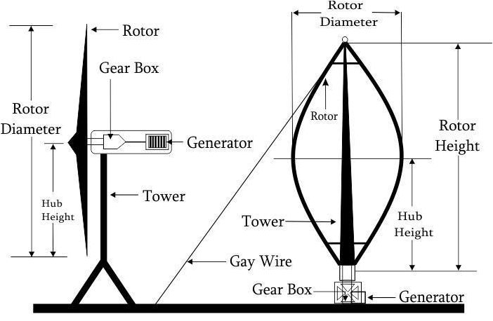
Types of Windmills
Horizontal Axis Wind Turbine (HAWT)
Vertical Axis Wind Turbine (VAWT):
100 kW – 10,000 kW
1 kW - 30 kW
Source: How Stuff Works
25
Notes:
Source: http://science.howstuffworks.com/environmental/green-science/wind-power2.htm
Power (HAWT): http://www.turbinesinfo.com/horizontal-axis-wind-turbines-hawt/
Power (VAWT): http://www.eng.src-vertical.com/products/wind-turbines/ (general power range)

Slide 26
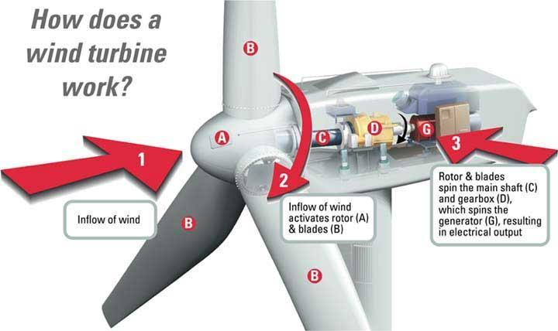
Source: CCEDC
26
Notes:
http://clearlyahead.com/energy-department-2/wind/how-it-works/
Maybe show

Slide 27


Small Scale Example
Wrigley Hall
at
Arizona State University
Using small scale HAWT to help support this building in sustain a green outlook.
Source: Arizona State University
27
Notes:
http://www.asu.edu

Slide 28
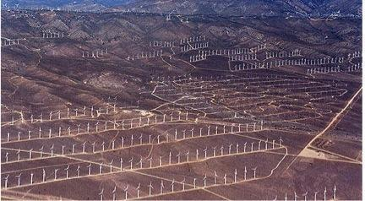
Largest Onshore Windfarm
Alta Wind Energy Center - USA / CA
2,680 GWh
1,020 MW (2012)
3,000 MW(2020)
9,000 acres
Electricity for
1,000,000 People
28
Notes:
http://www.cleanenergyactionproject.com/CleanEnergyActionProject/Wind_Power_Case_Studies_files/Alta%20Wind%20Energy%20Center%20.pdf

Slide 29
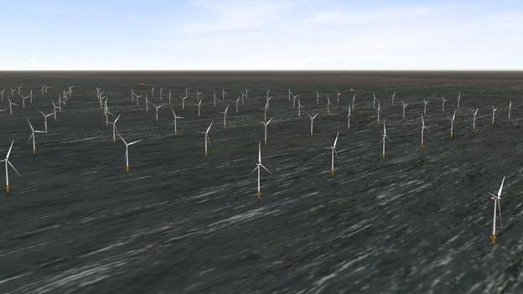
Largest Offshore Windfarm
London Array - UK
1,575 GWh
630 MW (2013)
280 miles Cable
Electricity for
500,000 People
29
Notes:
http://www.londonarray.com/

Slide 30
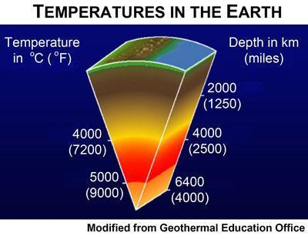
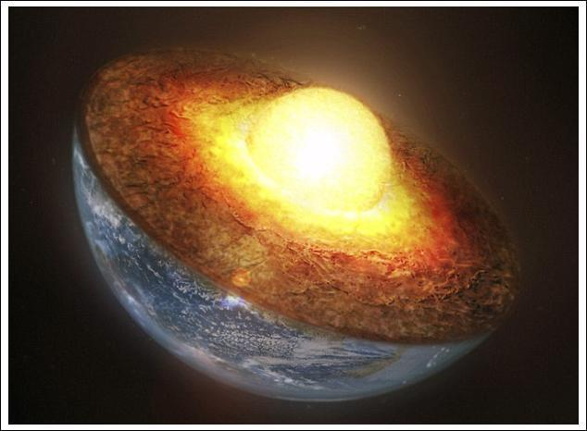
Geothermal
Obtaining heat from the earth
to heat and power our lives.
Enough energy (theoretically) in the first 6 miles of earth to power the world 50,000 times over.
30

Slide 31
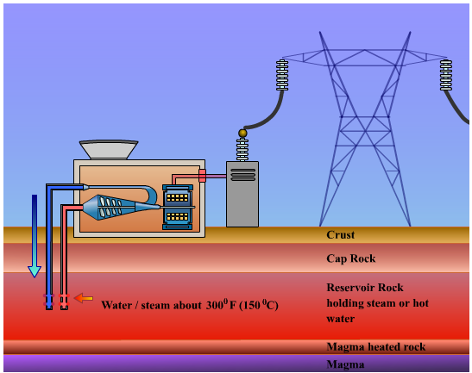
Geothermal Power Plant
Source: California Energy Commission
31
Notes:
http://energyalmanac.ca.gov/renewables/geothermal/types.html

Slide 32
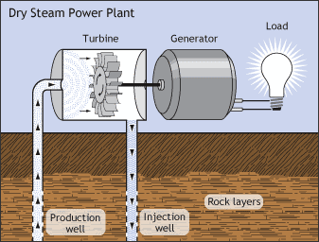
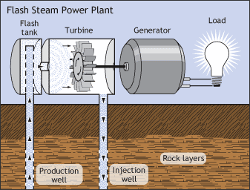
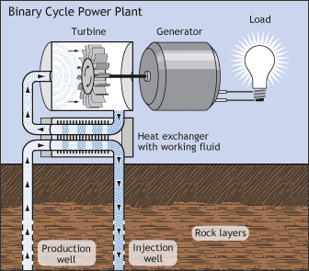
Different types of Generators
Direct Dry Steam Generator
- Steam goes directly to generator.
Flash Steam Generator
- Fluid is sprayed into a tank held at a much lower pressure than the fluid, causing some of the fluid to rapidly vaporize, or "flash."
Binary Cycle Generator
- Hot water flows from the pipes from the earth and heat up water in the plant to steam.
Source: Energy Almanac (CA)
32
Notes:
http://energyalmanac.ca.gov/renewables/geothermal/types.html

Slide 33
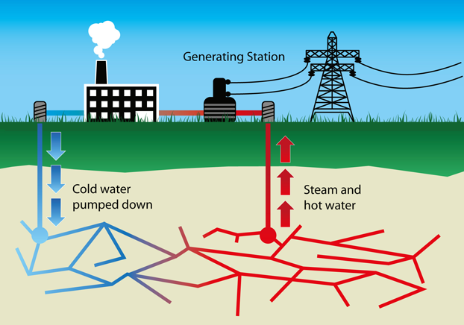
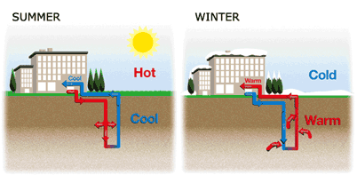
Purpose
Electricity Generation
Direct heating or cooling
33
Notes:
1) http://www.bbc.co.uk/schools/gcsebitesize/science/aqa_pre_2011/energy/mainselectricityrev5.shtml
2) http://www.vpsupply.com/lp/buffalo-geothermal-heat-pumps

Slide 34
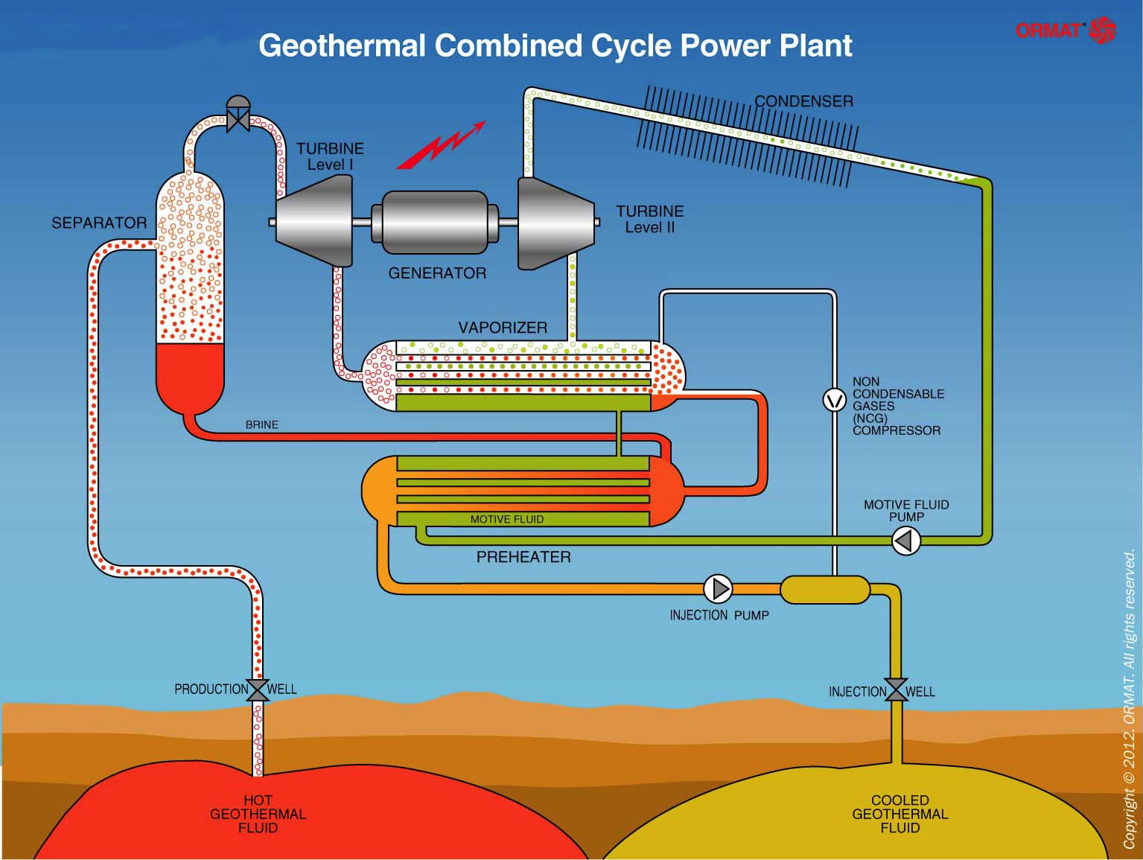
Heat and Electricity
34
Notes:
1) https://www.google.com/search?q=how+does+a+geothermal+power+plant+work&um=1&ie=UTF-8&hl=en&tbm=isch&source=og&sa=N&tab=wi&ei=GVXxUfazEKmCjAKj64Ag&biw=1527&bih=848&sei=HlXxUefZLOmpigKolIFQ#q=how+does+a+geothermal+power+plant+work&um=1&hl=en&tbm=isch&source=lnt&tbs=isz:l&sa=X&ei=HlXxUZyRNenGiwKL6YG4Dw&ved=0CBkQpwUoAQ&bav=on.2,or.r_qf.&bvm=bv.49784469%2Cd.cGE%2Cpv.xjs.s.en_US.MpiVkF51mpA.O&fp=630f4a7851d9cf72&biw=1527&bih=848&facrc=_&imgdii=_&imgrc=lNzxtXNfNPAjxM%3A%3BfReCl-FTPdIiAM%3Bhttp%253A%252F%252Fgeo-energy.org%252FImages%252FAIRCOOLEDCOMBINEDCYCLE-ENGLISH-G2-6E.JPG%3Bhttp%253A%252F%252Fgeo-energy.org%252Fbasics.aspx%3B1535%3B1155

Slide 35
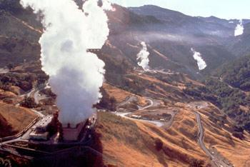
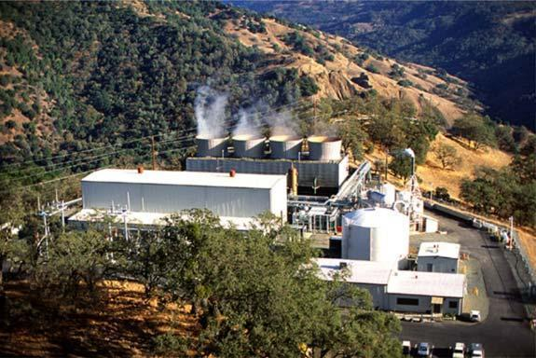
Example California
California Power plants: Combined for over 2,500 MW of Power and
13,500 GWh of Energy
almost
5%
of the entire Californian energy demand
Source: California Energy Gov.
35
Notes:
http://www.geo-energy.org/plants.aspx
http://www.energy.ca.gov/geothermal/
Last picture: http://geothermal.marin.org/geopresentation/sld053.htm

Slide 36
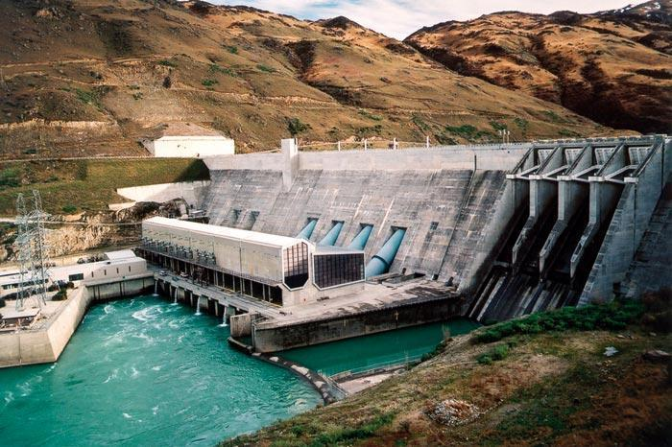
Hydro Power
Harnessing the kinetic energy found in the motion of water within various areas
Probably the most popular renewable energy source in the world
36
Notes:
http://www.oecd-ilibrary.org/sites/factbook-2013-en/06/01/03/index.html?contentType=&itemId=/content/chapter/factbook-2013-43-en&containerItemId=/content/serial/18147364&accessItemIds=&mimeType=text/html

Slide 37
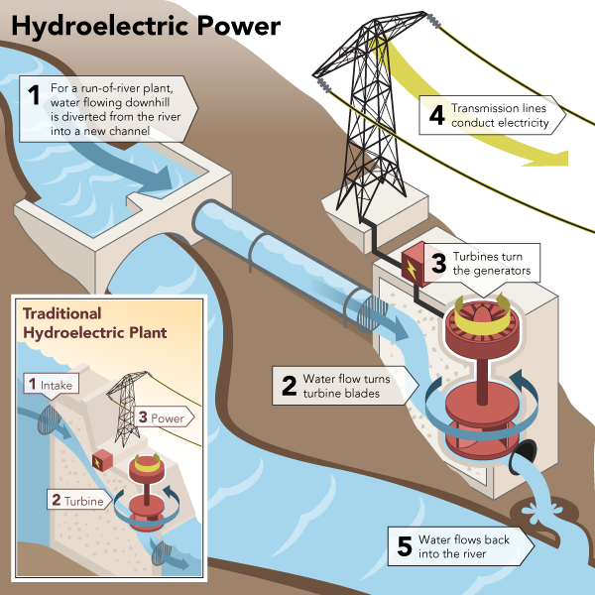
Hydroelectric Power
A hydroelectric power plant uses water to turn a turbine,
which then turns a metal shaft in an electric generator.
The electric generator produces electricity.
Source: Renewable Green Energy Power
37
Notes:
Source: http://www.renewablegreenenergypower.com/what-is-hydropower/

Slide 38
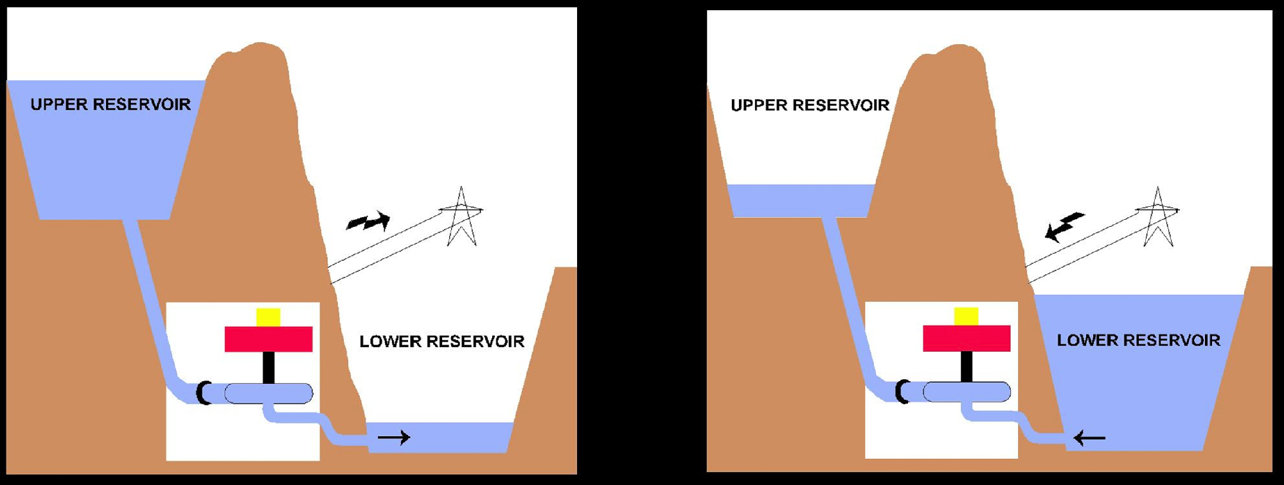
Pump and Storage Power Plants
Both generating and storage energy…
... which is really important for the future of energy supply
Source: ESKOM
38
Notes:
http://www.eskom.co.za/c/article/13/palmiet/

Slide 39
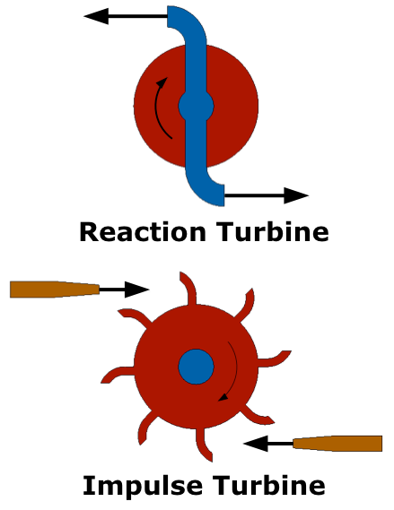
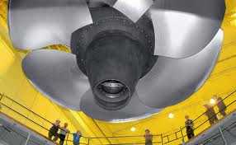
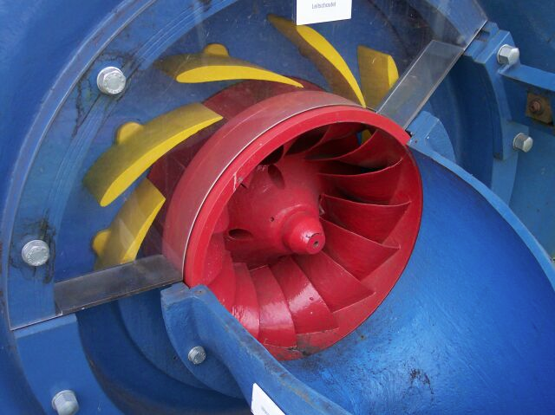
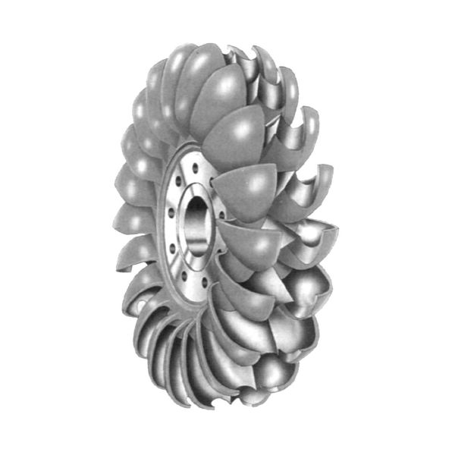
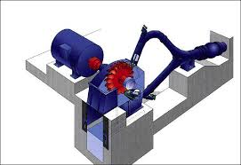
Different Types of Turbines
Reaction Turbine
- such as Kaplan & Francis Turbine
Impulse Turbine - such as Pelton Turbine
Source: EERE
39
Notes:
http://www1.eere.energy.gov/water/hydro_turbine_types.html

Slide 40
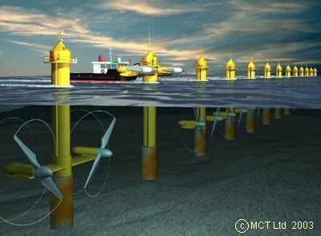
Tidal Turbines
Source: Renewable Energy Study
40
Notes:
source: eswrenewableenergystudy.files.wordpress.com

Slide 41
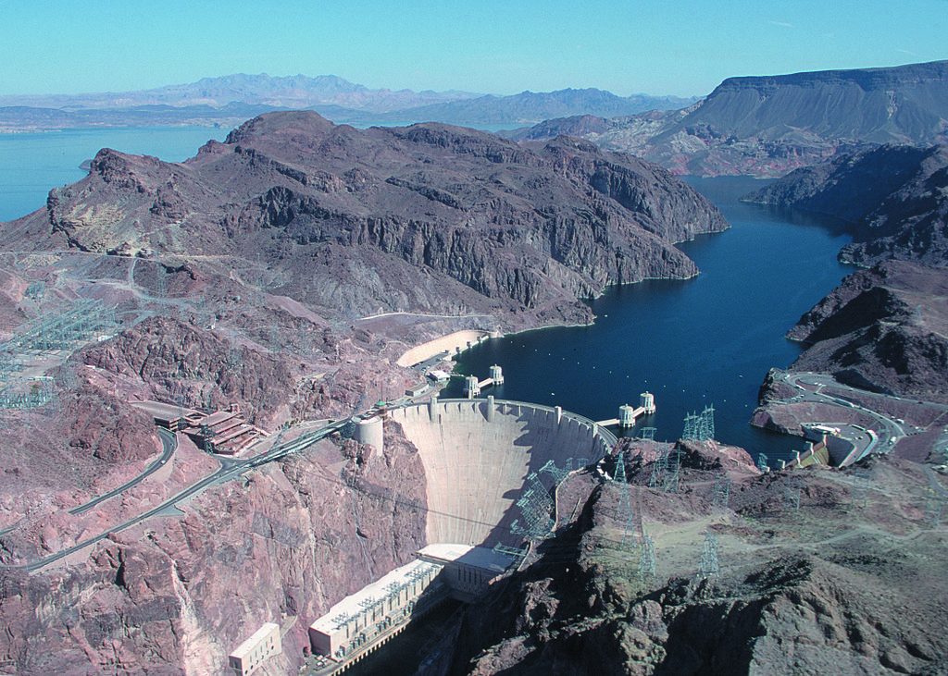
Hoover Dam - Nevada
4,200,000,000 kWh
2,080 MW
19 Turbines
Electricity for
1,700,000 People
41

Slide 42
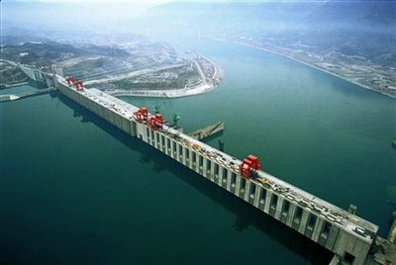
World Largest Water Power Plant
Three Gorges Dam - China
80,000,000,000 kWh
22,500 MW
34 Turbines
enough to Power entire
GERMANY
42

Slide 43

World’s Largest Water Power Plant
43

Slide 44

Biomass
Source: http://greenrenewableenergy.org/tag/guidebook/
44
Notes:
http://www.biomassenergycentre.org.uk/portal/page?_pageid=76,15068&_dad=portal&_schema=PORTAL

Slide 45

Biogas Gasification
45
Notes:
http://www.geopowerenergy.com/technology/biogas/

Slide 46

How It Works: Biomass Gasification
46
Notes:
http://stlenergy.org/?p=459

Slide 47

Benefits Regarding Biomass
While still releasing carbon emissions into the atmosphere, Biomass is beneficial to society by:
Releasing a small amount of carbon compared to fossil fuels - nearly ZERO
It can run 24/7 unlike many renewable resources
It finds use for items that regarded in society as waste.
47

Slide 48

Small Scale ExampleFireplace
48

Slide 49

Large Scale Example
Lutosa Potato farm
In Belgium, LUTOSA Potato farms has one of the largest biogas plants in Europe.
Creates over 5,920,351 kWh per year
Power to over 2000 people from Waste.
49
Notes:
http://www.biogasregions.org/doc/shining_examples/10.pdf

Slide 50

Cogeneration - Combined Heat and Power
Source: C2ES
50
Notes:
http://www.c2es.org/technology/factsheet/CogenerationCHP

Slide 51

Cogeneration - Combined Heat and Power
This technology is very important for both
- fossil fuels, such as Gas Turbines
- and renewable Resources
51

Slide 52

Masdar city
52
Notes:
https://www.youtube.com/watch?v=g9NH9W1Eg0E (2:29)
https://www.youtube.com/watch?v=MCAB0g55lQw (1:23)

Slide 53
"To truly transform our economy, protect our security, and save our planet from the ravages of climate change, we need to ultimately make clean, renewable energy the profitable kind of energy."
- President Barack Obama
53

Slide 54


