Slide 1
  Inform policy – Drive innovation – Empower wise decisions
California Center for Sustainable Energy

Slide 2

VISION
Clean energy for all generations
MISSION
To accelerate the adoption of clean, efficient and renewable energy solutions through education, technical consulting, and policy initiatives
Notes:
At CCSE we don’t have a particular product, we have a passion for a better future through our vision.

Slide 3




Renewable Energy
Building Performance
Transportation
We bridge the private and public sectors to advance the clean energy economy and support smart decision-making
Notes:
CCSE works in three major areas.

Slide 4
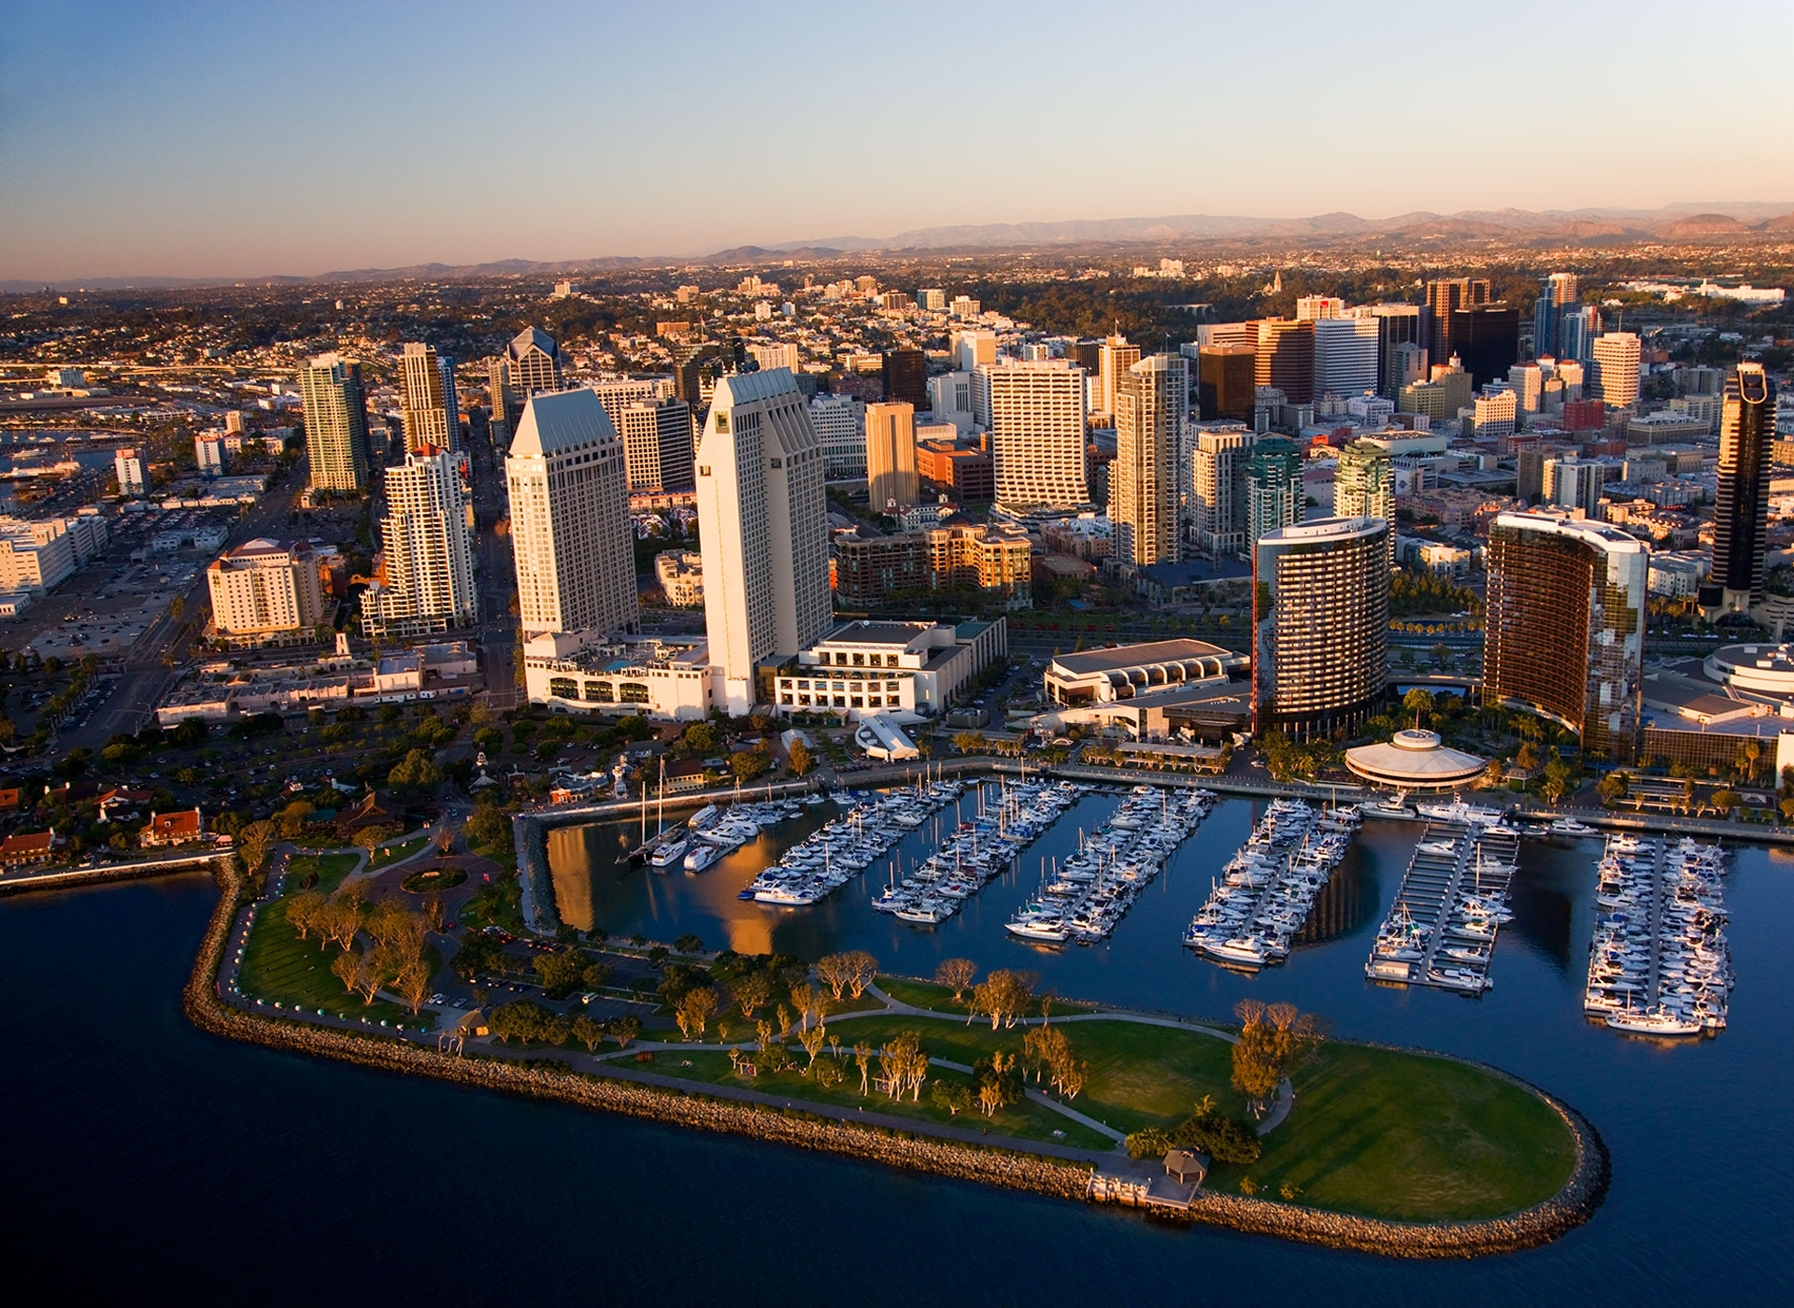
Notes:
So just how sustainable is San Diego as it relates to energy and AB 32?

Slide 5
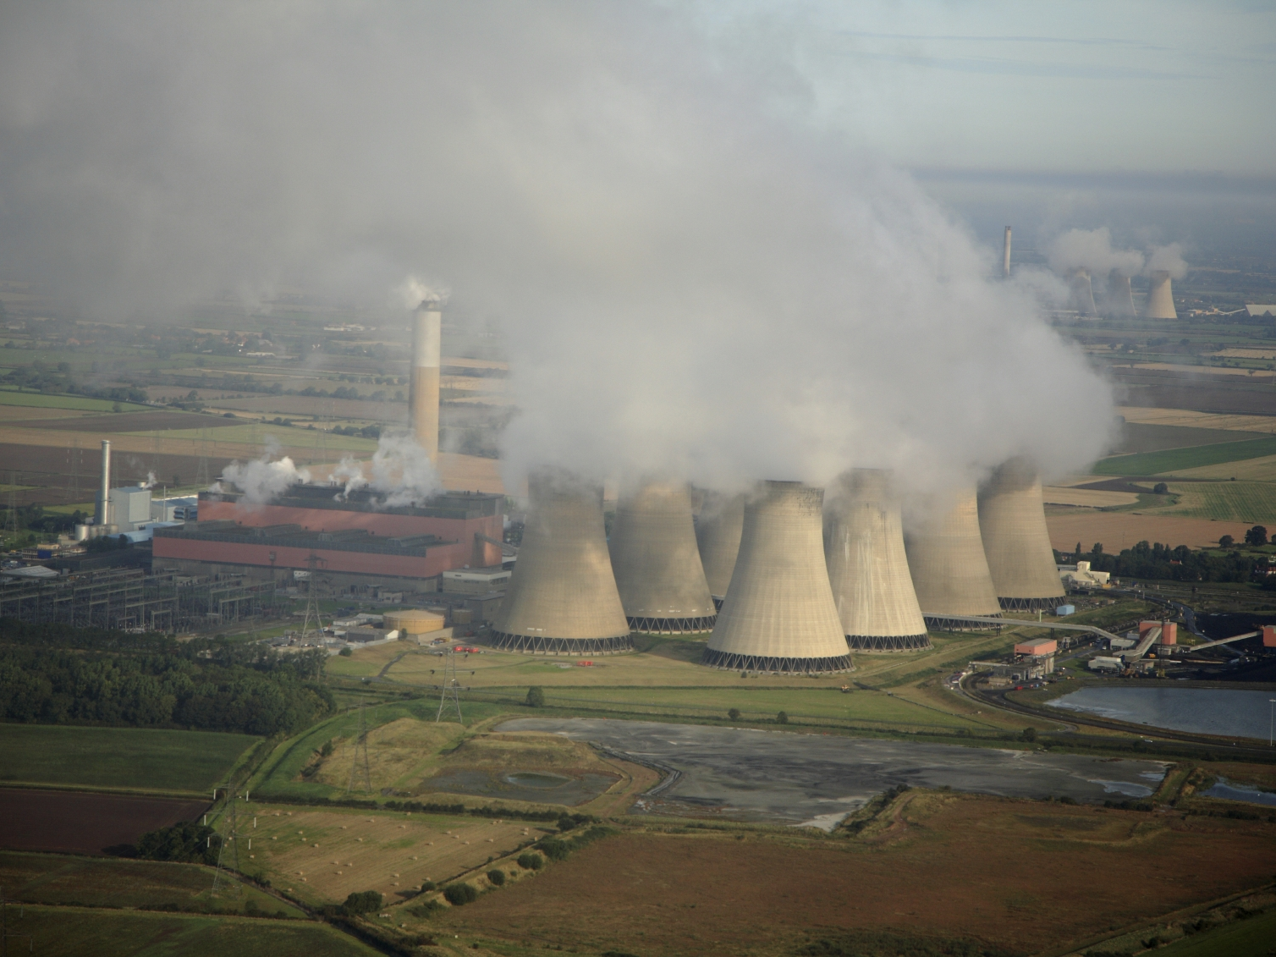
Notes:
Truth is not very. While the skyline of San Diego is pristine, thousands of these operate around the world providing energy for the masses.

Slide 6
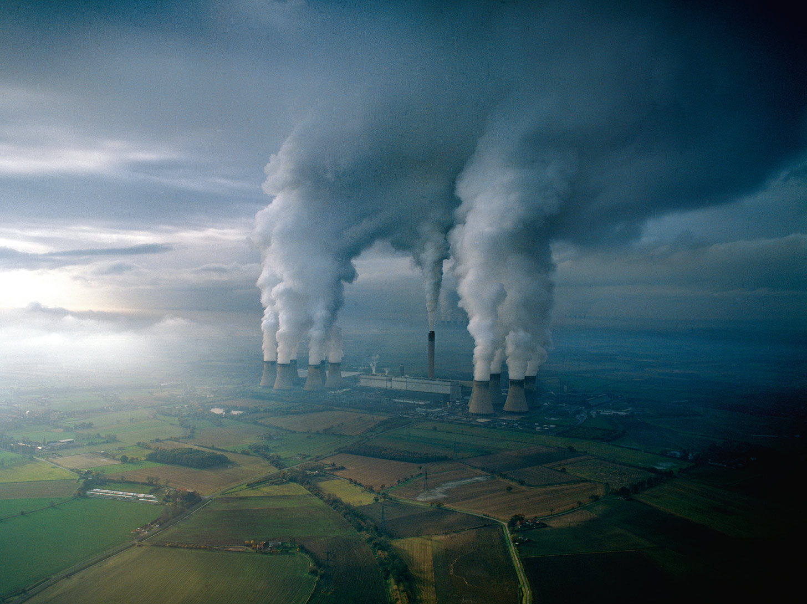
Notes:
Millions of pounds of carbon dumped into our atmosphere every day feeding the progress of civilization. While this is not a scene locally it is a scene in areas of the country that provide energy to the region.

Slide 7
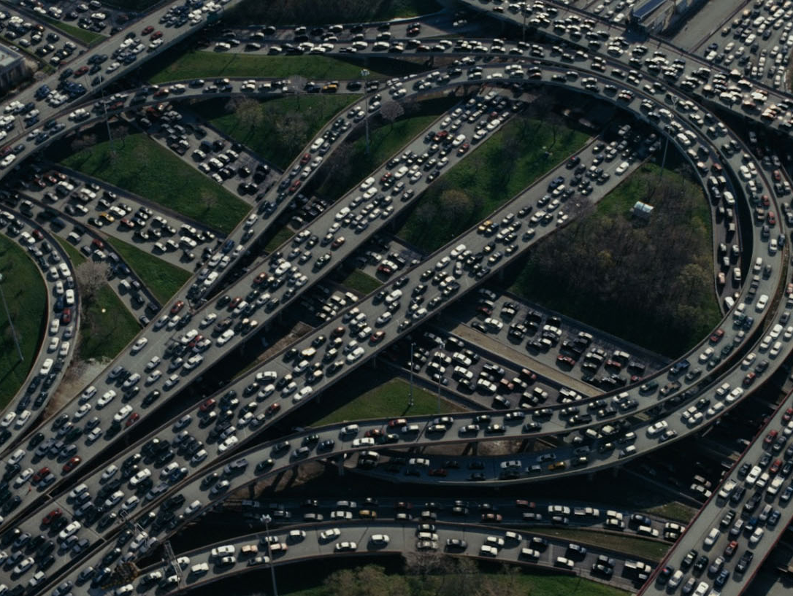
Notes:
A population of more than 300 million with more than 1 Billion registered vehicles on the road. San Diego traffic reports show that we spend an average of about 54 hours a year sitting in rush hour traffic - 20 percent more than just two years ago. Plans to expand this nightmare are as controversial and polarizing as abortion.

Slide 8
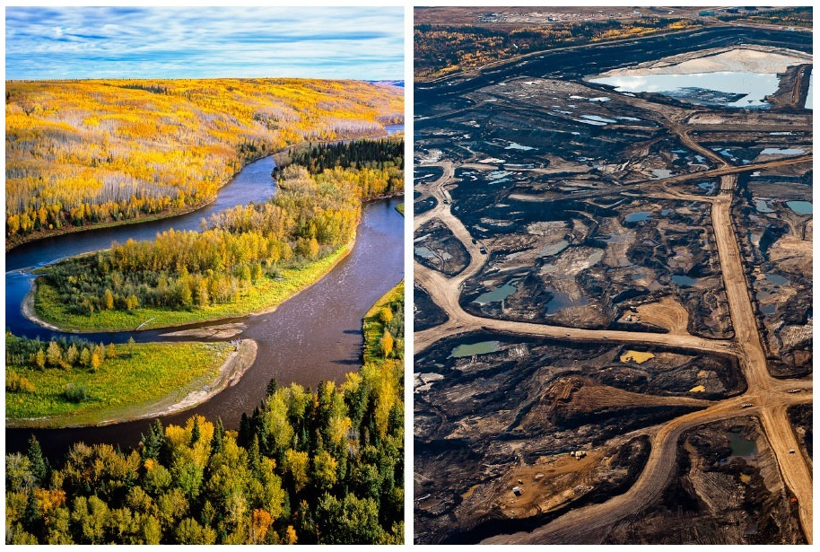
Notes:
And to make matter worse this is a before and after picture of a tar sands site in Canada.

Slide 9
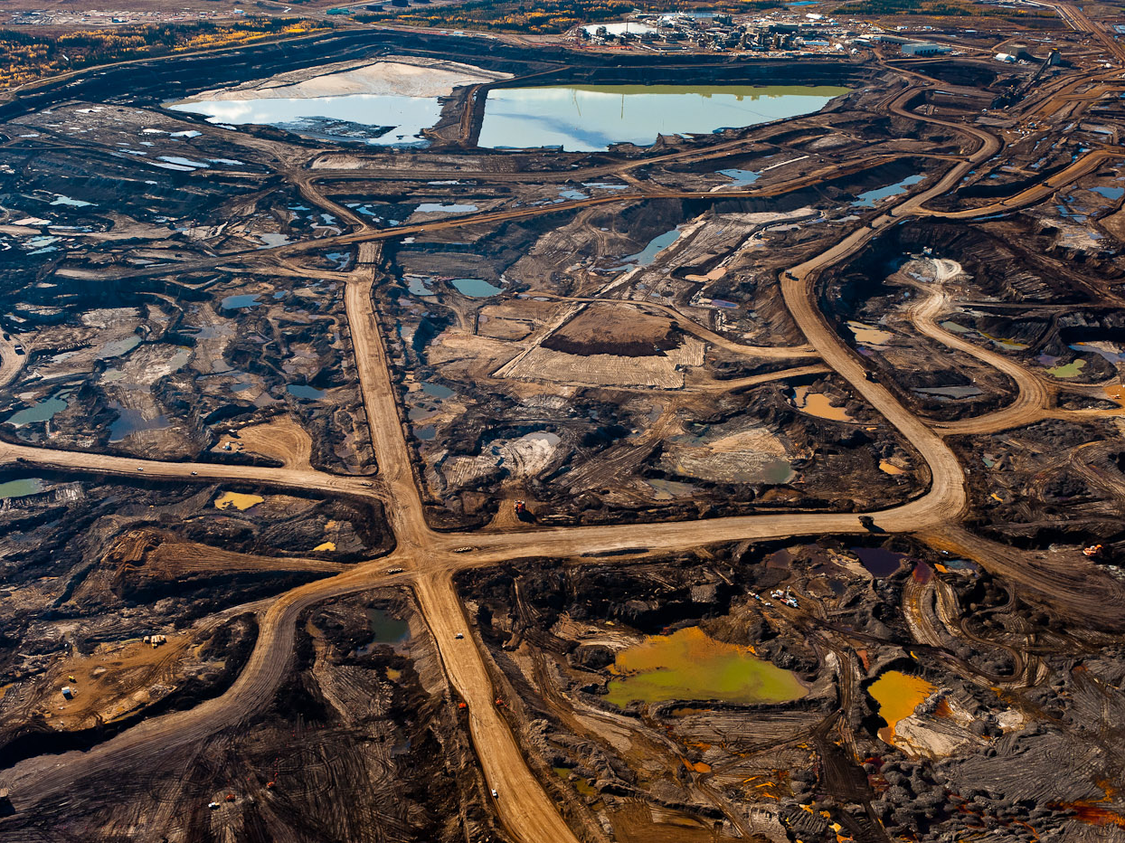
Notes:
The bad stuff…Tar sands

Slide 10
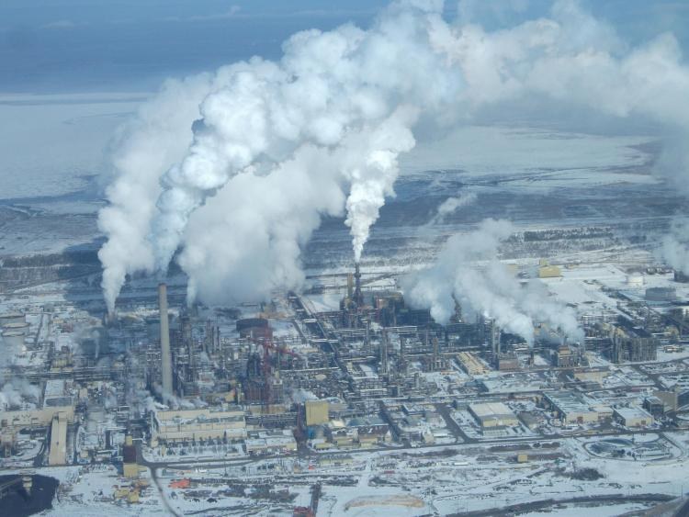
Notes:
And then we have the refinery to process those sands so we can feed the energy we claim to need.

Slide 11
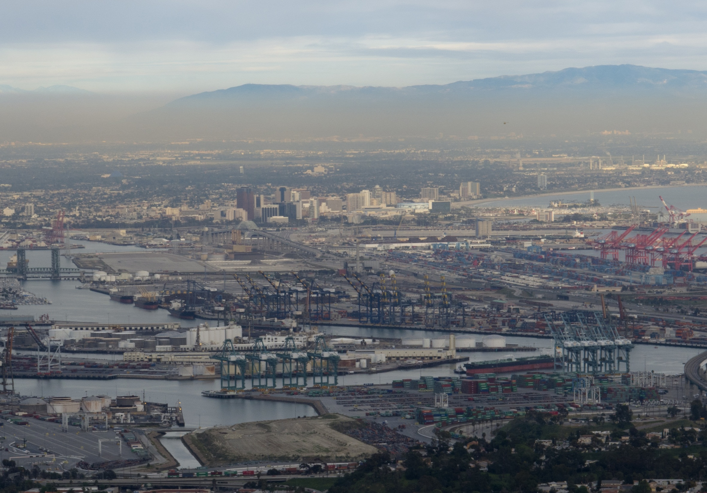
Notes:
Are we sustainable if we continue down the path built by our grandfathers in a different time and a different environment? I fear not.

Slide 12

Notes:
First we need to define sustainability as it relates to energy. (AB 32) directed the California Air Resources Board (ARB or Board) to begin developing discrete early actions to reduce greenhouse gases while also preparing a scoping plan to identify how best to reach the 2020 limit. Nothing is off limits and all aspects of the energy portfolio are placed center stage.

Slide 13
Notes:
Yet when all of the resources for renewables are considered many opportunities still exist. Opportunities in geothermal, Note the deep red zones where the greatest potential exist yet no site is identified or planned. Most of them in out of the way locations with no access to the grid……….really?

Slide 14
Notes:
Off shore wind potential .

Slide 15
Notes:
PV and solar thermal.

Slide 16
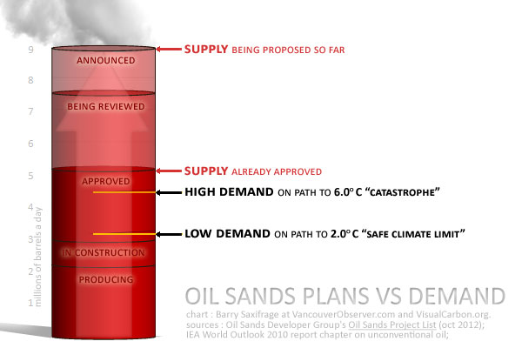
Notes:
Are we truly sustainable and can we afford to feed the demand for energy using the same old model. This chart from a recent BP study shows the impact to the global climate if we don’t realize the very fact that without a significant change we are not sustainable.

Slide 17

Notes:
Sustainability = not steal from future generations
This is why it’s important to me. These are two of my three grandchildren and I want them to live in a world that is as prosperous and full of opportunities that I grew up in. But again, truth is if we continue to move along the path we were provided by our grandparents that dream is less likely as every year passes.

Slide 18


Notes:
We aren’t sustainable given what we are facing [paint a picture]
Everyday we are faced with Increased plug load, every thing we do requires power, even our PEV adds an entire house load to the grid. Energy storage and storage technology lags, begging for a solution.
On top of that we are potentially facing the start of what some meteorologist believe could be a 100 year long drought. Bringing the water/energy nexus front and center. Energy to move potable water……

Slide 19

Notes:
What’s Working? Highlight the shining stars (case studies)
Solar/RE/EE are sustainable

Slide 20
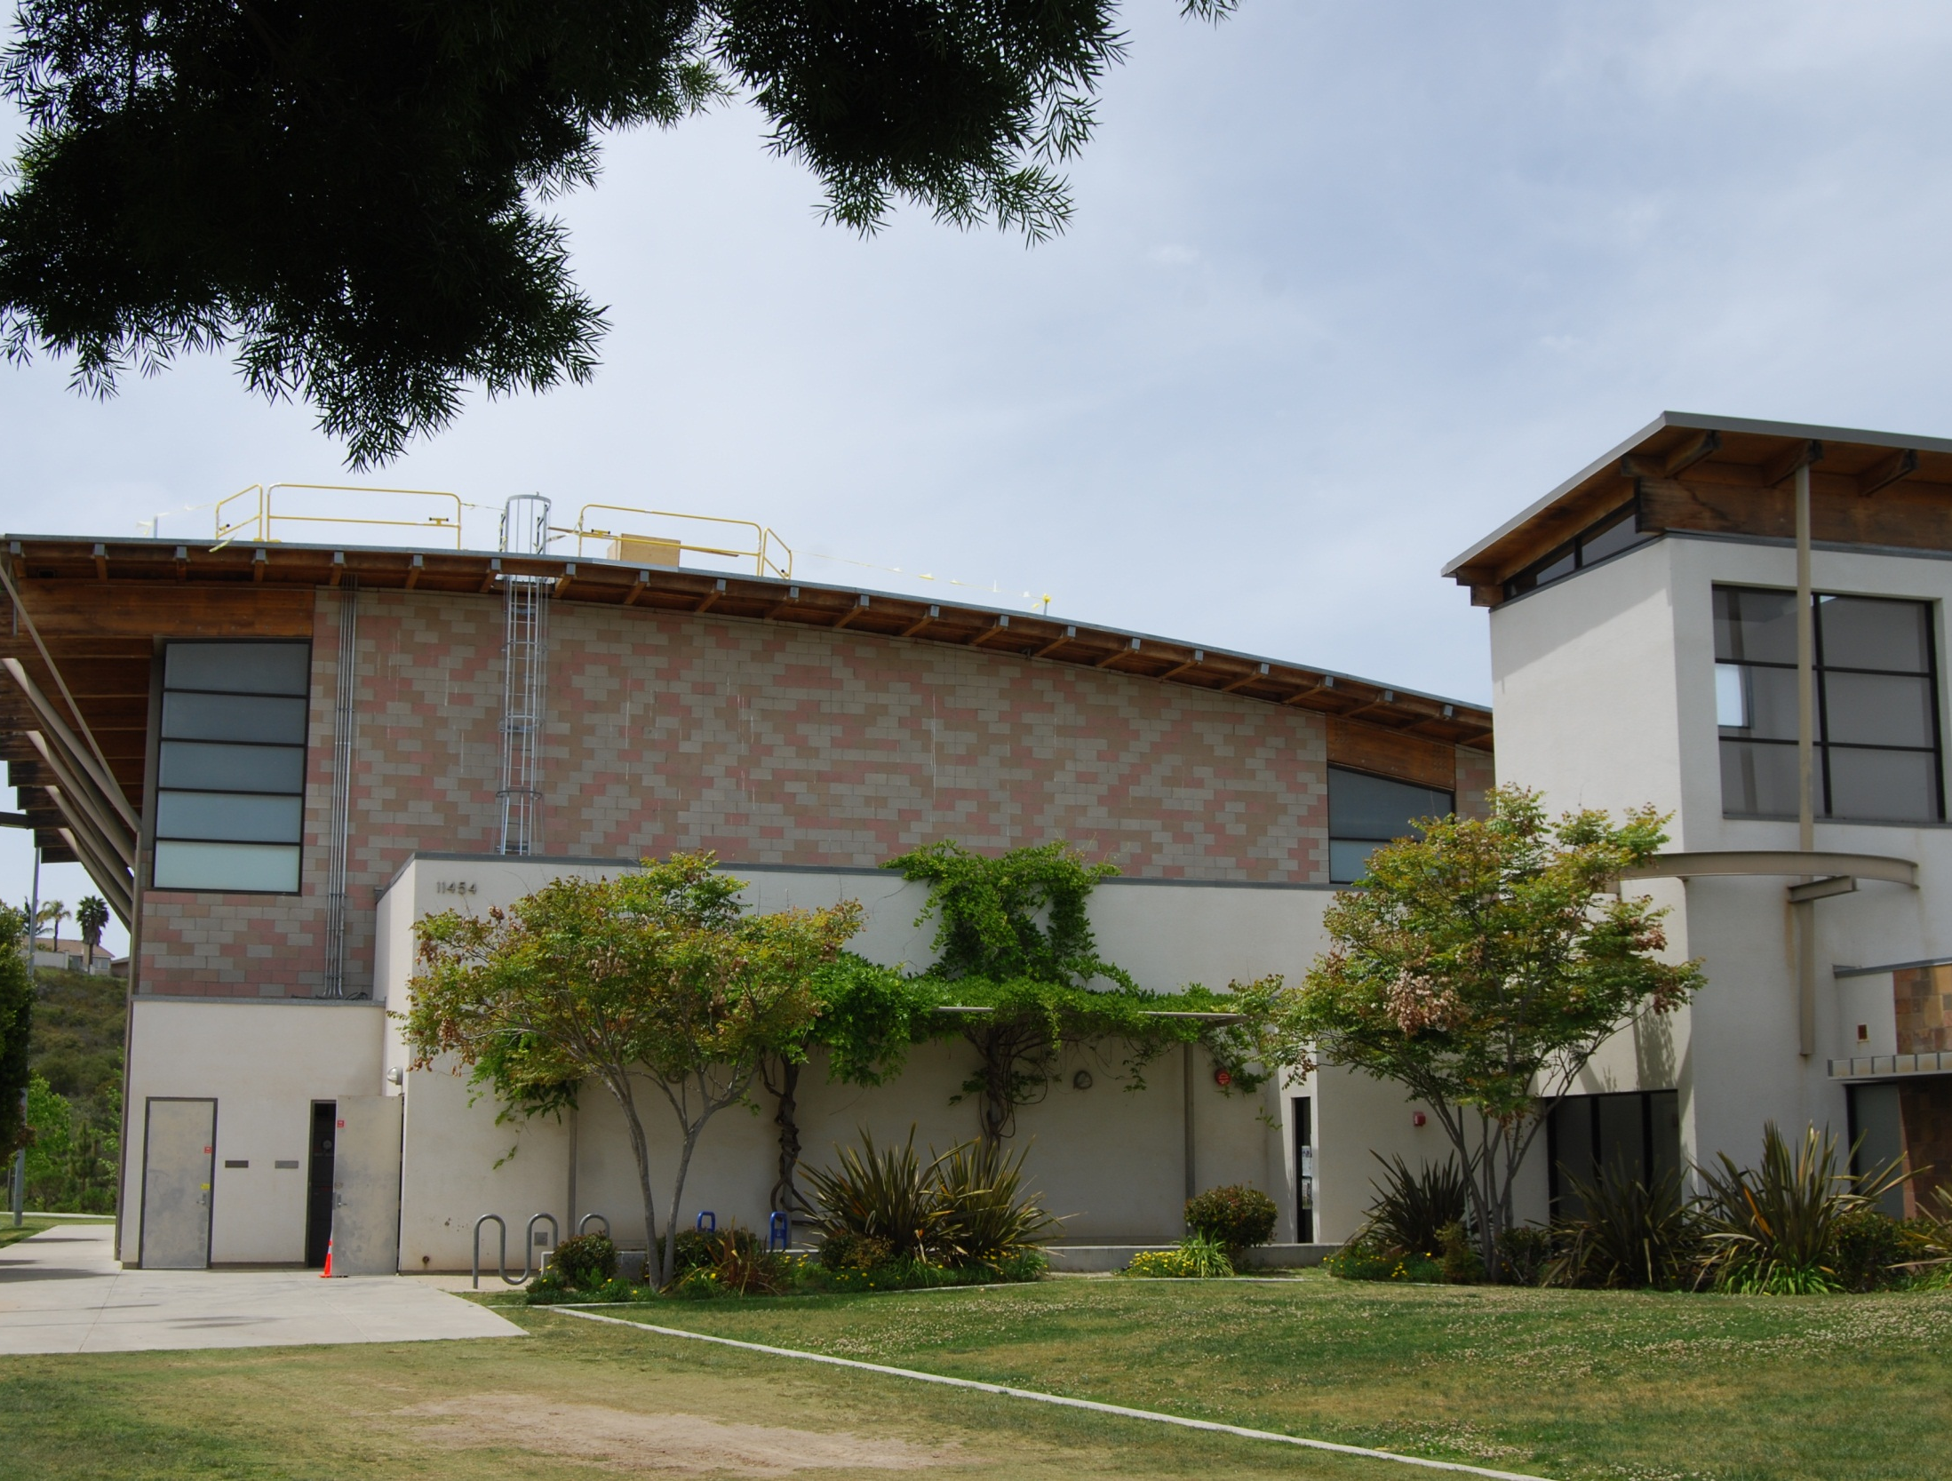
Scripps Ranch Community Recreation Center
Notes:
Some local examples – what we need more of
Scripps Ranch Community Recreation Center (3 slides)
Combines solar PV system with advanced energy storage. Put into service in September 2012.
System consists of a 30-kw solar array with a 100-kw lithium-ion battery energy storage bank.
During community emergencies, such as wildfires, the center can serve as an “island” command center for fire and police operations with its own power generation and storage.
In addition, the system is in daily operation, reducing the recreation center’s energy bill from $2,000 a month to near zero.
Funding for the $545,000 project came from a $345,000 grant from the California Public Utilities Commission and $200,000 from DOE as part of its Solar America Cities program. It also qualified for a $40,000 rebate from the California Solar Initiative issued by CCSE.
Among the first such projects in the nation to integrate solar with an innovative battery system of this size and scope.
It is a model for developing clean energy systems for ensuring reliable emergency services and communications during fires and other disasters not only locally, but in communities through California and the nation. The DOE has given high marks to the project for its ability to be replicated.

Slide 21
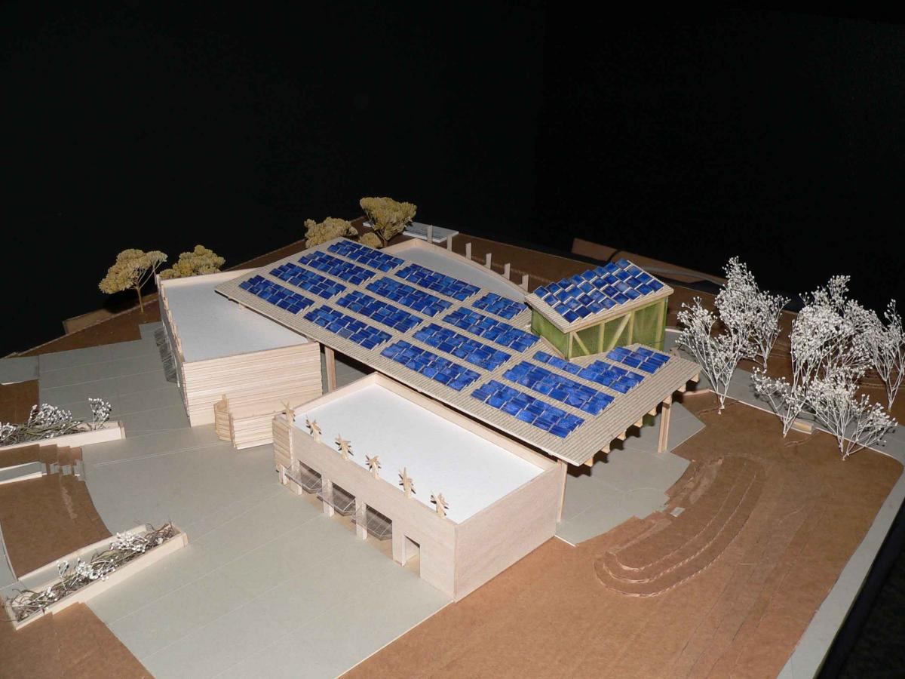
Notes:
Some local examples – what we need more of
Scripps Ranch emergency center – solar/AES

Slide 22
Notes:
Some local examples – what we need more of
Scripps Ranch emergency center – solar/AES

Slide 23
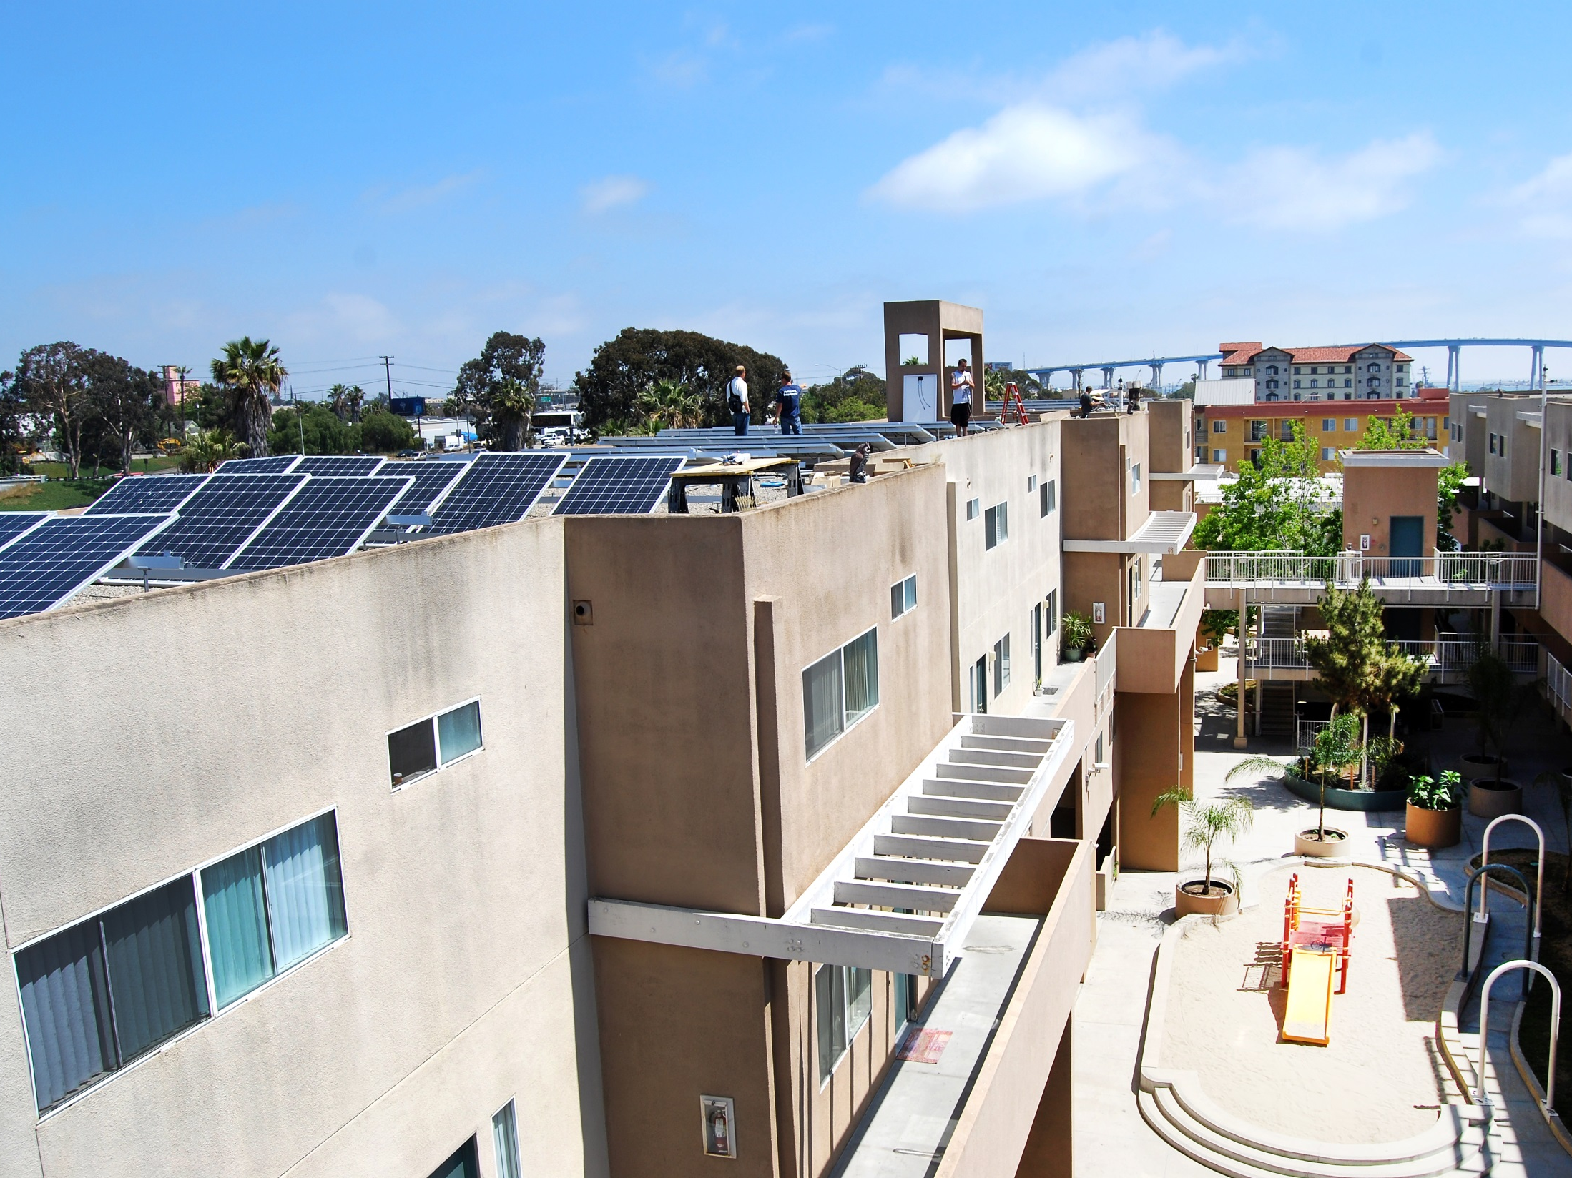
Hacienda Townhomes
Notes:
Some local examples – what we need more of . . .
Hacienda Townhomes (2 slides)
A 52-unit apartment building in San Diego’s East Village neighborhood with solar PV.
Owned and managed by the San Diego Community Housing Corporation, the townhomes are affordable housing units for low-income families.
A 19.8-kw PV system was the first installation in the San Diego region under the California Solar Initiative’s Multifamily Affordable Solar Housing program. It was dedicated during a press conference held July 2012.
The $112,000 project was built by Everyday Energy and received a $75,200 rebate from the MASH program.
Hacienda Townhomes was SDG&E’s first virtual net metering project, which allows the residents to share the solar benefits from one large solar system.

Slide 24
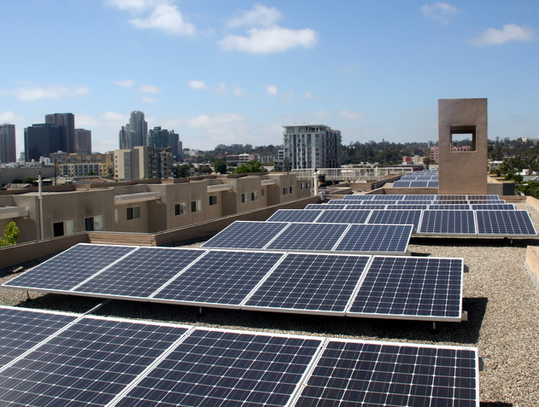
Notes:
Some local examples – what we need more of
Hacienda Townhomes - PV

Slide 25
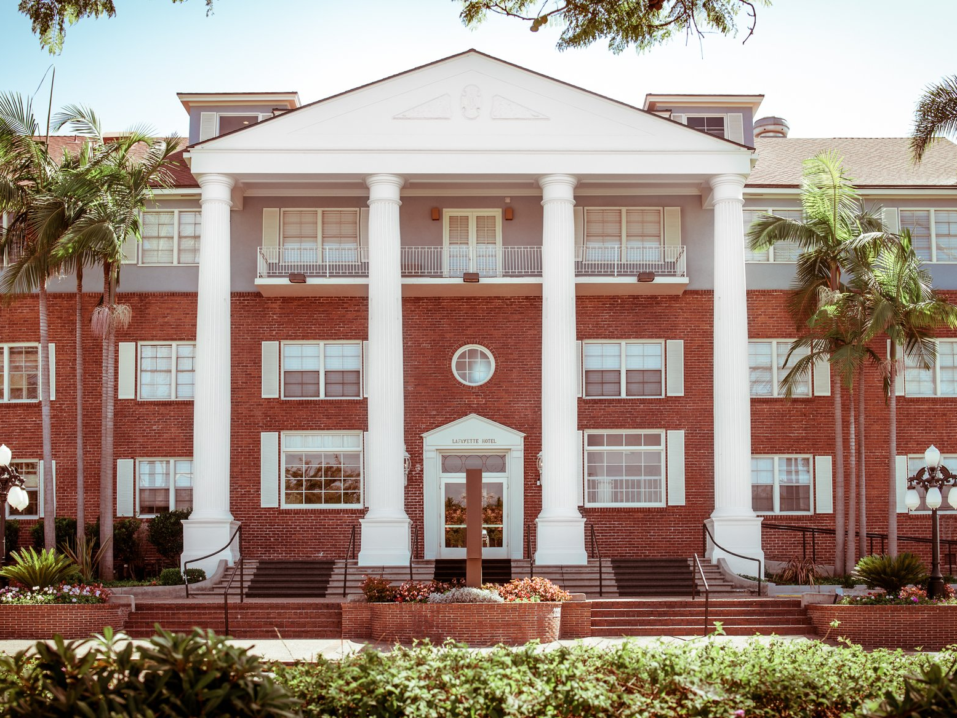
Lafayette Hotel
Notes:
Some local examples – what we need more of . . .
Lafayette Hotel (2 slides)
One of San Diego’s historic hotels upgraded with a fuel cell system that generates both heat and power.
During recent remodeling, the hotel’s owners decided the Lafayette Hotel, built in 1946, needed to incorporate sustainability within the overall project.
The solution was to install a 40-kw fuel cell energy system to generate power on site and to implement facility-wide energy efficiency.
The fuel cell provides 45% of the hotel’s electric energy needs for common areas and 131 guest rooms. In addition, as a byproduct, the cogeneration fuel cell system produces enough heat to help warm the hotel’s Olympic-size swimming pool.
The project resulted in an 80% annual energy savings, some $30,000 per year. Meaning the project will pay for itself in a little less than six years. They also reduced their greenhouse gas emission by more than 40%.

Slide 26
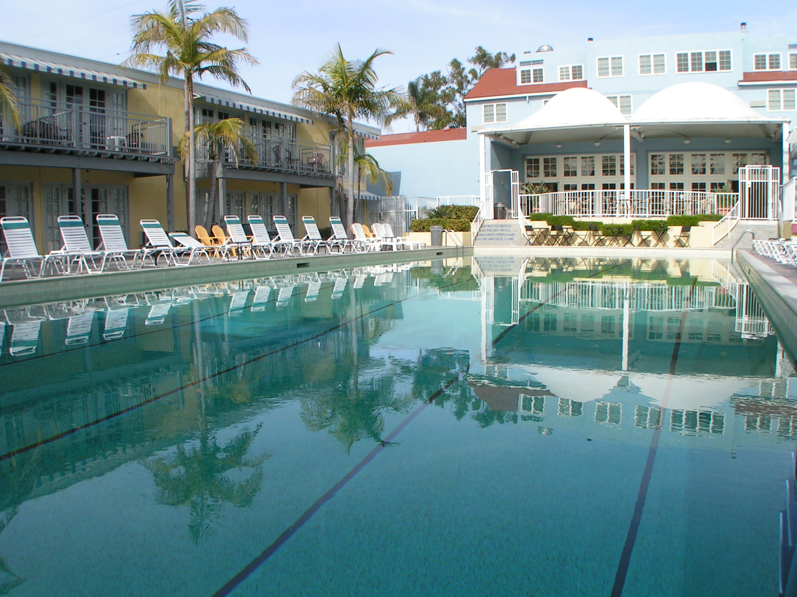
Notes:
Some local examples – what we need more of
Lafayette Hotel – fuel cell

Slide 27
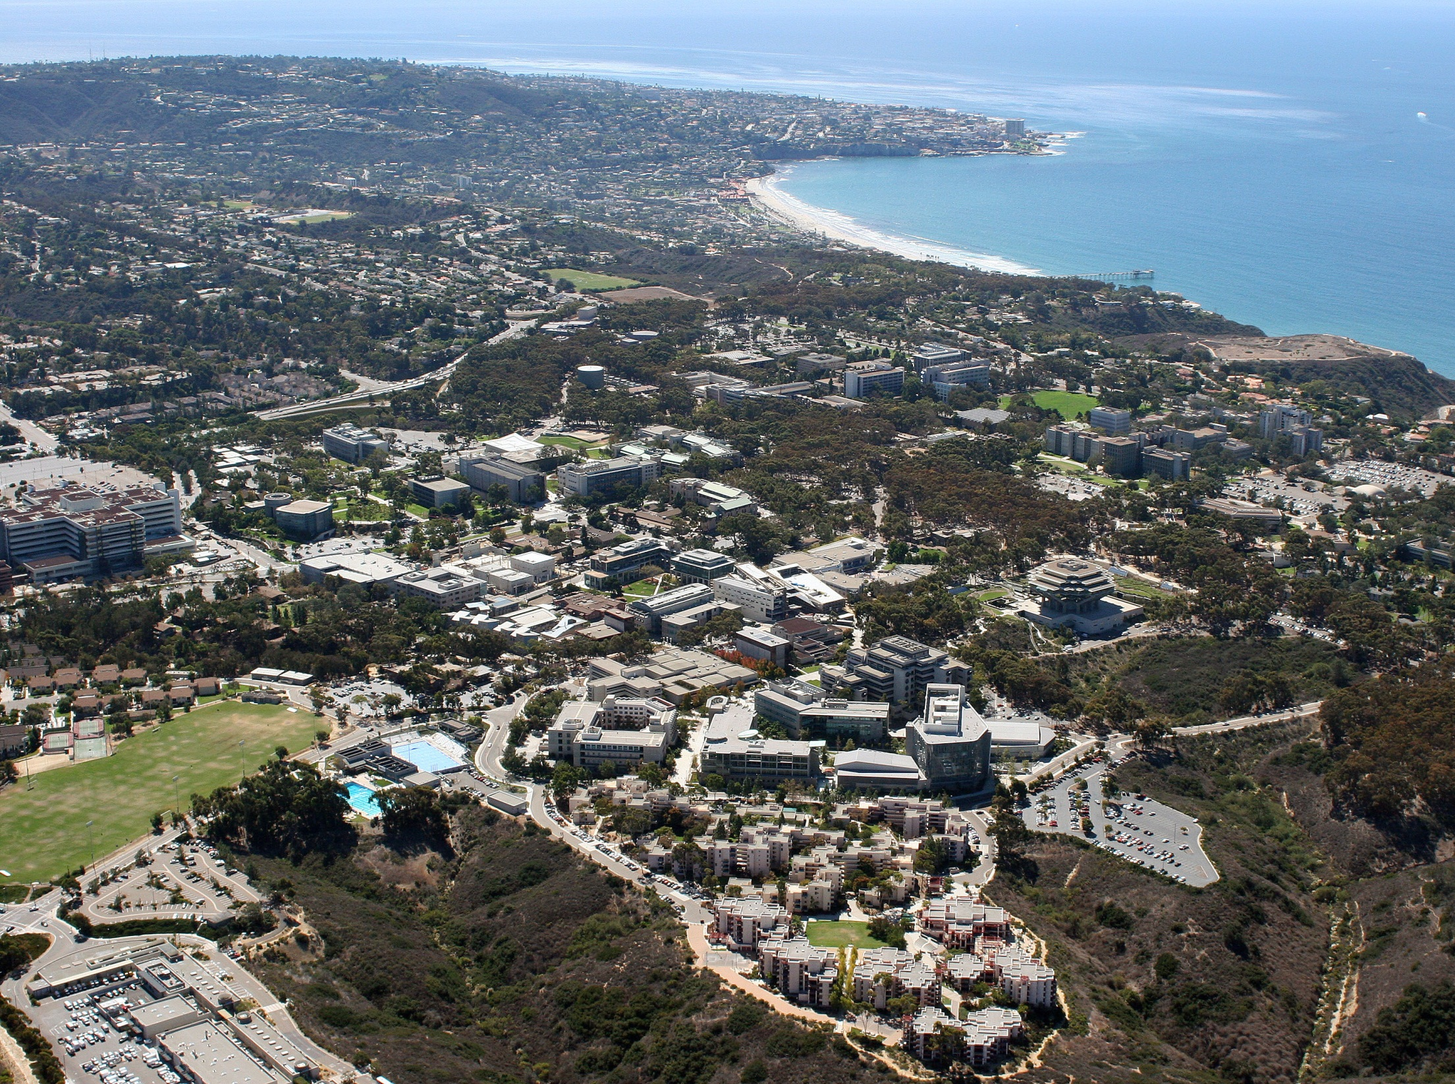
UCSD Microgrid
Notes:
Some local examples – what we need more of . . .
UCSD (2 slides)
Microgrid - to support demand management and integration of distributed generation into the local grid.
UCSD’s microgrid is one of the best examples of an electricity network that provides local control yet is interconnected with the larger electricity grid.
The central microgrid control allows operators to manage the diverse portfolio of energy generation and storage resources on the campus to minimize costs. In addition, the campus can “island” from the larger grid to maintain power supply in an emergency.
It includes a central cogeneration plant, an array of solar PV installations and a fuel cell that operates on natural gas reclaimed from a landfill site.
The microgrid provides the ability to manage 42 MW of generating capacity, across 1200 acres and powering more than 450 buildings.
In addition, UCSD is on track to having the largest, most diverse range of electric vehicle charging stations at any university in the world. The California Energy Commission recently approved funding of $220,500 to expand the campus’s burgeoning charging network for plug-in electric vehicles. By June this year, the university expects to have a total of 54 charging outlets, with more than 70% available for public use.
UCSD certainly is a living laboratory for our sustainable energy future.

Slide 28
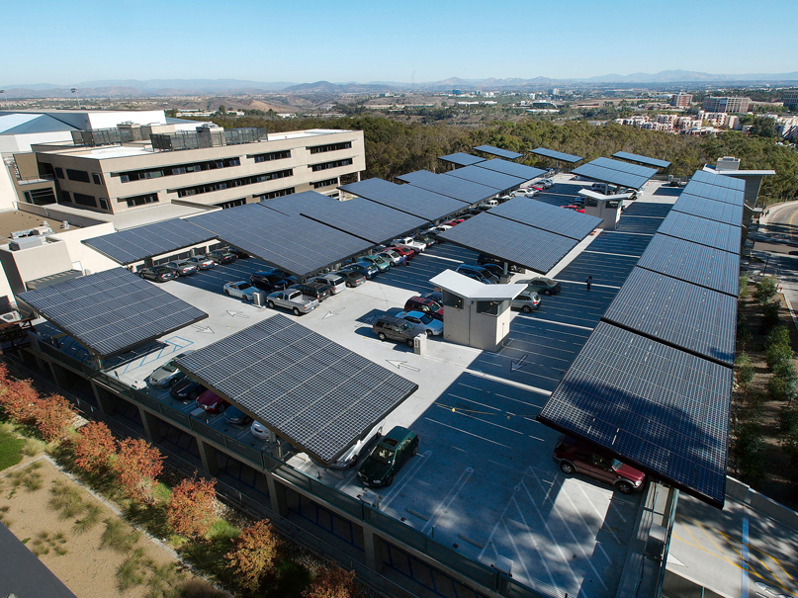
Notes:
Some local examples – what we need more of
UCSD - microgrid

Slide 29

Notes:
So what do we do?
AB 32 goals are achievable if we change the course of action

Slide 30
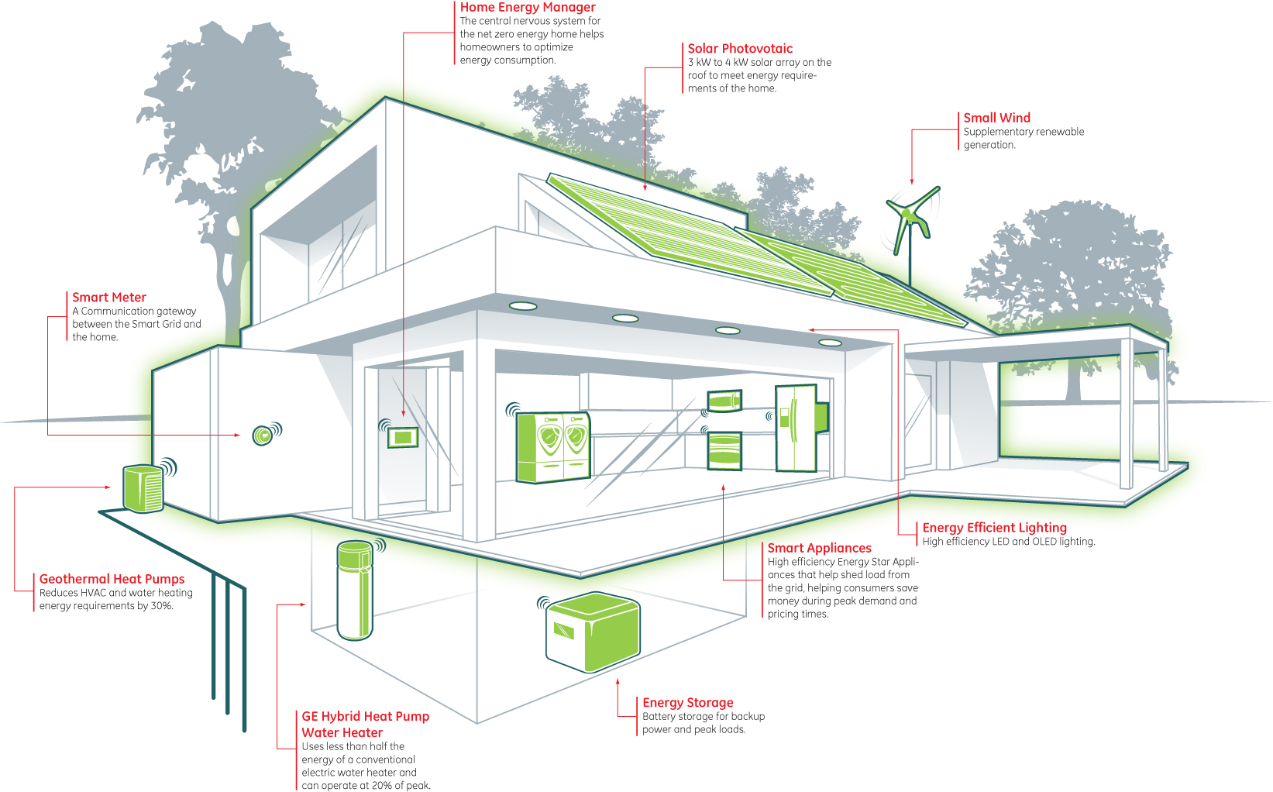
Notes:
Goal: zero net energy buildings and homes
How do we get to net zero? Through fuel cells, PV, geothermal or solar thermal, battery technology and storage
Smart communities, transportation, decrease demand
Hypothetical e.g. fuel cell in multifamily housing in East Lake (prefer real examples if possible, perhaps the new development Solara Apts)

Slide 31
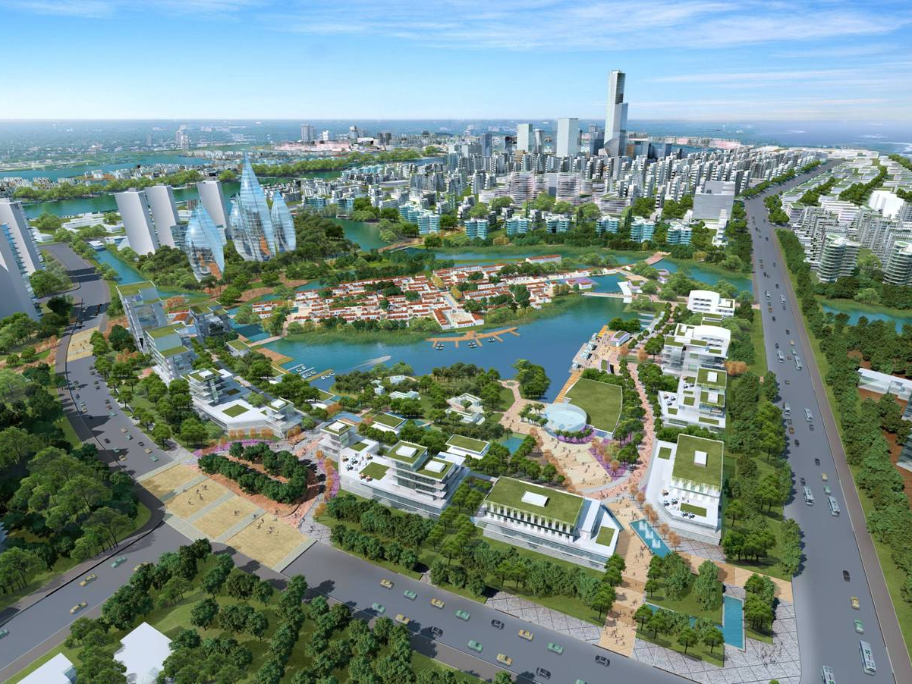

Slide 32
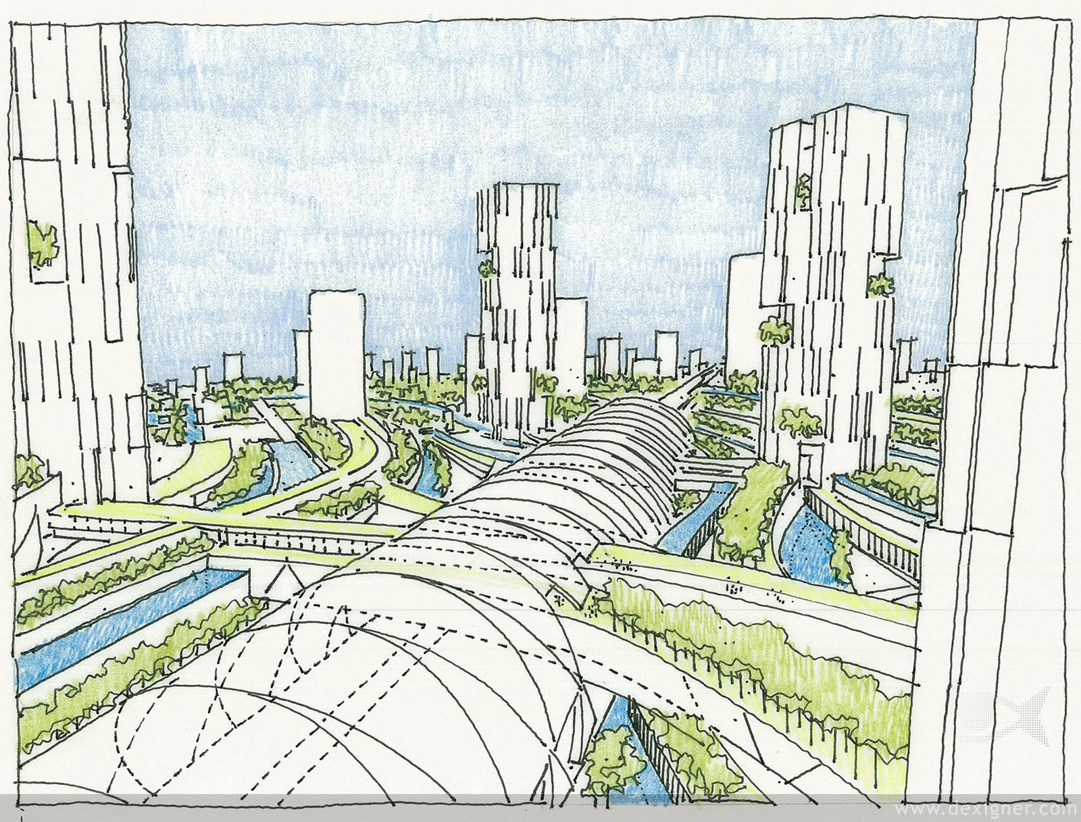

Slide 33

Notes:
We need to find new ways to move and commute, efficiently, effectively and more environmentally responsible.

Slide 34

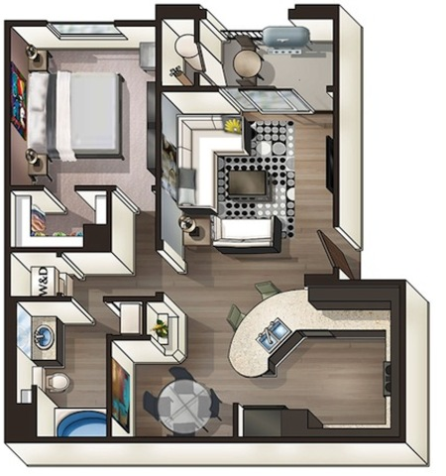

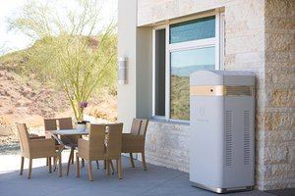

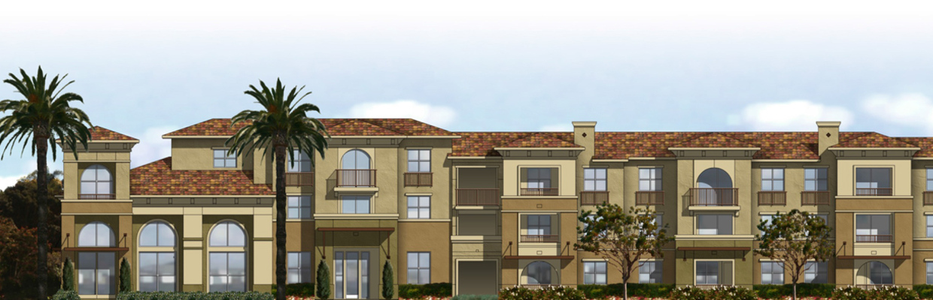
Notes:
fuel cell in multifamily housing in East Lake (prefer real examples if possible, perhaps the new development Solterra Apts)

Slide 35
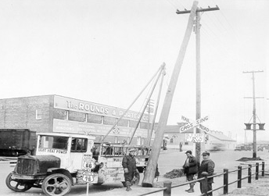
Notes:
We need to flip the 1920’s energy (utility profit) model on its head
The Utility model doesn’t work going forward . The model set up in the 20’-30’s is not sustainable.
In 1892 when JP Morgan formed General Electric, he declared “he would build a industry where every citizen would need his product every waking moment of everyday.”

Slide 36

SYSTEM CHANGE
AHEAD
Notes:
SO I guess the bottomline is there is hope, we need to work at it but more important for tonight's discussion is the old adage, What got us here won’t get us to where we want to go.

Slide 37
Thank You!
Contact Information
L. R. Hering, RADM, USN (ret)
Executive Director
California Center for Sustainable Energy
858.244.1177
www.energycenter.org

