Slide 1

Low Carbon Transportation: Policy, Planning and Alternative Fuel Implementation
SIM Center
August 12 2014
Nilmini Silva-Send

Slide 2
Low Carbon Transportation

Slide 3
Low Carbon Transportation
  Vehicles that use low carbon fuel
  B. Fuels that have low or no carbon
  C. Vehicles that emit nothing or very little in the tailpipe
  ZEV and LEVI, II, III, IV
  D. Vehicles that emit less than standard in the tailpipe
  Pavley I (AB1493) + federal CAFE
  E. Advanced Clean Cars

Slide 4
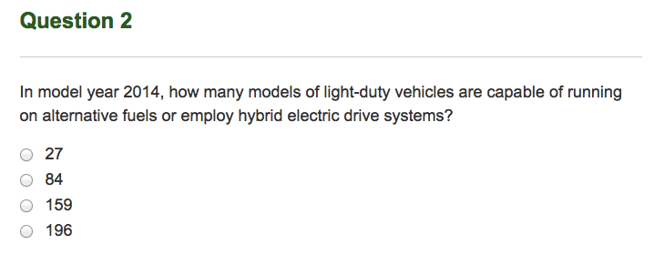
  A. Vehicles That Use Alternative Fuel

Slide 5
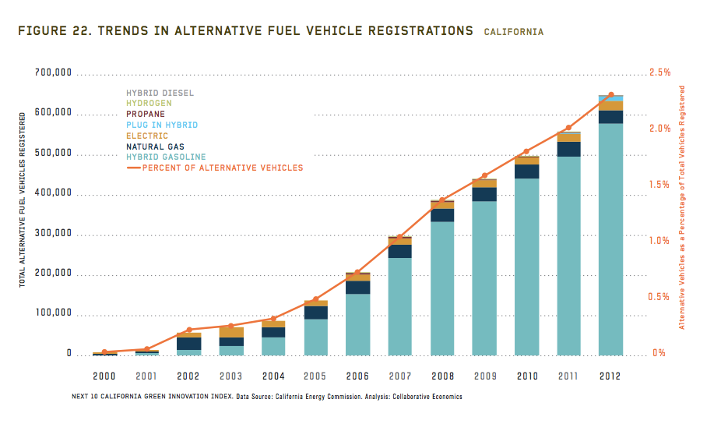
  A. Vehicles That Use Alternative Fuel

Slide 6
B. Alternative Fuels Sold
(LCFS data, CA)

Slide 7
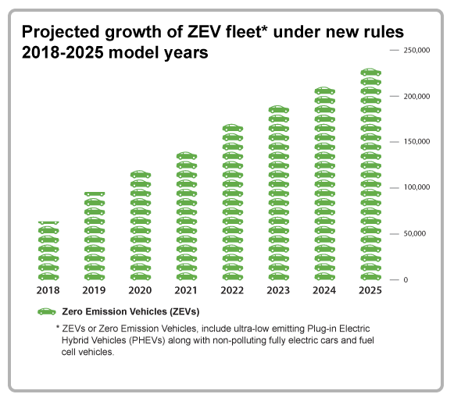
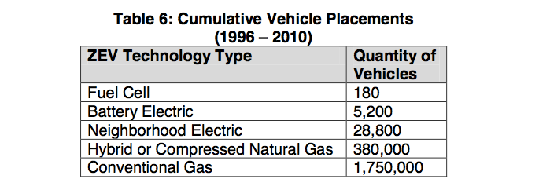
  C. Vehicles that emit nothing or very little (tailpipe)

Slide 8
  D. Vehicles that emit very little (tailpipe)
LEVs
LEV I
1981-2003 + 2% of 1998-2000 models (to 3750 lbs) be ZEVs; 5% 2001-2002, 10% for >2003
LEV II
2004 and up
All LDTs meet the same standards as passenger cars and <8,500 lbs is an LDT
Minimum % of LEV Iis
LEV III vehicles
must meet Pavley regulations 2006-2016 models and opt to meet 2017-2025 standards
LEV IV proposed
< 100 g/mile for >2025 models

Slide 9
  D. Vehicles that emit less than standard (tailpipe)
Pavley I (AB1493): tailpipe emissions standards (250 g/mile 2009-2016 models and 163 g/mile 2017-2025 models)
CAFE: tailpipe emissions and MPG standards 2017-2025 are combined (34.1 mpg/250 g/mile and 54.5 mpg/163 g/mile)

Slide 10
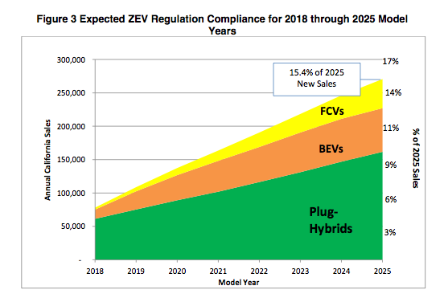
  D. Advanced Clean Cars Regulation Package
  = LEV + CAFE tailpipe standards + ZEVs and plug in hybrids to 15.4% of new sales by 2025 + Clean Fuels Outlet Regulation

Slide 11
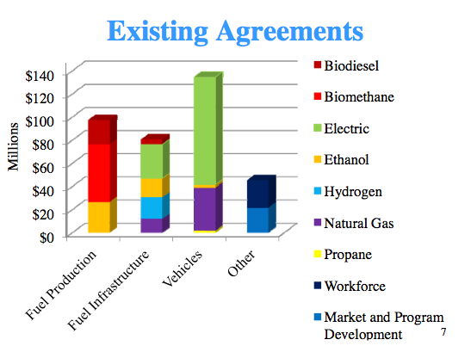
  Alternative and Renewable Fuel and Vehicle Technology
  Funding Summary 2009-2012 (CEC)

Slide 12
How Incorporated Into Climate Action Plans?

Slide 13
THANK YOU!
Nilmini Silva-Send
silvasend@sandiego.edu
619-260-2957

Slide 14


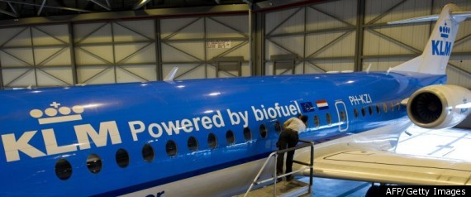
Ships and Planes
The U.S. navy goal: generate 50 percent of its energy from alternative sources by 2020: nuclear energy, electricity from renewable sources, and biofuels
Aviation has no alternative to liquid hydrocarbon fuels in the next decades

Slide 15
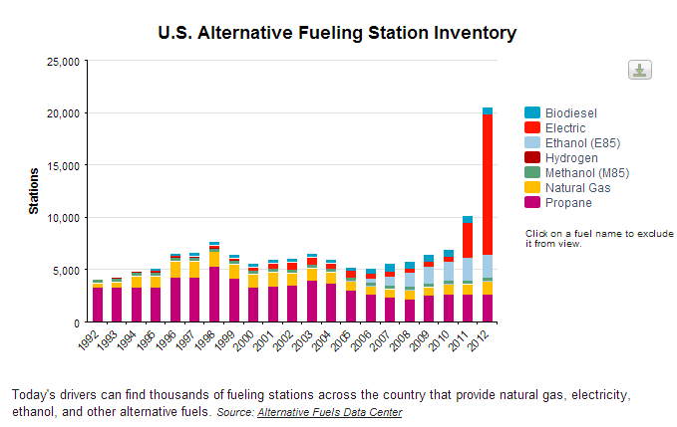
  US Alternative and Renewable Fueling Stations

Slide 16


