Slide 1
San Diego’s Water Supply
Is it Sustainable?
Presentation to the Green Scene
Public Utilities Department Briefing
Cathleen Pieroni, Principal Water Resources Specialist
January 10, 2013

Slide 2
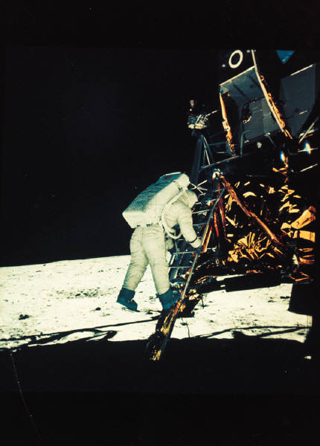
What does Water Supply Sustainability mean to San Diego?
Living within our water “means”?
Living within our water and energy “means”?
Having enough reliable water supplies to meet present and future water demands?
Minimal negative impacts to the environment?

Slide 3
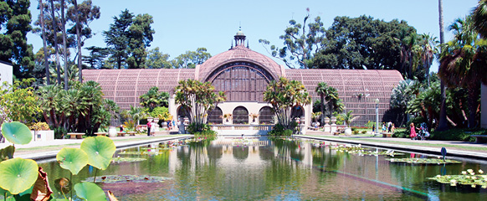

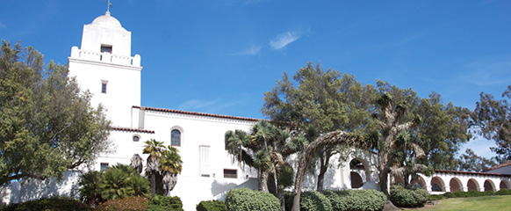
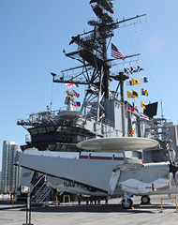

San Diego – America’s Finest City
Average of 267 days/year are mostly sunny
Semi arid or Mediterranean Climate
Average is less than 12 inches of rain annually
Wettest year was 1941 with 24.93 inches
Driest year was 1953 with 3.23 inches

Slide 4
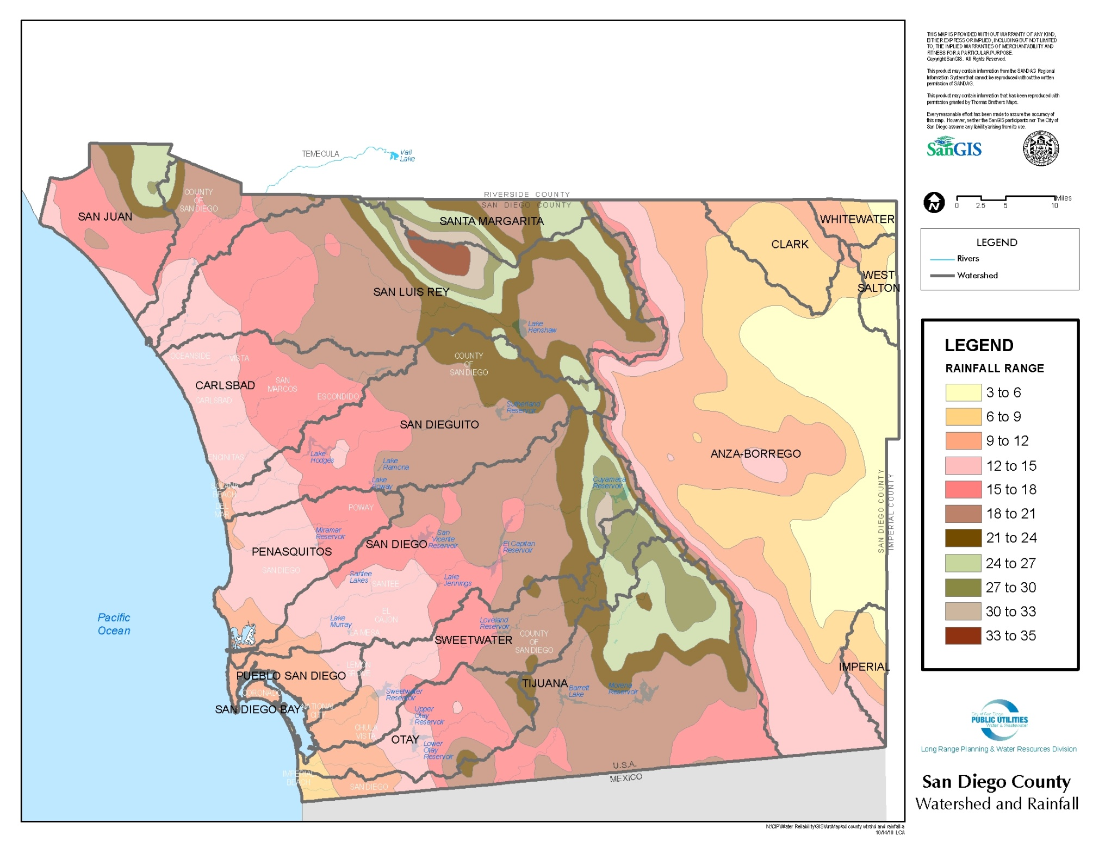
San Diego’s Limited Rainfall

Slide 5
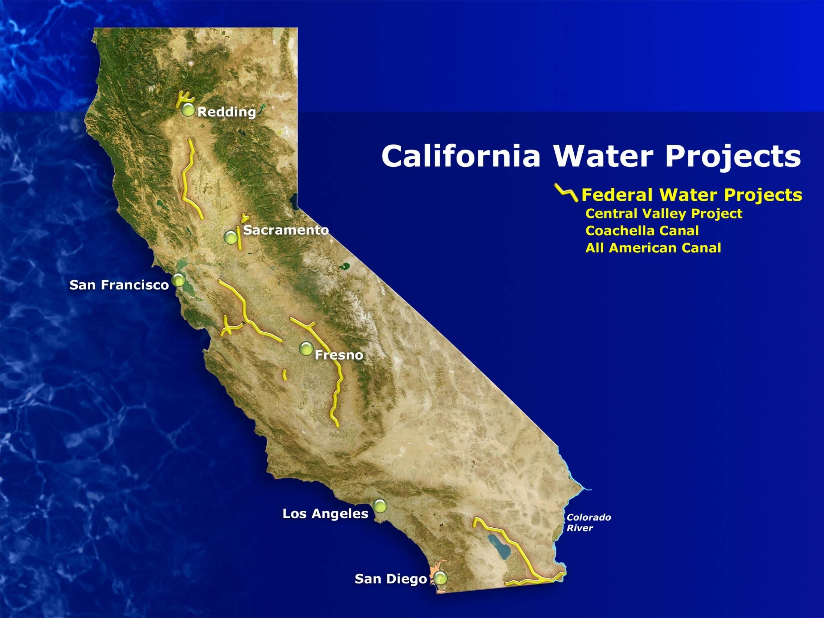
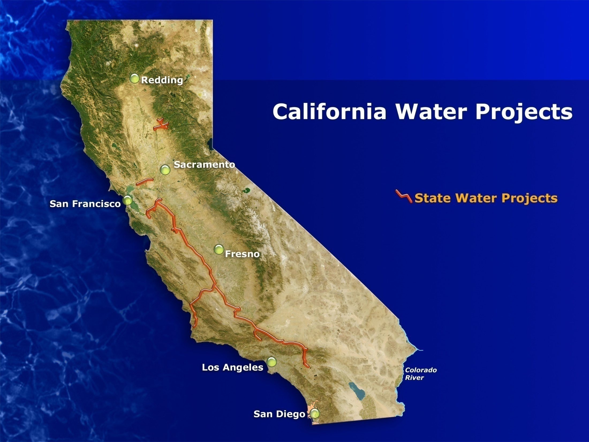
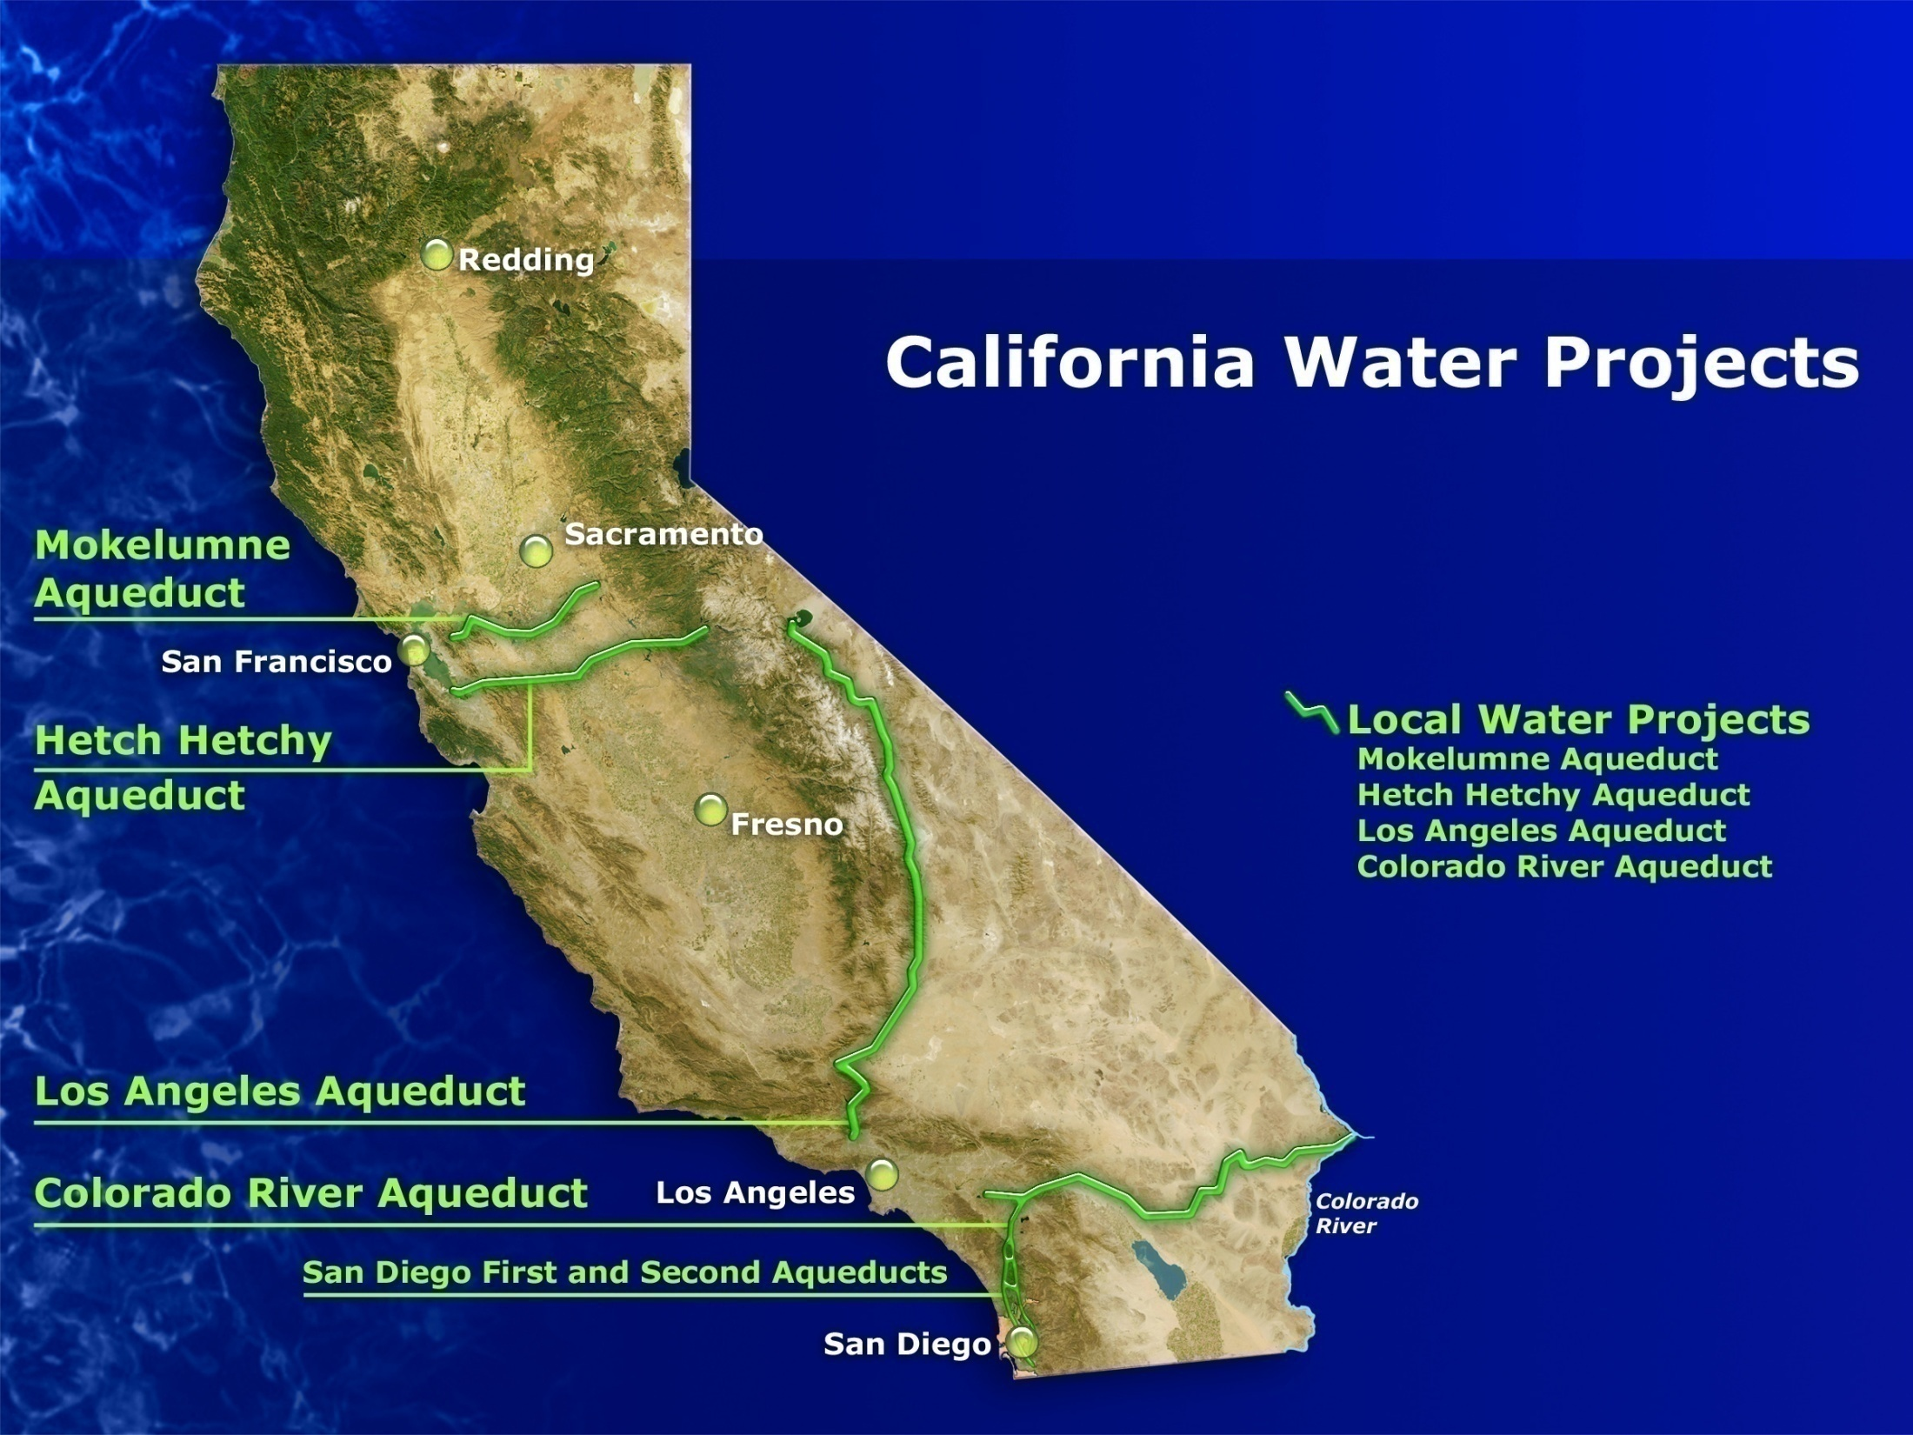
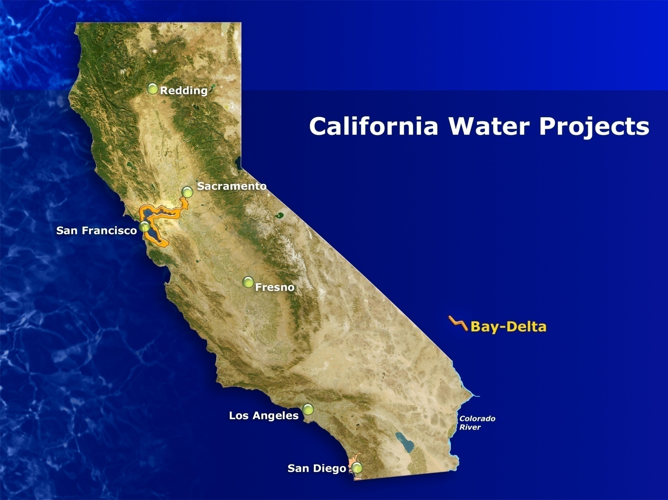
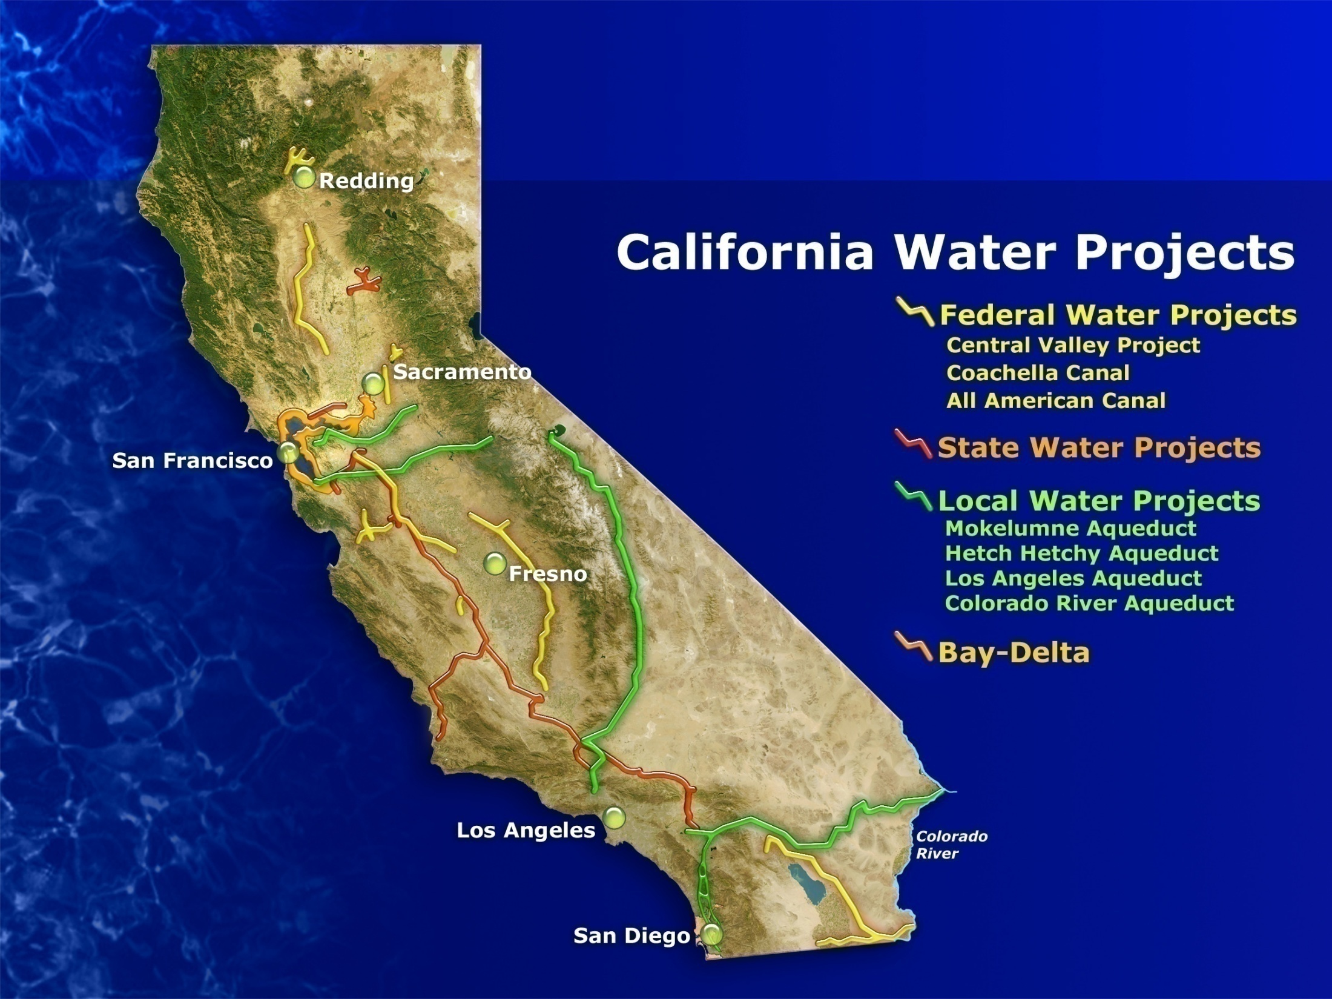
Notes:
Imported sources make up the vast majority of city water supplies. The City purchases this water from the San Diego County Water Authority which purchases the imported water from the Metropolitan Water District of Southern California. The mix of water from the Colorado River Aqueduct and the California Aqueduct varies yearly and is dependent on water supply conditions feeding these two aqueduct systems.
Imported water costs more than $187 million annually (FY10).
Largest line item in the department’s annual budget.
San Diego’s water system consists of reservoirs, drinking water treatment plants, more than 3,297 miles of pipeline, and 29 distribution reservoirs and standpipes throughout the city. As a result of this system we are able to deliver 210 million gallons a day (annual avg.) to 1.3 million people in a water service area of 404 square miles

Slide 6
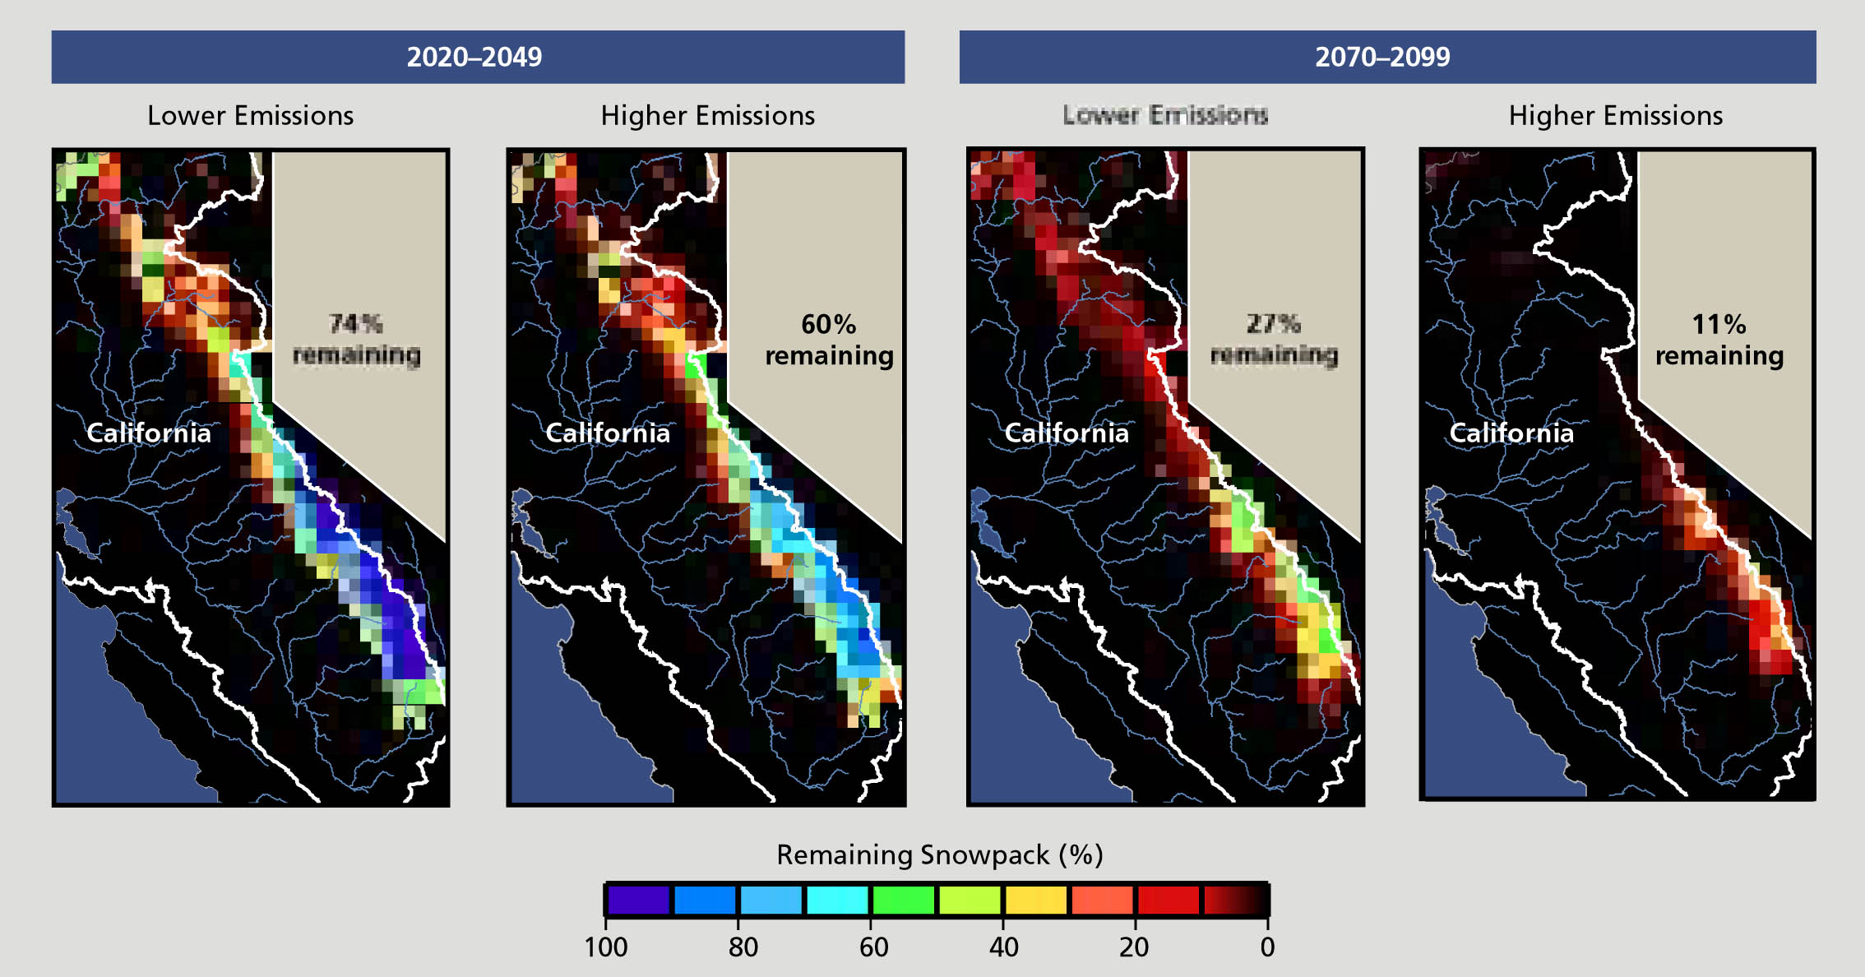
Diminishing Sierra Snowpack
% Remaining, Relative to 1961-1990
(Hanemann et al., 2004)

Slide 8
Living Within Our Water “Means”
City of San Diego’s Historic Direct Water Use Statistics
Population Growth

Slide 9
Living Within Our Water “Means”
City of San Diego’s Historic Direct Water Use Statistics

Slide 10
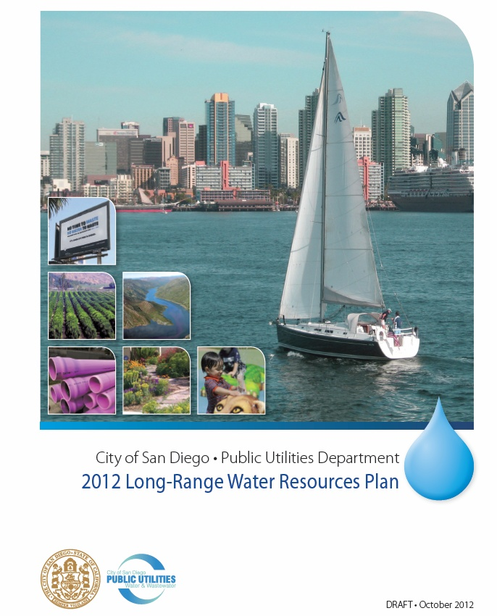
City of San Diego’s Long-Range
Water Resources Plan (2012)

Slide 11
Relation to Other Planning Work
LRWRP
Strategic planning
Conceptual analysis
Examines trade- offs between
alternatives
Develops overall targets for supply & demand-side programs
UWMP
Required by State every five years
Compares supplies and demands under normal & dry years
Summarizes conservation & drought management
Master Plans and Studies
Facilities plans for water & recycled water
Groundwater management plans & studies
CIP
Identified projects for near-term implementation
Detailed cost and schedule information

Slide 12
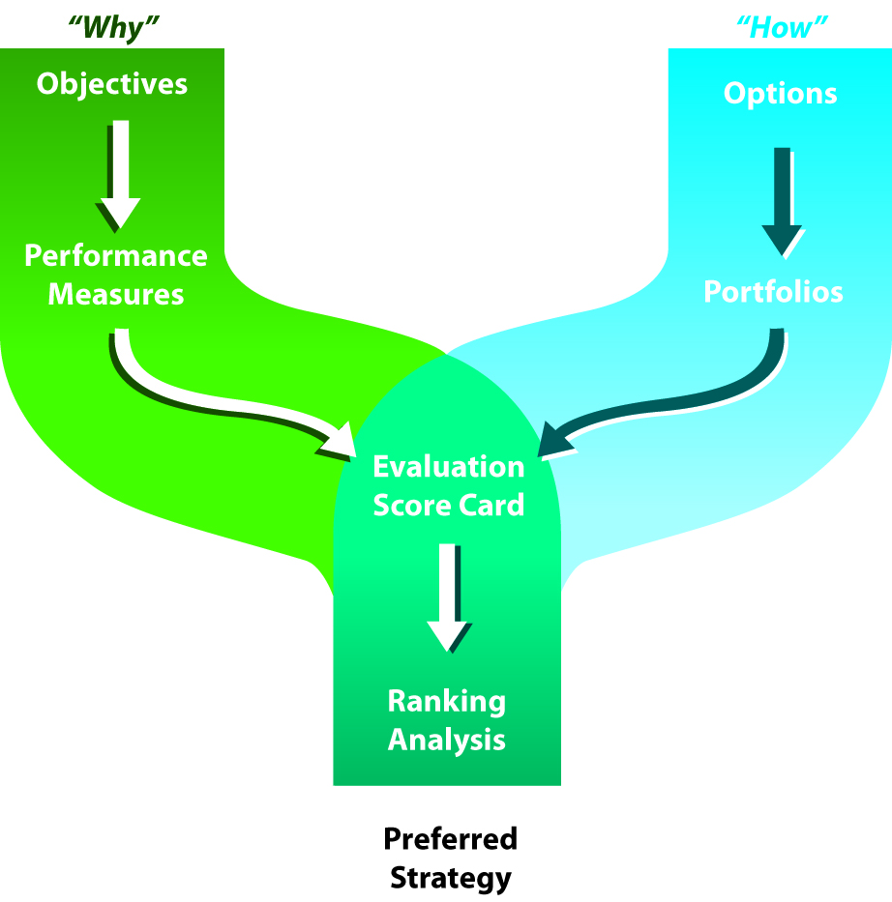
Long-Range
Water Resources Planning Process
Notes:
Here you can see as we moved along we different meetings accomplished different goals.
The “why” path devoted to defining the major goals of the 2012 LRWRP
The “how” path identifies the various options and strategies that can be selected for achieving the objectives stated in the “why” path.

Slide 13
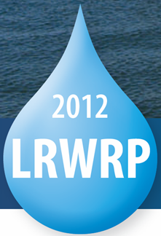
What is the 2012 LRWRP?
High-level strategy for City’s water resources
Evaluates water supply and demand-side options against multiple planning objectives
Takes a long-range viewpoint, through year 2035
Addresses risk and uncertainty
of future conditions

Slide 14
Projected 2035 Supply Mix
Under Critically Dry Conditions
Notes:
Finally as a example you can see here for the year 2035 for how the Hybrid #2 portfolio can help us achieve our water reliability goals.
So, that if we did nothing at all there is a possibility of being short water….
---Implementing the near-term options helps off-set some of the potential shortage…
----while enabling all of the hybrid # 2 options will negate any potential shortages.
These shortages are a result of imported water uncertainty and reductions in local supplies..… which mainly center around MWD’s rate structure, wheeling and drought allocation (where MWD and SDCWA disagree on many of these issues)

Slide 15
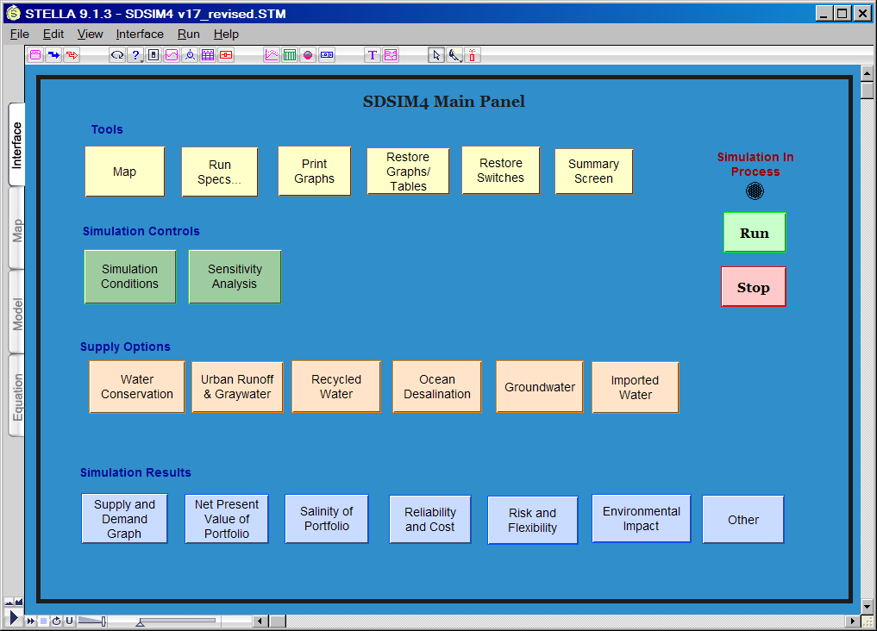
2012 LRWRP Planning Process
An open, participatory planning
Stakeholder driven process
The evaluation process relied on
  engineering expertise
  past technical studies
  water demand
  forecasting
  simulation models &
  decision tools

Slide 16
Stakeholders
Don Billings
Independent Rates Oversight Committee
Gordon Hess, P.E.
San Diego Regional Chamber of Commerce
Sean Karafin
San Diego County Taxpayers Association
Mike McSweeney
Building Industry Association of San Diego
Jim Peugh
Independent Rates Oversight Committee
Glen Schmidt
Schmidt Design Group, Inc.
Irene Stallard-Rodriguez
Independent Rates Oversight Committee
Yen Tu
City-10 Representative
Gail Welch
Independent Rates Oversight Committee
Daniel Wery
San Diego Section of the American Planning Association
Jill Witkowski
San Diego Coastkeeper
Notes:
we had four members of IROC, business, financial, planning and environmental interests and representatives……..a diverse group.

Slide 17
2012 LRWRP Objectives
(defined in Stakeholder Meeting #1)

Slide 18
Evaluate Portfolios

Slide 19
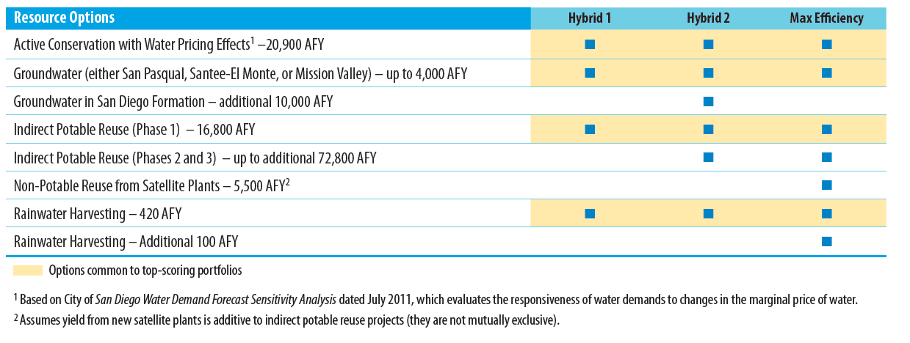
Common Elements in Top Portfolios
(Stakeholder Committee Meeting #3 & #4)

Slide 20
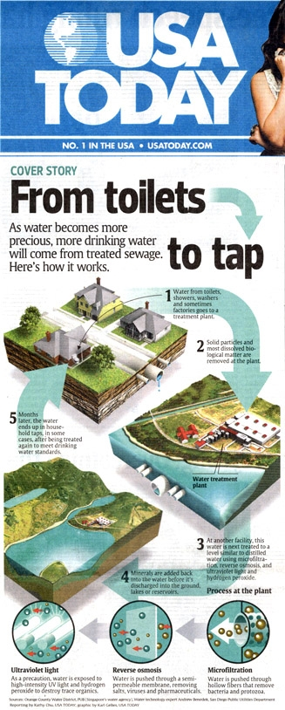
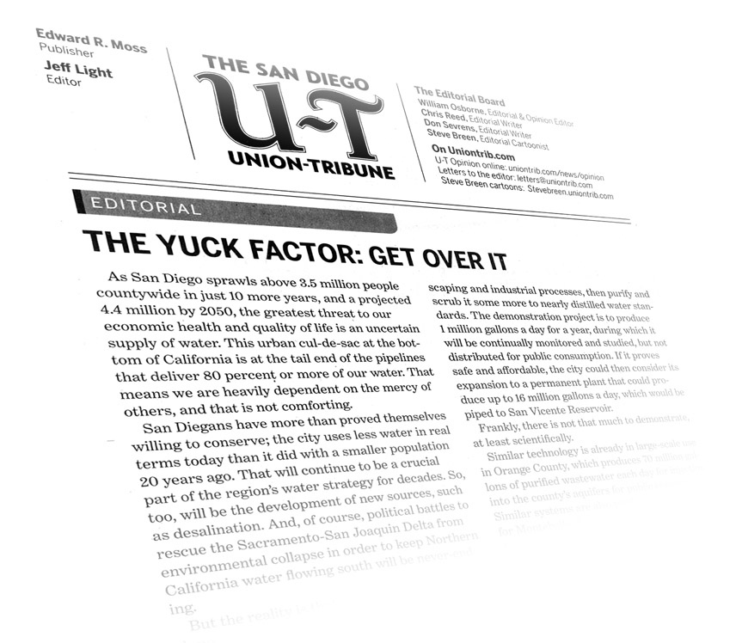
San Diego’s Potential New Local Supply: Water Purification

Slide 21
Upstream Wastewater Discharges
www.purewatersd.org
Notes:
Currently there are 346 dischargers putting treated wastewater into the Colorado River and the State Water project which provide San Diego’s water supply
Some people would determine this fact to mean “we are already drinking treated wastewater.”
The advanced water purification process will improve the quality of current water supply.
This technology can provide us a safe, reliable and local water supply.
For the Central Valley [watersheds of the Sacramento River, San Joaquin River, and other rivers tributary to the Bay Delta]
93 municipal discharges totaling 1027 MGD (~1.15 million acre feet per year)
For the Colorado Basin [entire Colorado River Watershed upstream of MWD’s intakes at Lake Havasu]
253 municipal discharges totaling 493 MGD (~0.55 million acre-ft per year)
So, combined, there are 346 municipal wastewater discharges, totaling 1.5 billion gallons per day, into our imported water sources. That works out to about 1.7 million acre feet per year. Please note that these numbers are design capacity of the plants.
Map Sources:
United States Environmental Protection Agency
California Department of Water Resources
Colorado River Basin Salinity Control Forum

Slide 22
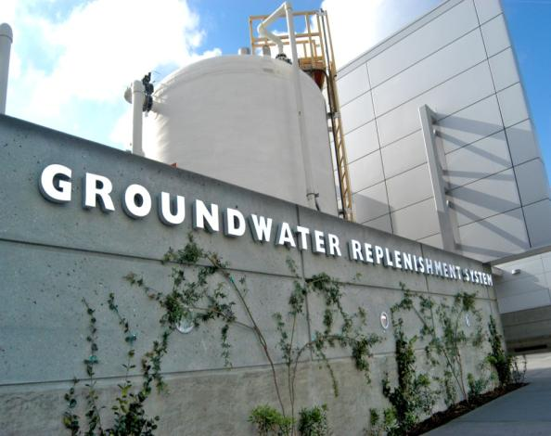

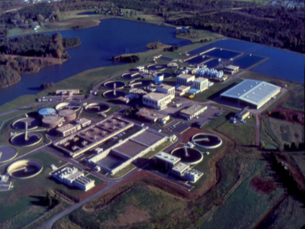
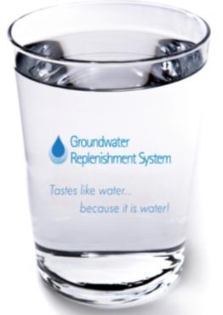
Water Purification: a proven technology
Orange County, California, 2008
Fairfax County, Virginia, 1982
www.purewatersd.org
Notes:
Currently advanced water purification technology is being used successfully in Southern California and Fairfax County, Virginia.
OCWD’s Groundwater Replenishment System uses the same advanced water purification process being examined by the Demonstration Project to supply a safe and reliable water source to nearly 600,000 residents.
Orange County Sanitation District Groundwater Replenishment System facility is being expanded to produce another 30 MGD of purified water....total capacity, after completion in 2014, is 100 MGD or 103,000 AFY, enough water for 850,000 people.
Recycled water is used to supplement a drinking water open lake reservoir in Fairfax County, Virginia. The Upper Occoquan Reservoir project has been in place for almost 30 years (about 1982).
The Upper Occoquan Sewage Authority's effluent supplies 20 percent of the inflow into the Occoquan Reservoir, which gives the residents of Fairfax County, Virginia, their drinking water. In droughts, it can supply 80 percent, and the sewage authority maintains that its highly treated effluent is cleaner than most water sources that end up in the reservoir.
A key benefit of this opportunity is it allows for storage of large amounts of recycled water that might be produced in winter when irrigation demands are low.
In 1978, the UOSA (Upper Occoquan Service Authority) Regional Water Reclamation Plant, began operation.
Through several expansions, the initial ten million gallons per day (mgd) capacity of UOSA was increased to 32 mgd, and a major expansion to 54 mgd was recently completed.

Slide 23
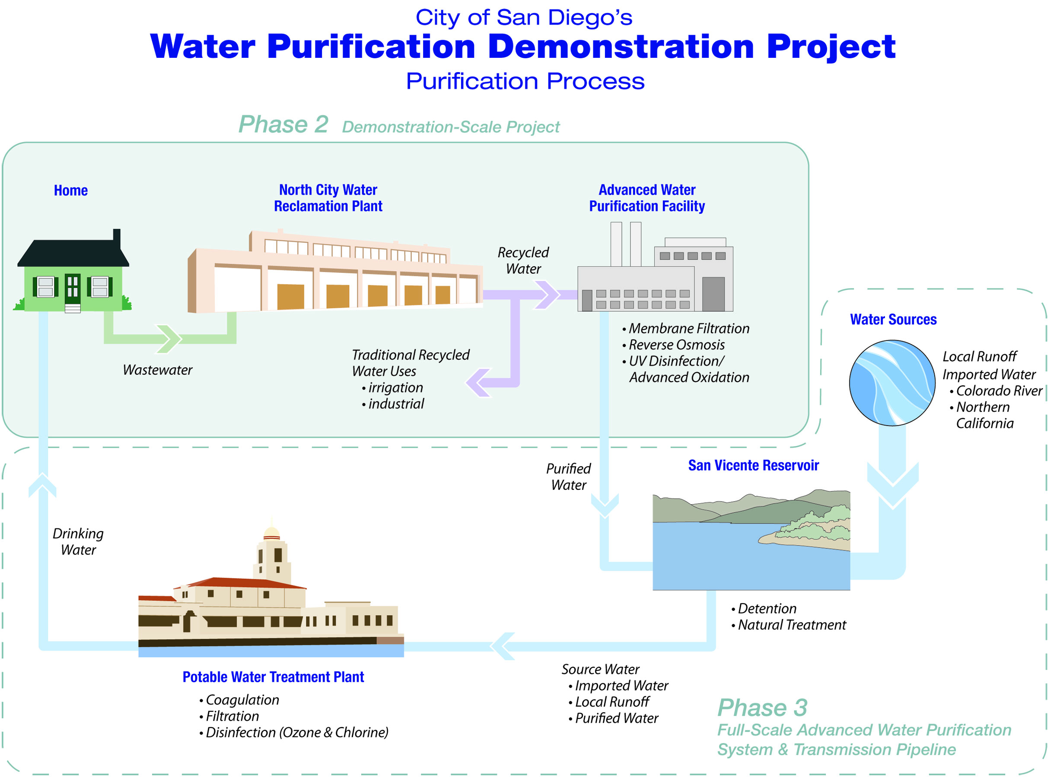
www.purewatersd.org
Notes:
The WPDP is examining and testing a process which can take wastewater from your home and put it through multiple steps of purification to supply safe, reliable and sustainable drinking water to your tap.
The process involves sending highly treated recycled wastewater to an advanced purification facility where it is purified to remove all contaminants and harmful substances.
If Reservoir Augmentation is approved, the purified water produced form this process can be sent to a local reservoir where it would blend with existing “raw” water supplies that would eventually be treated like all drinking water to meet State and Federal health and safety standards at a drinking water treatment plant.

Slide 24

A look inside…
The Water Purification Process
Notes:
This animation will show you how the technology works inside the equipment that you will see outside.
Membrane-filtration: Barrier One
Wastewater is first sucked up into thousands of tiny straws (no wider than three hundredths the thickness of a human hair) which help separate out bacteria.
This step improves the performance of the reverse osmosis process by eliminating bacteria, protozoa and suspended particles.
The Demonstration project is testing 2 types of membrane filtration to determine which is most effective: Ultra-filtration and Micro-filtration to determine which works best for the purposes of the WPDP.
Reverse Osmosis: Barrier Two
a process where intense pressure is used to force the molecules through a sheet of plastic.
Also used by bottled water companies and for seawater desalination.
Reverse osmosis removes viruses, pesticides, and dissolved organics and salts. The water is similar to distilled water quality.
NOTE: 99+% removal of dissolved organics and approximately 99.99% removal for the protozoa, bacteria, and virus. (source: Bill Pearce)
Ultraviolet Light / Advanced Oxidation: Barrier three
This process destroys any contaminants that may be remaining in the water following the first two steps (Microfiltration & RO).
The UV light, at an intensity 40 times that typically used for water disinfection, breaks up remaining organic molecules. The hydrogen peroxide oxidizes remnants of broken molecules.
Ultraviolet light is used to disinfect medical and dental instruments and hydrogen peroxide is a common skin disinfectant.
The entire process ensures that not even the tiniest bacterium, virus, or chemical can survive.
This is the same 3 step AWT process used in Orange County’s Groundwater Replenishment System.

Slide 25
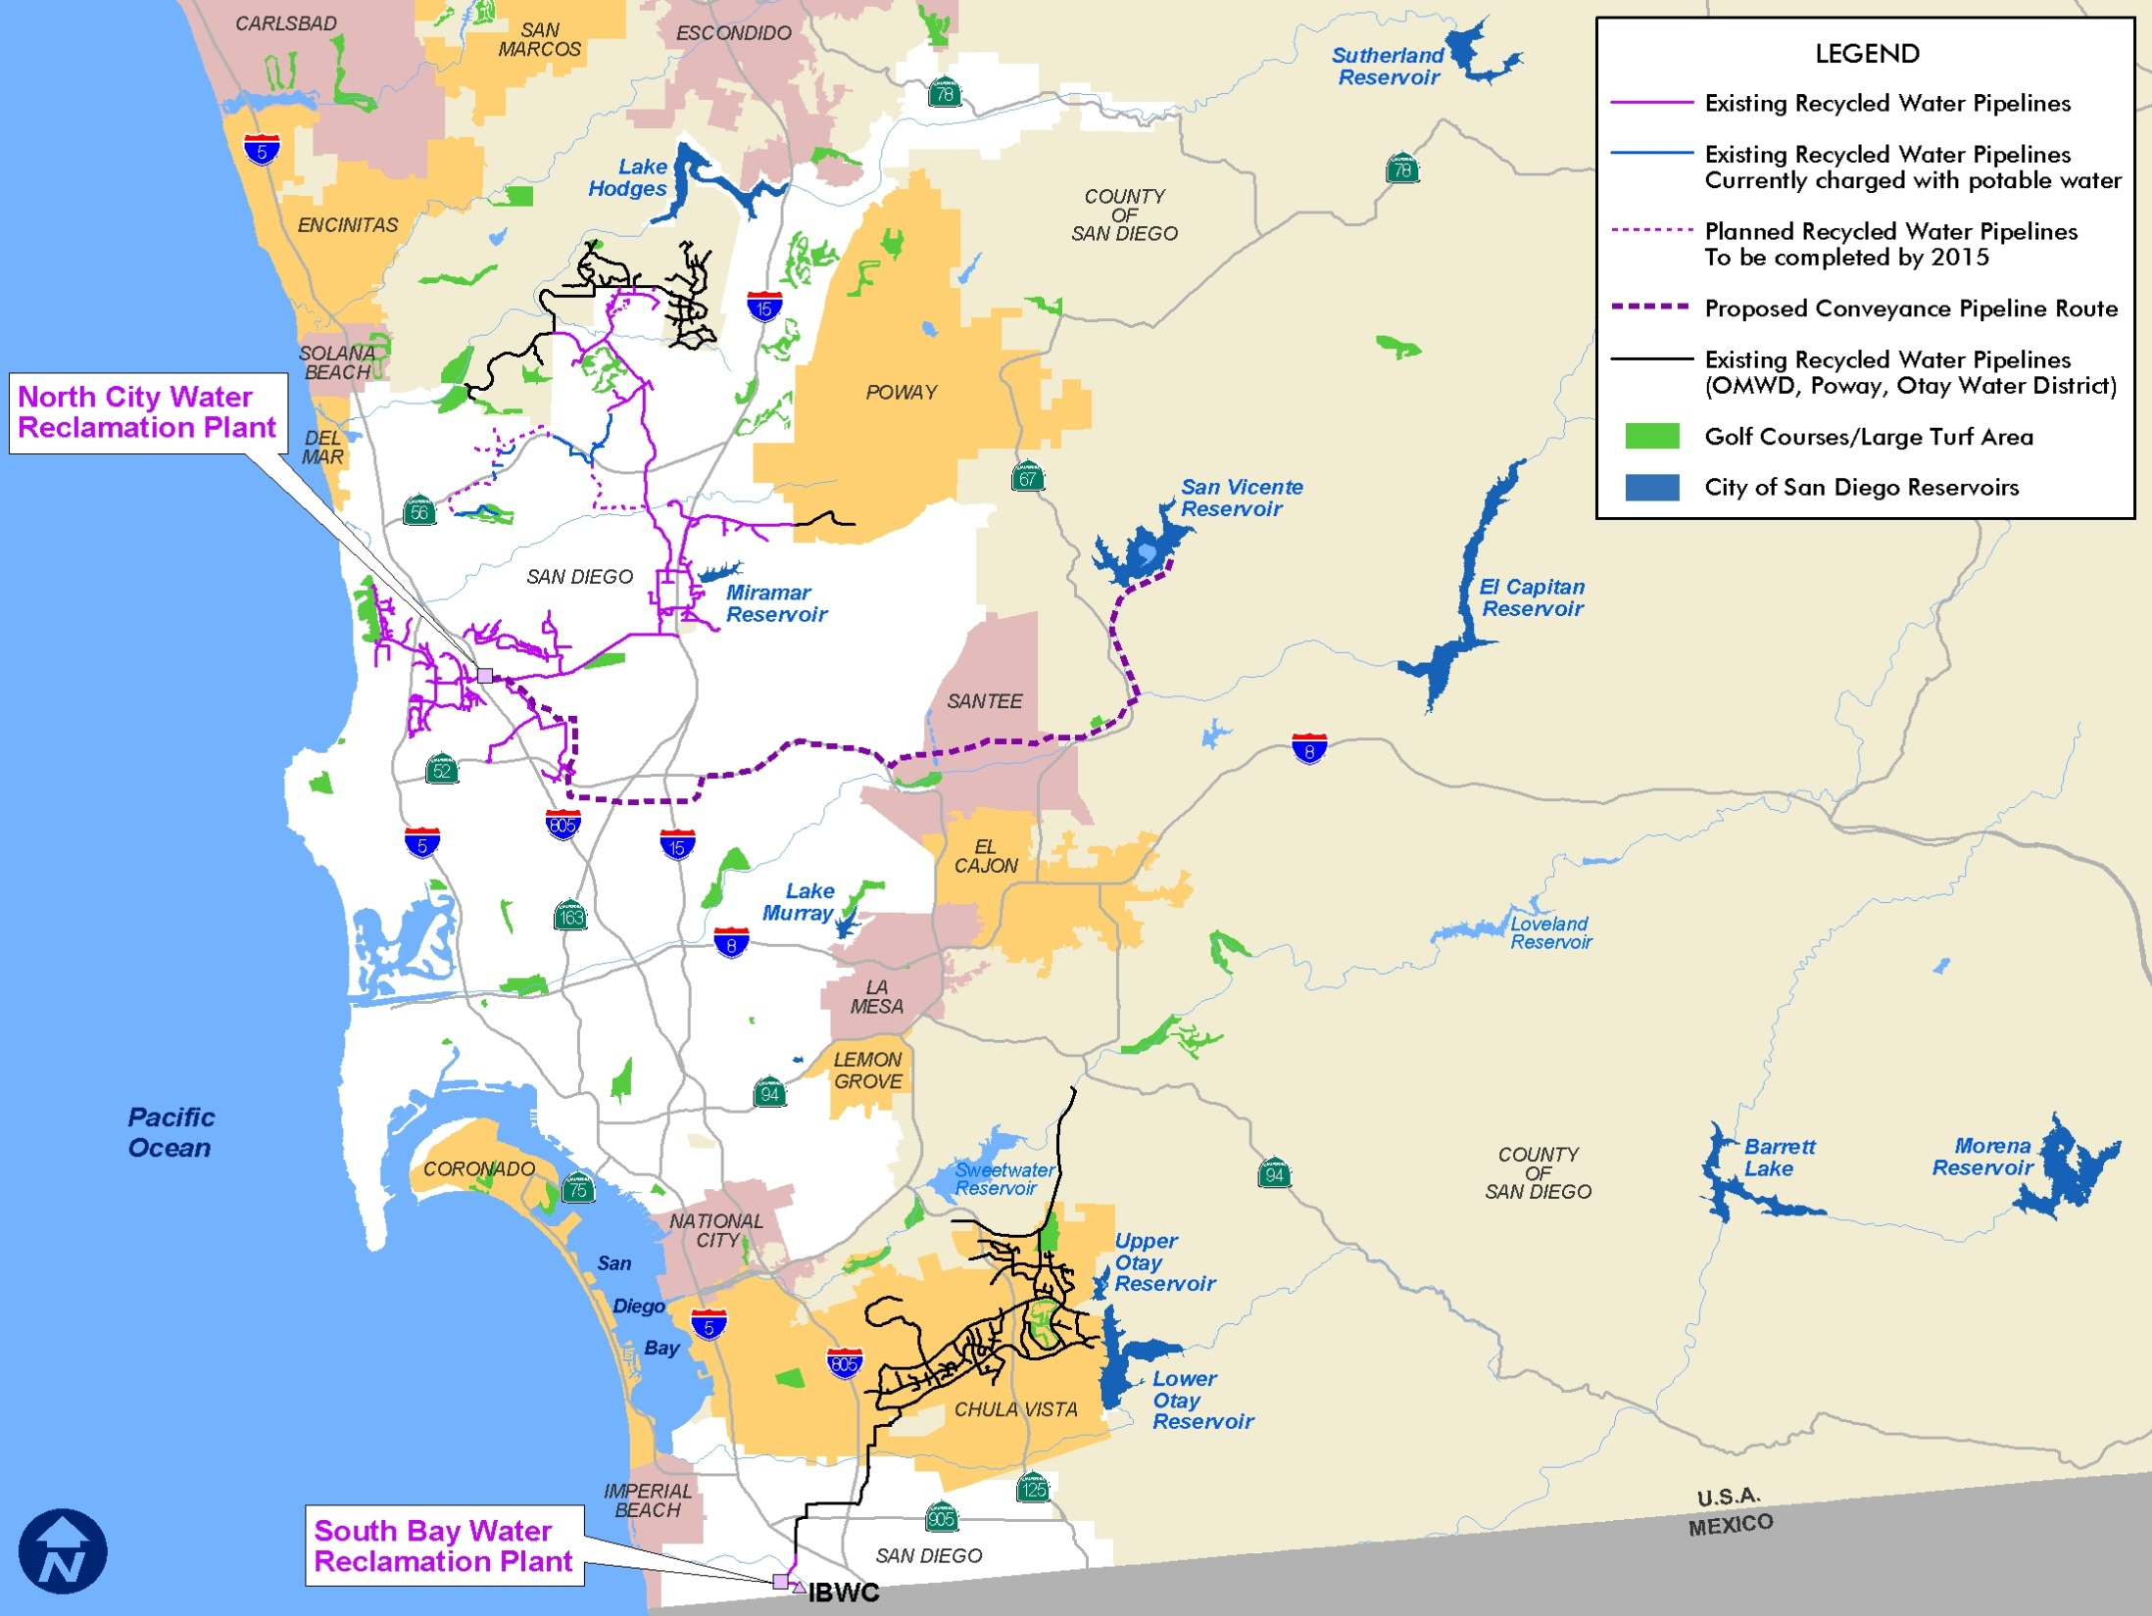
Demonstration Project Concept

Slide 26
Sustainability Benefits of Water Purification
Local Supply
  Living within our water “means”
  Uses Less Energy than Imported Water
    Living within our water and energy “means”
Could provide a significant amount of the City of San Diego’s future water supplies
  Having enough reliable water supplies to meet present and future water demands
Beneficial to the Environment

Slide 27







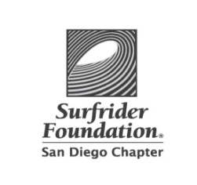




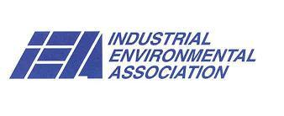

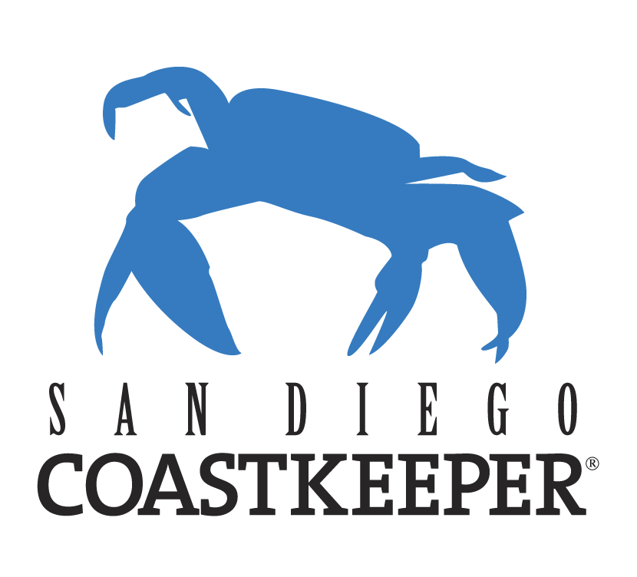
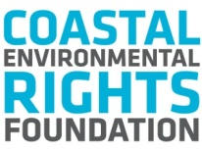






www.SDWaterSupply.com
Friends of Infrastructure
BIOCOM
Building Industry Association of San Diego
Building Owners and Managers Association, San Diego Chapter
Citizens Coordinate for Century 3
Coastal Environmental Rights Foundation
Empower San Diego
Endangered Habitats League
Environmental Health Coalition
Friends of Infrastructure
Industrial Environmental Association
National Association of Industrial and Office Properties
San Diego and Imperial Counties Labor Council
San Diego Audubon Society
San Diego Regional Economic Development Corporation
San Diego Coastkeeper
San Diego County Apartment Association
San Diego County Taxpayers Association
San Diego Regional Chamber of Commerce
San Diego River Park Foundation
Surfrider Foundation, San Diego Chapter
Sustainability Alliance of Southern California
Utility Consumers’ Action Network
Notes:
New WR Coalition Website: www.SDWaterSupply.com

Slide 28
Questions?

