Slide 1
The Economics of Rooftop Solar
Your Roof is an Asset

Slide 3



Information Resource &
Expert Implementation Partner
What We Do
Energy Programs
Technical Assistance
Training & Education

Slide 4






Areas of Expertise
Building Performance
Clean Transportation
Distributed Generation
Energy Efficiency
Energy
Storage
Renewable Energy

Slide 5
CSE Disclaimer
Workshops are provided as a public service with the understanding that the Center for Sustainable Energy makes no warranties, either expressed or implied, concerning the accuracy, completeness, reliability, or suitability of the information.
The Center for Sustainable Energy does not endorse any particular product, manufacturer or service mentioned and does not represent that any goods or services are fit for any purpose or use.

Slide 6

California Solar Initiative

Slide 7
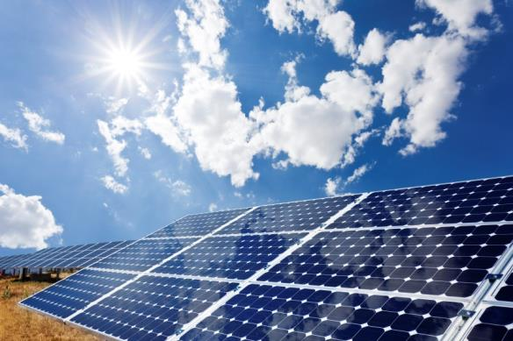
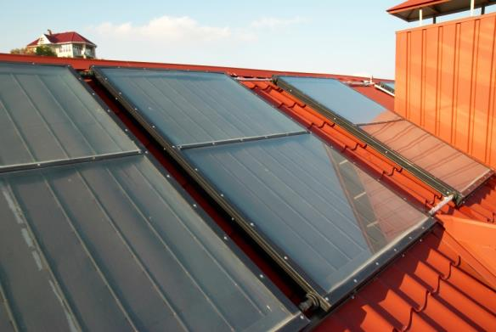
Solar Photovoltaics vs. Solar Water Heating
Solar Photovoltaic (PV) Systems
  use light from the sun to produce electricity for your home.
Solar Water Heating Systems
  use the sun’s heat to provide hot water for your home.

Slide 8
New Solar Homes Partnership
Builders partner with CA Energy Commission to install solar on new homes
http://www.gosolarcalifornia.ca.gov/about/nshp.php
Renewable@energy.ca.gov
844-217-4925

Slide 9


What’s a Watt?
=
100 Watts (W)
1 Light Bulb
=
1,000 Watts (W)
or
1Kilowatt (kW)
10 Light Bulbs

Slide 10


If you keep 10 bulbs turned on for 1 hour…
x
=
kW
1 Kilowatt
1 Hour
1 Kilowatt-hour (kWh)

Slide 11
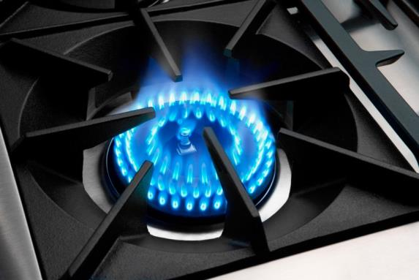

What is a Therm?
A therm is the unit of measurement for the natural gas you consume
SDG&E tracks and bills for natural gas usage in therms
Source: www.capital-cooking.com

Slide 12
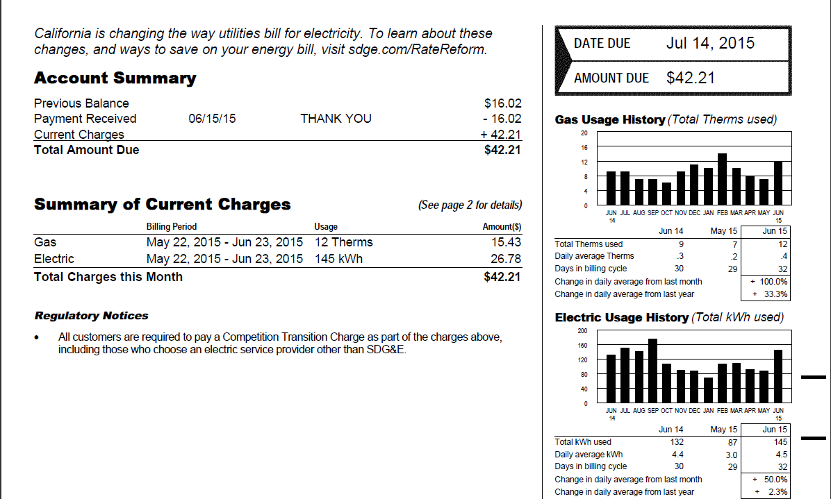
What’s your energy use?
Know your energy use before contacting contractors.

Slide 13
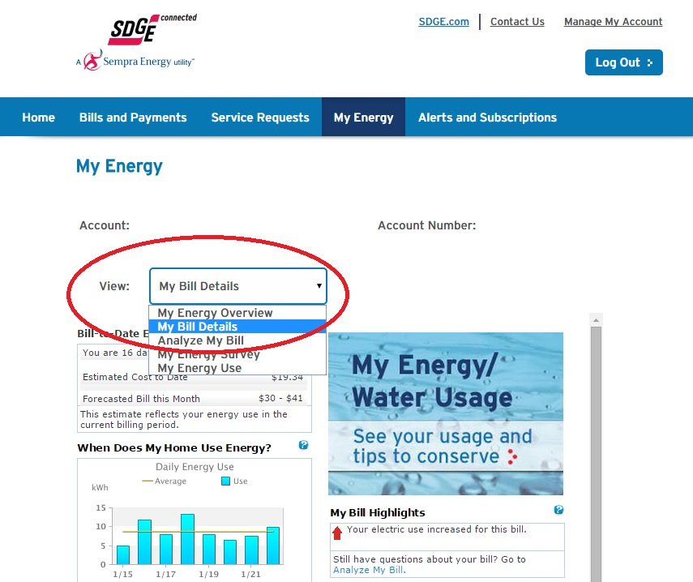
What’s your energy use?

Slide 14
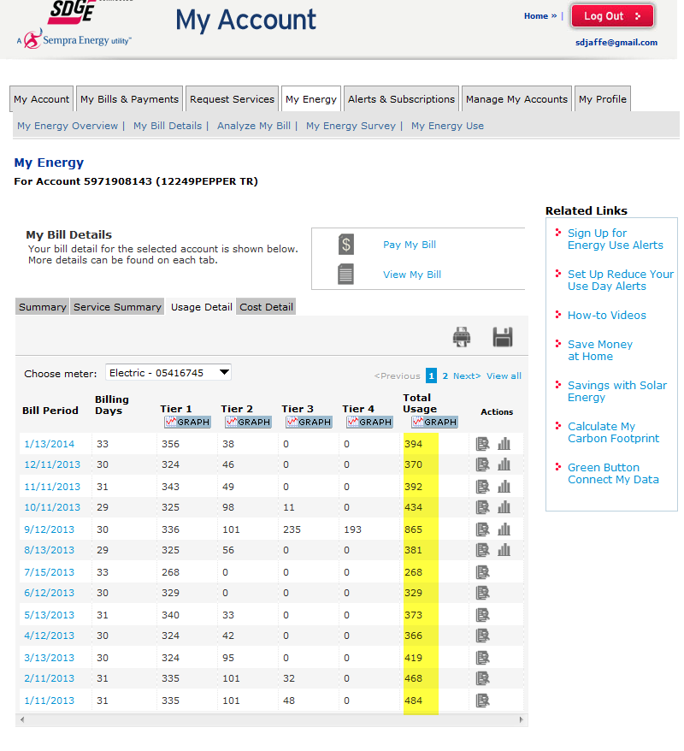
What’s your energy use?

Slide 15
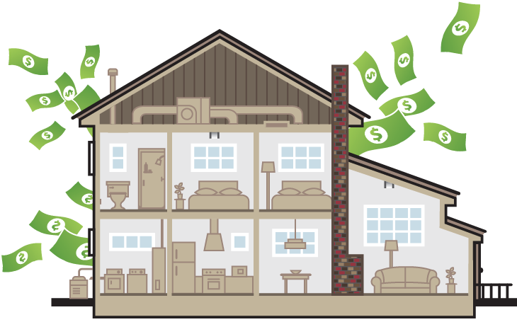
Energy = Money
Reduce your use before you produce

Slide 16
Home Energy Efficiency
Start Simple (temperature, water, lighting, appliances)
Seal and Insulate (attics, walls, floors, ducts, building envelope)
Upgrade HVAC (A/C, furnace, pumps, water heaters)
Windows
Contractor tips
Rebates & Financing
https://energycenter.org/homeowners/energy-efficiency/start-simple

Slide 17
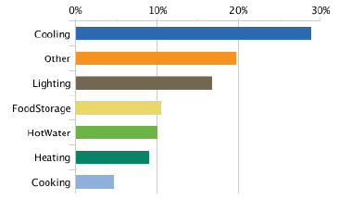
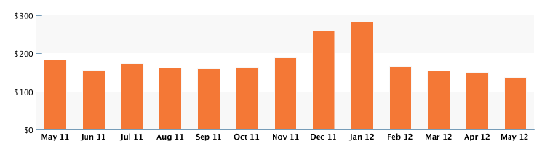
SDGE Home Energy Audit
Accessed through My Account on the SDG&E website using your log-in ID and password
Uses data from your account
Analyzes the energy use at the home based on survey responses and makes customized recommendations to save energy and water

Slide 18

Energy Efficiency Rebates
SDG&E’s Home Upgrade offers incentives between $1,000 and $6,500
  Insulation, air sealing and duct sealing/replacement
  High efficiency heating, cooling and/or water heating systems
  Cool roofs, high efficiency windows, etc.
It also offers third-party quality assurance
You must work with a participating contractor
Contact SDG&E to participate
www.sdgehomeupgrade.com

Slide 19
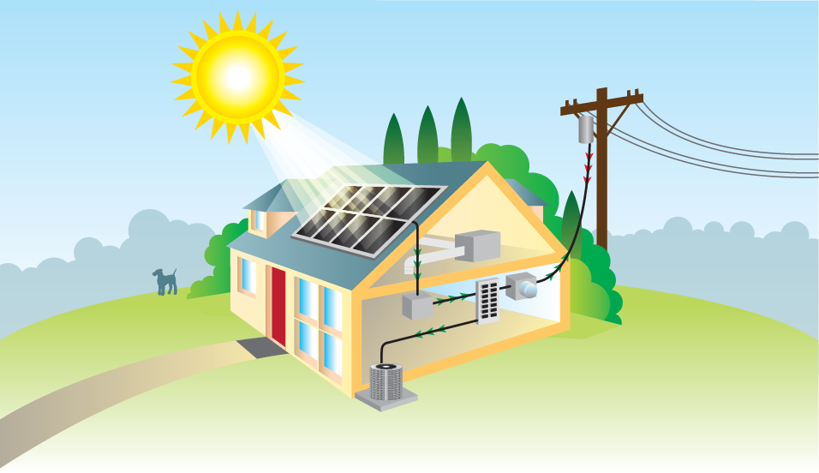
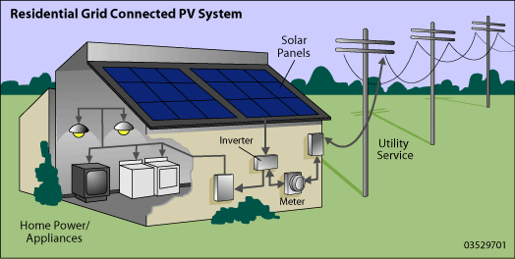
How does solar PV work?
Utility Service
Solar PV Panels
Inverter
Meter
Home Power/Appliances

Slide 20
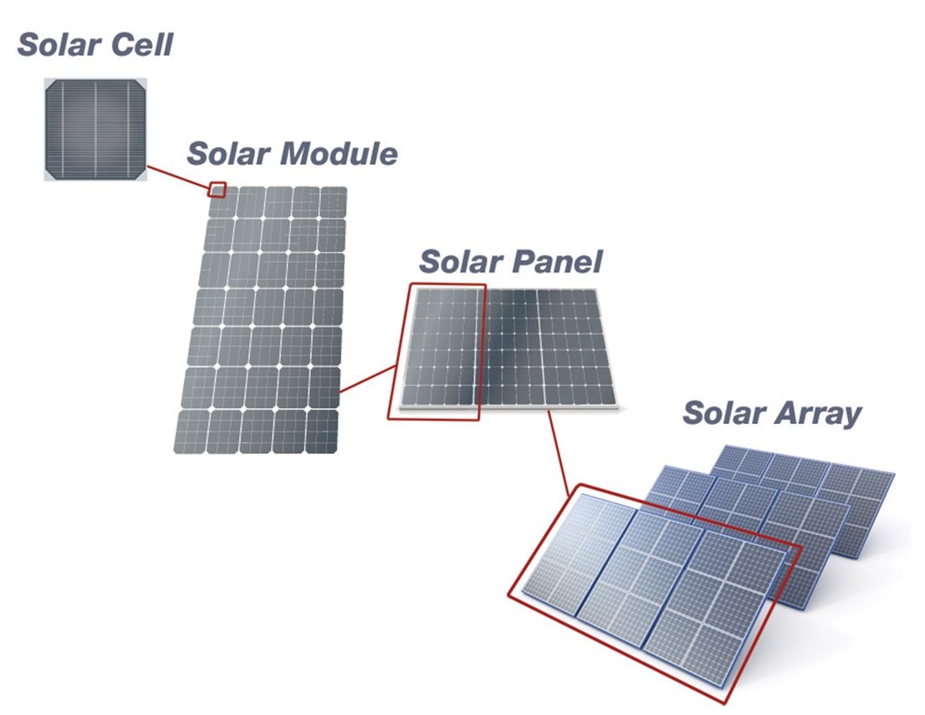
PV terminology

Slide 21

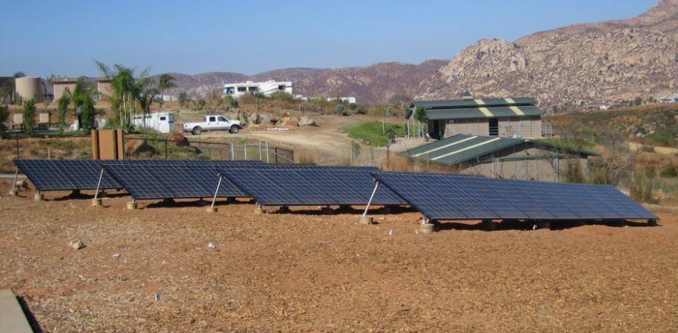
Crystalline Silicon PV Panels
Rigid crystals
Longest track record, over 50 years
Most common, over 93% of the market
Extreme heat reduces performance
Shade highly reduces performance
Roof Mounted
Ground Mounted

Slide 22
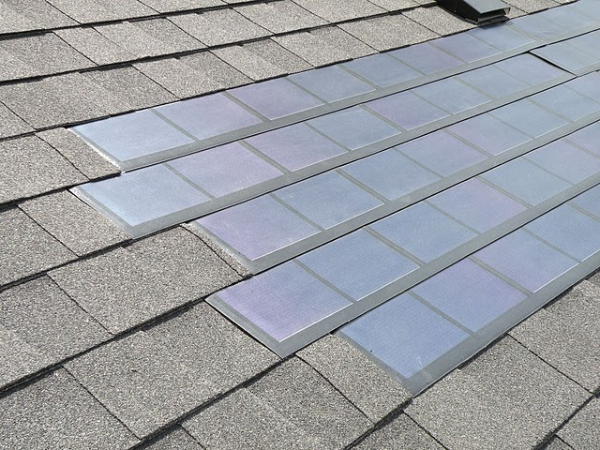
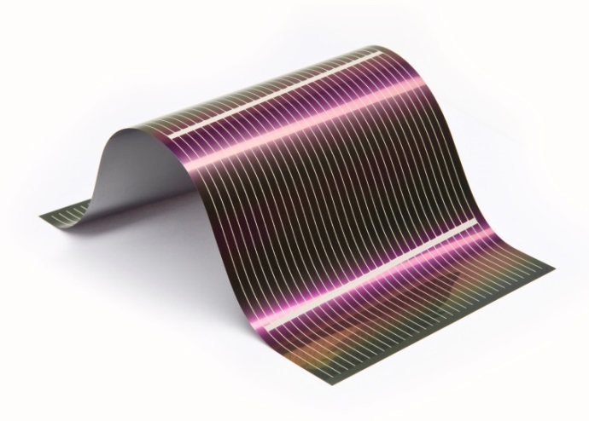
Alternative Panel Options
Building Integrated PV
Thin-film

Slide 23
Module Comparison
http://www.solardesigntool.com/compare-solar-panels-modules.html
Module Efficiency
  1960 14%
  2016 29.8%
  (usually above 20%)

Slide 24
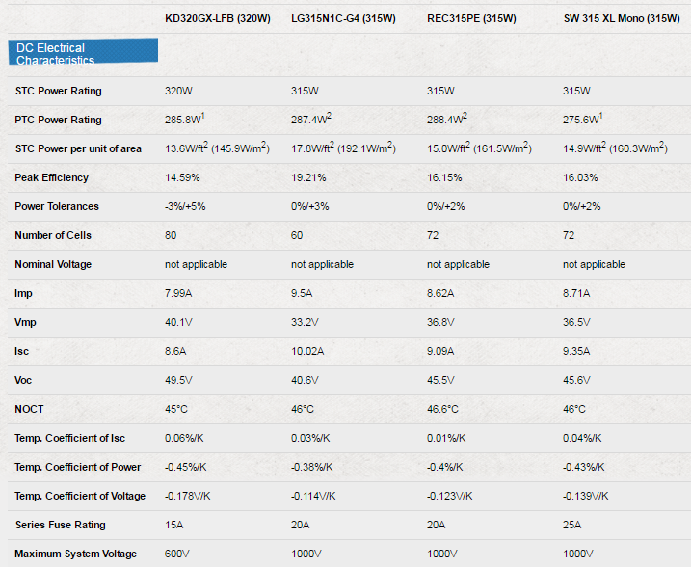


Module Comparison Results

Slide 25
Inverters
Inverter

Slide 26
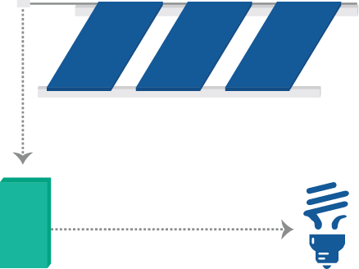
Inverters
Inverters change DC electricity from panels to AC electricity for use in your home
Two Types
Central Inverters
Micro Inverters
DC
(Direct Current)
AC (Alternating Current)
Inverter

Slide 27

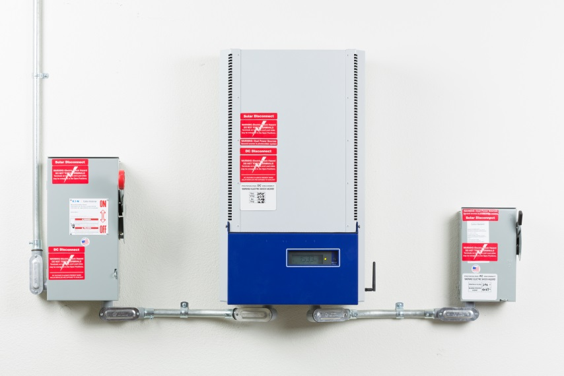
Central Inverters
One individual inverter per array

Slide 28
Central Inverters
One individual inverter per array.
Benefits:
Central point of failure
Longer track record
(c. 1991)
Disadvantage:
Shading can affect power output dramatically
Does not allow for easy system size increases
Shorter warranty

Slide 29

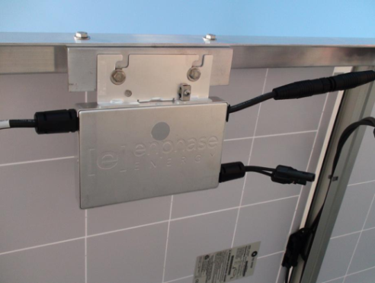
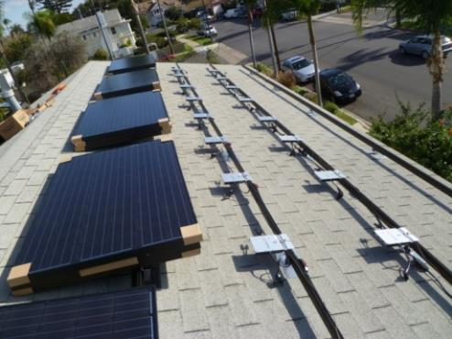
Micro Inverters
One individual inverter per panel

Slide 30
Micro Inverters
One individual inverter per panel.
(c. 1993; on market 2008)
Benefits:
Disadvantage:
More tolerant to shading
Allows flexibility in design and for future additions
Longer warranty
Shorter track record

Slide 31
Inverter Comparison
http://www.gosolarcalifornia.org/equipment/inverters.php
http://www.solardesigntool.com/compare-inverters.html
Inverter Efficiency
  Peak ~96-98%
  Weighted ~95-97%

Slide 32
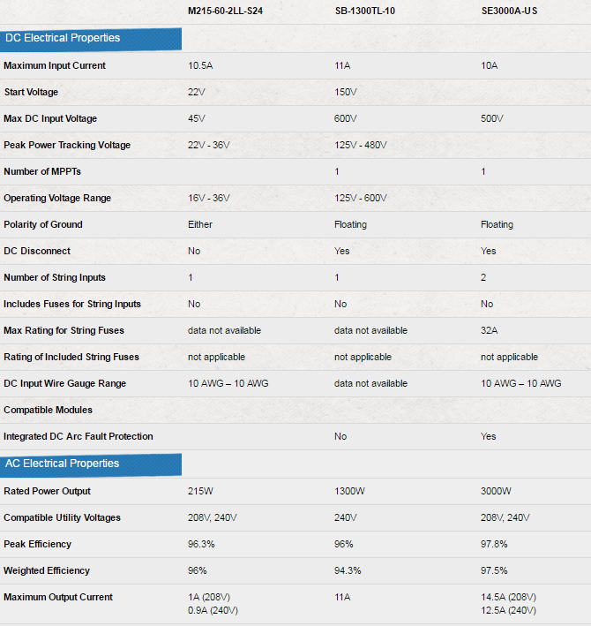



Inverter Comparison Results

Slide 33
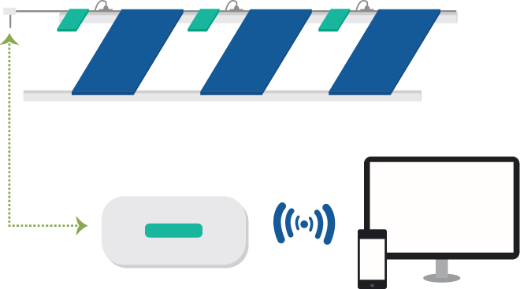
System Performance Monitoring
Micro Inverters
Display
Monitoring & Management

Slide 34
Solar Rights & Shade Acts
Solar Rights Act (1978)
  Legal framework for solar access
  Limits covenants, conditions & restrictions by HOAs & jurisdictions to restrict solar installations
  (more than $1,000 or more than 10% performance decrease)
  Solar easement (right of receiving sunlight over land)
  http://energy.gov/savings/solar-rights-act
Solar Shade Act (1978)
  Prevents neighboring property owner from planting trees/shrubs that will shade an existing solar system
(cannot cast shadow more than 10% between 10am-2pm)
  http://energy.gov/savings/solar-easement-and-solar-shade-control-act

Slide 35
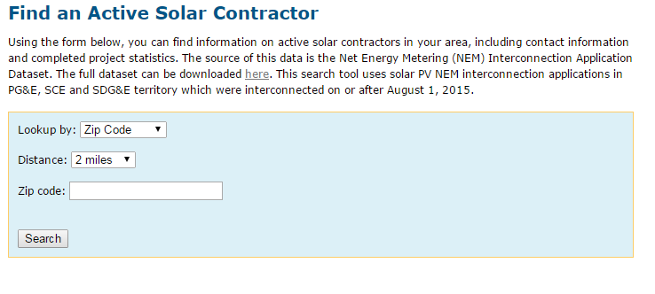

Find a Contractor
https://www.californiasolarstatistics.ca.gov/search/contractor/

Slide 36
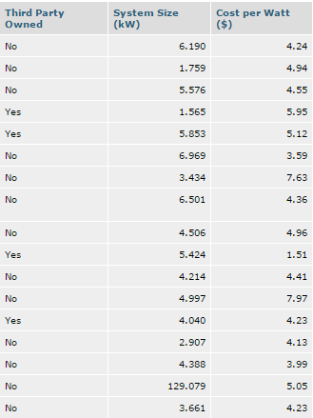
Contractor Results

Slide 37

Research solar contractors at:
www.cslb.ca.gov
www.bbb.org

Slide 38
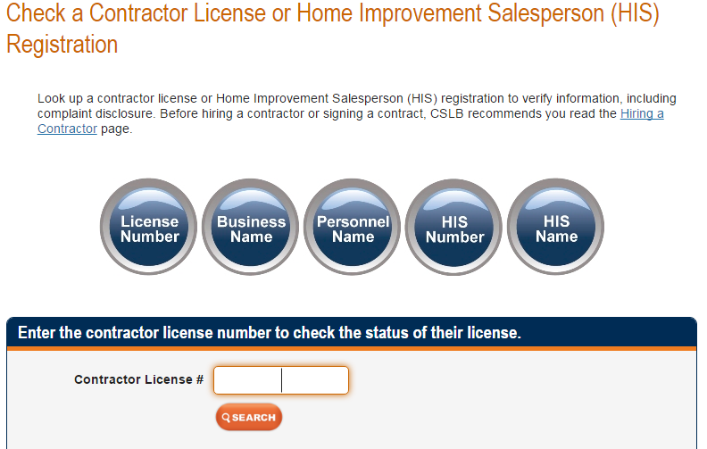
Contractors State License Board
https://www2.cslb.ca.gov/OnlineServices/CheckLicenseII/checklicense.aspx

Slide 39
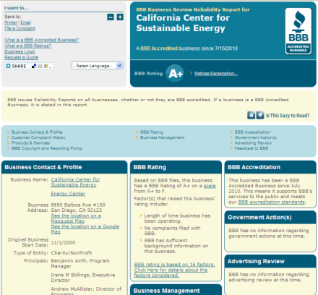
Better Business Bureau

Slide 40
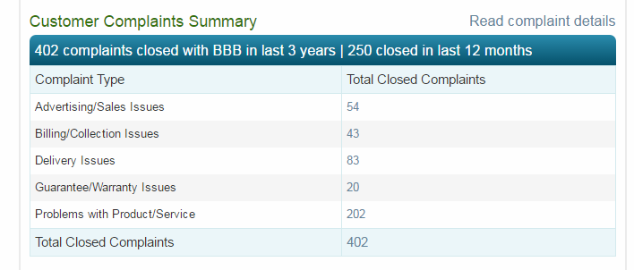
BBB Results (solar contractor search)

Slide 41
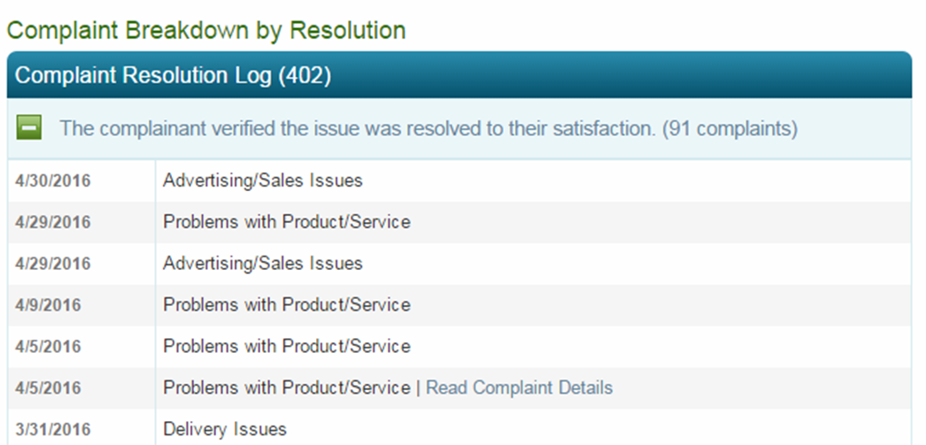
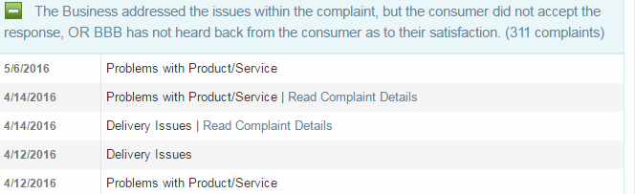
BBB Results cont.

Slide 42

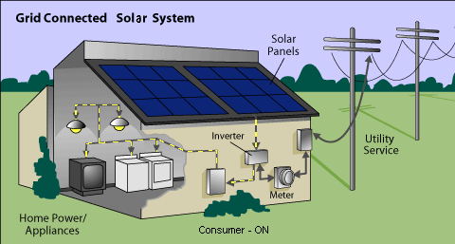
What is Net Metering?

Slide 43
Consumption/Production Patterns

Slide 44
The California Solar Surplus Act
AB 920 requires the utility to purchase annual over generation by net metered utility customers.
Purchase price is ≈$0.04/ kWh
Note - If you offset more than 100% of your kWh usage, you will receive a minimum charge of $10/month.
http://www.sdge.com/clean-energy/excess-generation-credit/annual-compensation-excess-generation

Slide 45
Changes to Net Energy Metering
NEM 1.0 will end in July of 2017 or when renewables reach 5% of SDGE’s MW capacity (whichever comes first)
  SDG&E expected to reach 5% in ~ Summer 2016
    http://www.sdge.com/clean-energy/net-energy-metering/overview-nem-cap
If you interconnect under current NEM rules, you are grandfathered in for 20 years
On January 28, 2016, the CPUC approved Decision (D.) 16-01-044 adopting a NEM successor tariff
http://www.cpuc.ca.gov/General.aspx?id=3934

Slide 46
Changes to Net Energy Metering
New elements of NEM made by the Decision include:
  Interconnection fee
    ~$132 for SDG&E customers
  Non-bypassable charges (~$0.02/kWh)
    Applied to all energy usage from the grid
  Mandatory time-of-use (TOU) rate in 2019

Slide 47
Time of Use Rate
SDGE residential NEM 2.0 participants are not required to select TOU until after SDGE TOU rates are determined for all residential customers
Residential customers can participate in NEM 2.0 prior to TOU rates being determined (while on SDGE tiered rates)
NEM 2.0 participants prior to TOU rate determination can remain on SDGE tiered rates for 5 years
Once TOU rates are determined, all NEM 2.0 participants will be on TOU
TOU implementation is expected in 2019

Slide 48
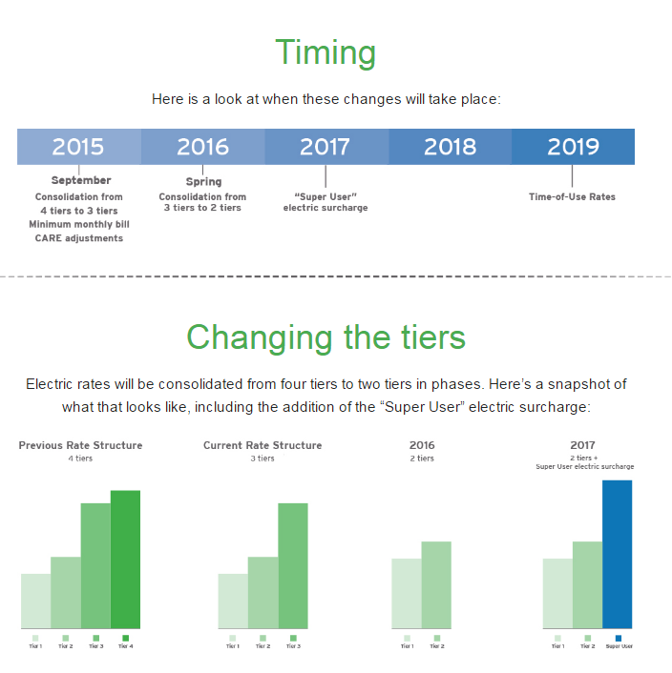
SDGE Tier Changes
http://www.sdge.com/RateReform/

Slide 49
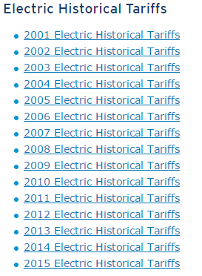
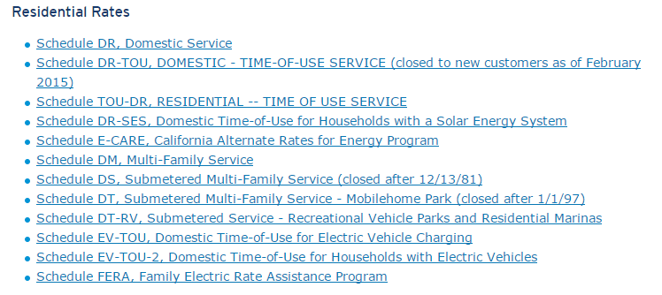
SDGE Historical Rates
http://www.sdge.com/rates-regulations/historical-tariffs

Slide 50
California Public Utilities Commission
NEM Successor (NEM 2.0)
http://www.cpuc.ca.gov/General.aspx?id=3934
Utility Advice Letter and Tariff Information
https://cpucadviceletters.org/documents/list/recent/
PUC Contact Page
http://www.cpuc.ca.gov/contactus/

Slide 51
System Sizing
/
1,700 kWh (average annual production of 1 kW in San Diego)
# of kW
that would offset your electricity use
12 month electricity consumption (kWh)
=
**Remember: this will offset 100% of your annual electricity use**

Slide 52
System Sizing Example
/
=
4.1 kW
PV System
7,000 kWh
1,700 kWh
12 month electricity consumption (kWh)
average annual production of 1 kW in San Diego
kW that would offset your electricity use
**Remember: this will offset 100% of your annual electricity use**

Slide 53
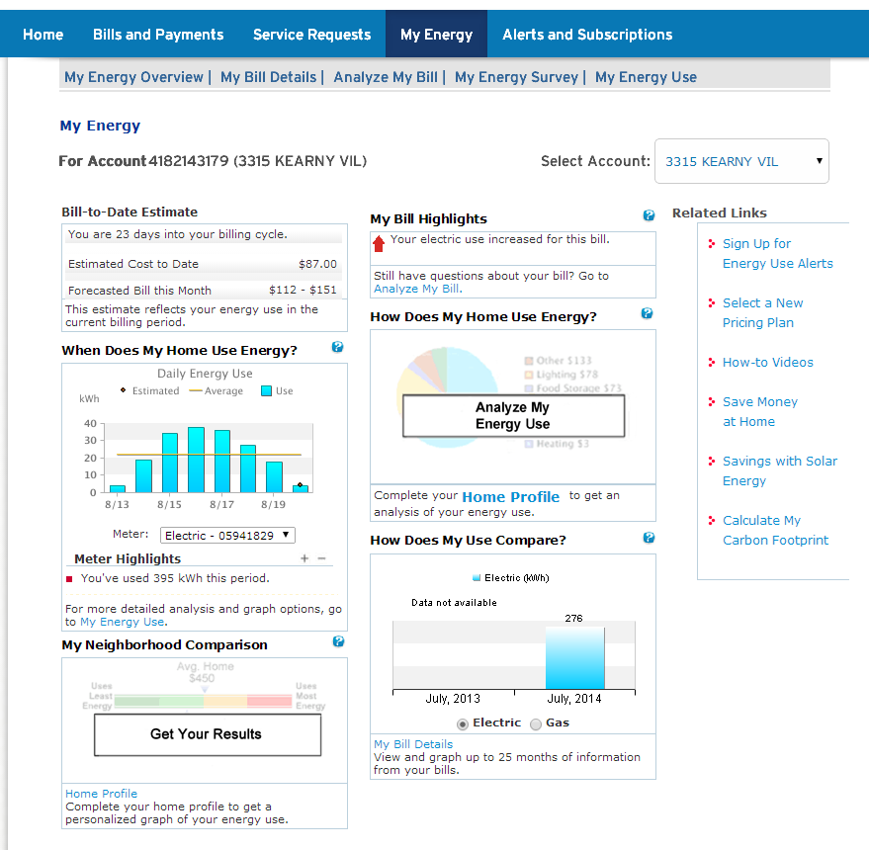
SDG&E Solar PV Calculator

Slide 54
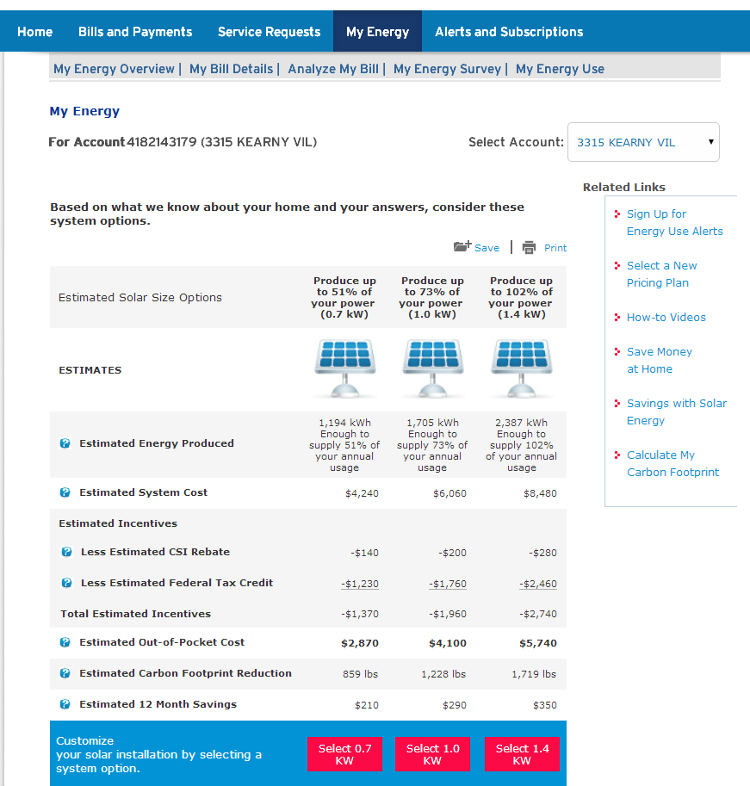
SDG&E Solar PV Calculator

Slide 55
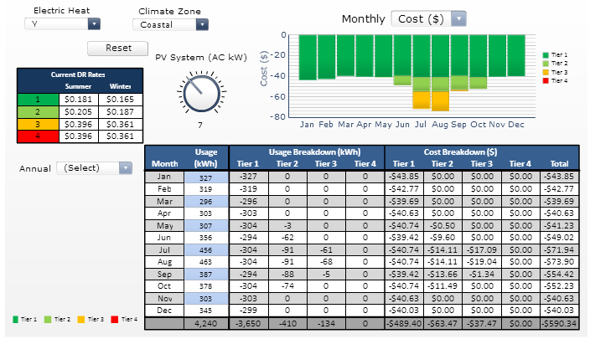
CSE’s Electric Rate Analyzer
https://energycenter.org/california-solar-initiative/homeowners/electric-rate-analyzer

Slide 56

Two Paths to Solar PV
Purchase
Lease or Power Purchase Agreement

Slide 57
Purchase Options
Cash Purchase
Loans
  Home Equity Loan: bank loan secured with equity from the house (if available)
  Energy Efficient / Solar Loan
      San Diego Metropolitan Credit Union
      Point Loma Credit Union
  Property Assessed Clean Energy (PACE) Loan
http://energycenter.org/policy/property-assessed-clean-energy-pace#PACE-FAQs

Slide 58

Energy Upgrade California
http://myenergy.energyupgradeca.org/page/gogreenfinancing

Slide 59
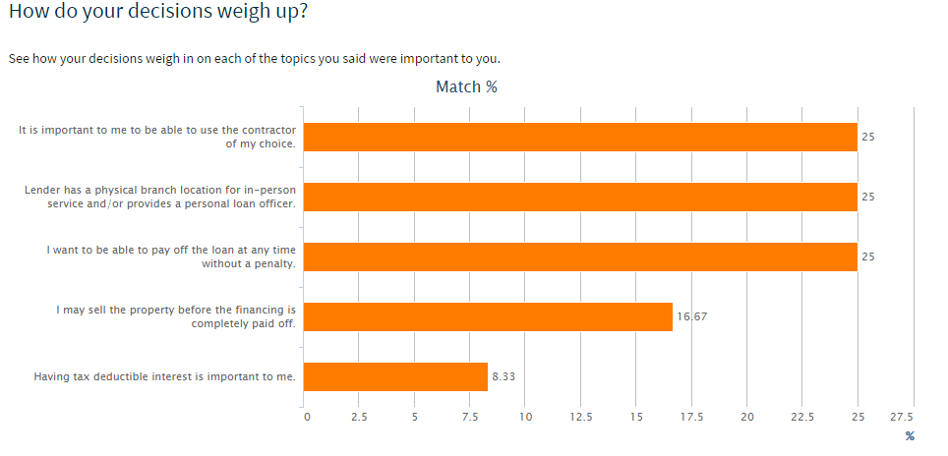
Financing Concierge System

Slide 60
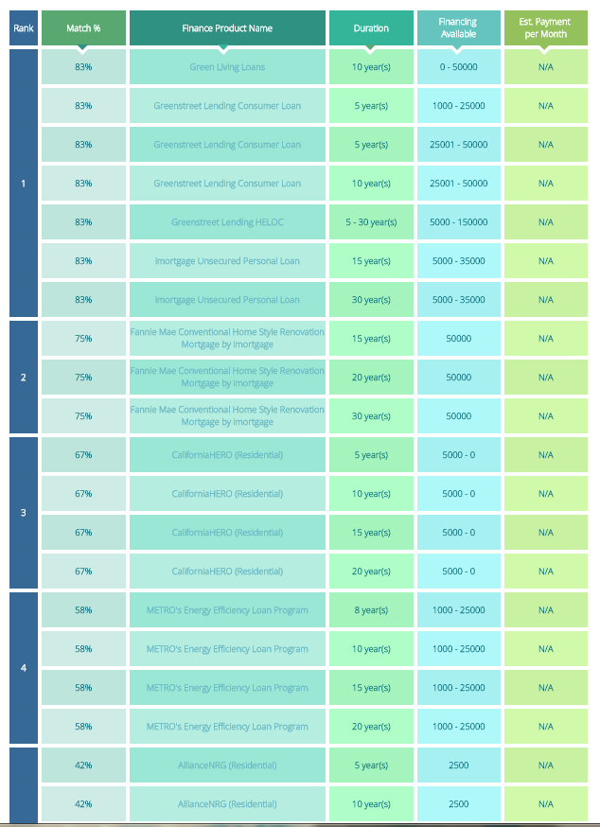
Finance Product Ranking

Slide 61
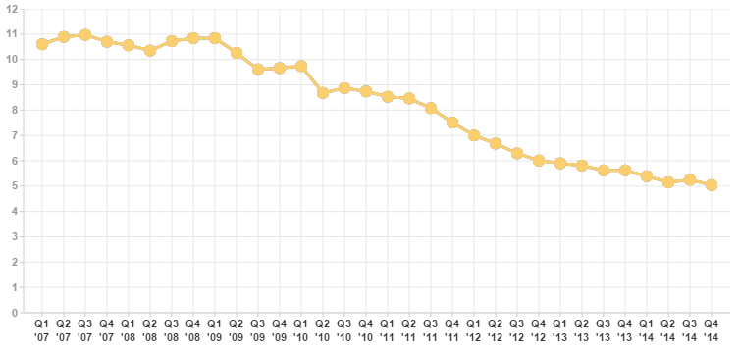
How much does solar PV cost?
Average Residential PV Cost:
$3 to $5 per Watt (AC)

Slide 62
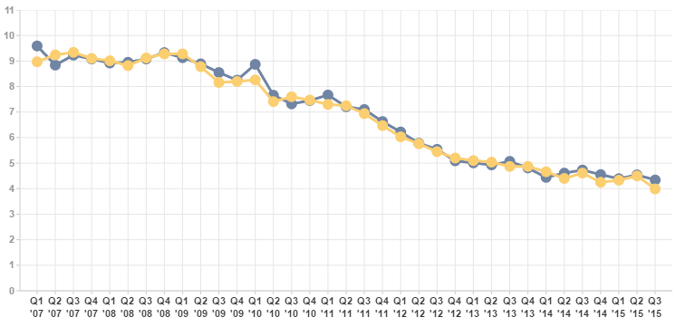
Historical Cost per Watt
Blue data points= Residential under 10 kW in SDGE territory
Q1 2007=$9.59/W Q3 2015=$3.99/W
https://www.californiasolarstatistics.ca.gov/reports/quarterly_cost_per_watt/

Slide 63
How much does solar PV cost?
Factors that could increase costs:
Roof replacement
Electrical panel upgrades
Tree trimming
Trenching (for ground-mounts)

Slide 64
Federal Solar Investment Tax Credit
30% of the total system cost available through 2019
26% in 2020
22% in 2021
One-time credit, but may be carried over
IRS Form 5695 (Renewable Energy Credit)
Talk to your tax professional!
https://energystar.zendesk.com/hc/en-us/articles/216375477

Slide 65
Purchased System Example
Home consumes 5100 kWh/year | 5100 kWh / 1700 kWh | 3kw system
System Cost | 3,000W x $5.00/Watt | $15,000
Federal Tax Credit | 30% x $15,000 | $4,500
Total Cost After Tax Credit | $15,000 - $4,500 | $10,500

Slide 66
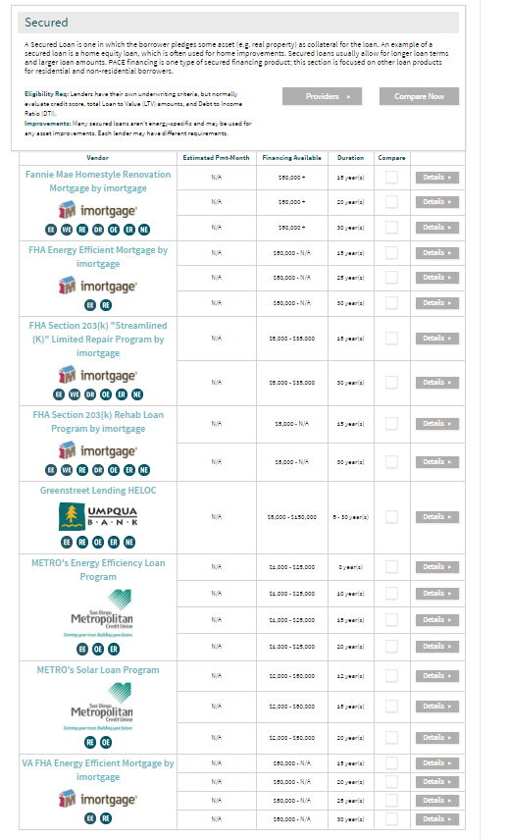
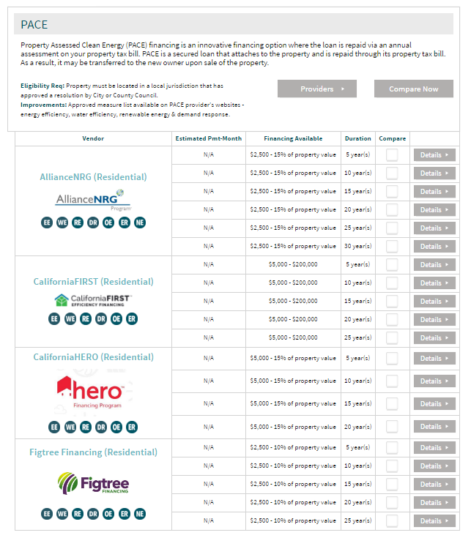
Find Financing
http://myenergy.energyupgradeca.org/vendor/financing

Slide 67
Third Party Options
Lease
  Fixed $ per Month
  May be pre-paid or monthly
Power Purchase Agreement (PPA)
  Fixed $ per kWh produced by system
  Customer buys all power produced by system

Slide 68
Owning | Leasing
What are you buying?
What is included in the purchase?
What are the tax implications?
What are the risks?
What happens if I move?
What are the financial benefits?
Buying an asset
Buying a service, usually with a purchase option
Not inverter replacement, O&M, insurance, may include monitoring
Generally includes O&M, inverter replacement, insurance, monitoring
Need to have the tax appetite to make use of the 30% ITC
Solar pv services provider has the tax appetite for the 30% ITC AND can make use of commercial depreciation tax benefits
Responsible for O&M
Longevity of the solar pv services provider
Can transfer payments to new homeowner or must buy out the remainder of the contract at ‘fair market value’
New homeowner buys the asset
Return on investment in the form of lower electricity bills and increased home value
No or little upfront cost, reduced monthly energy bills

Slide 69
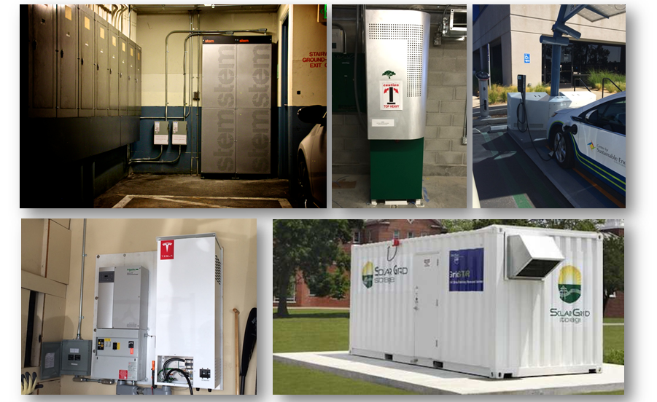
Batteries
https://energycenter.org/self-generation-incentive-program/business

Slide 70
Chula Vista Case Study
~2,500 sq ft home in Chula Vista built in 1998
Install Cost Jan 2013 $25,360*
CSI Incentive ($1,203)
Federal Tax Credit ($6,873)
--------------------------------------------------
Total System Cost $17,284
*24 microinverter panels @ 5.76 kW

Slide 71



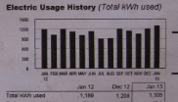
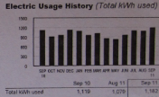



Chula Vista Case Study cont.
Jan 27, 2013
102 gas therms @ $115.14
1,305 elec kWh @ $309.05
$424.19
Aug 24, 2014
19 gas therms @ $26.77
Zero elec kWh @ $000.00
$26.77
Sept 27, 2011
27 gas therms @ $34.13
1,182 elec kWh @ $287.30
$321.43

Slide 72

Solar Water Heating

Slide 73
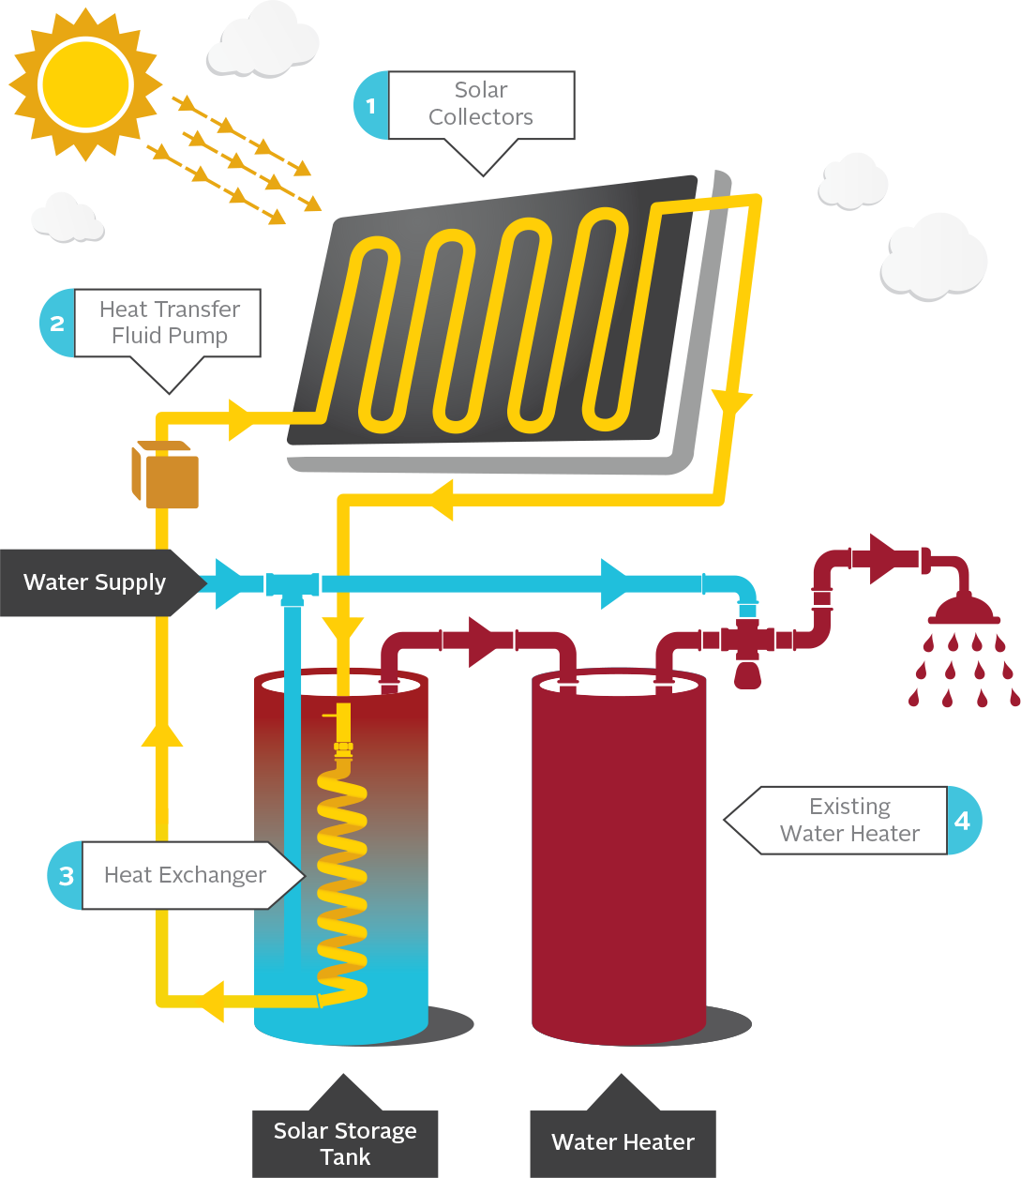
How Does Solar Water Heating Work
  Technology that captures the sun’s heat to create hot water
  Pre-heat system for your existing water heater

Slide 74
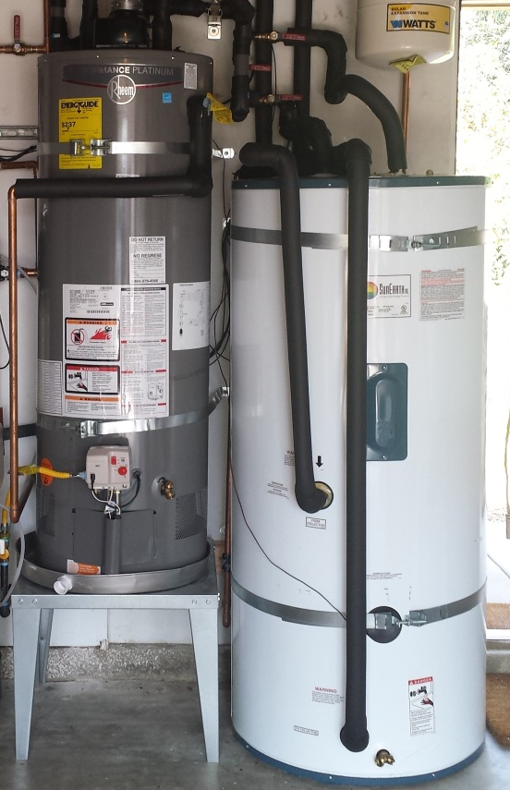
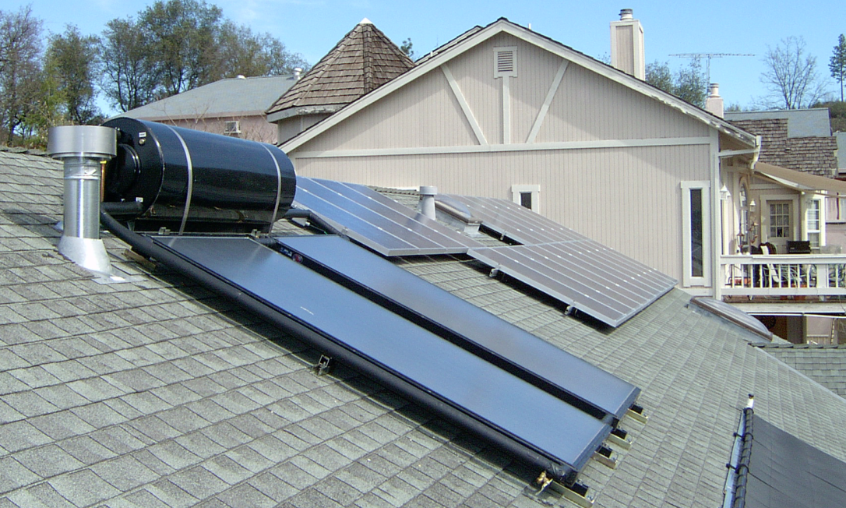
Solar Storage Tanks
All solar water heating systems have a storage component
Solar storage is separate from your existing tank or tankless water heater
Roof mounted storage
Solar storage tank next to existing water heater

Slide 75
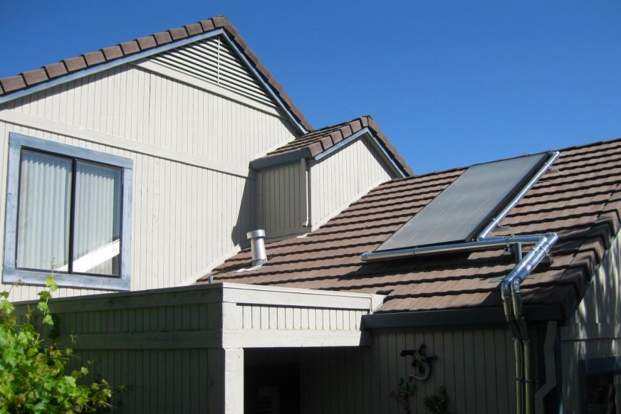
Solar Water Heating – General Considerations
Works with any backup
(natural gas, electric, propane)
Not required to replace existing water heater
Can be compatible with tankless
1-3 collectors on your roof
(32-120 sq. ft.)

Slide 76
SWH Average Savings
Save up to 75%
of hot water heating costs!
Solar water heating reduces the
energy needed
to heat
your water.
You save $$$ on your utility bill
75%

Slide 77
SWH Passive vs. Active Systems
  Passive Systems
    Require no pumps
    Simple design
    Solar storage is on the roof
  Active Systems
    Use a pump and a heat exchange fluid
    The heat exchange fluid is heated in the collectors and then pumped into the storage tank to heat water
    Fluid may be either glycol or water

Slide 78

Example ICS System
Example Passive System

Slide 79

Example Glycol System

Slide 80
California Solar Initiative-Thermal Program
ELIGIBLE
Gas water heating customers of SDG&E, PG&E, or SoCalGas | Retrofit New Construction
NOT ELIGIBLE
Pool & Spa Systems, Space heating/cooling, Radiant Floor Heating
https://energycenter.org/programs/california-solar-initiative-thermal

Slide 81

SWH Incentives: Natural Gas
Steps | $ per Therm Saved | Single Family Cap
Step 1 | $29.85 | $4,366
Step 2 | $25.37 | $3,710
Step 3 | $14.30 | $2,091
Step 4 | $3.23 | $472

Slide 82
SWH Example: Incentive Formula
(Natural Gas)
Average Energy Savings | 115 Therms
x $/Therm | x $29.85
x Surface orientation factor | x 1.0
x Shade factor | x 1.0
= $ Rebate | = $3,433

Slide 83

Federal Solar Investment Tax Credit
30% of the net system cost thru 2019
26% in 2020
22% in 2021
IRS Form 5695
(Renewable Energy Credit)
Talk to your tax professional!
http://www.energystar.gov/about/federal_tax_credits

Slide 84

Average Costs of SWH
 | Initial Investment | Cost After Rebate | Fed Tax Credit (30%) | Net Cost
Gas | $7,300 | $4,000 | $1,200 | $2,800
Electric | $7,300 | N/A | $2,190 | $5,110

Slide 85
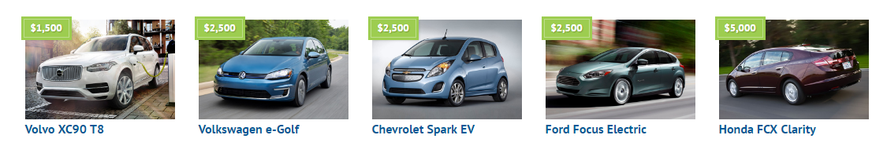

Electric Vehicles
https://cleanvehiclerebate.org/eng/eligibility-guidelines

Slide 86
Electric Vehicles - Available Rebates
Clean Vehicle Rebate Project
Vehicle Type | Rebate Amount
Fuel-Cell | $5,000
All-Battery or Range Extended | $2,500
Plug-in Hybrid | $1,500
Neighborhood Electric Vehicle | $900
Zero-Emission Motorcycle | $900
Federal Tax Credit
Vehicle Type | Rebate Amount
All Battery or Range Extended | $7,500
Plug-in Hybrid | Up to $7,500
cvrp@energycenter.org

Slide 87



Climate Action Plan

Slide 88

Climate Action Plan cont.

Slide 89

California Solar Initiative
$2.167 billion over ten years; 1,940 MW installed by end 2016
https://www.californiasolarstatistics.ca.gov/reports/agency_goals/

Slide 90


San Diego Residential Energy Consumption

Slide 91


SDG&E Distributed Solar Installations & Capacity

Slide 92


Annual CA Solar PV Installations
http://www.seia.org/sites/default/files/CA%20State%20Fact%20Sheet_2.26.2016.pdf

Slide 93

Annual U.S. Solar PV Installations
http://www.seia.org/research-resources/solar-market-insight-2015-q4

Slide 94
858 – 244 – 1177
csi@energycenter.org
swh@energycenter.org
cvrp@energycenter.org

Slide 95


Slide 96


