Slide 1
Homeless in San Diego: meeting the need
Ruth Bruland, Executive Director
St. Vincent de Paul Village, Inc.

Slide 2
Setting the Stage

Slide 3
Homelessness: National
The overall level of homelessness remained essentially the same from 2011 to 2012, with the number of homeless individuals falling slightly and the number of homeless families increasing slightly.¹
In 2011, 8.5 million very-low-income families without housing assistance paid more than half their incomes for housing — an increase of 43 percent from 2007.²
Over the last two decades, more than 350,000 apartments have been removed from subsidy programs, boarded up, or torn down.²
Notes:
1: http://www.nytimes.com/2012/12/10/us/homeless-rates-steady-despite-recession-hud-says.html?ref=housingandurbandevelopmentdepartment & HUD Homeless Resource Exchange Website
2: http://www.nytimes.com/2012/12/05/opinion/the-affordable-housing-crisis.html?emc=eta1&_r=0
In 2011, 8.5 million very-low-income families without housing assistance paid more than half their incomes for housing — an increase of 43 percent from 2007.
Over the last two decades, private landlords have removed more than 200,000 apartments from subsidy programs so that they could raise rents. And, faced with weak federal support and no money for repairs, the local housing authorities that manage federally supported developments have boarded up or torn down more than 150,000 units.
http://www.nytimes.com/2012/12/05/opinion/the-affordable-housing-crisis.html?emc=eta1&_r=0

Slide 4
Homelessness: San Diego
There were an estimated 8,879 homeless people in San Diego in January 2013, according to the point-in-time WeALLCount Campaign. Chronic homelessness increased (4%) and Veteran homelessness decreased (3%).¹
San Diego had the third largest homeless population of any American metropolitan area in 2012, surpassed only by New York City and Los Angeles.²
57% of renter households in the city of San Diego pay more than 30 percent of their income on rent.³
San Diego has one of the lowest rental vacancy rates in the nation. Predictions show that the vacancy rate is likely to remain in the 2% range for the next few years. ³
Notes:
1: http://www.rtfhsd.org/docs/03-13-12-RTFH-WeALLCount.pdf (2012); and HUD Homeless Resource Exchange Website
2: http://www.kpbs.org/news/2012/dec/11/san-diegos-homeless-population-third-nation/?utm_source=kpbs.org&utm_medium=email&utm_campaign=user-share
3: http://www.voiceofsandiego.org/opinion/article_39ac3bb2-e027-11e1-a84a-001a4bcf887a.html
More than half (57 percent) of renter households in the city of San Diego pay more than 30 percent of their income on rent, according to the 2010 American Community Survey. This is 14 percentage points higher than 42.9 percent of households that paid more than 30 percent of their income on rent in 2000.
If you are a renter looking for an apartment in San Diego, you are in a market that has one of the lowest rental vacancy rates in the nation. A recent REIS survey of the larger apartment complexes shows a vacancy rate of 2.9 percent, even less than the 2002 vacancy rates, and predicts that the vacancy rate is likely to remain in the 2 percent-range in the next few years. REIS is an organization that provides commercial real estate data https://www.reisreports.com/about-real-estate-data-experts/
The city of San Diego has a projected need for more than 88,000 housing units by 2020, of which 38,680 units need to be affordable to low- and very low-income households.

Slide 5
More…
National
Unemployment Rate: 8.1%
San Diego
Unemployment Rate: 8.9%
Fair Market Rent for a two-bedroom rental unit is $1,378
Fair Market Rent for a two-bedroom rental unit is $949
Cost of Living is 36% above the national average
Occupancy rates expected to hover at 2%
Notes:
The cost of living here is 36% above the national average.
Statistic on the average cost to rent a market rate apartment in San Diego.
Final FY2012 FMRs By Unit Bedrooms – San Diego County
Efficiency - $984
One-Bedroom - $1,126
Two-Bedroom - $1,378
Three-Bedroom - $1,960
Four-Bedroom - $2,421
*http://www.huduser.org/portal/datasets/fmr/fmrs/FY2012_code/2012summary.odn
2012 National and San Diego average unemployment rate for the year
Nation – 8.1
San Diego – 8.9
*http://data.bls.gov/pdq/SurveyOutputServlet
SSI Application Process: 18 months – 3 years; HOPE-SD Application Process: an average of 88 days or less

Slide 6
Eliminating Homelessness in San Diego

Slide 7
What does a homeless person need to leave homlessness?
Two Things
Income
Housing
Notes:
Proposed: The Mission of St. Vincent de Paul Village is to end homelessness one life at a time.
We can all agree that in order to obtain or maintain housing, people must have some sort of income.
Our alternative that we used recently: The mission of St. Vincent de Paul Village is to help our neighbors in need break the cycle of homelessness and poverty, to return people to homes as quickly as possible through innovative multi-disciplinary programs and partnerships that come together in the spirit of our CREED

Slide 8
Income
Sources:
  Employment
  Social Security Disability
  Retirement Benefits, etc.
  Rental vouchers
Manage it:
  Life skills , math skills….not always enough.

Slide 9
Housing
Find it:
  2% vacancy
  Shortage of 956,461 affordable units
Qualify for it:
  Evictions
  Deposits
Keep it:
  Life skills, social skills…not always enough
Notes:
The shortage of affordable units is for the state of CA

Slide 10
What can tip the scale?
Mental Health Issues
  Up to 40% of the population
Addiction Issues
  Up to 80% of the population
Additional Issues
  Chronic health issues
  Traumatic brain injury
  Post Traumatic Stress Disorder

Slide 11
How does change happen?
“Dosage” of Services:
Resources first
then Need
Shelter Diversion
Housing First – with or without services
Emergency Shelter
Transitional Housing
Interim Housing

Slide 12
Let’s Operationalize It

Slide 13
WHAT ST. VINCENT’S DOES
PMC
350
881 Transitional Housing Beds
BMC
150
JKC Women
65
JKC Families
248 beds
( 67 units)
Josue Homes
38
Toussaint
26 (14-18)
4 (18-24)
3478
Residents & Tenants Housed
365 Permanent Housing Units
16th & Market
136 (7 PSH)
VHM
90 (45 PSH)
Village Place
51 (30 PSH)
Comm. & 15th
65 (49 PSH)
Blvd. Apts
24 (9 PSH)
Notes:
2,787 in Transitional Housing, 712 in PH, 3478 unduplicated in housing.
Last year, 3436 residents and tenants housed
There are 10,013 homeless people in San Diego.
There are only 3,801 year round transitional housing beds in the County. (from 2012 Housing Inventory Count HUD)
We have 23% of the total year round beds.
There are 2421 Permanent Supportive Housing units in the County (from 2012 Housing Inventory Count HUD)
We have 15% of total.

Slide 14
WHAT WE DO
Facilities
Security
Food Services
Assessments
Employment & Housing Services
Integrated Healthcare
Chaplaincy
Case Management
Therapeutic Childcare
Homeless Prevention Services
Volunteer Services
Tenant Services
Supportive Services
MAS Teams
Therapeutic Childcare
Integrated Healthcare
Employment & Education
Homeless Prevention Services
Meals
Chaplaincy

Slide 15
Taking Care of the Basics
Our Security Program was the 2012 San Diego County Mental Health Services Support Program
of the Year.
Notes:
Foundation because Maslow’s Hierarchy: Physiological (food, water, shelter) & Security
2011- We had four violent crimes: Three physical assaults and one stabbing.
2012- Five violent crimes: Four physical assaults; three against staff and one indecent exposure on a minor.
Most in permanent housing – Also, one started at Studio 15 and came onto our property.

Slide 16
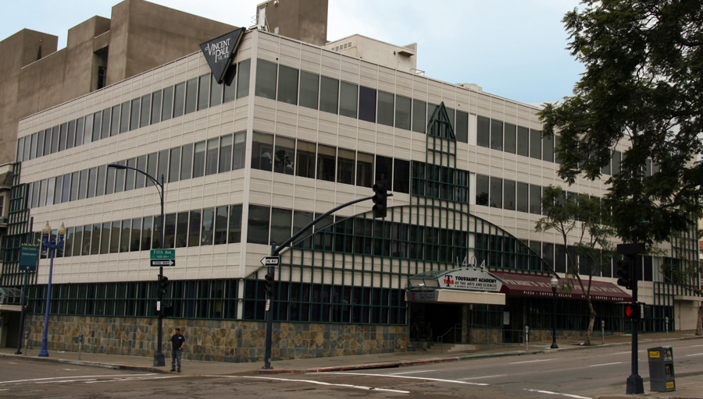
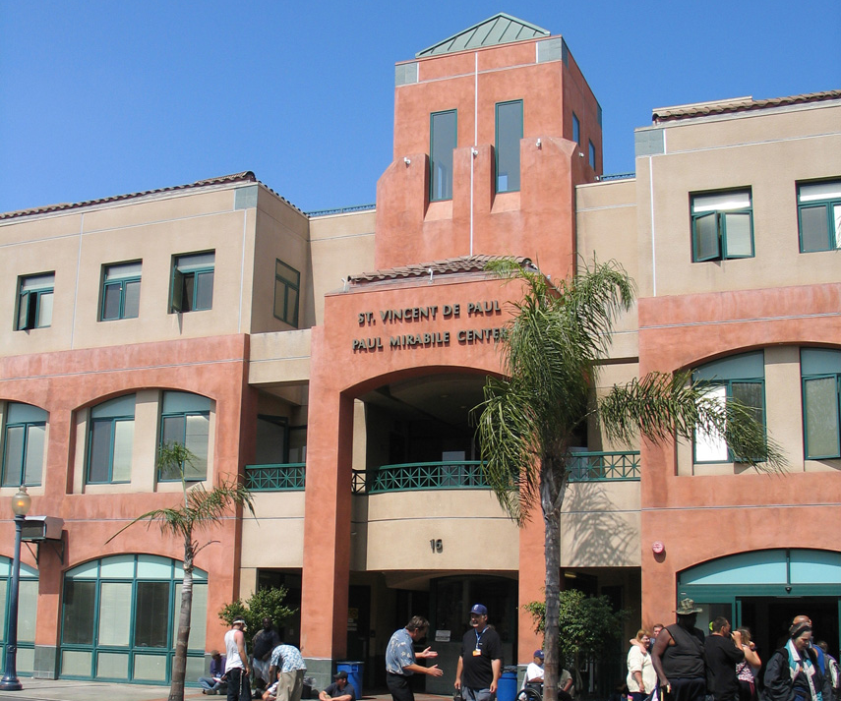
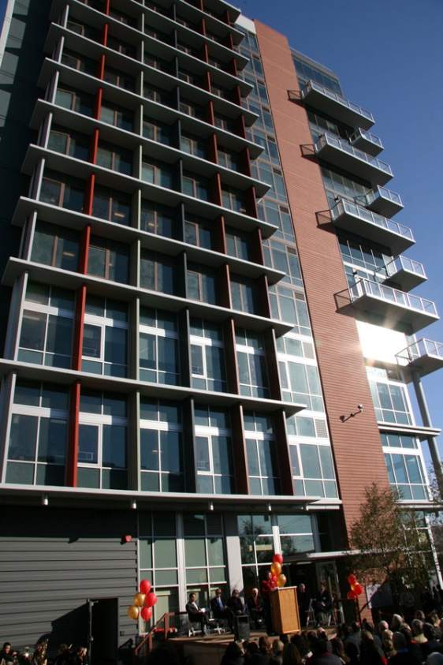
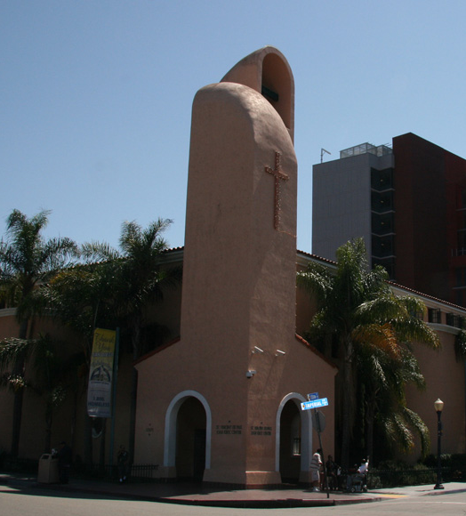

Transitional Housing
Notes:
Clockwise:
TASD
PMC
Saranac House – Josue
JKC
BMC and VCDC

Slide 17
How we do it: Transitional Housing
Are we the right place?
Notes:
Client presents asking to get on the Wait List.
Our process has always worked to match services to assessed need (aka matching dosage to assessment), including “Are we the right place for that particular client?”
Housing Assessment – do you have income, recent work history
Rapid Re-entry Team: Clients who have an income or low barriers to employment engage with this Team. The team provides targeted housing placement and employment assistance to help these clients achieve income and housing very quickly. They also support the clients who we divert from Shelter.
Stage 2 Assessment completed within 30 days for Families and after 60 days for singles (manage the flow of clients onto the teams) – which Team can best support your needs and what are you going to do for income?

Slide 18
How we do it
MAS: Multidisciplinary Approach to Services
MAS
Veteran Team
Family Team
Rapid Re-Entry Team
Supported Income Team
Employment Team
Tenant Services Team
Notes:
Interim and Transitional Housing MAS Teams: The Multidisciplinary Team Approach to Services (MAS) Teams use evidence-based practices including Motivational Interviewing and a strengths-based and Solution-focused approach to empower homeless men, women, and children to achieve and maintain income and housing. They work in partnership with clients to develop and actively work on goals and objectives that will help them return to their own homes as quickly as possible, while taking each client’s unique needs into account. Each of the 5 MAS Teams works with a specific subpopulation and provides expertise in a particular area.
Employment Team: The team supports clients who are seeking employment to develop a resume, enhance interviewing skills and connect with employers so that they can secure the income that will fund their permanent housing.
Supported Income Team: Clients on the Supported Income Team pursue permanent benefits through HOPE, the best practice disability benefits process or work with supported employment agencies that specialize in employing clients with mental health disabilities. Once obtained, their income is budgeted and targeted toward permanent housing.
Veterans Team: supports Veterans of all military branches and eras regardless of discharge status. Team members are experts in the unique needs of Veterans and are knowledgeable about income and housing resources available to Veterans.
Families Team: The Families Team specializes in the unique challenges faced by homeless families and children. While assisting the adult members of the family to obtain income and permanent housing, the Families Team also works closely with our therapeutic childcare program to identify developmental delays and ensure healthy children.

Slide 19
MAS Team
Client
Addiction Treatment Counselor
Mental Health Clinician
Nurse
Chaplain
Case Manager
Residential Specialist
Team Leader
Team Leader
Job Developer
Housing Locator
Case Manager
Therapeutic Childcare Teacher
Instructor
Notes:
Rapid Re-Entry – Team Leader, Case Managers supported by Job Developer, Housing Locator (who finds the most affordable housing available and communicates availability to clients)

Slide 20
Outcomes: TRANSITIONAL Housing
2012
745
People Moved from Home-lessness
to Home
92% to Unsubsidized
Permanent Housing with
a 7 ½ Month Average Length of Stay.
Notes:
2012 data - Rapid Re-Entry Team: 69% (148/215)
Team Support: 50% (289/578) – combined Teams including RR is
No Team Support: 17% (160/917
The N for Teams/No Teams: the total number of clients who exited is virtually the same from 2011 to 2012 (1490 exited in 2011 and 1495 in 2012). The difference is between the number who were supported by a team and those that were not. The difference is accounted for by 2 things: 1) we lost a team in 2011 and 2) we moved the date back by which we would start seeing clients on a team from the 30th day to the after the 60th day. The second change was made both to account for the fact that we lost a team and to help manage the demand for teams. We were not able to meet demand when the flow was 30 days.
according to Kathi’s hand count using a functional length of stay (FLOS: contiguous stay to the most recent exit), 424/1352 (31%) of PMC residents in 2012 exited in 30 days or less.
In 2012 - 118 moved from PMC to Rental, No Subsidy. Of those, 22 were identified as SROs.
2011 data – 165/228 : 72% (RR), 371/772 48% (Team), 206/718 : 29% (no team)

Slide 21
Outcomes: TRANSITIONAL Housing
2012
930 People
Increased or Maintained Their Income
Notes:
All income, employment and benefits
The chart breaks out the teams like the PH slides but this data is combined.
2012 - Team Support (both RRSD and MAS Teams):61% (485/793) - No Team Support: 30% (271/917)
2011 – Team Support (both RRSD and MAS Teams): 64% (357/559) – No Team Support: 21% (232/1131)

Slide 22
Outcomes: TRANSITIONAL Housing
Healthcare
=
Housing
114/209
patients treated for diabetes have control over the disease
patients treated for hypertension have
control over the disease
participants show improved emotional
well-being
participants remain
drug free 4 months
or more
Notes:
Integrated healthcare can help identify an appropriate income source. If a person has long-term health issues that impact their daily functioning they may be eligible for SSI or SSDI. Also, once in permanent housing, access to reliable, affordable healthcare is vital to being able to sustain that housing. Our FQHC is that resource.
Additionally for ATEC: 76% of clients who are newly off the streets decreased their drug and alcohol use after participating in our harm reduction treatment group.
72% of single men in the BMC and 86% of adults in families who participated in our Addiction Treatment Program maintained their sobriety for 4 months or more.

Slide 23
Outcomes: TRANSITIONAL Housing
Employment
=
Housing
332/345
residents improved work readiness skills
residents increased scores to 9th grade
residents without a HSD/GED who obtained it
Notes:
2011 –
work readiness 97% (293/303)
Education 92% (167/182)
GED 23%
2012
Work Readiness: 96% (332/345)
Education: 93% (180/194)
GED: 22% (5/23)

Slide 24
Outcomes: TRANSITIONAL Housing
Break
the Cycle
Increase school readiness
Improve their ability to thrive in society
Notes:
Families need reliable, affordable childcare. Children who are homeless develop special needs that families can help them overcome when they know how.
2012 - 0-5 year olds 80% (92/110) : 6-18 year olds: 82% (89/109)
2011 – 0-5 yr olds 75% (91/122) : 6-17 yr olds 66% (129/196)
School readiness indicators are: improvement for kids who have delays and maintenance of expected level of development for kids who test without delays as measured by ages and stages, improvement in early literacy skills.
Thrive in society indicators are: increase in positive behavior in the personal development program, decrease in negative behaviors or maintenance of expected level of behavior as measured by the Achenbach, improvement in reading skills

Slide 25

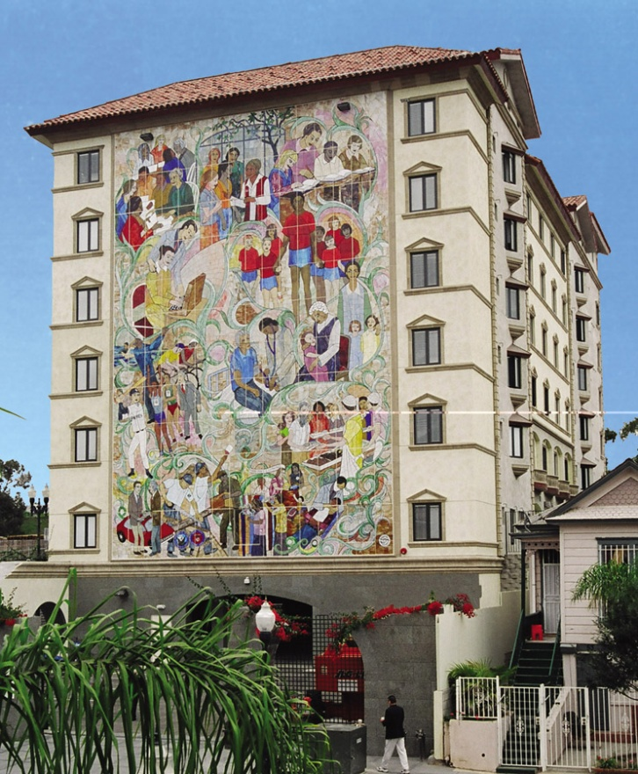
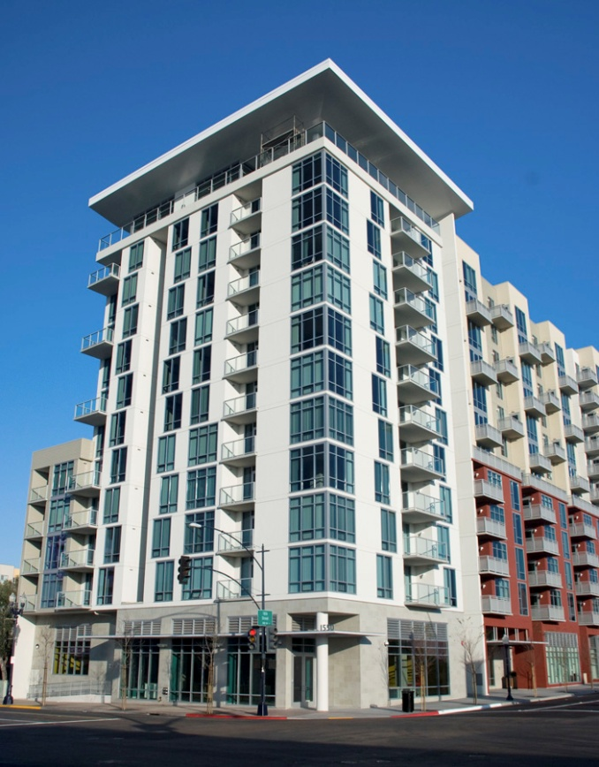
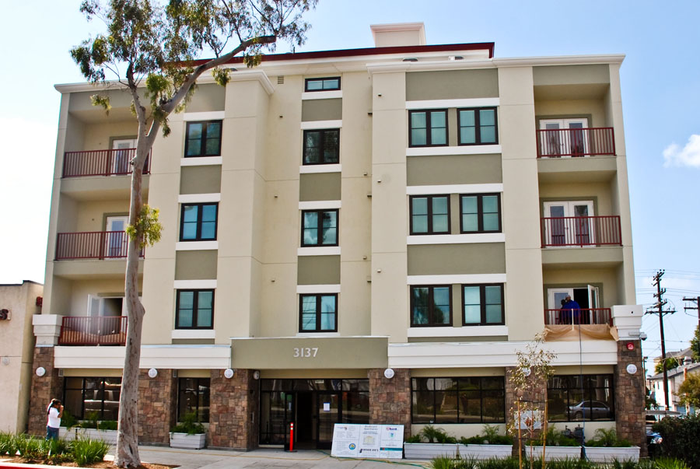
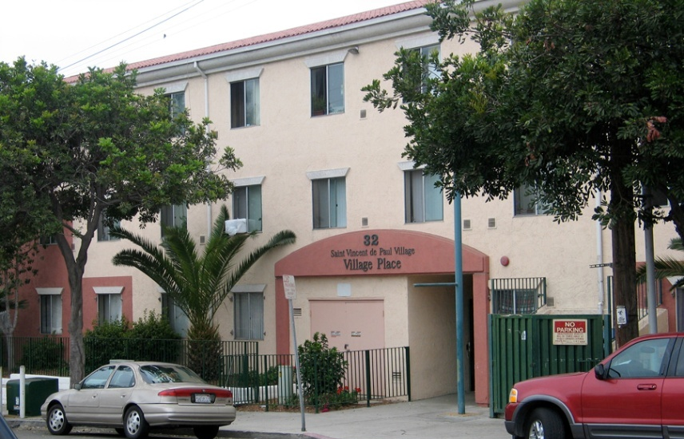
Permanent Housing
Notes:
Clockwise:
C15
VHM
SAM
Village Place
Blvd.

Slide 26
How we do it: Permanent Housing
Tenant Services Team
Client
Psychiatrist
Mental Health Clinician
Nurse
Tenant Services Coordinator
Life Skills Coach/PSS
Team Leader
Program Assistant
Chaplaincy
Instructors
Notes:
At the end of 2012 we merged ACT into Tenant Services. Medical billing is going to allow us to have this team as we bill for MHC and Psychiatrist. Worked to maintain the best of ACT while being fiscally responsible. Same multidisciplinary team model with many of same positions but less frequency and intensity of visits.
Peer Support Specialist is a volunteer. Program Assistant critical to make sure billing is successful and to help manage activities.
ACT data from the grant term:
96% of the 82 tenants who participated in the Village Assertive Community Treatment program remained in stable housing for at least 1 year. 82% of them improved or stabilized psychiatric functioning. The program was able to reduce psychiatric hospital admissions by 100%. The successful program has now been expanded to reach all of Father Joe’s Villages 140 Permanent Supportive Housing units.

Slide 27
Outcomes: PERMANENT Housing
Tenants Served
73/165
Notes:
The differential in the number of people housed is 115. The majority of that is accounted for by the opening of C15. There were 71 additional C15 tenants served in 2012 that were not served in 2011. The remaining 44 tenants can be accounted for by move-outs (3% drop in housing stability from 2012 to 2011 see next slide) and the differential in the number of kids in each household.
People Housed: 712 people were housed in our PH programs in 2012; 35 housed through Project 25; 228 through VHPD.
Of the new people moving in to Village Permanent Housing, 44% came directly from a homeless situation such as the streets or transitional housing.
2011 data – 597 people housed in PH (does not include P25 or VHPD totals)
108 households with families, 250 single adults - 165 new tenants 40 (24%) from a homeless situation

Slide 28
Outcomes: PERMANENT Housing
Notes:
Housing Stability
2012 – 9 passed away
Of those who moved in before 2012:
➢ 96% stayed in FJV PH for more than 1 year
➢ 45% of those who left moved to other PH
Of those who moved in during 2012:
➢ 95% maintain their housing in FJV PH
➢ 33% of those who left moved to other PH
2011 – 6 passed away
25 unknown destination for 2011 PH exits (19% of total checkouts)
Of those who moved in before 2011:
78% stayed in FJV PH for more than 1 year
65% of those who left moved to other PH
Of those who moved in during 2011:
98% maintain their housing in FJV PH
64% of those who left moved to other PH

Slide 29
Outcomes: PERMANENT Housing
Notes:
We work hard to limit exits from our permanent housing to movement to other permanent housing. This slide depicts where tenants went:
2011
22% did not stay over a year – 65% of that 22% moved to other permanent housing.
2% of those who moved in during 2011 did not stay at least through the end of the year. 64% of that 2% moved to other permanent housing
6 died in 2011
2012
4% did not stay over a year – 45% of that 4% moved to other permanent housing
5% of those who moved in during 2012 did not stay at least through the end of the year. 33% of that 5% moved to other permanent housing
9 died in 2012

Slide 30
2014 and beyond
Community:
  Create more affordable housing
  Provide a broader variety of employment opportunities
  See your neighbor – homelessness isn’t a problem, it’s a person.
Service Providers & Stakeholders:
  Maximize new rental assistance offerings from the Housing Commission
  Dosage, dosage, dosage
Notes:
The first two priorities reflect HEARTH Act expectations.
The third priority reflects the reality that to meet the expectations of HUD we must increasingly help our clients to manage rents that are not subsidized (because of the shortage of affordable housing options).
Because of the shortage of affordable housing, we must continue to help FJV tenants achieve higher income potential so they can move into unsubsidized housing thereby making room for new tenants in affordable housing.
Historically and currently when we report program costs we are comprehensive in that calculation. We must make sure that we are calculating costs in a way that allows for “apples to apples” comparisons. (For example, the National Alliance calculates that using housing first for families costs $3,000 per placement whereas Transitional Housing costs $15,000. Does that calculation include the cost of the rent voucher, building costs, etc. Additionally, Connections Housing, in reporting their budget, did not include the cost of the services that occur within the building that are provided by other agencies.)

Slide 31
What’s Next for
St. Vincent de Paul Village?
  Continue “Housing First” effort to highest users of public/private services (Project 25), which saved the community $1.9 million in one year
  Continue “best dosage” philosophy
  Use strengths of transitional housing to continue successful exits from transitional housing to market rate and unsubsidized housing
  Promote movement from subsidized permanent housing to unsubsidized permanent housing

Slide 32
Finally – More Systemic
Change Needed!
Strengthen the “safety net” so resources don’t disintegrate.
  EXAMPLE: In partnership with Corporation for Supportive Housing, St. Vincent’s designed, facilitated and implemented HOPE San Diego. Our staff have trained 24 community agencies in the best practice.
    80% of clients seeking benefits through the HOPE San Diego process received benefits within 88 days of application. Nationally, only 30% of people receive benefits on the first application and it can take from 18-36 months.
Earlier intervention
makes a difference.
Notes:
HOPE: Nationally, only 30% of people receive benefits on the initial application using the traditional process which can take from 18-36 months.
Actively involved = 10 (SVdPV, SSA, DDS, MHS, CRF, Telecare, Rescue Mission, Providence, Exodus, Catholic Charities)
There are only 10 actively involved however some agencies have several programs within the agency doing it. For example MHS has Center Star ACT, North Star ACT, SIP, and mid coast recovery center.
Trained: 27 (includes 10 actively involved)
Active Advisory Level: 12

Slide 33
“Neighbors helping neighbors”
St. Vincent de Paul Village, Inc.

