Slide 1
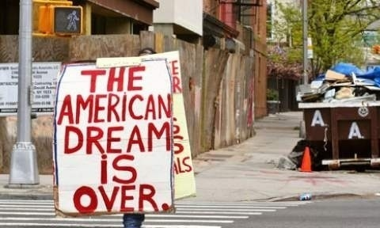

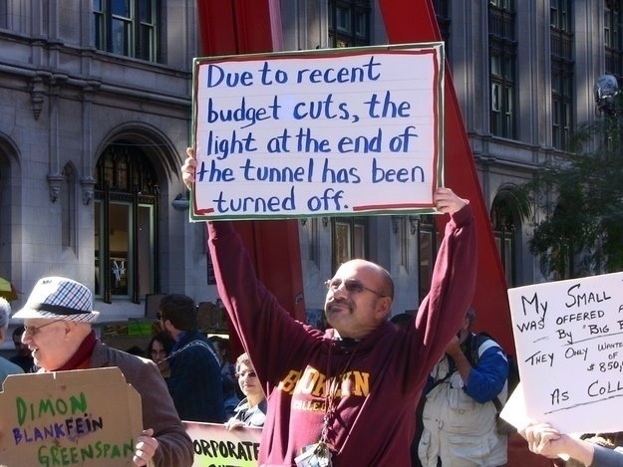
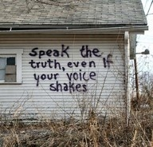
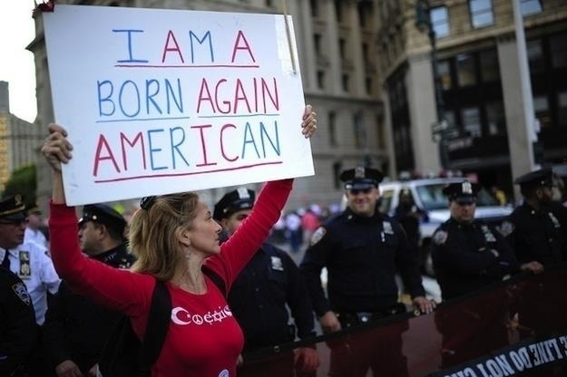

Slide 2

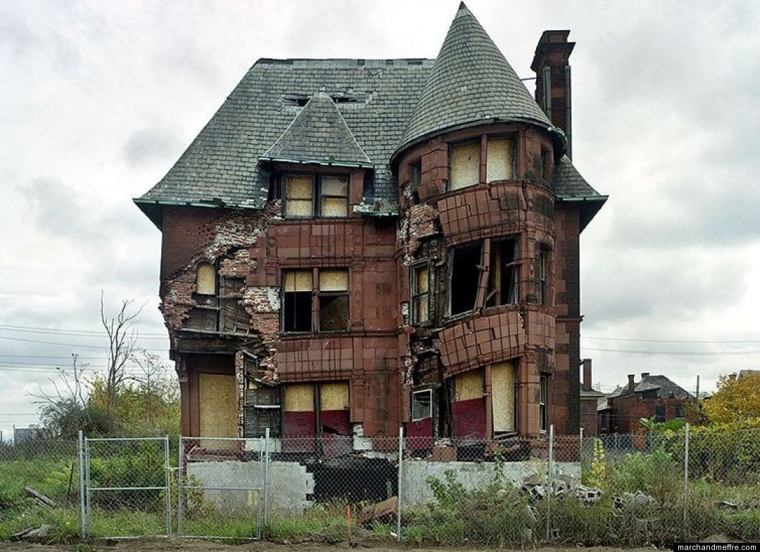
ILL FARES THE LAND: AN ERA OF NATIONAL CIVIC CATASTROPHE or “LIFE ON OUR PLANTATION”
Jeoffry B. Gordon, MD, MPH
paradocs2@hotmail.com

Slide 3
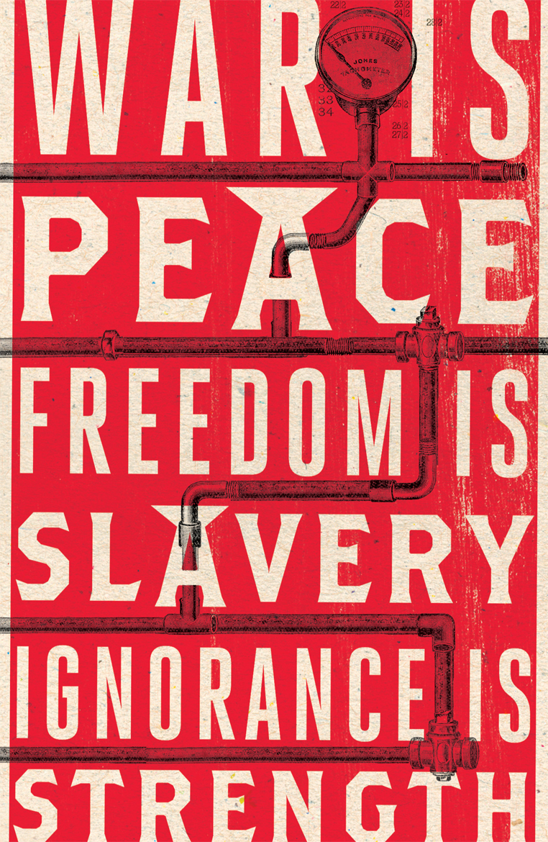
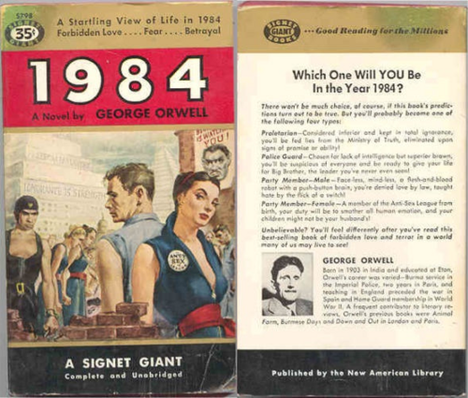

WAS ORWELL 30
YEARS OFF??

Slide 4
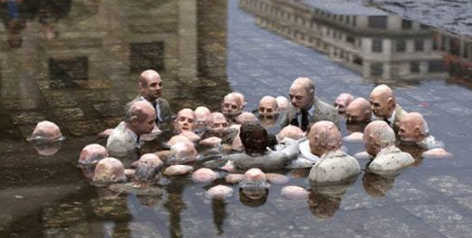
Fla. gov. bans the terms climate change, global warming, USA TODAY
Republican politicians overwhelmingly oppose any action to limit emissions of greenhouse gases, and that the great majority reject the scientific consensus on climate change. Last year PolitiFact could find only eight Republicans in Congress, out of 278 in the caucus, who had made on-the-record comments accepting the reality of man-made global warming. All of the contenders for the Republican presidential nomination are solidly in the anti-science camp. And climate-denial orthodoxy doesn’t just say that the scientific consensus is wrong. Senior Republican members of Congress routinely indulge in wild conspiracy theories, alleging that all the evidence for climate change is the product of a giant hoax perpetrated by thousands of scientists around the world. And they do all they can to harass and intimidate individual scientists. - Paul Krugman THE NEW YORK TIMES, Dec. 4, 2015

Slide 5
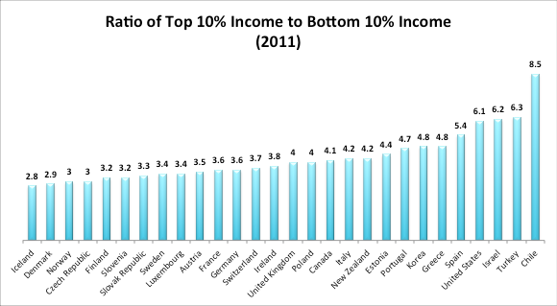
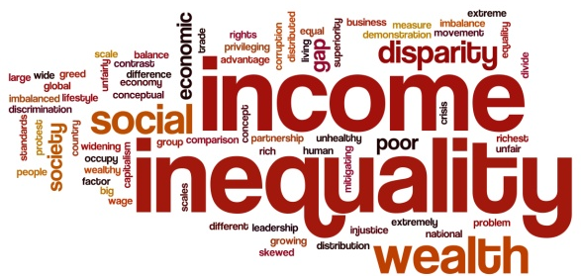
I. LIVING IN A “BANANA REPUBLIC”
THE BASIC FACTS of INCOME INEQUALITY

Slide 6
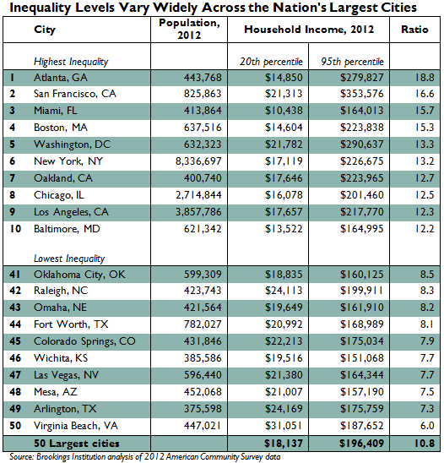
Below are the 25 metropolitan areas, ranked in order of the salary needed in those areas to afford a median-priced home (in January, 2014):
1. Cleveland: $19,435.17
2. Cincinnati: $22,226.95
3. St. Louis: $22,397.54
4. Atlanta: $24,390.94
5. Tampa: $24,650.88
6. Orlando: $28,298.47
7. San Antonio: $29,305.47
8. Dallas: $29,751.24
9. Houston: $31,298.99
10. Chicago: $32,388.90
11. Phoenix: $32,811.94
12. Minneapolis: $33,800.09
13. Philadelphia: $36,836.47
14. Baltimore: $41,155.40
15. Sacramento: $42,832.20
16. Miami: $43,918.66
17. Portland, Ore.: $45,872.78
18. Denver: $48,122.72
19. Seattle: $59,129.86
20. Washington, D.C.: $62,809.63
21. Boston: $63,673.13
22. New York City: $66,167.27
23. Los Angeles: $72,126.90
24. San Diego: $81,570.40
25. San Francisco: $115,510.06

Slide 7
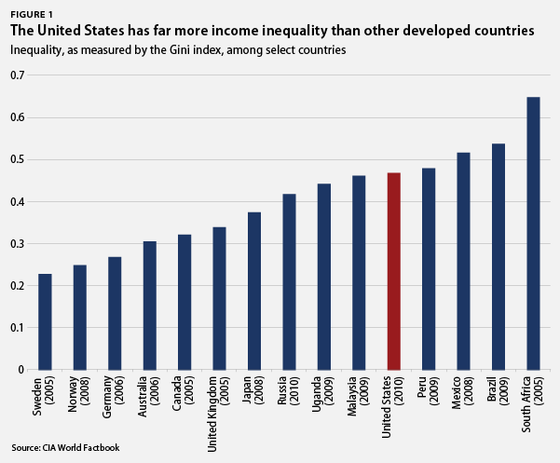
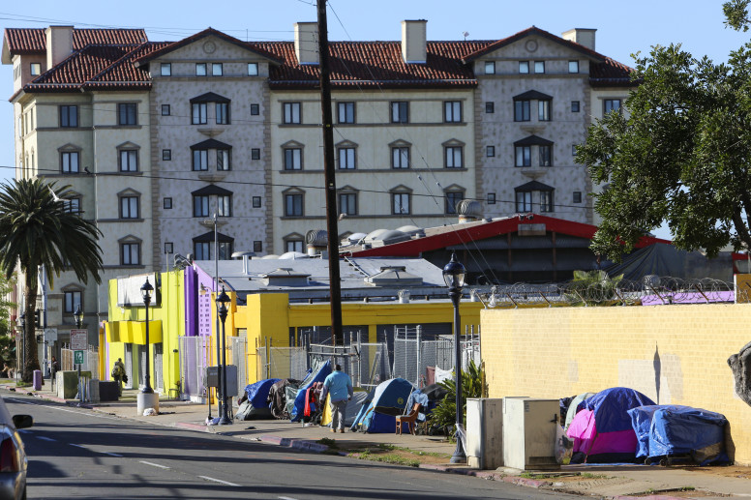
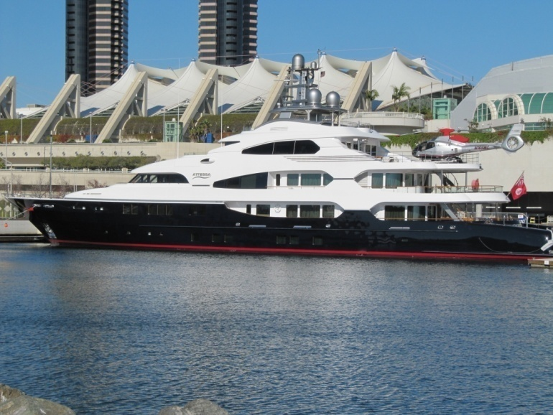
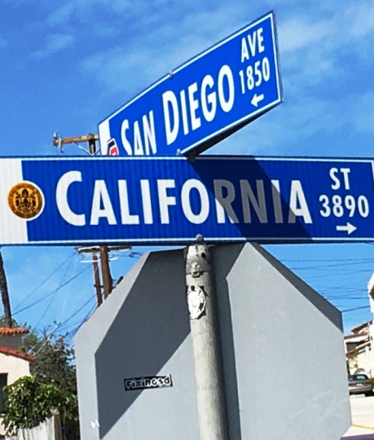

Slide 8
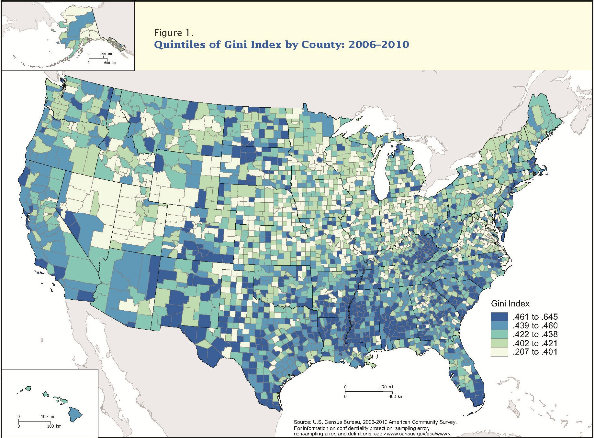


Slide 9
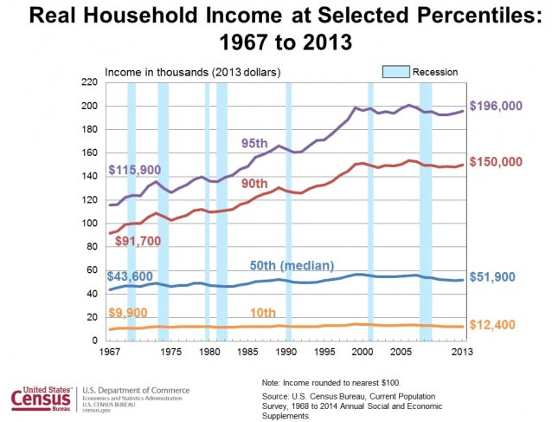

Slide 11
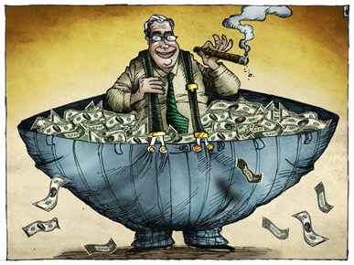
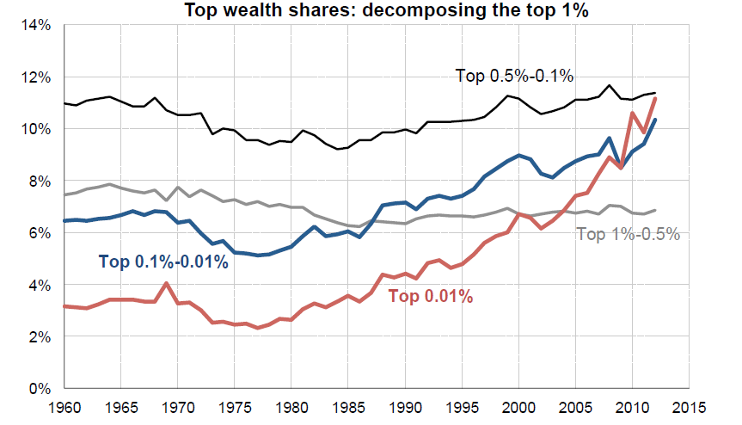

Slide 12
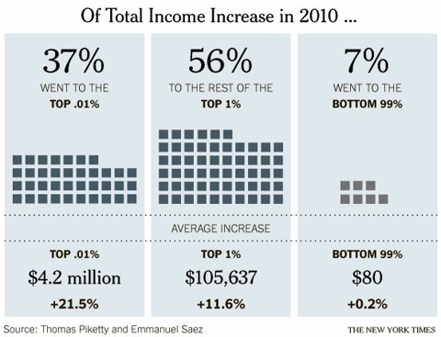

The top .01% (14,000 of us) earn an average of $23.8M/YR. The top 1% (1.4M) includes people earning over $352,000 in annual income.

Slide 13
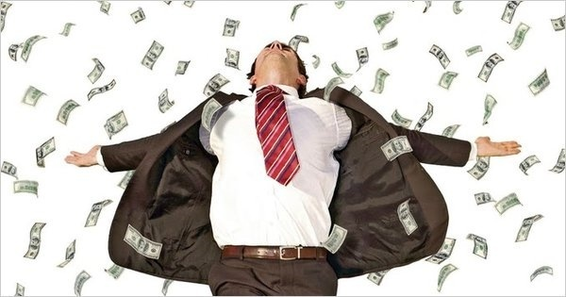
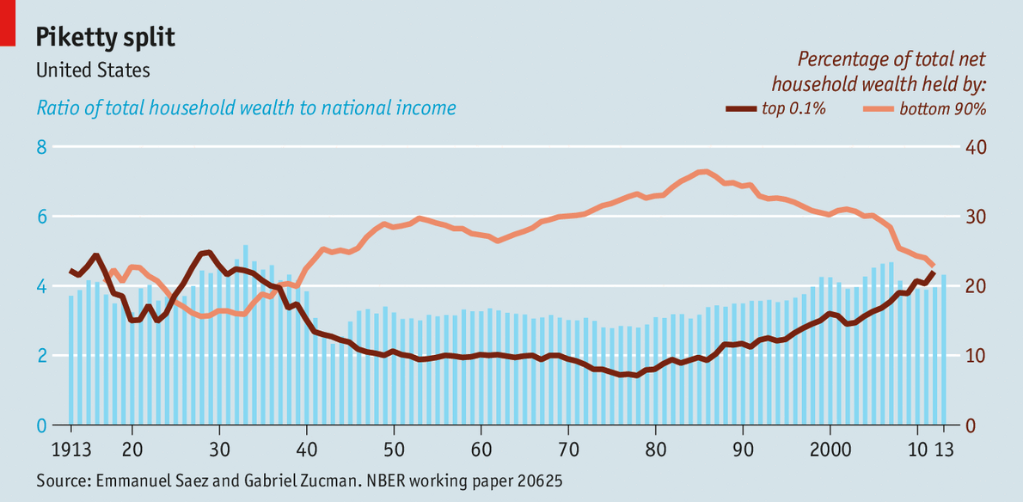
The Stock/Equity Wealth of the Richest 12,000 Households Has Surpassed Housing Wealth of 108,000,000 Households

Slide 14
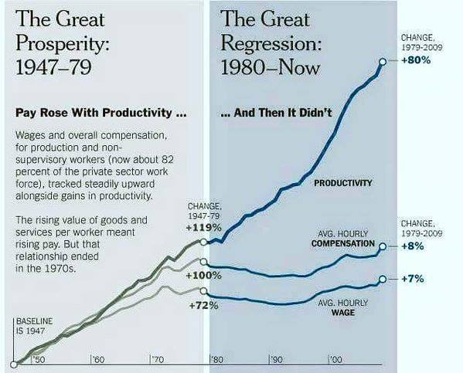

Slide 15
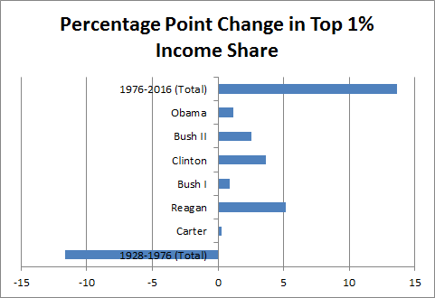

Slide 16
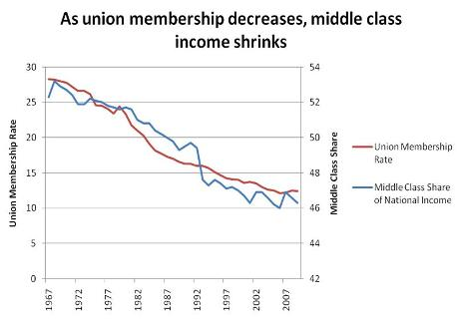
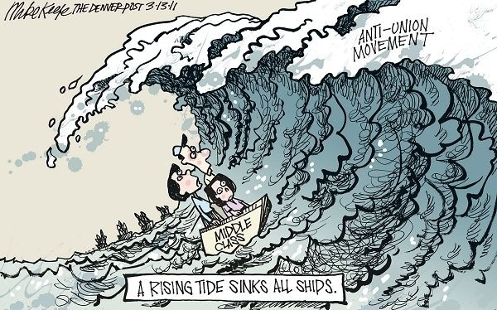
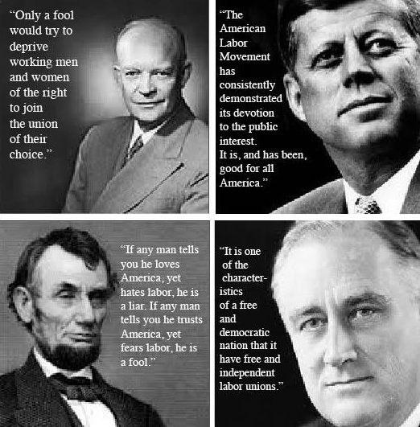


Slide 17
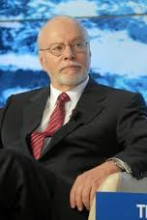
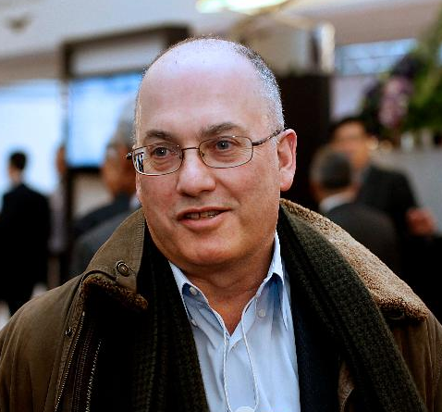
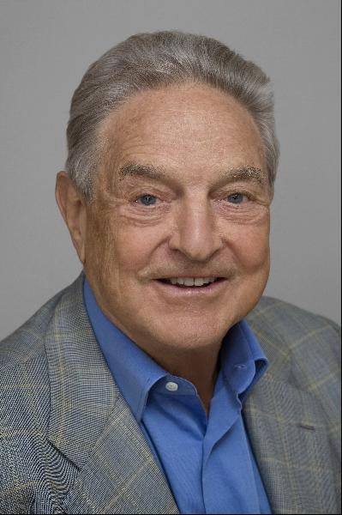
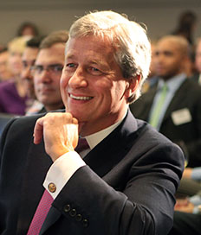
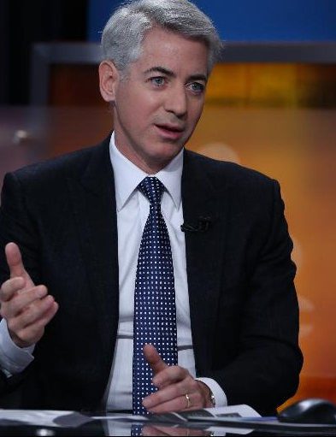
*** In 2014 top 7 Wall Street hedge fund managers earned more than the total annual salary of all the kindergarten teachers in the USA
Hedge funds manage to collect hefty fees: *“two and twenty” fee structure: investors must pay a management fee of 2%, and then a performance fee of 20% on any returns above a set target.
*carried interest loophole: By act of Congress hedge fund managers pay taxes at a 20% capital gains rate on their profit, rather than the normal 39.6% rate. This incredibly generous loophole will cost taxpayers $180 billion in lost revenue over the next ten years.

Slide 18

Panama Papers Could Lead to Capitalism’s Great Crisis TIME, April 4, 2016
The Panama Papers, an analysis of 11.5 million leaked documents from global law firm Mossack Fonseca revealed by the International Consortium of Investigative Journalists (ICIJ) shows that the shadow financial system was growing. Mossack Fonseca was working with big name financial groups to help global financiers hide cash in offshore havens around the world. The Panama Papers illuminate a key aspect of why the system isn’t working–because globalization has allowed the capital and assets of the 1 % (be they individuals or corporations) to travel freely, while those of the 99 % cannot. Globalization is set up to enable that mobility mainly for the rich (or for large corporations). The result is global tax evasion, the offshoring of labor, and an elite that flies 35,000 feet over the problems of nation states and the tax payers within them. Global Financial Integrity found developing economies lost $7.8 trillion in cash because of maneuvers like those allegedly done by Mossack Fonseca, between 2004 and 2013.

Slide 19
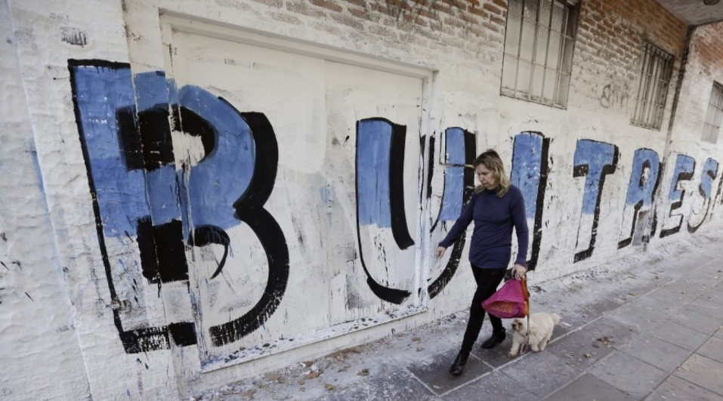
After 15 Years, Argentina Agrees To Pay Back U.S. Creditors: Singer Makes 369% of Principal on Argentine Bonds in Debt Offer
Argentina’s debt crisis is finally over. The Argentine Senate voted 54-16 to issue $12.5 billion in bonds. Part of the money raised will be used to pay back $4.65 billion to U.S. hedge funds, most notably Paul Singer’s NML Capital, an offshore subsidiary of Elliott Management. Argentina’s 2005 restructuring imposed losses of about 70 percent on investors’ claims, and Argentina made a similar offer in 2010. While about 92 percent of creditors tendered their debt in those two restructurings, Singer and other holdouts pursued better terms in the U.S. courts which backed him.
According to a Bloomberg estimate, Elliott Management will get back $2.28 billion, or about 369 percent of the firm’s $617 million investment in distressed bonds; Singer paid just $117 million for them 15 years ago.

Slide 20

The new Gilded Age: Close to half of all super-PAC money comes from 50 donors, THE WASHINGTON POST, April 15, 2016
Close to half the money — 41 percent — raised by super PACs for the 2016 elections to the end of February came from just 50 mega-donors and their relatives, according to the Washington Post. Thirty-six of those are Republican supporters trying to shape the GOP nomination contest — accounting for more than 70 percent of the money from the top 50. In all, donors this cycle have given more than $607 million to 2,300 super PACs, which can accept unlimited contributions from individuals and corporations.
The Top 10
Rank Name Total Donations Supporting
1 Tom Steyer (D) $17 million climate change
The Wilks family (R) $15.3 million Ted Cruz
Maurice "Hank" Greenberg (R) $15 million* Bush & Rubio
4 Robert Mercer (R) $14.6 million Ted Cruz
5 Toby Neugebauer (R) $10.1 million Ted Cruz
6 Paul Singer (R) $9.9 million Marco Rubio
7 Ronald Cameron (R) $8.6 million* Huckabee & Rubio
8 Kenneth C. Griffin (R) $8.3 million Koch/Rubio
9 George Soros (D) $8 million Hillary Clinton
10 Elizabeth and Richard Uihlein (R) $7.5 million Walker & Rubio

Slide 21
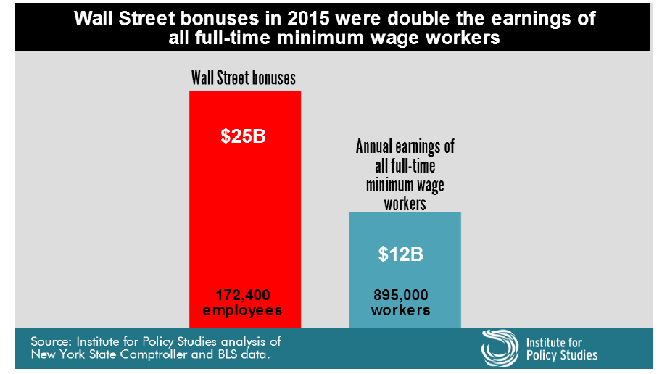
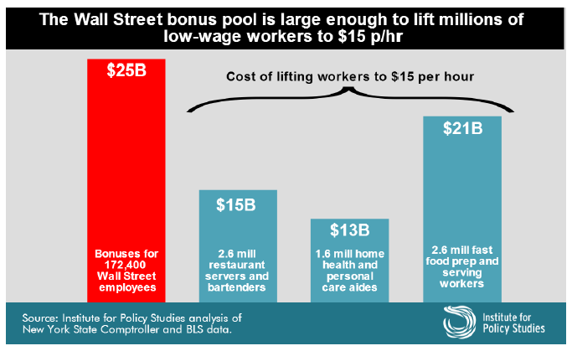


Slide 22
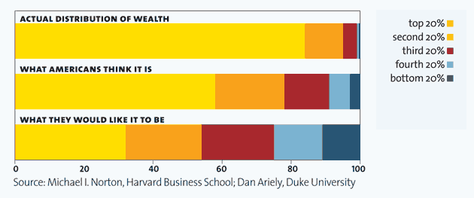
Rising Wealth Inequality: Should We Care? The Lottery Mentality
Americans actually live in Russia, although they think they live in Sweden. And they would like to live on a kibbutz.
Culturally Americans have not raised income inequality as an issue in the past because Americans don’t begrudge the rich so much as they want to join them. The Norton and Ariely (2011) study suggests otherwise. Given a choice, Americans would prefer to live in a society more equal than even highly egalitarian Sweden.

Slide 23
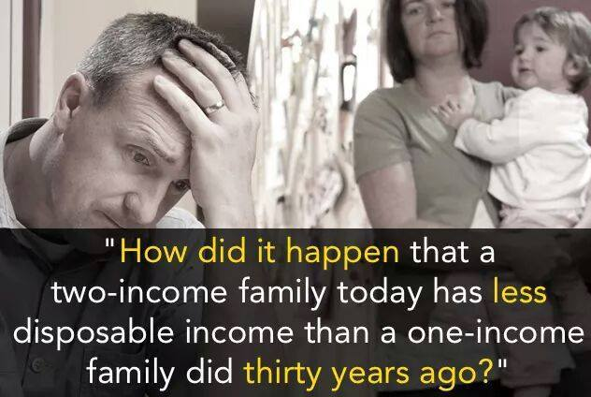

II. THE MIDDLE CLASS
(and JUST ABOUT EVERYONE ELSE):
TRAPPED,FRUSTRATED and ANGRY

Slide 24
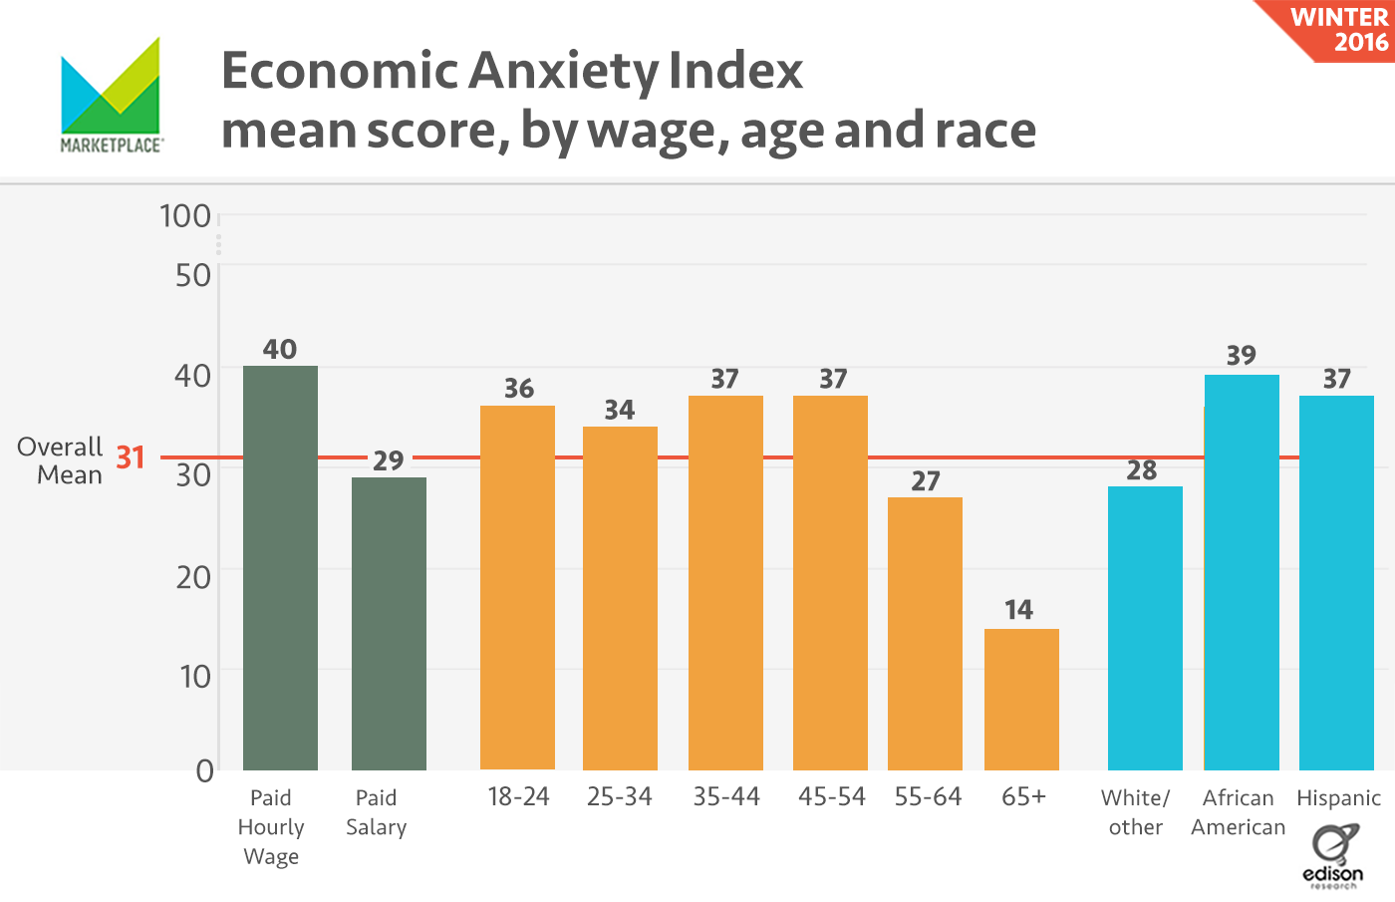

Among the more than 1,000 people surveyed, more than 60 percent reported feeling at least some anxiousness about their financial situations, while 30 percent said concern over their financial situation is causing them to lose sleep. A majority, or 64%, of Americans don't have enough cash on hand to handle a $1,000 emergency expense.

Slide 25
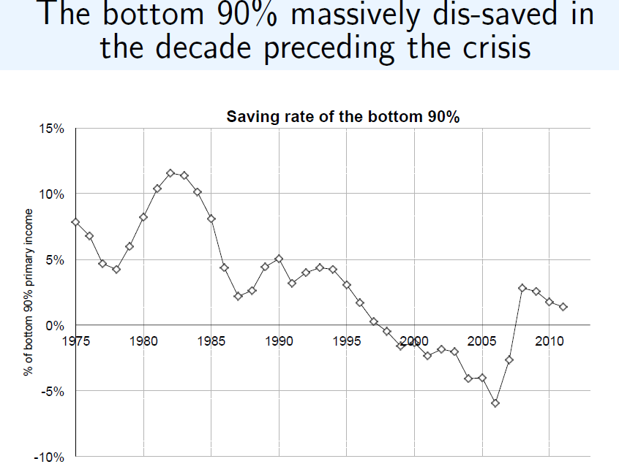
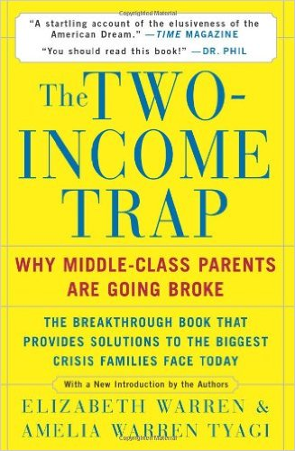
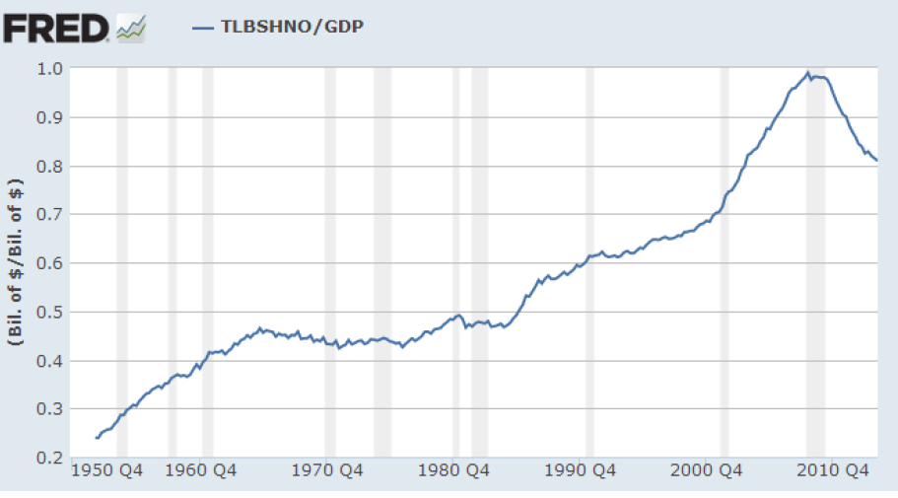
Written by a law school professor and her daughter in 2003 and outlining and predicting the current and future exploitation of the middle class

Slide 26
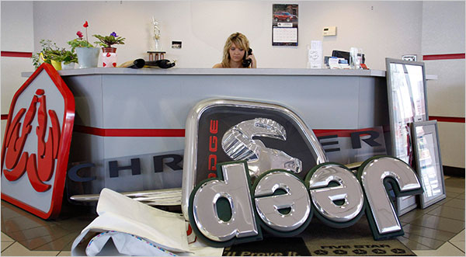

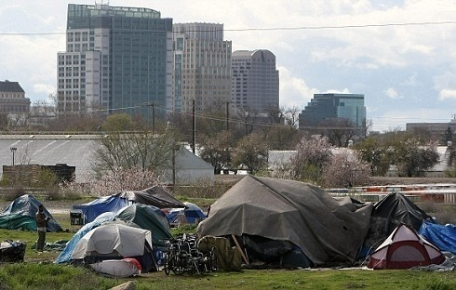
THE GREAT RECESSION OF 2008
Estimated total GDP loss $12T
$40,000/per person

Slide 27
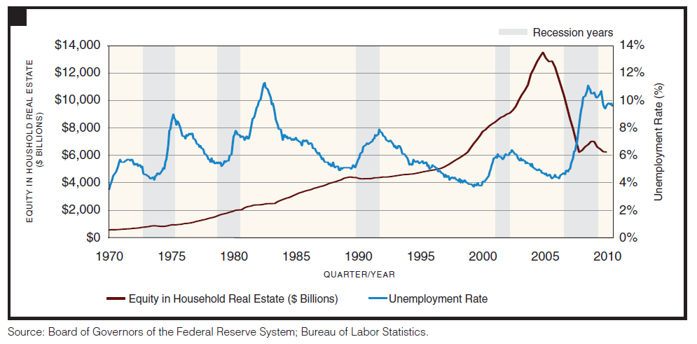
THE GREAT RECESSION

Slide 28

** 8.3 million jobs lost 2008-09, total 26.2 million unemployed
** 10% white unemployment rate, 16% Black unemployment rate, 13.2% Hispanic unemployment rate
** 17% underemployment rate
** 17.4 million U.S. families went hungry at some point in 2009, according to the USDA which also found that 6.8 million households with up to 1 million children had continuing financial problems that left them unable to eat regularly
** 5.4 million people have been added to federal disability rolls as discouraged workers give up looking for work
** GDP fell 6% in 2008, 2.6% in 2009 (total US GDP, 2008 $14.4 T)
** $17 trillion (22% of all value) lost in net household worth ($5.6 T in lost home prices)
** 3.1 million foreclosure filings during 2008 (one of every 54 households) 861,664 families lost their homes in 2008, 5 million foreclosures total. Another 2,824,000 foreclosure filings in 2009
** Stock market fell by 1/3 (retirement funds lost $2.8T)
** Household bankruptcies 2.5 million in 2008-09

Slide 29
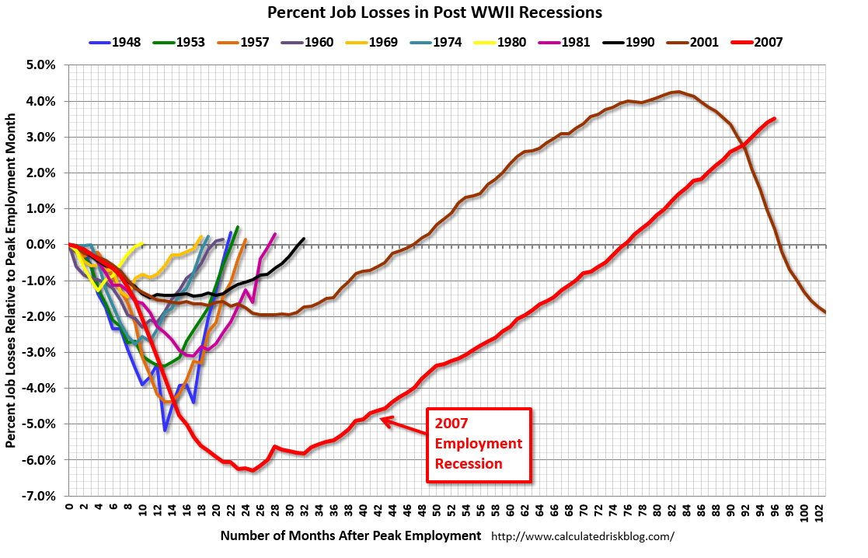
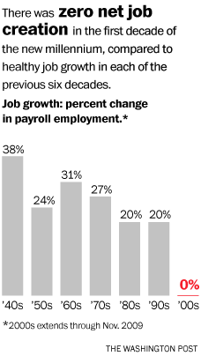
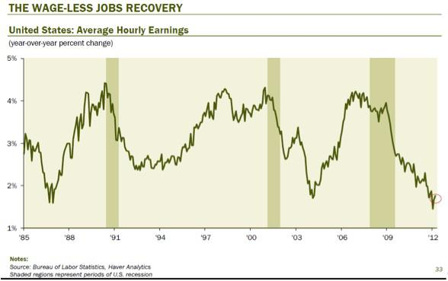


Slide 30
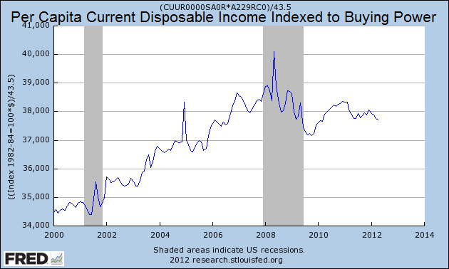
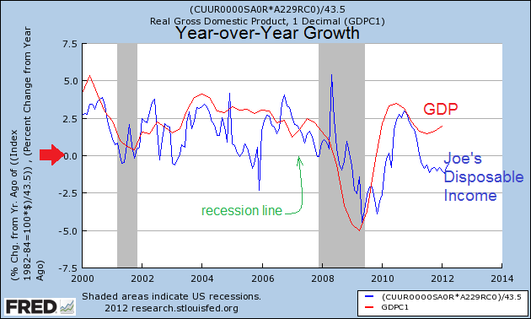
The graph above shows April 2012 per capita disposable income 0f $37,711 (current dollars) indexed to the buying power of the dollar. Joe's world is operating at the same levels as five years ago. This is Joe's real income growth - and it shows Joe's real income is shrinking.
Taking the data in the graph to the left, and comparing growth year-over-year with GDP - Joe's disposable income has been shrinking since mid 2011 - just as the establishment was telling Joe the economy is growing.

Slide 31
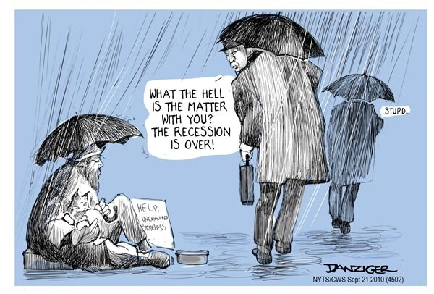



Slide 32


From January 2007 to December 2011 there were more
than four million completed foreclosures (over $6
trillion in lost value) and more than 8.2 million
foreclosure starts …. As of May 2012, approximately
1.4 million homes, or 3.4 percent of all homes with a
mortgage, were in the national foreclosure inventory.

Slide 33


Slide 34



Slide 35




Slide 36




Rising health care spending—both on premiums and out-of-pocket costs—totally erased wage gains for a typical family from 1999 to 2009.
D. Blumenthal and D. Squires, "Do Health Care Costs Fuel Economic Inequality in the United States?" The Commonwealth Fund Blog, Sept. 9, 2014.

Slide 37


Slide 38



80 years ago Social Security system’s benefits were intended as an unbreakable commitment based on a lifetime of work. Social Security benefits could not be taken away by banks or other creditors. That changed in 1996 when Newt Gingrich’s Congress added a loophole allowing outstanding student loans to override Social Security’s guarantee.
This April the U.S. Department of Education took actions that could result in the discharge of over $7 billion worth of student loan debt, helping 387,000 Social Security recipients with disabilities.

Slide 39


Slide 40


Marquette Nat. Bank of Minneapolis v. First of Omaha Service Corp. (439 U.S. 299 (1978)), is a unanimous U.S. Supreme Court decision holding that state anti-usury laws regulating interest rates cannot be enforced against nationally chartered banks based in other states.

Slide 41


Slide 42
U.S. Techno-Peasant Numbers
25.4M – Age 18-64 have not completed high school (or equivalent)
8.1M – Have dropped out before 9th grade
28.8M – With a high school diploma or less are not earning living wages
8.3M – Age 18-64 with high school diplomas or less have difficulty speaking English or speak no English at all
1.5M – Included in this group are in state & federal prisons

Slide 43


Slide 44


New School Year Brings Steep Cuts in State Funding for Schools Center on Budget and Policy Priorities, October 7, 2011
Of 46 states that publish education budget data in a way that allows historic comparisons:
** 37 states are providing less funding per student to local school districts in the new school year than they provided last year.
** 30 states are providing less than they did four years ago.
** 17 states have cut per-student funding by more than 10 percent from pre-recession levels.
Four states— South Carolina, Arizona, California, and Hawaii — each have reduced per student funding to K-12 schools by more than 20 percent.

Slide 45


Slide 46





Slide 47
Only one in 10 families in the bottom 20 percent of income earners have retirement savings accounts. This is because lower-income workers receive skimpier matching contributions from employers, can least afford to contribute or bear investment risks, and receive little or no tax benefit – but still face a penalty if they need to tap their savings early.
Conversely, nine in 10 families in the top 20 percent have a retirement savings account and make up 74 percent of the TOTAL retirement savings in America.
Two-thirds of seniors rely on Social Security for the majority of their income. And, as Americans face an unprecedented $7.7 trillion retirement savings gap – meaning that for the first time in our country’s history, current and future retirees are preparing for a lower standard of living in retirement than their parents

Slide 48

III. THE TRAGIC IMPLICATIONS of INEQUALITY for CIVIL SOCIETY:
HEALTH and SOCIAL PROBLEMS

Slide 49


Slide 50

OPTIMAL HEALTH OUTCOMES DEPEND ON SOCIAL and ECONOMIC JUSTICE

Slide 51



Slide 52

A PLANTATION ECONOMY PRODUCES CAUDILLO POLITICS

Slide 53


Death rate for U.S. non-Hispanic whites (USW), U.S. Hispanics and six comparison countries, aged 45-54. (Source: Proceedings of the National Academy of Sciences.)
White middle-aged Americans have suffered a startling rise in death rates between 1999 and 2013, showing a sharp reversal in decades of progress toward longer lives. The mortality rate for white men and women ages 45-54 with less than a college education increased markedly, most likely because of problems with legal and illegal drugs, alcohol and suicide. An increase in the mortality rate for any large demographic group in an advanced nation has been virtually unheard of in recent decades, with the exception of Russian men after the collapse of the Soviet Union.
“Drugs and alcohol, and suicide . . . are clearly the proximate cause,” said Angus Deaton, the 2015 Nobel laureate in economics, who co-authored the paper with his wife, Anne Case. Both are economics professors at Princeton University. “Half a million people are dead who should not be dead.”

Slide 54



Slide 55




Slide 56


Slide 57




Slide 58





Slide 59

IV. GOVERNMENT BY CORPORATION
THE FABLE OF “FREE MARKET FUNDAMANTALISM”

Slide 60

Robert Rubin: 'Virtually Nobody' Saw Crisis Coming, Bush Deserves Much Of The Blame Huffington Post Grace Kiser 03- 3-10
Robert Rubin, the former Clinton-era Treasury Secretary and noted champion of deregulation, told a New York City audience last night that "virtually nobody" -- himself included -- foresaw the financial meltdown….Rubin touched on the financial crisis, Obama's economic policies and America's potential in the new global economy -- but not on financial reform or the deregulatory agenda of the 1990s.
Greenspan reflects on crisis, deflects blame By Dana Milbank Washington Post
Thursday, April 8, 2010
While finding himself blameless, he assigned fault to, among others, Congress, the Bush and Clinton administrations, Fannie Mae and Freddie Mac, the Europeans, other regulators, and one of his Fed colleagues. They all contributed to what Greenspan, in his testimony, called "the most prominent global bubble in generations…." When the collapse finally came, Greenspan acknowledged "a flaw" in his philosophy that unfettered free markets are best and regulations don't work.

Slide 61

Revealed: See Who Was Paid Off In The AIG Bailout
HuffPost Reporting 01-27-10
The Federal Reserve Bank of New York, then led by now-Treasury
Secretary Tim Geithner, purchased a slew of souring assets from
the world's biggest banks for 100 cents on the dollar in November
and December 2008. The terms of the bailout of American International Group (AIG) were negotiated, in part, by then-Treasury Secretary Henry Paulson, a former CEO of Goldman Sachs. The deal Paulson helped negotiate got AIG 100 cents on the dollar for its insurance contracts, called credit default swaps and made all of AIG's counterparties - including Goldman Sachs - completely whole on risky bets made with AIG for toxic mortgage bonds -- home mortgages that were bundled together and securitized. The banks could never have gotten anywhere near such a generous deal on the open market, so the move served essentially as a direct subsidy to those banks from taxpayers . (At the time, Goldman's $14 billion in souring derivatives had a market value of just $6 billion. Goldman had more than $8 billion in collateral from AIG to protect it from losses and ultimately received about $8 billion from taxpayers via AIG. Goldman posted a $1.3 billion profit for 2008.) In a startling response to a FOIA request in 2015, the Treasury Department is claiming, amazingly, that there are no records of official communication between then-Secretary Hank Paulson and AIG executive Joe Cassano during bailout negotiations.

Slide 62

Goldman Sachs pays $5 billion to settle allegations it sold shoddy mortgages
THE WASHINGTON POST, April 11, 2016
NEW YORK — Goldman Sachs, one of
the most powerful investment banks
on Wall Street, agreed on Monday to
pay $5.06 billion to settle allegations
that it sold packages of shoddy
mortgages to investors during the
period leading up to the financial crisis.
But, similar to other massive settlements reached with large banks over the last few years, no individual bank employee is being held responsible for the alleged bad behavior that led to the settlement.
Instead, the settlement includes a $2.385 billion civil penalty and $1.8 billion for distressed borrowers and communities affected by the housing crisis.
“Today’s settlement is another example of the department’s resolve to hold accountable those whose illegal conduct resulted in the financial crisis of 2008,” Benjamin C. Mizer, head of the Justice Department’s civil division, said in a statement.

Slide 63


Slide 64


Slide 65





Slide 66


Slide 67



** Big firms in the United States have never had it so good.
** American capitalism has a corrosive lack of competition: their returns on equity are 40% higher in the United States than they are abroad. Aggregate domestic profits are at near-record levels relative to GDP.
**The excess cash generated domestically by American firms beyond their investment budgets is running at $800 billion a year, or 4% of GDP.
**The tax system encourages them to park foreign profits abroad.
** Were America’s firms to cut prices so that their profits were at historically normal levels, consumers’ bills might be 2% lower.

Slide 68
“When Verizon workers went on strike last week, they were angry about the company’s unwillingness to invest in its own business. In particular, Verizon has shown a remarkable lack of interest in expanding its Fios high-speed Internet network, despite strong demand. Verizon does not want to invest because it doesn’t have to: many customers have no place else to go, so the company can treat its broadband business as a cash cow,
Corporate profits are at near-record highs, thanks to a substantial decline in the percentage of G.D.P. going to workers. You might think that these high profits imply high rates of return to investment. But corporations themselves clearly don’t see it that way: their investment in plant, equipment, and technology (as opposed to mergers and acquisitions) hasn’t taken off, even though they can raise money, whether by issuing bonds or by selling stocks, more cheaply than ever before.
Suppose that those high corporate profits don’t represent returns on investment, but instead mainly reflect growing monopoly power. In that case many corporations would be able to milk their businesses for cash, but with little reason to spend money on expanding capacity or improving service. The result would be what we see: an economy with high profits but low investment, even in the face of very low interest rates and high stock prices.
And such an economy wouldn’t just be one in which workers don’t share the benefits of rising productivity; it would also tend to have trouble achieving or sustaining full employment.
We aren’t just living in a second Gilded Age, we’re also living in a second robber baron era.” --- Paul Krugman, NYT, April 18, 2016

Slide 69


“NEARLY SEVEN YEARS INTO THE US RECOVERY, THE
ECONOMIES OF THE INDUSTRIAL WORLD ARE IN A PERIOD
OF SECULAR STAGNATION, SUFFERING FROM AN
IMBALANCE RESULTING FROM AN INCREASING PROPENSITY
TO SAVE AND A DECREASING PROPENSITY TO INVEST. THE
MAIN CONSTRAINT ON THE INDUSTRIAL WORLD’S ECONOMY
TODAY IS ON THE DEMAND, RATHER THAN THE SUPPLY, SIDE.
(According to the OECD, the percentage of GDP invested in a category that is mostly plant and equipment has fallen: in the US, it fell from 8.4% in 2000 to 6.8% in 2014; in the EU, it fell from 7.5% to 5.7% over the same period.) AN EXPANSIONARY NATIONAL FISCAL POLICY, PATRICULARLY WHEN PURSUED THROUGH PUBLIC INVESTMENT, CAN STIMULATE GROWTH. IT IS TRAGIC THEREFORE, THAT IN THE US TODAY, FEDERAL INFRASTRUCTURE INVESTMENT, NET OF DEPRECIATION IS RUNNING CLOSE TO ZERO, AND NET GOVERNMENT INVESTMENT IS LOWER THAN ANYTIME IN NEARLY SIX DECADES. OTHER STRUCTURAL POLICIES THAT WOULD PROMOTE DEMAND INCLUDE MEASURES TO RAISE THE SHARE OF TOTAL INCOME GOING TO THOSE WITH A HIGH PROPENSITY TO CONSUME, SUCH AS SUPPORT FOR UNIONS AND INCREASED MINIMUM WAGES.”
---- Larry Summers March, 2016

Slide 70
GOVERNMENT BY LOBBYISTS
1. Lobbyists are the major source of technical information for legislation. (Think Chamber of Commerce, ALEC)
2. Think tanks, interest affinity groups, and astroturf organizations frame the “intellectual environment.”
3. Business interests curate media content.
4. Revolving door between legislative staff and corporate/lobbying employment.
5. Businesses are a major source of campaign funds.
6. Many businesses have tax and regulatory subsidies.
7. Corporations are legal “persons” and money is speech.
8. Business lobbyists spend $34 for every $1 spent by opponents (13x more on lobbying than on political action).
9. Frequent legal challenges to regulatory constraints.
Companies that spend more on lobbying have a greater return on equity, have stocks that outperform the DJA, have lower tax rates, and are less likely to be investigated for fraud.

Slide 71


Slide 72


Slide 73



INEQUALITY IS THE RESULT OF PUBLIC POLICY
AND POLITICAL DECISIONS
Social expenditure and relative poverty rates in selected OECD countries, late 2000s

Slide 74

On February 15 millionaires and billionaires stopped paying into Social Security for 2016.
That’s right—millionaires and billionaires don’t pay into our Social Security system for most of the year. This is because our Social Security system is primarily funded by payroll contributions (or FICA). But what most Americans never realize is that payroll FICAcontributions are only paid on the first $118,500. Once the FICA cap of $118,500 is reached, millionaires and billionaires stop paying into the system, while the vast majority of Americans continue to pay in on all of their salary.

Slide 75




Slide 76

V. THREE CRITICAL AREAS of REFORM
1. TAXATION
2. RULES OF THE MARKET
3. RULES OF POLITICS

Slide 77
RULES OF THE MARKET
1. Expand anti-trust law
2. Break up the big banks
3. Reintroduce Glass-Steagall
Encourage unionization with legislation
Raise the national minimum wage to $15
6. Revise corporate governance
7. Repeal NAFTA, reject TPP
8. Establish a mandatory criminal referral process and Criminal Referral Coordinators at every financial regulatory agency.
9. Reinstitute usury limits on interest rates
10. Reverse and forbid privatization of “public goods,” especially in state and municipal services
11. Provide a national, universal health care system, largely not for profit
12. Allow students and ex-students to include student loans when they declare bankruptcy
13. Reverse Supreme Court decisions favoring arbitration and impairing Class Action

Slide 78
RULES OF POLITICS
1. Repeal Citizen’s United by legislation
2. Develop public financing of elections or “democracy vouchers”
Facilitate universal adult voter registration
Reintroduce broadcast fairness policy for political speech
Minimize gerrymandering
TAXATION
REVISING EXISTING TAX CODE
1. Increase income taxes on very high incomes (> $5 million)
2. Increase estate taxes
3. Eliminate trust fund loophole (exempting unrealized capital gains from estate taxes)
4. Eliminate lower tax rates for dividends and capital gains
5. Eliminate “carried interest” for hedge fund and private equity profits
6. Eliminate income cap on Social Security tax (FICA)
7. Enforce Foreign Account Tax Compliance Act (FATCA)
8. Modernize corporate tax code to effectively cover multinational corporations
POSSIBLE NEW TAX POLICY
Tax on financial transactions
Carbon Tax
Using low interest rates borrow money to build and renew
infrastructure and create employment

Slide 79
Ill Fares the Land,
By Tony Judt, THE NEW YORK REVIEW OF
BOOKS, APR 29,2010
Something is profoundly wrong with the way
we live today.
*For thirty years we have made a virtue out of
the pursuit of material self-interest: indeed,
this very pursuit now constitutes whatever
remains of our sense of collective purpose.
We know what things cost but have no idea what they are worth. We no longer ask of a judicial ruling or a legislative act: Is it good? Is it fair? Is it just? Is it right? Will it help bring about a better society or a better world? Those used to be the political questions, even if they invited no easy answers.
*The obsession with wealth creation, the cult of privatization and the private sector, the growing disparities of rich and poor and the rhetoric that accompanies these: uncritical admiration for unfettered markets, disdain for the public sector, the delusion of endless growth.
*We cannot go on living like this….But if we do no more than pick up the pieces and carry on as before, we can look forward to greater upheavals in years to come.

Slide 80

It was the best of times, it was the worst of times, it was the age of wisdom, it was the age of foolishness, it was the epoch of belief, it was the epoch of incredulity, it was the season of Light, it was the season of Darkness, it was the spring of hope, it was the winter of despair, we had everything before us, we had nothing before us, we were all going direct to heaven, we were all going direct the other way - in short, the period was so far like the present period.
  Charles Dickens, A Tale of Two Cities
  English novelist (1812 - 1870)

