Slide 1
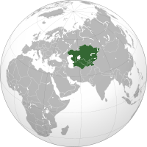
Energy Trade in Central Asia
Uzbekistan, Kazakhstan, Turkmenistan, Krgyz Republic, and Tajikistan
All have an abundance of natural resources and energy potential
Modern economic and social climate shaped by their membership in the USSR

Slide 2
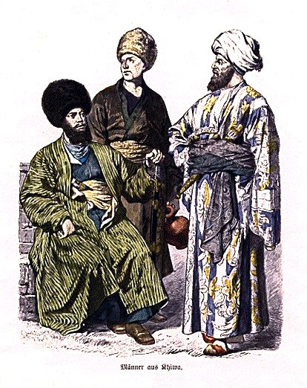
Central Asian History
Arid climate caused nomads to rule for most of early history (steppe nomads)
As a result experienced constant conflict
Staging point for the Huns
16th century, firearms allowed settled people to maintain power

Slide 3
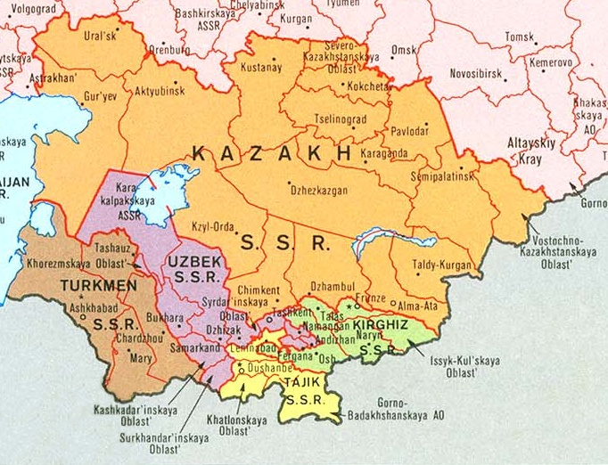
Central Asia in the USSR
USSR had large military, and economic interest in Central Asia
As a result, it subsidized 25-50% of each state’s budget
Pitted regional powers against each other
Suffered from failed attempts at collectivized farms
Drained of resources needed, used as nuclear testing grounds
Viewed Central Asian’s as ethnically inferior

Slide 4
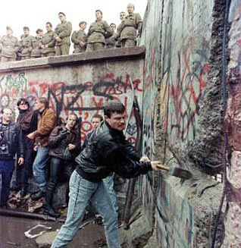
Fall of the Soviet Union
Because of fall, 25-50% of state budget was lost
Power retained by former Soviet Autocracies
Many Soviet energy and resource projects were left unfinished
Energy Demand significantly less than during Cold War

Slide 5
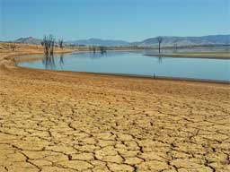
Economic Decline
Drastic drop in trade from multilateral to bilateral
Trade volume went down by 68%
Poorly managed dams and energy projects had disastrous effects
Water heavily polluted
Breakdown of regional water and electricity trading dipped the region into further poverty

Slide 6
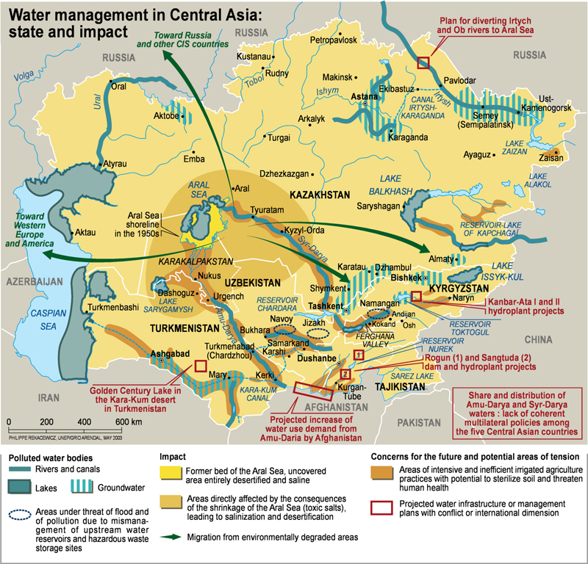
Central Asian Potential
Suspended power projects could be completed
Large sunk costs already incurred by Soviets
Soviets designed facilities for regional distribution
Could supply nearby regions with energy
Could complement Thermal power (winter) with hydropower surplus in spring and summer

Slide 7
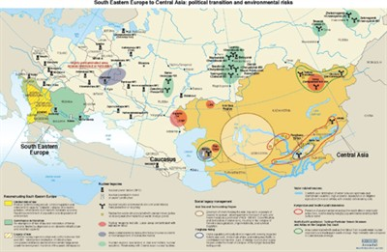
Political Tensions
Energy potential is heavily impeded by political and civil strife
July 2010, Uzbekistan blocks Tajik construction of Rogun dam
Downstream countries do not want hindered water sources
Water sources essential to developing regions

Slide 8
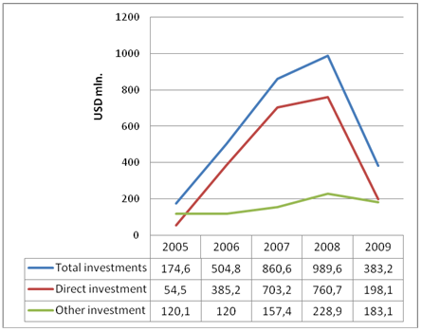
Foreign Investment
Political instability causes uneasiness and unwillingness in investors
For instance, Tajikstan’s Rogun dam will cost 85% of its Gross National Income
In 2007 a Chinese Investment company pulled out of the Rogun dam
Foreign Direct Investment increased due to eased investment law
Fell again during global recession

Slide 9
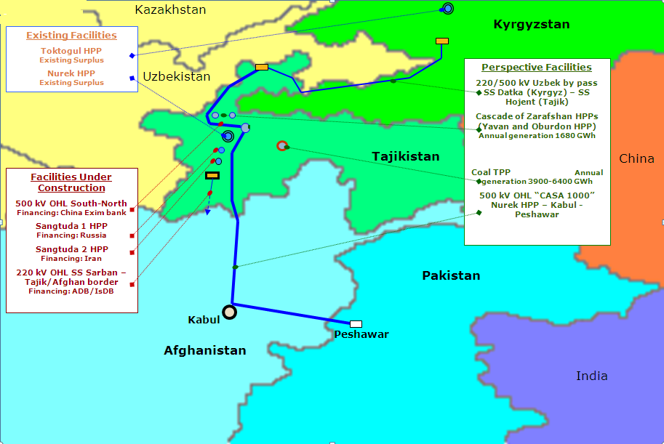
Solutions: CASARED-1000/ CAEWDP
Central Asia South Asia Regional Energy Development-1000 World Bank’s solution
Proposes interconnected energy grid linking Central Asia
Facilitates multilateral energy trade network
Unfortunately, has no regional executive authority
Central Asia Energy Water Development Program: Also prompted by the World Bank
Seeks to improve investment information

Slide 10
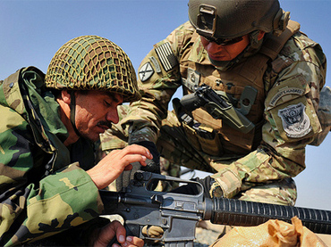
World Interest
Central Asia could supply energy to all surrounding regions
Would bring higher standard of living and political and economic stability
Such stability hinders ability of groups like Al-Qaeda
US Foreign Policy goal: Return of power to Afghan government

