Slide 1
HOW IS 100% RENEWABLE ENERGIES POSSIBLE IN SOUTH KOREA BY 2020 ?

Slide 2
South Korea
48 million population
Only border: North Korea
member of many organizations (APEC, IEA, OECD…)
No primary ressources => 97% dependant on foreign energy

Slide 3
Energy Profile
Electricity Production, 2010, %

Slide 4
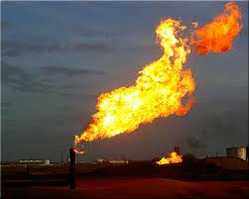
Energy Autonomy?
4th
3rd
2nd
largest importer of the world

Slide 5
CO₂ emissions
CO₂ emissions South Korea, 1960 to 2011
Target by 2030: reduce by 30%

Slide 6
Background with renewables
Map of renewable energies use

Slide 7
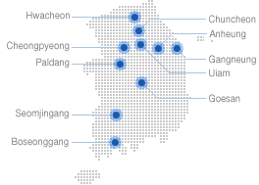
Background with renewables
South Korea hydro power plants
South Korea wind power plants

Slide 8
Background with renewables
Solar PV capacity, 2010

Slide 9
Background with renewables

Slide 10
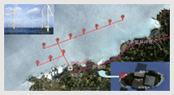
Potential in renewables
Hydro and Tidal
Extension of Cheongpyeong hydro power plant :
Extended capacity: 60MW
Jeju Offshore Wind Power Construction Project:
Capacity: 30MW

Slide 11
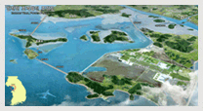
Potential in renewables
The Busan Wind Power Construction Project
Capacity: 10MW
The Incheon Bay Tidal Power Project:
Capacity: 1,320MW – Annual output: 2,4 GWh

Slide 12
Potential in renewables
Solar
Global Horizontal Solar Radiation

Slide 13
Potential in renewables
Geothermal
High potential in low
temperatures
Heat Flow Distribution map of South Korea

Slide 14
Targets

