Slide 1
Overview of Electric Vehicles in San Diego
100% Renewable San Diego: Will your Next Car be an Electric Vehicle?
June 10, 2015
Colin Santulli, Senior Manager, CSE Transportation
Notes:
I’m very happy to be participating in the summit and to provide an overview ZEV market in California

Slide 2
Outline
Plug-in Electric Vehicle (PEV) 101
  New and Upcoming Vehicles
  Benefits of Driving Electric
  Charging Options
California & San Diego EV Market Trends
National Drive Electric Week 2015
Notes:
This morning I’ll be discussing a high-level review of the new ZEV products, how many ZEVs are in CA and where they are distributed across the state, and I’ll finish with a look at the latest driver demographics and what is motivating them to purchase or lease their vehicles.

Slide 3
PEV 101

Slide 4
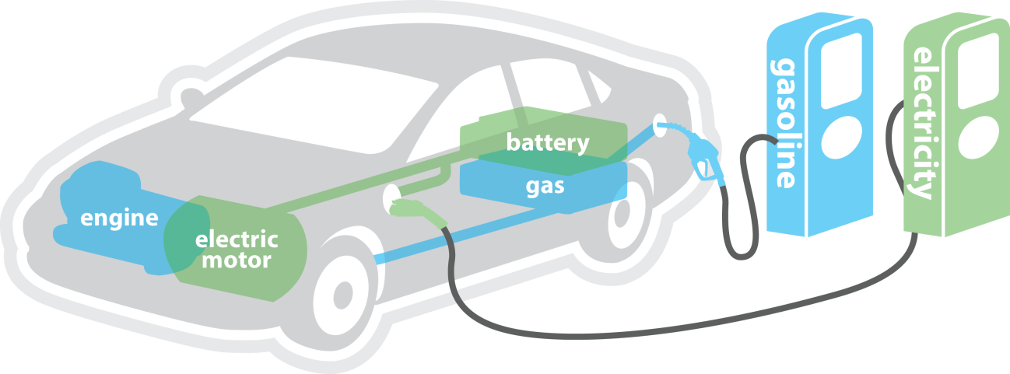
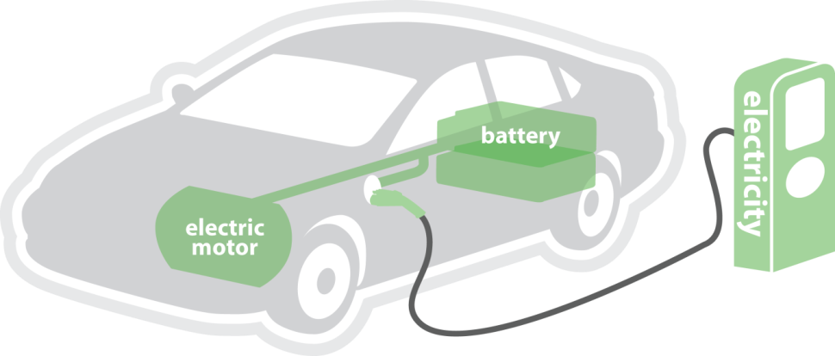
Plug-in Electric Vehicles
Plug-in Hybrid Electric Vehicle
Runs on gasoline and electricity from grid
Up to 40 miles on electricity, 150 to 400 miles total range, depending on model
Battery Electric Vehicle
Runs entirely on electricity that is stored on an onboard battery
Range of 60 to about 100 miles, depending on model

Slide 5

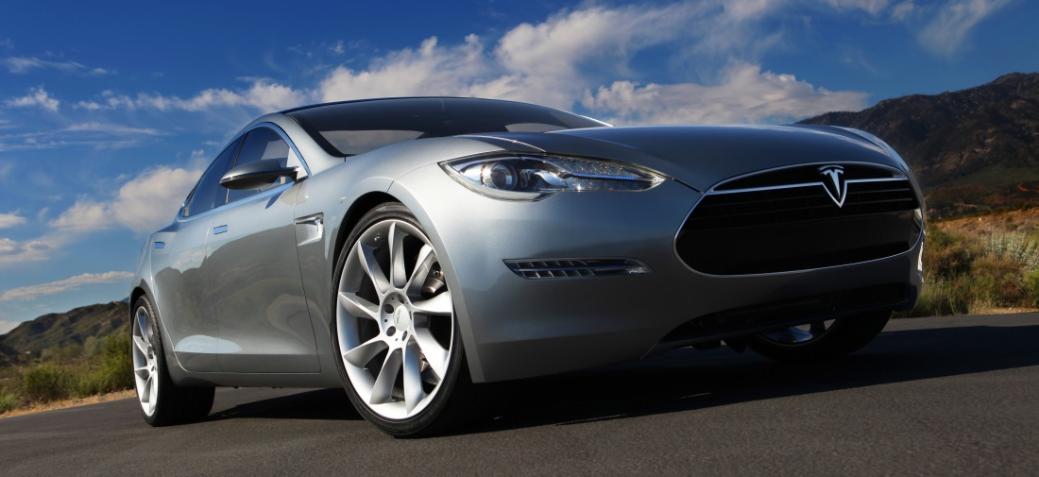
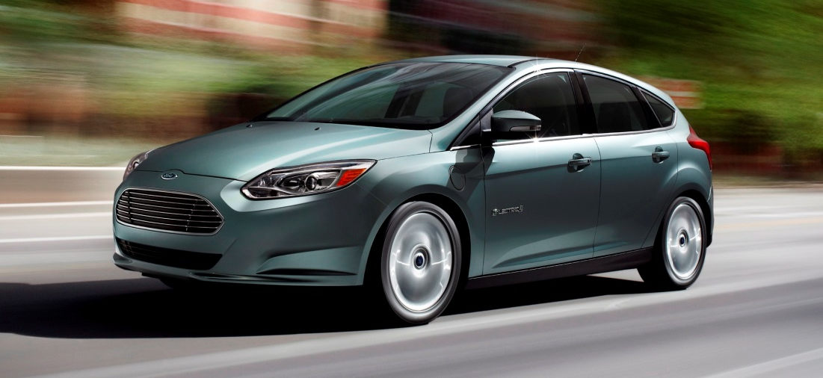
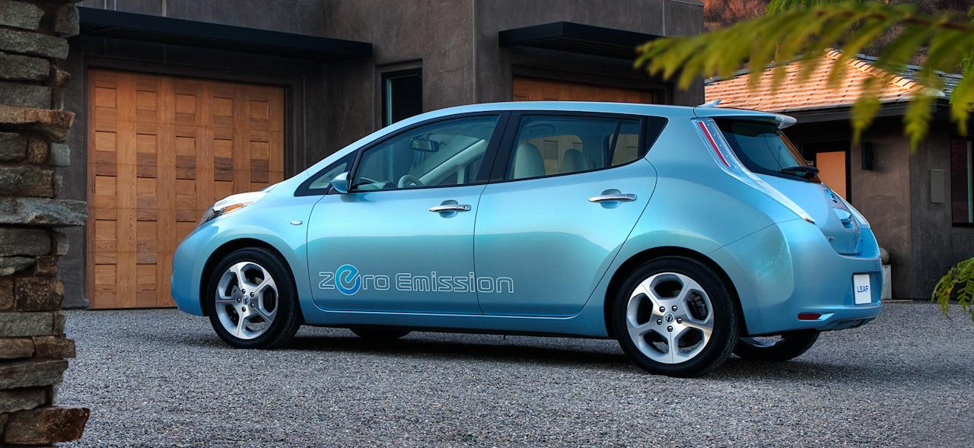
Vehicles on the Road
All-battery
Fuel: 100% Electric
Rebate: $2,500

Slide 6
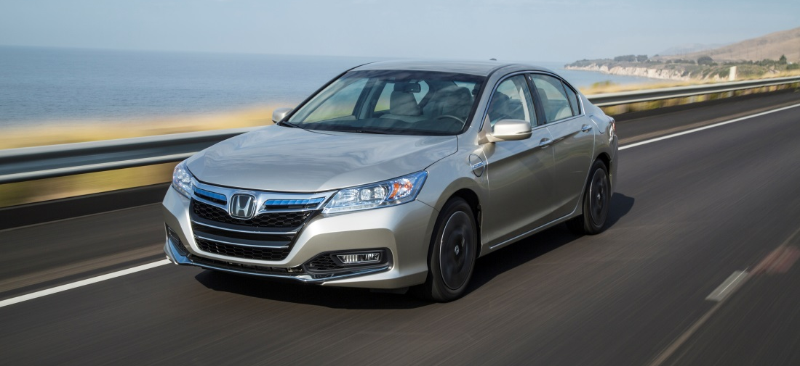

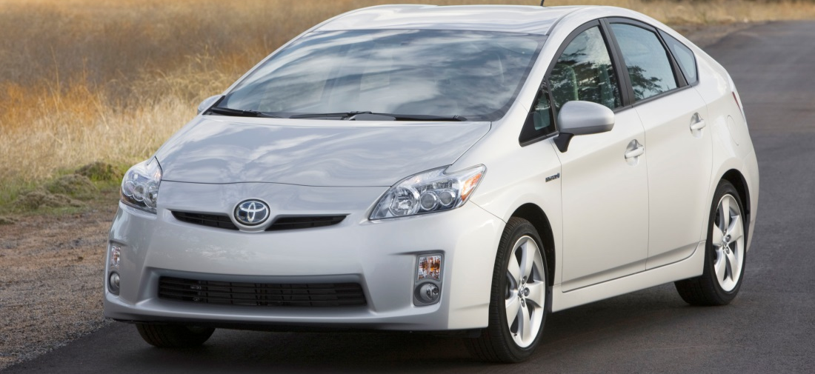
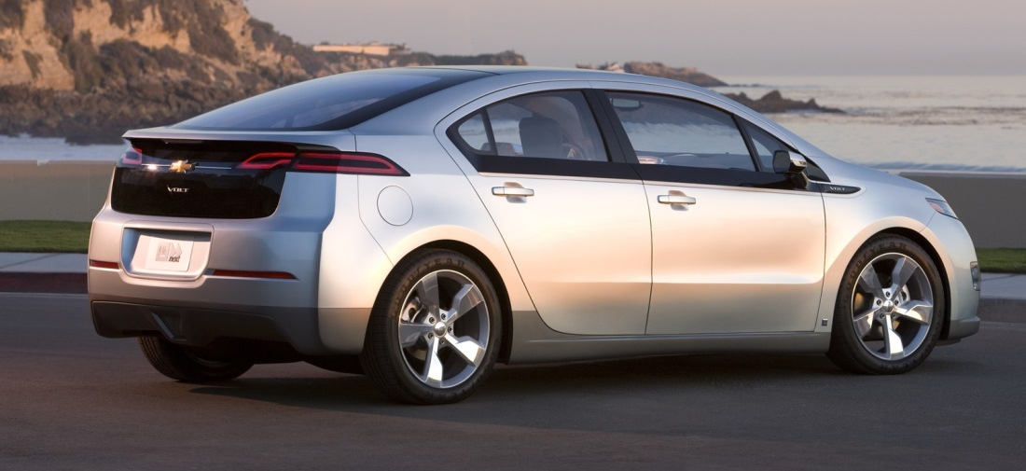
Vehicles on the Road
Plug-in Hybrid Electric Vehicle
Fuel: Electric and Gasoline
Rebate: $1,500

Slide 7
New and Upcoming Vehicles
Notes:
2014 was a big year for the introduction of new ZEV products ->next slide

Slide 8
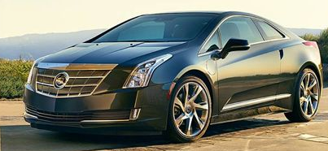
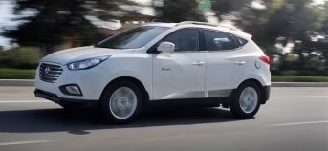
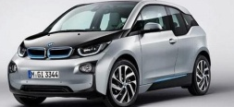
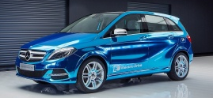
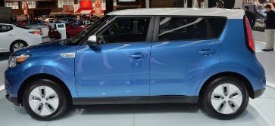
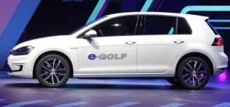
2014 Additions (All-Battery, Plug-in Hybrid, and Fuel-Cell )
 | Vehicle | Vehicle Category | EPA Fuel Economy | EPA Range
 | Cadillac ELR | PHEV | 82 mpg_{e,} 33 mpg (gas) | 37 e-mi 340 total
 | Hyundai Tucson Fuel-Cell | FCEV | 48–50 kg/mi (city–hwy) | 265 mi
 | BMW i3, i3 REx | BEV, BEVx | 124 mpg_{e,} 117 mpg_{e} | 81 e-mi, 72 e-mi; 150 total
 | Mercedes B-Class Electric | BEV | 84 mpg_{e} | 87 e-mi
 | Kia Soul EV | BEV | 105 mpg_{e} | 93 e-mi
 | Volkswagen e-Golf | BEV | 116 mpg_{e} | 83 e-mi
Notes:
We added 10 new models over the course of the year. Shown here are the 6 new models that are eligible for the state incentive, the Clean Vehicle Rebate Project, listed in order of release date.
We now have 12 vehicles that cost less than $30k after state and federal incentives
Overall, consumers have 23 models from 16 brands to choose from today.

Slide 9
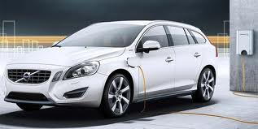
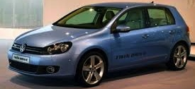
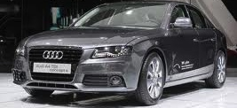

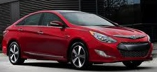
Upcoming PHEVs
 | Vehicle | Vehicle Category | Expected Release
 | Volvo V60 PHEV | PHEV | 2015
 | Volkswagen Golf GTE | PHEV | 2015
 | Audi A4 e-quattro | PHEV | 2015
 | Audi A3 e-tron | PHEV | 2015
 | Hyundai Sonata Plug-in Hybrid | PHEV | 2015
Notes:
And we have lot of new models to look forward to
In particular, a number of PHEVs are expected to be released later this year.

Slide 10
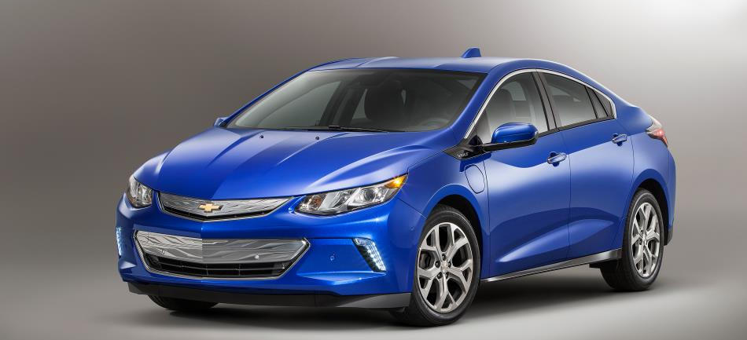

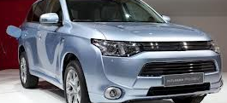
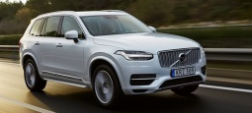
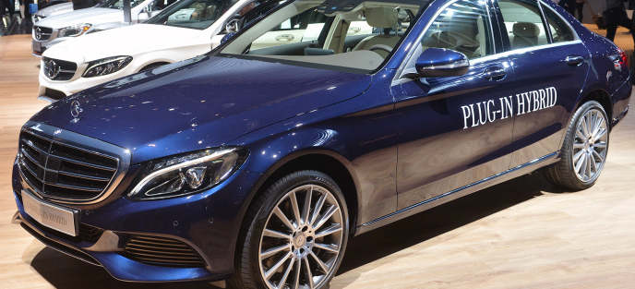
Upcoming PHEVs
 | Vehicle | Vehicle Category | Expected Release
 | Chevrolet Volt (MY2016) | PHEV | 2015
 | Mercedes S500 Plug-in Hybrid | PHEV | 2015
 | Mitsubishi Outlander PHEV | PHEV | 2015
 | Volvo XC90 T8 Plug-in Hybrid | PHEV | 2015
 | Mercedes C350 Plug-in Hybrid | PHEV | 2016
Notes:
Some noteworthy points:
Vehicles have been available long enough to go through major redesigns
PHEVs with SUV body types are coming to the market
And we’re seeing more brands with multiple model offerings

Slide 11
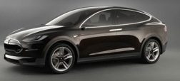
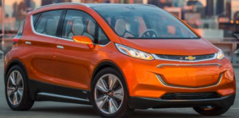
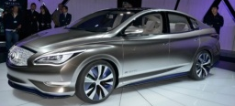
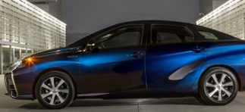
Upcoming BEVs and FCEVs
 | Vehicle | Vehicle Category | Expected Release
 | Tesla Model X | BEV | 2015
 | Chevrolet Bolt | BEV | 2016
 | Infinity LE | BEV | 2017
TBD in 2017 | Tesla Model 3 | BEV | 2017
 | Toyota Mirai | FCEV | Fall 2015
Notes:
After the wave of new PHEVs this year, we expect to see more long-range BEVs and fuel cell electric vehicles become available to consumers.

Slide 12
Benefits of Driving Electric
Notes:
2014 was a big year for the introduction of new ZEV products ->next slide

Slide 13
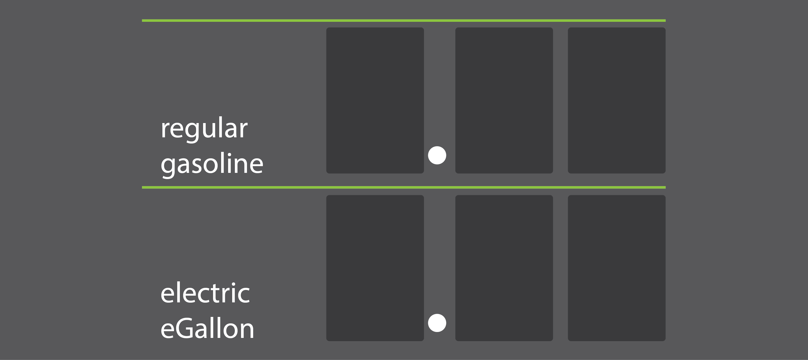

Benefits: Lower Fuel Costs
On average, it costs about half as much to fuel an electric vehicle.
3
6
9
1
6
8
Notes:
Source: http://energy.gov/maps/egallon
Note: fuel cost number can be changed directly on this slide. Double click the number to change.
Is eGallon cost based on TOU rate? Research
Change title to “fuel cost savings too”

Slide 14
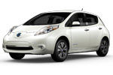
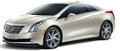
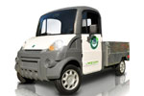
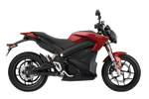
Benefits: Incentives
State Rebate
Federal Tax Credit
Battery Electric Vehicles (& i3 REx)
$2,500
$7,500
Plug-in Hybrid Electric Vehicles
$1,500
Up to $7,500
Neighborhood Electric Vehicles
$900
Zero-Emission Motorcycles
$900

Slide 15
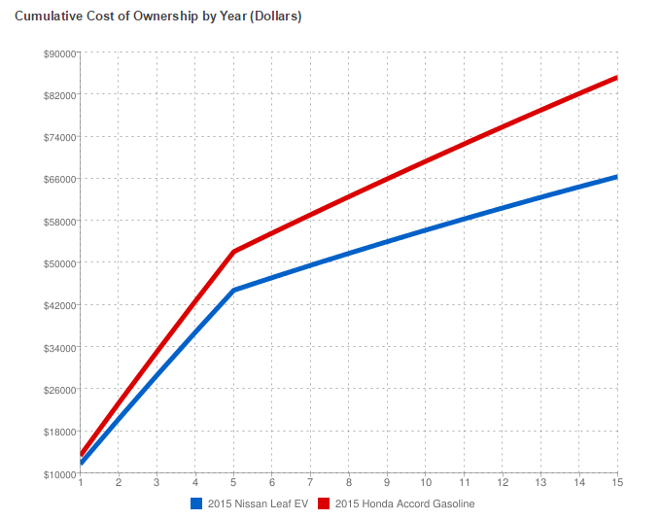
Benefits: Lower Total Cost of Ownership
Savings of ~$8,000 at 7 years of ownership
Savings of ~$20,000 at 15 years of ownership
Typical EV owner saves $750-$1200 in fuel costs
Source: AFDC Vehicle Cost Calculator
Notes:
EV owner gas savings: http://www.ucsusa.org/clean_vehicles/smart-transportation-solutions/advanced-vehicle-technologies/electric-cars/electric-vehicle-infographic.html
The Alternative Fuel Data Center Vehicle Cost Calculator takes into consideration:
Cost of gasoline vs. cost of electricity
Tires + maintenance costs (from AAA)
EV Tires + maintenance costs (from UC Davis study)
Insurance + license + registration
Vehicle down payment (10% of vehicle cost)
Loan interest (6% annually)
Term of loan (5 years)
Discount factor
Travel Data
Avg annual miles for driver
Avg highway vs city miles

Slide 16








Benefits: Public Health
Cleaner Air:
Reduce emissions
and pollution
California vehicles emit 272 tons of smog-forming VOCs and NOx per day
Improving air quality to federal eight-hour ozone standard could save over $2.5 billion in medical costs and lost work days
30% increased risk for new asthma cases in children living in communities with higher vehicle traffic

Slide 17
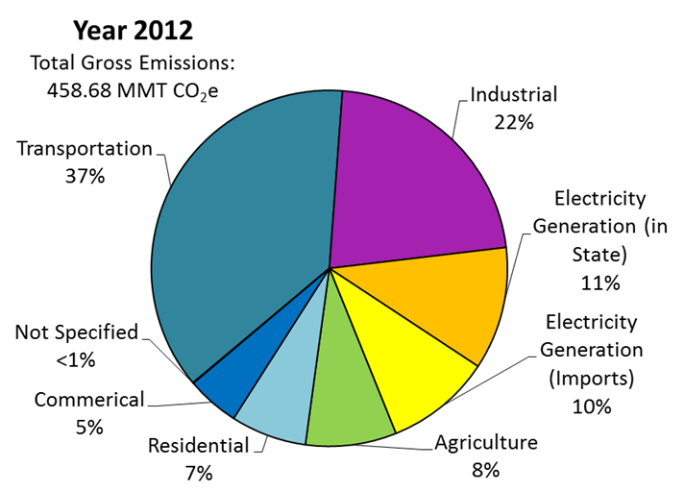
Benefits: GHG Emissions Reductions
California GHG Emissions
Notes:
Sources:
Bedsworth, Louise Wells. “Climate Change Challenges: Vehicle Emissions and Public Health in California” Public Policy Institute of California. http://www.ppic.org/content/pubs/report/R_310LBR.pdf.
American Lung Association. “The Road to Clean Air: Public Health and Global Warming Benefits of Advanced Clean Car Standards”. http://www.lung.org/associations/states/california/assets/pdfs/advocacy/clean-cars-campaign/the-road-to-clean-air.pdf.

Slide 18



Benefits: Time Savings
All-battery EVs
Currently unlimited availability
Plug-in hybrid EVs
Limited number available
Valid until January 1, 2019

Slide 19
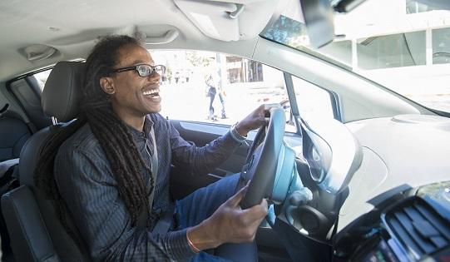
Benefits: FUN!
Performance!
Notes:
Tesla 2014 Motor Trend Car of the Year
Volt Consumer Reports’ owner satisfaction list – 2011 and 2012, top of list

Slide 20
Charging Options
Notes:
2014 was a big year for the introduction of new ZEV products ->next slide

Slide 21
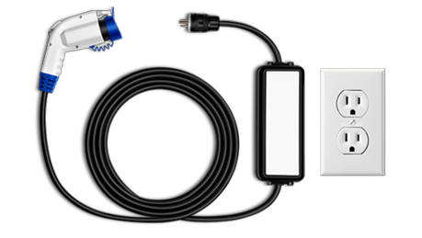
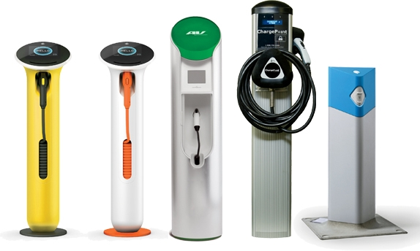
Charging Equipment: L1 & L2
AC Level 1
AC Level 2
Uses a standard 110/120-volt alternating current (VAC) three-pronged wall plug
4-6 miles per hour of charge
Uses 208/240 VAC and can be hardwired or connected with a plug
8-24 miles per hour of charge

Slide 22
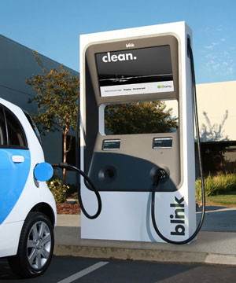
Charging Equipment: DC Fast Charging
Uses commercial-grade 440 /480 VAC – produces direct current (DC) to charge
Commercial/Public – due to costs
Charges vehicle 80% in 30 minutes

Slide 23
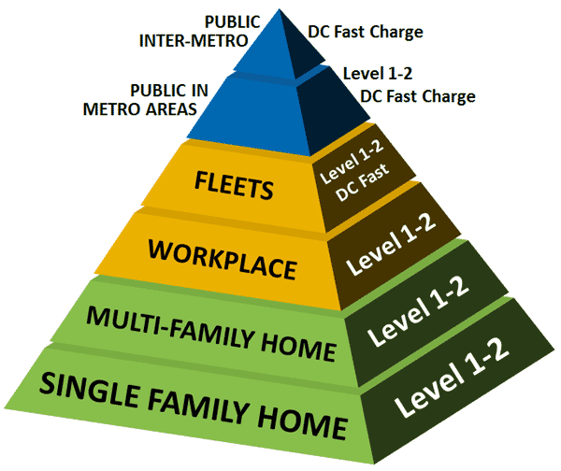
Charging Pyramid
Majority of charging occurring at home, next workplace, lastly public chargin.

Slide 24
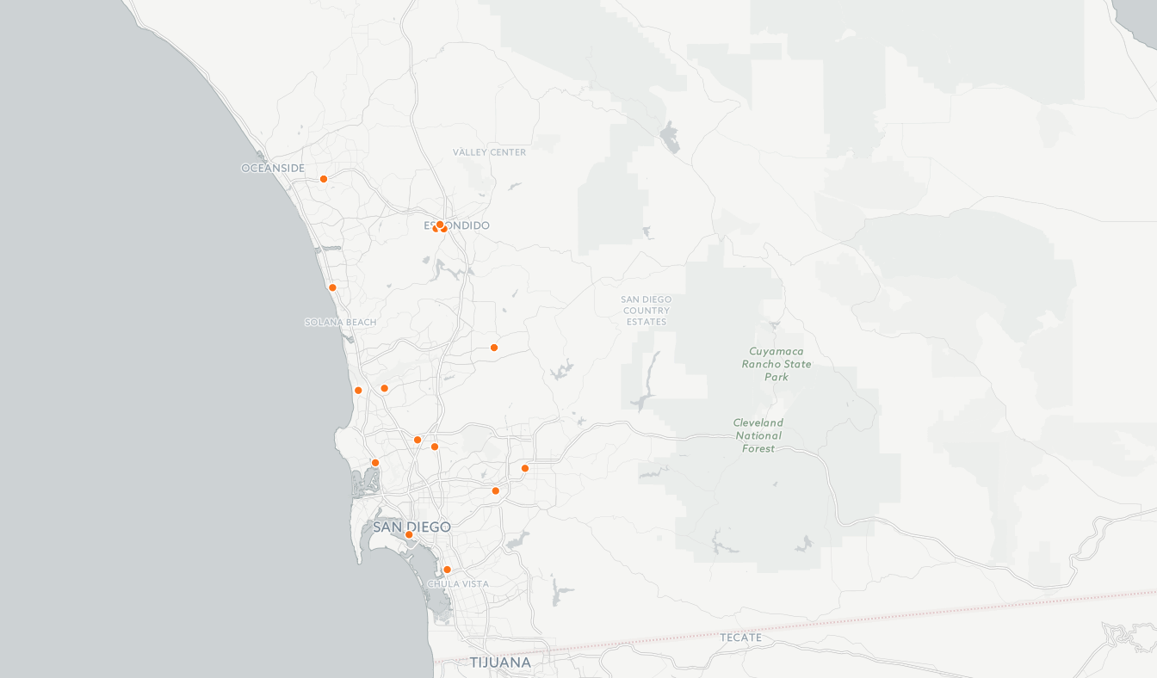
Public Electric Vehicle Charging Sites - 2012

Slide 25
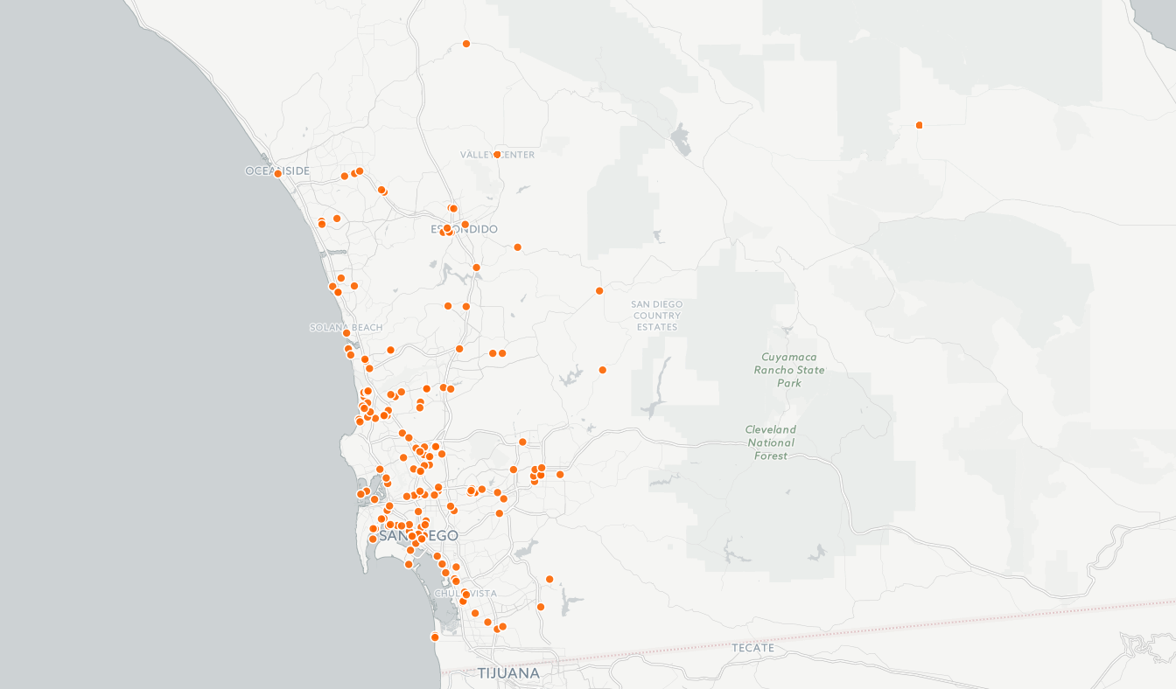
Public Electric Vehicle Charging Sites - 2015

Slide 26

Public DC Fast Charging Sites - 2012

Slide 27
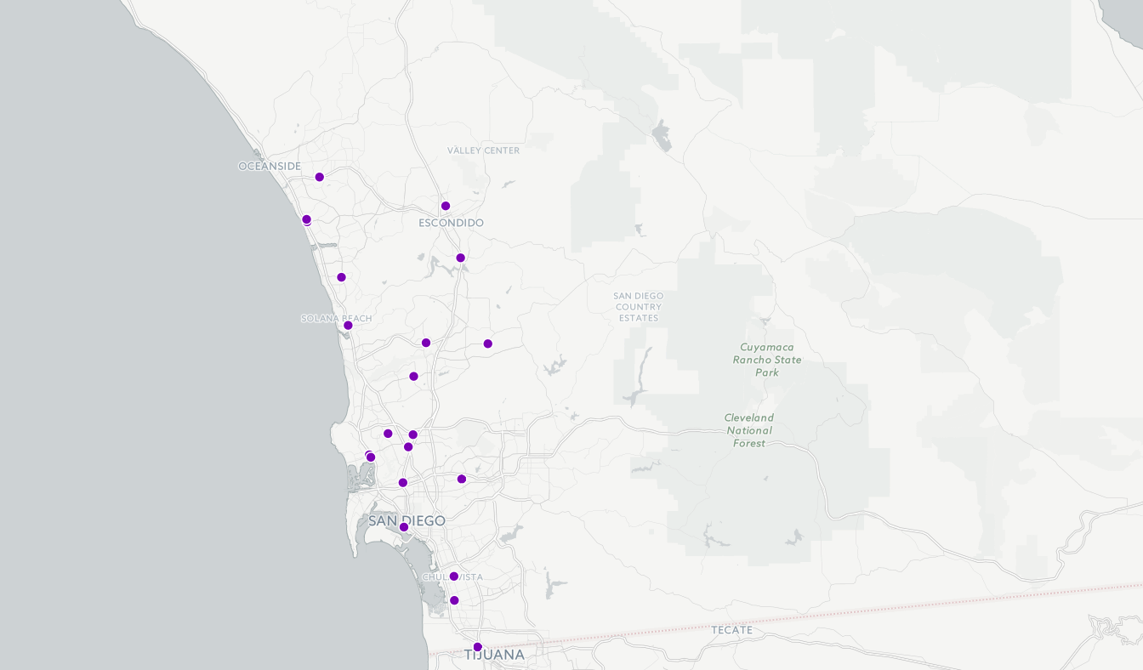
Public DC Fast Charging Sites - 2015

Slide 28

Total Public Charging Sites
500+ EV Charging Stations
30+ DC Fast Charging Stations

Slide 29
CA EV Market Trends
Notes:
The variety of vehicles available continues to expand, as is the number of vehicles being sold each year ->

Slide 30
Cumulative ZEV Sales, 2010 – 2014
Notes:
As of the end of 2014, more than 125,000 ZEVs have been sold in California. And we continue to see year on year increases -> next slide

Slide 31
Cumulative ZEV Sales, 2010 – 2014
2014 ZEV sales: 41% increase over 2013
Notes:
We saw a 41% increase in sales during 2014 compared to 2013. -> next slide

Slide 32

ZEV Market Share
Q4 2014 Market Share
5.5% of new cars
3.4% of new light-duty vehicles
Notes:
By the end of 2014 ZEVs represented over 5% of the new car market, and nearly 3 and a half percent of new total light-duty vehicle sales.

Slide 33
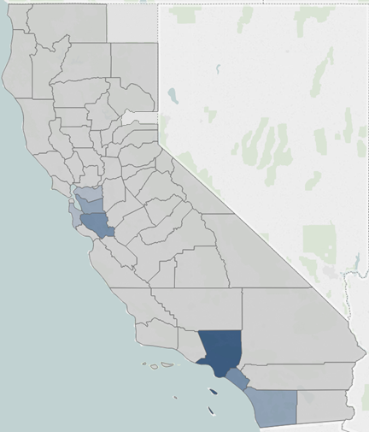
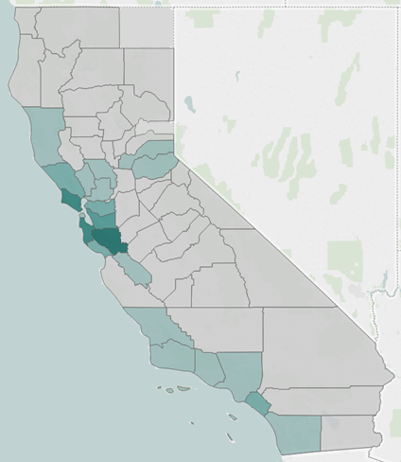
Where are ZEVs Located?
New ZEV Registrations, 2010–2014
New ZEV registrations (2010–2014) per
1,000 population (18 or older)
11.2
14.0
4.5
6.5
~10,000
0.1
14.0
4.2
1
34k
Notes:
The highest number of ZEVs in the state are in counties you’d expect.
Collectively in the Bay Area, roughly 1 out of 13 new light-duty vehicles sold in 2014 was a zero emission vehicle.
Slide: On a per capita basis, the picture is similar, with the Bay Area again as a hot spot. Santa Clara County had the highest number of ZEVs sold per capita in the state last year. But other regions such as North of San Francisco and along the central coast also become more prominent.
In terms of growth, the trends are even more interesting. Considerable growth was seen in the San Joaquin Valley, among others there, Fresno County grew at over 200% per/capita from the previous year. And we see signs of some other new markets starting to develop as well.
This is encouraging, as we all know the San Joaquin Valley has some of the poorest air quality in the state and has been a focus of state investment.

Slide 34
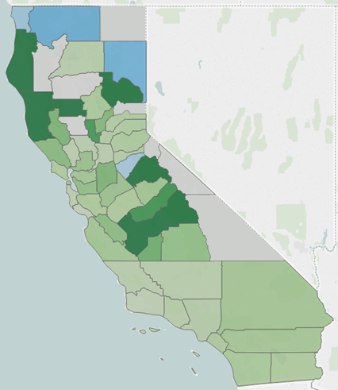
Where are ZEVs Located?
(Percent Change)
New ZEV registrations (2010–2014) per
1,000 population (18 or older)
Percent change in density, 2013–2014
11.2
200%
14.0
228%
61%
4.5
6.5
0.1
14.0
4.2
43%
-50%
>200%
Notes:
The highest number of ZEVs in the state are in counties you’d expect.
Collectively in the Bay Area, roughly 1 out of 13 new light-duty vehicles sold in 2014 was a zero emission vehicle.
Slide: On a per capita basis, the picture is similar, with the Bay Area again as a hot spot. Santa Clara County had the highest number of ZEVs sold per capita in the state last year. But other regions such as North of San Francisco and along the central coast also become more prominent.
In terms of growth, the trends are even more interesting. Considerable growth was seen in the San Joaquin Valley, among others there, Fresno County grew at over 200% per/capita from the previous year. And we see signs of some other new markets starting to develop as well.
This is encouraging, as we all know the San Joaquin Valley has some of the poorest air quality in the state and has been a focus of state investment.

Slide 35
San Diego EV Market: Volume
2014 ZEV sales: 43% increase over 2013

Slide 36
San Diego EV Market: Vehicles
Top Vehicle Makes:
Nissan
Chevrolet
Tesla
Ford
Toyota

Slide 37
National Drive Electric Week 2015
Notes:
The variety of vehicles available continues to expand, as is the number of vehicles being sold each year ->

Slide 38
National Drive Electric Week 2015
Organized nationally by the Sierra Club
Over 100 events last year, 150 expected 2015
San Diego: Center for Sustainable Energy and San Diego Gas & Electric
This year:
  Saturday, September 19, 10am
  Liberty Station
https://www.youtube.com/watch?v=L2krChQmJow

Slide 39
National Drive Electric Week 2014
https://www.youtube.com/watch?v=L2krChQmJow

Slide 40
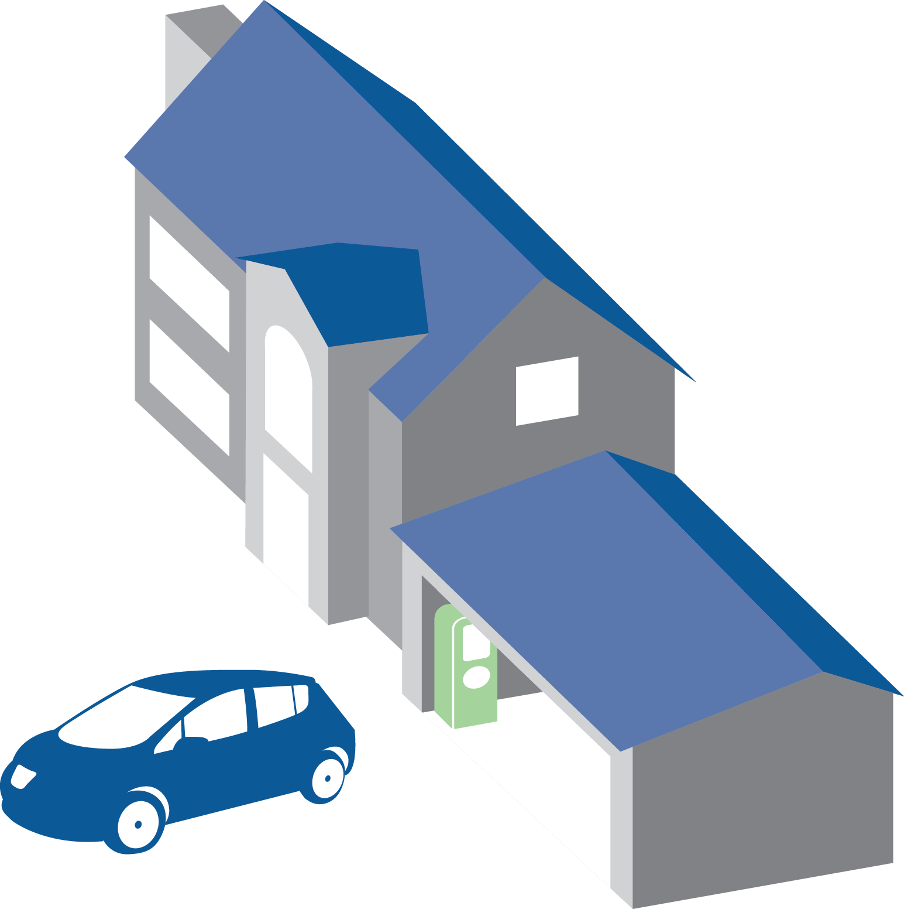
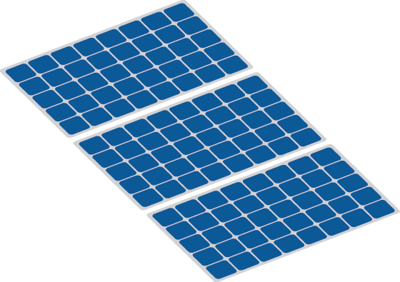
Best of Both Worlds: Fuel Your Car with Solar Energy
Learn more in the handout Plug Into the Sun

Slide 41
colin.santulli@energycenter.org
Includes content supplied by R.L. Polk & Co.; Copyright © R.L. Polk & Co., 2015. All rights reserved
Notes:
Thank you for the time. I hope this provides a good basis for the rest of the presentation and discussions planned for the Summit. And thank you for making the commitment to be here today.

