Slide 1
California Takes Charge:
Policies and Incentives for Energy Storage
February 11, 2015
Rebecca Feuerlicht, SGIP Project Manager, Center for Sustainable Energy

Slide 3
CSE is an expert implementation partner to energy policy makers, regulators and businesses tasked with achieving ambitious energy goals.

Slide 4

Energy Storage
is a Game Changer

Slide 5

Energy Storage in the Golden State: Overview
The Role of Energy Storage in California
Energy Storage Mandate: AB 2514
Customer-Sited Storage Benefits
Self-Generation Incentive Program (SGIP)
Challenges and Opportunities Ahead
Notes:
So the title of my presentation is Policies and Incentives for Energy Storage in California. So as you may imagine I will be discussing AB 2415, our energy storage mandate, and the Self-Generation Incentive Program, the only program that incentives customer-sited storage in the state. But first, I think it’s important to take a step back and remind ourselves why we have these policies in place.

Slide 6
The Role of Energy Storage in California

Slide 7


The Need for Energy Storage Resources
Aggressive transition from fossil fuels to renewable energy sources, energy efficient homes and businesses, and flexible transmission and distribution infrastructure
Helps achieve various California policies and mandates already in place, including:
Executive Order for 1.5 million electric vehicles by 2025
RPS: 33% renewable procurement by 2020

Slide 8
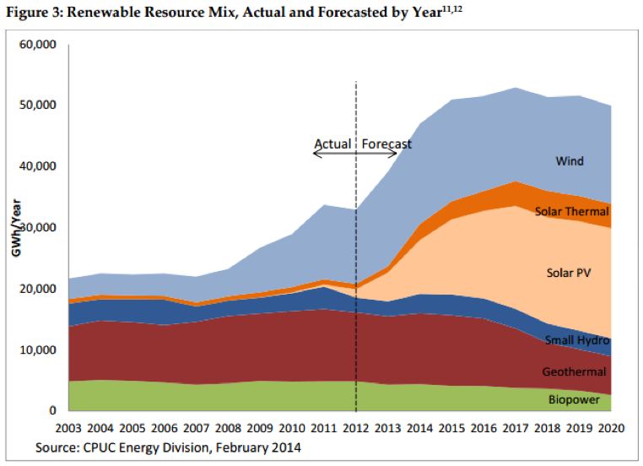
California’s Renewable Resource Mix

Slide 9
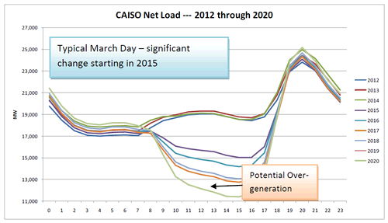
Duck Curve
“As more renewable resources come on line, not only will the net load curve look substantially different than it does today but so will the need for load regulation and load following.”
– CAISO, 2012

Slide 10
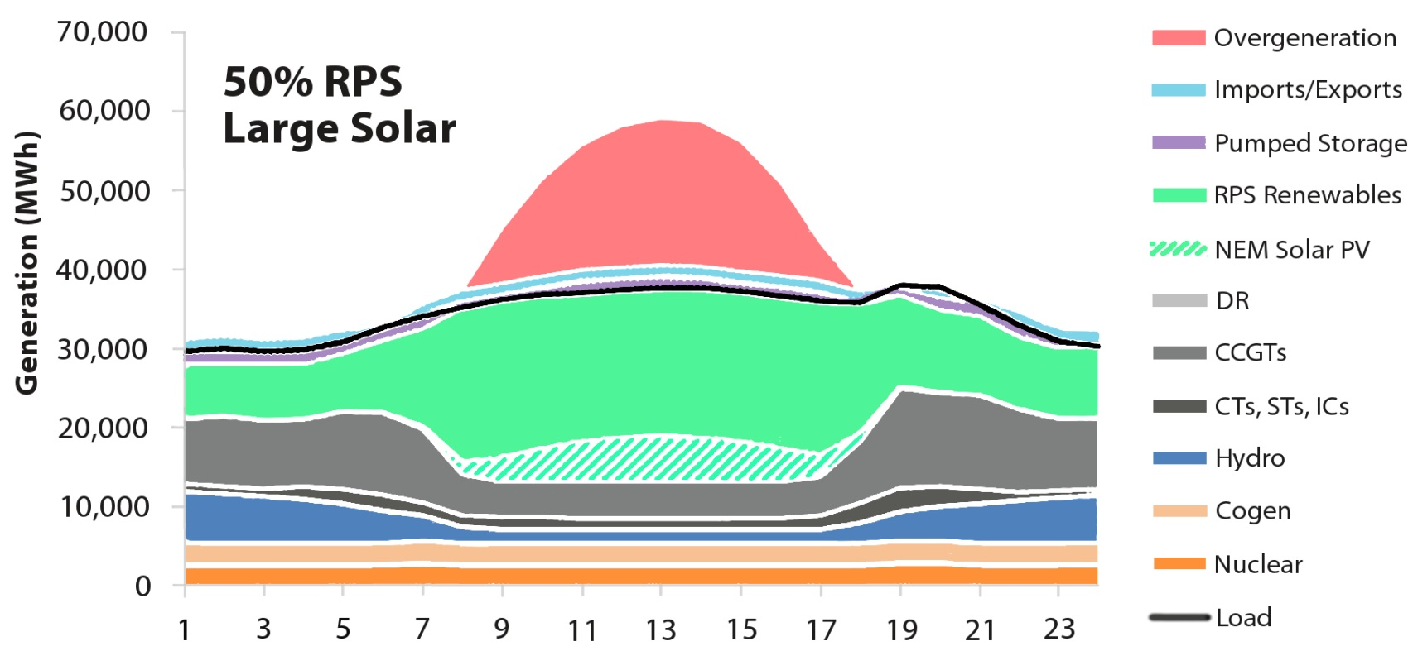
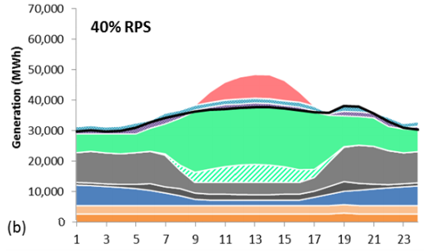
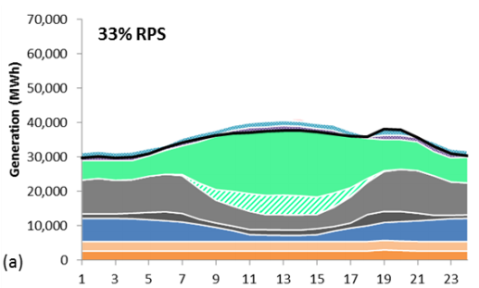
Beyond 2020
Source: Energy and Environmental Economics, Investigating a higher renewables portfolio standard in California, 2014

Slide 11
Beyond 2020
Source: Energy and Environmental Economics, Investigating a higher renewables portfolio standard in California, 2014

Slide 12
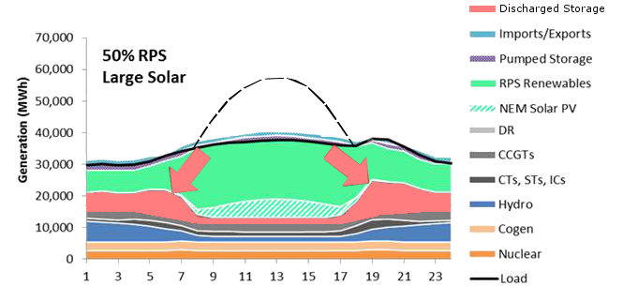
Beyond 2020
As solar energy becomes increasingly significant part of California’s generation resources, storage will become critically important.
Source: California Center for Sustainable Energy, 2014

Slide 13
California’s Energy Storage Mandate: AB 2514

Slide 14
AB 2514
Early 2010: Assembly member Nancy Skinner introduced AB2514
    Directed the CPUC to establish procurement targets and effective policies for energy storage systems within the territories of PG&E, SCE and SDG&E.
September 2010: Gov. Schwarzenegger signed AB 2514
In 2012: CPUC began rulemaking to establish set procurement targets for the IOUs
In 2013: CPUC set procurement target of 1.325 GW by 2020, the largest of its kind worldwide.

Slide 15
AB 2514
The 2013 Storage Ruling noted that the storage procurement policy should be guided by 3 purposes:
  Optimization of the grid, including peak reduction, contribution to reliability needs, or deferment of transmission and distribution upgrade investments
  Integration of renewable energy
  Reduction of greenhouse gas emissions to 80 percent below 1990 levels by 2050, per California’s goals

Slide 16
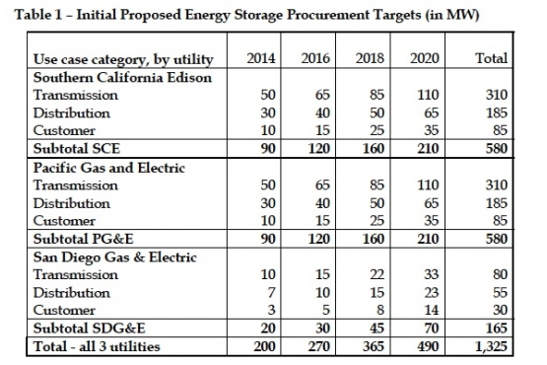
Storage Procurement Targets for California’s IOUs
Note: Of the 1.325 GW, 200 MW is allocated for customer-sited systems

Slide 17
Customer-sited Storage

Slide 18
Customer-Sited Storage
“There are multiple, concurrent value streams for energy storage, and those value streams change as you change location on the grid. It’s a question of picking and choosing which applications are most lucrative. And at this time, those applications tend to be closer to the customer load.”
– Zach Pollock, GTM Research, Senior Smart Grid analyst
Source: Grid-Scale Energy Storage in North America 2013: Applications, Technologies and Suppliers
Notes:
Bundle of benefits is most for customer sited storage in today’s climate.
Energy storage is most valuable on the “edges of the grid”

Slide 19
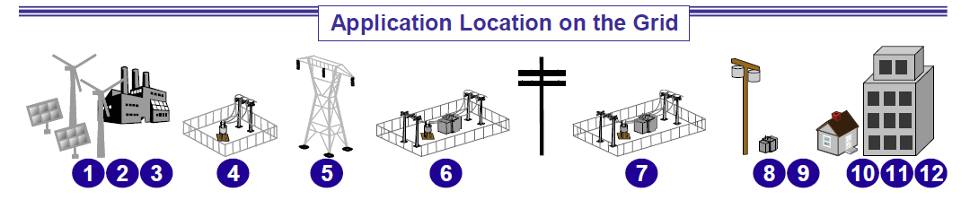
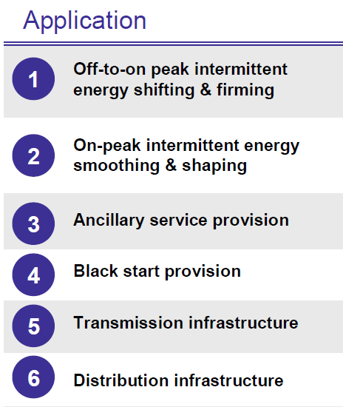
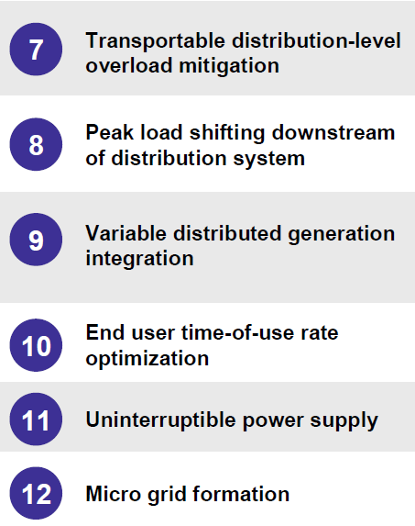
Energy storage is most valuable at the “edge” of the grid
Source: Moving Energy Storage From Concept to Reality: Southern California Ediosn’s Approach to Evaluating Energy Storage

Slide 20
Self-Generation Incentive Program (SGIP)

Slide 21
Storage and the Self-Generation Incentive Program (SGIP)
Provides cash incentives for the installation of clean and efficient distributed generation technologies that are installed on the customer's side of the utility meter
Ratepayer funded and overseen by the CPUC
One of the longest running incentive programs in the country and has incentivized distributed generation technologies since 2001
Currently the only program in California that provides rebates for customer sited distributed storage systems
Now, SGIP plays a key role in realizing the goals of AB 2514
Notes:
Stand-alone and PV paired Advanced Energy Storage technologies added to the program in 2011 with the implementation of SB 412.

Slide 22
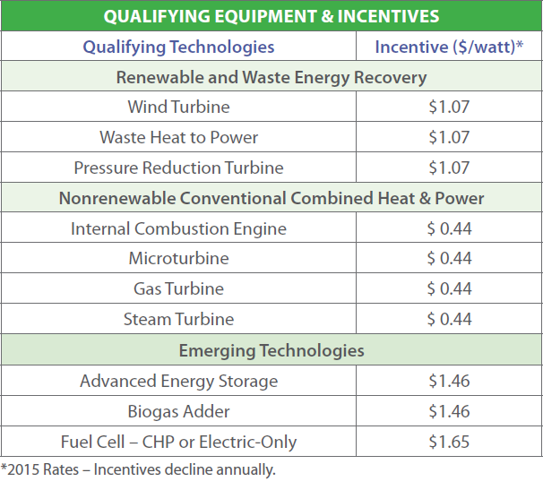
Storage and the Self-Generation Incentive Program (SGIP)
Eligible Technologies and Incentive Levels (2015)

Slide 23
Example Incentive Calculation
40 kWh discharged over 2 hours
20 kW SGIP capacity rating
20 kW x $1.46/watt = $29,200
Upfront Incentive for projects < 30 kW
(SGIP pays up to 60% of total project cost. Minimum applicant investment of 40% is required)
Notes:
Average discharge over 2 hours or max capacity of inverter (which ever is less) usable energy down to the minimal state of charge

Slide 24
Influx of Storage Applications in SGIP
Number of applications
From solar to storage
Source: Self Generation Incentive Program Quarterly Statewide Report Last Updated: December 31, 2014
Notes:
SGIP initially helped create energy market for solar, now solar is helping to accelerate the market for storage

Slide 25
SGIP Storage Statistics – Capacity and Sector
Source: Self Generation Incentive Program Quarterly Statewide Report Last Updated: July 1, 2014

Slide 26
SGIP Storage Statistics – Top Manufacturers
Rank | Manufacturer | Total Rated Capacity
1 | Tesla Motors, Inc. | 71%
2 | Stem Inc | 8%
3 | GE Energy | 5%
4 | Desert Power | 4%
5 | REP Energy/Eaton Crop | 3%
91% of the cumulative SGIP storage capacity
Source: Self Generation Incentive Program Quarterly Statewide Report Last Updated: July 1, 2014
Notes:
What is telsa owned vs customer owned

Slide 27
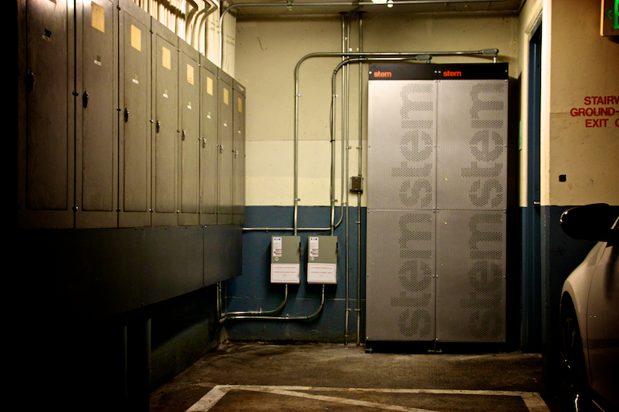
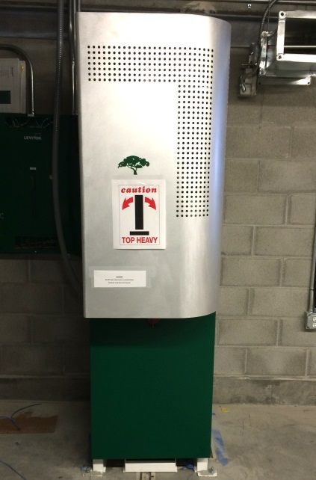
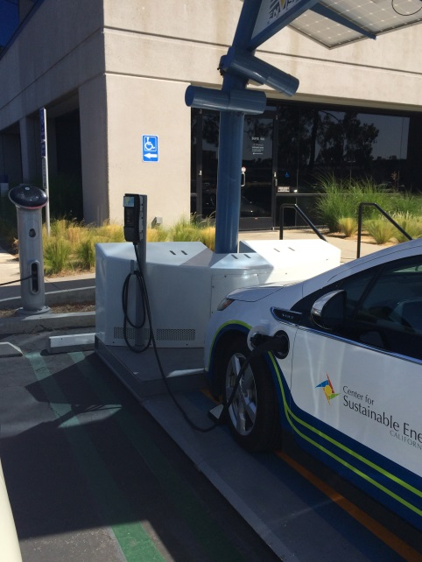
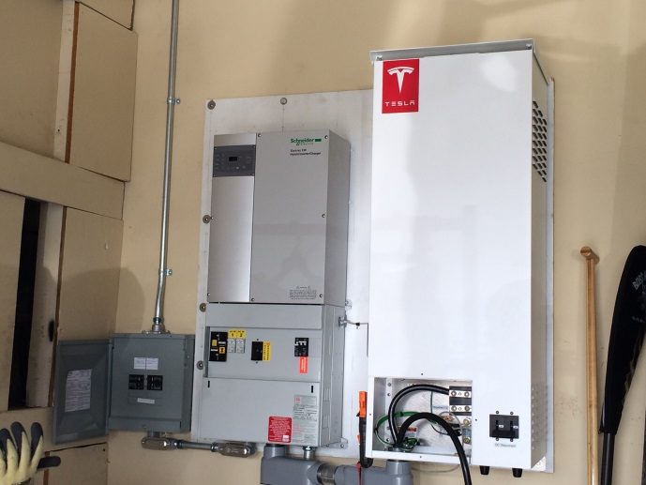
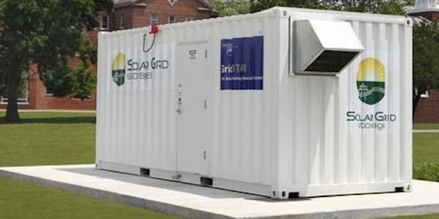
Storage Applications in SGIP

Slide 28
SGIP Reauthorization through 2020
Current legislation (SB 412) was expected to sunset at the end of 2015
In June 2014, Governor Brown signed a Public/Natural Resources trailer bill into law
Immediately enacted SB 861, which maintains annual funding of $83 million per year for SGIP through 2019, with administration through 2020
“The signing of the SGIP extension underscores California’s continuing recognition of and support for the environmental and grid-enhancing benefits of energy storage. This significant funding will maintain program momentum and add 200 MW of energy storage resources to California’s electricity grid by 2020.”
- Janice Lin, Executive Director of CESA

Slide 29
Challenges and
Opportunities Ahead

Slide 30
Looking Ahead
Technological capabilities of storage are still outpacing storage policy & continued regulatory developments will be necessary.
  Net Energy Metering
  Time of Use Rates
  SGIP focus on storage
    Thermal Energy Storage
    Residential Energy Storage

Slide 31
Energy Storage in the Golden State: Key Takeaways
Energy storage is essential to California’s energy future
Customer-sited storage is developing recognition as a necessary part of a well-functioning grid
CA has the opportunity to lead on a national and global level
Continued regulatory developments will be necessary for California to realize all the benefits storage has to offer.
Notes:
Similar to the example set by solar PV during the past 10 years, CA has the opportunity to lead on a national and global level
Foundational legislation has been implemented, however technological potential is still outpacing policy. Continued regulatory developments will be necessary for California to realize all the benefits storage has to offer.

Slide 32
Thank you!
Rebecca Feuerlicht
SGIP Project Manager
Center for Sustainable Energy
Rebecca.feuerlicht@energycenter.org
www.energycenter.org/sgip

